Slide 1

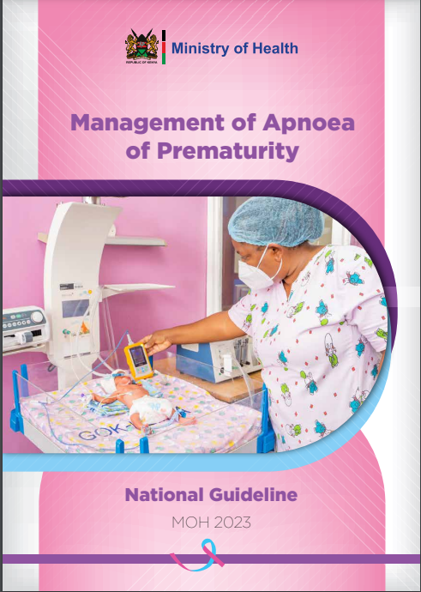
Apnoea of Prematurity

Slide 2

Objectives
Definition of apnoea of prematurity (AOP)
Epidemiology of AOP
Prevention of AOP
Diagnosis and management of AOP

Slide 3
Definition of AOP
Apnoea of Prematurity:
Cessation of breathing ≥ 20 seconds
  OR
a shorter respiratory pause accompanied by:
  Desaturations
  Central cyanosis
  Bradycardia
With no underlying disorders causing apnoea in an infant <37 weeks gestation
It is a diagnosis of exclusion
Notes:
Bradycardia <100 beats/min
Oxygen saturations <90%
Explain the difference between periodic breathing

Slide 4








Other causes of Apnoea
 | Airway : | Airway Obstruction
 | Respiratory: | Aspiration, pulmonary hemorrhage
 | Cardiovascular: | Anemia, Hypotension, Hypertension, Patent ductus arteriosus.
 | Metabolic: | Hypothermia, hypoglycemia, hyperthermia, hypocalcemia, hyponatremia, hypernatremia
 | Gastrointestinal: | gastroesophageal reflux disease abdominal distension, intestinal perforation
 | Central nervous system: | Seizures, Intraventricular hemorrhage, brain trauma, congenital malformations, hypoxic injury.
 | Pain: | Acute or chronic pain
 | Drugs: | Maternal drugs, general anesthesia and sedatives e.g. phenobarbital
 | Infections: | Sepsis, necrotizing enterocolitis, meningitis
Royal Children’s Hospital Melbourne AOP guidelines

Slide 5

Epidemiology of apnea of prematurity
AOP is inversely related to gestational age and birth weight.
10%
20%-85%
90%
>34 weeks GA
30 weeks – 34 weeks
<1000 grams
Newborns born <34 weeks GA are at risk for Apnea of Prematurity!
Notes:
80% below 34 weeks but we need to categorize the GA – to inform what we anticipate and so take measures

Slide 6
Prophylactic Management
All preterm neonates <34 weeks should be started on prophylactic caffeine citrate
Given as soon as possible after birth (best within 72 hours of life)
Stop Prophylactic caffeine citrate:
  At 34 weeks corrected gestational age
  No apnoea, bradycardia or desaturation requiring intervention for approximately 48hrs
Continue monitoring the newborn for 5-7 days after stopping caffeine
Schmidt B, Roberts RS, Davis P, Doyle LW, Barrington KJ, Ohlsson A, et al. Long-Term Effects of Caffeine Therapy for apnoea of Prematurity. N Engl J Med. 2007;357(19):1893–902

Slide 7
Prophylactic Caffeine Citrate
 | Dose | Route | Frequency
Loading dose | 20 mg/kg. | Oral route is recommended. IV infusion over 30min DO NOT administer caffeine citrate intramuscularly | Once Administered within the first 72 hours of life.
Maintenance | Start at 5 mg/kg/day once daily | Oral route is recommended Give IV if oral route is contraindicated | Once daily 1st maintenance dose administered with next scheduled treatment
Dobson NR, Hunt CE. Pharmacology review: caffeine use in neonates: indications, pharmacokinetics, clinical effects, outcomes. Neoreviews 2013;14:e540e50.
Notes:
All babies whether stable or unstable should be given loading as soon as possible

Slide 8
Diagnosis and treatment of AOP
Preterm infants should be on continuous monitoring to allow prompt recognition and management of AOP
Appropriate alarm limits should be set on pulse oximeters/ patient monitors.
Non pharmacological
Tactile stimulation
Initial stabilization (Warmth A,B, C, D,E)
Investigate any other causes and manage appropriately incase present
Treatment of AOP
Pharmacological
Caffeine citrate

Slide 9
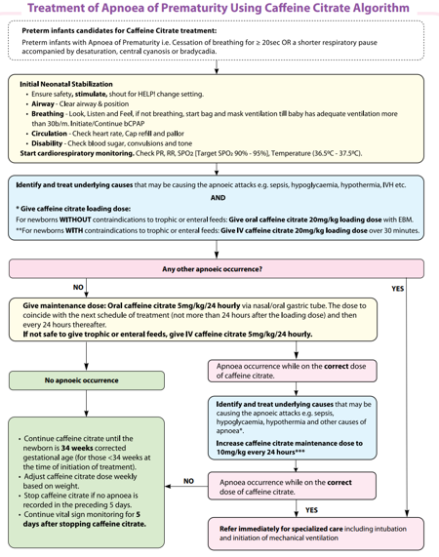
Page 24 of the AOP guidelines

Slide 10
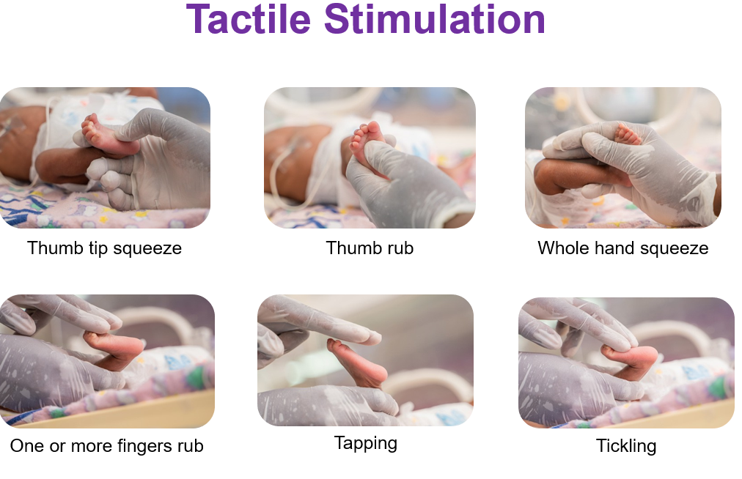

Slide 11
Caffeine Citrate Treatment dosing
 | Dose | Route | Frequency
Loading dose | 20 mg/kg. | Oral route is recommended. No dilution required Given with trophic feeds IV infusion over 30min if oral is contraindicated DO NOT ADMINISTER IM | Once
Maintenance | Start at 5 mg/kg/day once daily Increase to 10mg/kg/day in case of persistent apnoea* | Oral route is recommended Give IV over 10 min if oral route is contraindicated | Once daily (1st maintenance dose administered with next scheduled treatment)
Dobson NR, Hunt CE. Pharmacology review: caffeine use in neonates: indications, pharmacokinetics, clinical effects, outcomes. Neoreviews 2013;14:e540e50.
Notes:
All babies whether stable or unstable should be given loading as soon as possible
*For those already on a maintenance at 5mg/kg/day presenting with apnoea, increase the dose to 10mg/kg/day
*For those whose caffeine was recently discontinued restart caffeine at the previous maintenance dose

Slide 12
Monitoring of babies on caffeine citrate
Monitor vital signs:
  Withhold if HR> 180bpm and other causes of tachycardia have been ruled out
Observe clinical response
Adjust dose weekly based on highest weight attained
Update corrected gestation age daily
Notes:
possible causes of tachycardia e.g. fever, pain, crying etc

Slide 13

Questions

Slide 14

Summary
AOP is a diagnosis of exclusion
Caffeine citrate is the drug of choice for the prevention and treatment of AOP
Newborns born <34 weeks GA are at an increased risk of AOP and should be initiated on prophylactic caffeine citrate
Ensure continued monitoring and follow up to 44 weeks corrected gestation age

