Slide 1

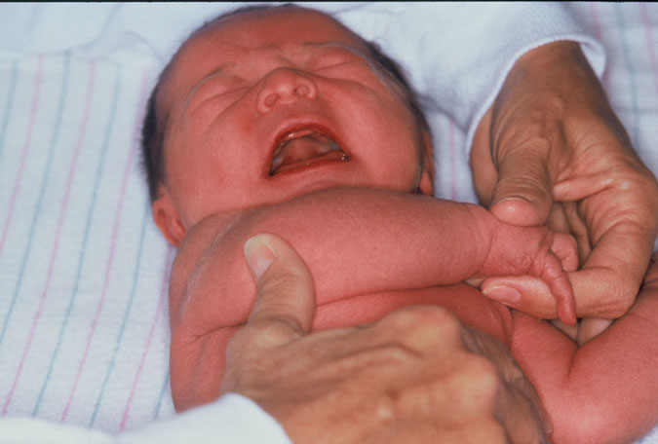
Ballard score

Slide 2

Objectives
Introduction
Components of the Ballard score
How to interpret the total score

Slide 3
Introduction
Determining the gestational age is important for the timing of newborn interventions
Gestational age assessment can be done using:
  Last Normal Menstrual Period,
  Obstetric Ultrasound (1st trimester),
  Ballard scoring.

Slide 4
New Ballard Score
A method used to determine the gestational age
It assesses 6 external physical and 6 neuromuscular signs of maturity.
Assessment of gestational age from 20 to 44 weeks
Scores range from-10 to +50
Done at birth (Unreliable >4 days old)

Slide 5
Neuromuscular maturity
Assesses the development of the CNS
As maturation progresses, the fetus gradually assumes increasing passive flexor tone that proceeds in a centripetal direction
Lower extremities flex slightly ahead of upper extremities
  Very early in gestation only the ankles are flexed.
  Knees will flex as wrists just begin to flex.
  Hip flexion, then adduction are just ahead of elbow, then shoulder girdle flexion.
The preterm infant primarily exhibits unopposed passive extensor tone, while the term infant approaching term shows less opposed passive flexor tone.

Slide 6
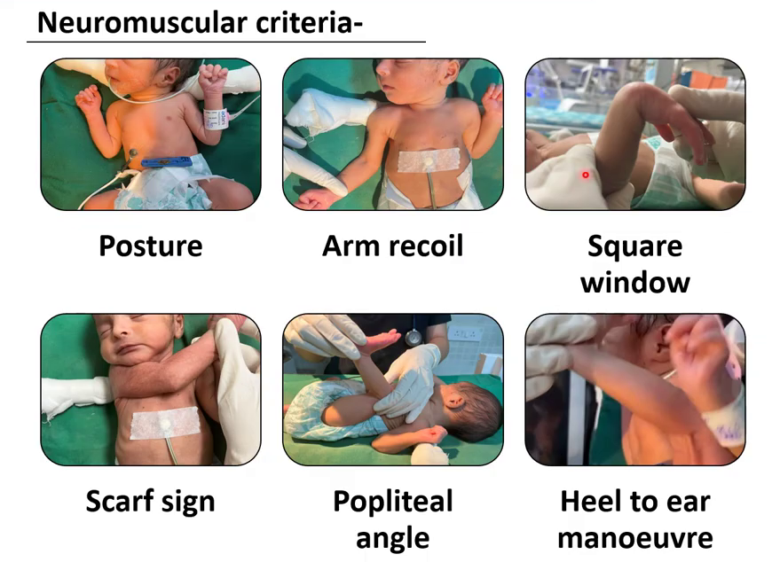
New Ballard Scores

Slide 7
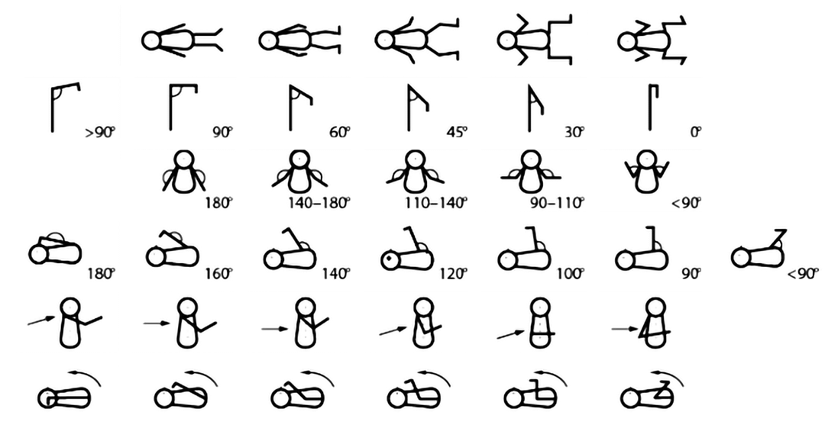
Neuromuscular Score
 | -1 | 0 | 1 | 2 | 3 | 4 | 5
Posture
Square Window
Arm Recoil
Popliteal Angle
Scarf Sign
Heel to Ear
Notes:
Total body muscle tone is reflected in the infant's preferred posture at rest and resistance to stretch of individual muscle groups. As maturation progresses, the fetus gradually assumes increasing passive flexor tone that proceeds in a centripetal direction, with lower extremities slightly ahead of upper extremities. For example, very early in gestation only the ankles are flexed. Knees will flex as wrists just begin to flex. Hip flexion, then adduction are just ahead of elbow, then shoulder girdle flexion. The preterm infant primarily exhibits unopposed passive extensor tone, while the infant approaching term shows progressively less opposed passive flexor tone.

Slide 8
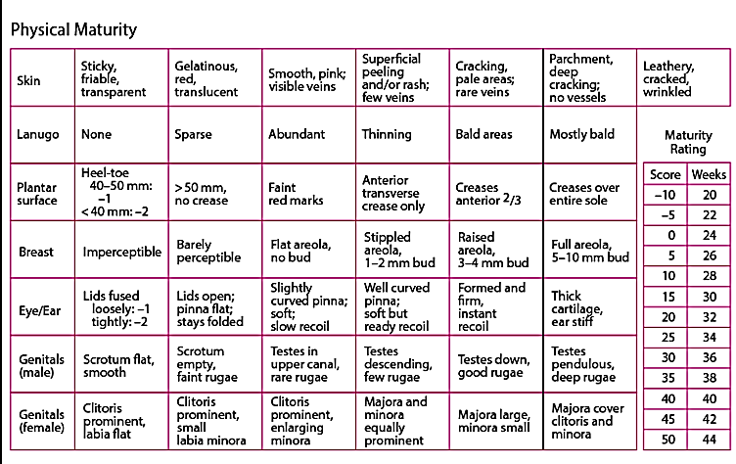

Slide 9

Questions

Slide 10

Summary
Gestational age assessment is key in identifying preterm newborns
Ballard score is a clinical tool used to estimate the gestational age
Ballard score should be done to newborns at admission to ascertain the gestational age

