Slide 1

Module 2:
Basic Life Support:
Infant and child
(ABCs in a collapsed infant/child)

Slide 2

Objectives
To describe the structured ABC approach to BLS for infants and children
Review basic emergency drugs used in resuscitation

Slide 3




Being prepared
Who is responsible?
    Who comprises the team? Specific roles?
    How are they alerted?
Who?
Where will Life Support take place?
    Special area or Bedside?
Where?
What?
Equipment?
  Responsibility?
Knowledge & Skills/Competence (guidelines)?
  Training and Orientation?
How?

Slide 4


What are the most common causes of ‘collapse / arrest’ in children?
Respiratory failure
Pneumonia
Circulatory failure
  Severe anaemia
  Dehydration
  Septic shock.
  (Pump failure – adults and children with CHD)

Slide 5

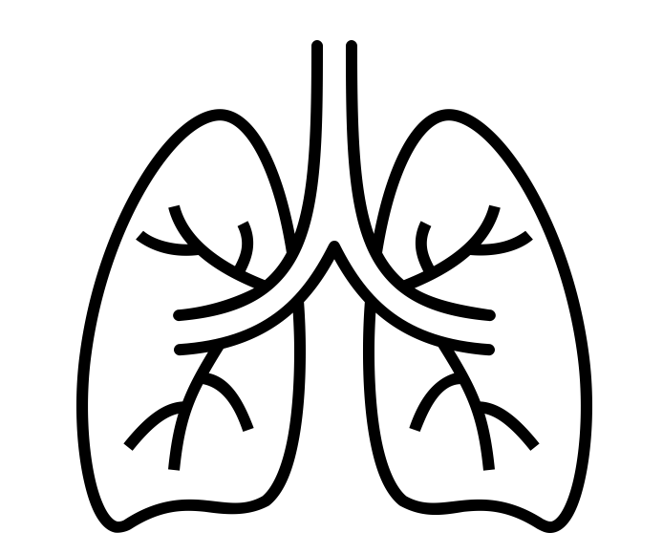

The collapsed child - A structured approach
Safe, Stimulate, Shout, Setting
Airway-patency, position
Breathing - Child IS NOT breathing Or only gasping
5 rescue breaths with Bag and Mask device, Attach 100% oxygen to BVM device
Circulation - Heart Rate < 60 bpm, 15 compressions to every two Ventilations
Aim for 6 – 7 cycles of 15:2 per minute (for 2 minutes)
Reassess ABC after every two minutes
Notes:
.

Slide 6

Drugs in Resuscitation
Consider IO/IV line insertion when a 3rd helper arrives
Get samples for random blood sugar, Hb and GXM.
Consider IO/IV Adrenaline (0.1ml/kg 1:10,000) as rapid push plus a flush of 2-5mls normal saline
How to make 1:10,000 adrenaline:
Mix 1 ml of 1:1,000 adrenaline with 9mls of water for injection, to make 10mls of adrenaline 1:10,000
Manage hypoglycemia with IO/IV 10%dextrose
Notes:
In Kenya’s paediatric guidelines, the dose for managing hypoglycemia is 5mls/kg of 10% dextrose. In newborns, this is 2.5mls/Kg.

Slide 7


Post-Resuscitation Care
Assess ABCDE fully with frequent reassessment every 2 minutes
  Airway: correct positioning, consider airway adjuncts
  Breathing: Oxygen at 10-15L/min NRM and titrate flow depending on oxygen sats. Target SpO2 94-98%
  Circulation: maintain normal blood pressure to perfuse end organs (brain, heart, kidneys)
  Disability: manage hypo/hyperglycemia
  Exposure: Thermo-control, ?antibiotics ?other issues
Decide on admission care for definitive and supportive care

Slide 8

Summary
The Collapsed Infant
4 S- Safe, stimulate, shout for help, change setting
Airway: Clear? Position?
Breathing: Is BVM needed? (add oxygen to bag)
Circulation: Are chest compressions needed (no signs of life)
Reassess A then B&C (together) after every two minutes

