Slide 1

Danger Signs and Neonatal Sepsis

Slide 2

Objectives
Recognize and respond to danger signs in the neonate
Discuss neonatal sepsis and management

Slide 3
Introduction to new-born danger signs
What are danger signs?
Why these signs and symptoms?
These are evidence based signs that indicate an increased risk of morbidity and mortality
They require prompt medical intervention
Are included in the national guidelines
They are:
Observed commonly in common illnesses
Help in the assessment of the nature and severity of illness
Indicate risk of death
Useful for monitoring progress
Easy for everyone to observe and learn

Slide 4

Danger signs in Newborns

Slide 5
Other Danger signs in Newborns
Poor feeding
Fast breathing
Chest indrawing
Jaundice
Lethargy/no movement
Convulsions
Hypothermia
Fever
Other Common Signs
Vomits everything
Irritable or inconsolable
Apnoea
Pus and cellulitis at the umbilicus
Skin pustules
Notes:
Add the NAR and tick the danger signs in NAR

Slide 6
Please note:
A neonate presenting with any danger signs should be handled as an emergency
Check and correct the ABCDE before going through the routine admission process

Slide 7
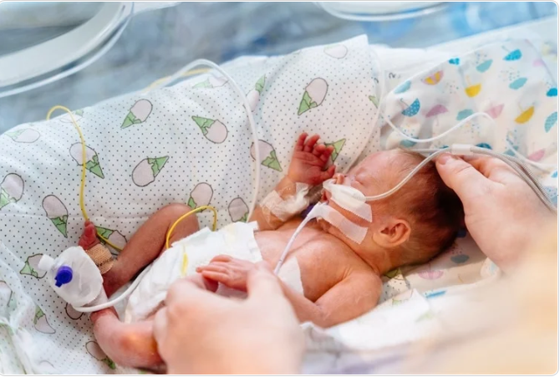
Neonatal sepsis: Definitions
Neonatal sepsis is a systemic infection occurring in the neonatal period
It is the 3rd cause of morbidity and mortality in newborns
Early onset neonatal sepsis
Sepsis occurring at ≤72 hrs
Late onset neonatal sepsis
Occurring > 72 hrs
Simonsen KA, Anderson-Berry AL, Delair SF, Davies HD. Early-onset neonatal sepsis. Clin Microbiol Rev. 2014 Jan;27
Notes:
put a baby

Slide 8
Neonatal risk factors for sepsis
Prematurity or low birth weight
Congenital anomaly that disrupts skin
Invasive procedures
Direct exposure to infectious agents in hospital or in the community
Underdeveloped immune system
Disruption of neonatal immune defenses
Direct introduction of microbes to the neonate
Birth asphyxia
Vertical transmission of maternal bacteria from lower genital tract to uterus
Neonatal Sepsis
Downey LC, Smith PB, Benjamin DK Jr. Risk factors and prevention of late-onset sepsis in premature infants. Early Hum Dev. 2010 Jul;86 Suppl 1(Suppl 1):7-12.
Notes:
Add on birth asphyxia
Arrow insertion

Slide 9









Prevention of neonatal sepsis
Hand washing
Pre-emptive antibiotics and short hospital stay
Cord care
Early initiation of breastfeeding
Recommended cot distancing, AVOID sharing cots
Ventilation in NBU
Skin preparation in sterile procedure
https://globalhealthmedia.org/portfolio-items/early-initiation-of-breastfeeding/?portfolioCats=191%2C94%2C13%2C23%2C65
https://globalhealthmedia.org/portfolio-items/inserting-an-iv/?portfolioCats=191%2C94%2C13%2C23%2C65
Notes:
Sharing cot and change the cot

Slide 10
Lab Investigations
Blood culture: Gold standard
FHG:
  WBC <5000cells/ul more informative of sepsis than >20000cells/ul
  Absolute Neutrophil count: Neutropenia has greater specificity
  Thrombocytopenia <100 000 × 10⁹ cells/l
Acute Phase reactants:
  CRP
  Pro-calcitonin
Urinalysis
Urine culture
CSF analysis (CSF culture is gold standard)
Notes:
CRP
An acute phase protein produced by the liver in response to inflammatory cytokines esp IL6 produced during an infective process.
A single value has low sensitivity especially in the early stages of infection.
Serial determination 24-48 hrs after the onset of signs of sepsis achieves a sensitivity of 74-89% and a specificity of 74-95%
useful for monitoring the response to treatment and guiding antibiotic therapy, though nothing replaces the clinical impression and the gold standard
In a study of 401 newborn infants of <28 days of age with suspected sepsis, CRP on adjusted analysis was independently predictive of a positive blood culture .
In a study of 176 newborns >1,500 g, CRP was calculated to have a negative predictive value of 99% . This demonstrated the potential usefulness of this biomarker to guide early discontinuation of antimicrobial therapy in suspected early-onset neonatal bacterial infection .
PROCAL
Better sensitivity but less specificity than CRP
Increased serum levels can be seen in non-infectious episodes such as respiratory distress syndrome, perinatal asphyxia, intracranial hemorrhage, hemodynamic failure, pneumothorax, resuscitation, and fetal distress
Although some studies have suggested improved sensitivity and specificity of PCT for identification of LOS , given the current evidence and the availability of tests in clinical laboratories, serial CRP measurements are commonly used in most NICUs to identify infants with LOS.
Urine culture obtained by catheter or bladder tap should be included in the sepsis evaluation for infants one week of age or older.
A urine culture need not be routinely performed in the evaluation of an infant ≤6 days of age, because a positive urine culture in this setting is a reflection of high-grade bacteremia rather than an isolated urinary tract infection
Leukocyte esterase – Positive leukocyte esterase on dipstick analysis is suggestive of UTI but is nonspecific
Nitrite – Positive nitrites on dipstick analysis indicate that UTI is likely
Standard microscopy – In standard microscopy, a centrifuged sample of unstained urine is examined for WBCs and bacteria.
With standard microscopy, pyuria is defined as ≥5 WBC/high-power field (hpf) and bacteriuria as any bacteria per hpf.

Slide 11
Is there meningitis?
Meningitis
You will never know unless you do an LP!
Clinical signs of meningitis in neonates are notoriously unreliable.
Proven cases in neonates have a bulging fontanelle/stiff neck/ convulsions
Meningitis is common in neonatal sepsis – up to 1 in 5 babies with sepsis had Meningitis in one Kenyan study (Laving, 2003).
Chu SM, Hsu JF, Lee CW, et al. Neurological complications after neonatal bacteremia: the clinical characteristics, risk factors, and outcomes. PLoS One. 2014;9(11):e105294. Published 2014 Nov 3. doi:10.1371/journal.pone.0105294
Notes:
Once again you will never know about meningitis unless you do an LP.
Clinical signs of meningitis in young infants are notoriously unreliable.
In a local study nearly 1 in 5 babies being treated for ‘suspected sepsis’ had meningitis.
Even if CSF culture is not possible simple analysis can be helpful in confirming the presence of meningits.
In most developed countries, even using cephalosporins, at least 2 weeks treatment for proven meningitis is recommended and many experts suggest a 3 weeks minimum course.
Ceftriaxone should not be used in Neonates with Jaundice
Treatment for a few days only in a child who makes an initial improvement and who has not had an LP but does have meningitis risks partial treatment, recurrence of the disease and serious sequelae such as hydrocephalus or death

Slide 12




Treatment of neonatal sepsis
Choice of antibiotic
Empiric treatment
2 Considerations to make:
IV Benzyl penicillin and gentamicin
If staph infection is suspected (presence of many Pustules, Abscess or Omphalitis) use IV Flucloxacillin and Gentamicin
In case of surgical NEC (Bell stages 3&4) add IV Metronidazole
Likely organisms
Antimicrobial resistance patterns

Slide 13

Management ctd…
Supportive care
Oxygen therapy as required
Maintaining warm chain,
Controlling hyperthermia,
Feeding
Vital signs monitoring
IFCDC
Use of blood products when indicated
Isolate culture positive neonates

Slide 14
When to switch antibiotics?
Yes
Minimum 7 days, injectable penicillin and gentamicin
Critically sick New born
Neonatal sepsis (NOT Critically sick) completely well after 48hrs
Yes
Change to oral amoxicillin 50mg/kg/dose
If a neonate does not improve in 2–3 days, antibiotic treatment should be changed
Yes
Consider 3rd generation cephalosporins e.g. ceftazidime, cefotaxime
CULTURES (BLOOD, URINE, CSF) MUST BE DONE

Slide 15
?
Questions?

Slide 16

Summary
It is important to recognize key danger signs and other signs of illness that will help guide basic treatment in 80-90% of newborns admitted.
Neonatal sepsis is the third cause of neonatal mortality
Judicious use of antibiotics is important
Remember documentation: What is not documented is assumed not done!
16

