Slide 1
Module 9: Diabetic Ketoacidosis (DKA)

Slide 2
Objectives
By the end of this module, you should be able to:
Define DKA
Outline the criteria for diagnosing DKA
Identify the clinical presentation of DKA
Classify DKA
Discuss the management of DKA
Transition to subcutaneous insulin after DKA resolved

Slide 3
Definition of DKA
Is a major life threatening complication of type 1 diabetes characterized by:
Diabetes: Random blood sugar >11mmol/l (~200 mg/dl)
Ketosis (blood ß-hydroxybuyrate ≥3 mmol/L) or moderate or large ketonuria(2+).
Acidosis: Venous pH <7.3 or bicarbonate <18 mmol/l
Notes:
“euglycemic ketoacidosis”

Slide 4
Risk factors for DKA
IN NEWLY DIAGNOSED DIABETICS
IN KNOWN DIABETICS
Younger patients <2 yrs
Delayed diagnosis
Lower Socioeconomic status
Countries with low prevalence of type 1 DM
Insulin omission
Poor control of sugars
Previous DKA episodes
Acute GE with persistent vomiting and inability to maintain hydration
Peripubertal and adolescent girls/ eating disorders
Limited access to health services
Insulin pump failures
Binge alcohol consumption

Slide 5
Diagnosis: Clinical/ laboratory
Clinical Signs and Symptoms
Laboratory
Polydipsia, polyuria, weight loss, vomiting
Dehydration
Fruity” smell to breath (acetone)
Kussmaul respirations( deep sighing breathing pattern)
Abdominal pain (can mimic surgical abdomen)
Signs of infection
RBS >11mmol/l (~200 mg/dl)
Blood ketones- ß-hydroxybuyrate ≥3 mmol/L)
Urinalysis- moderate or large ketonuria(2+).
BGA-Venous pH <7.3 or bicarbonate <18 mmol/l
Other tests; UECS, Septic screen
Kussmaul breathing Video link
https://youtu.be/TG0vpKae3Js

Slide 6
Classification of DKA
Severity Grading | Venous pH | Bicarbonate level (mmol/L)
Mild | 7.2 - <7.3 | 10 - <18
Moderate | 7.1 - <7.2 | 5 - <10
Severe | <7.1 | <5

Slide 7
Principles of DKA Management
Date
Slide no 7
Restoration of volume status: Correction of Shock and dehydration
Correction of hyperglycemia and Ketoacidosis ( insulin Therapy)
Correction of electrolyte imbalances
Management of precipitating factors
Note that the patient should be Nil per mouth until DKA resolves
Notes:
7

Slide 8
Where Should a patient with DKA be Managed?
Children in DKA should be managed in an Intensive Care Unit(ICU) or High dependency Unit (HDU)
If no ICU or HDU, manage in the Acute room/ emergency room of the ward
Need:
  Clinical team well trained in management of DKA.
  laboratory support
  Written DKA guidelines
Notes:
At list they need to have a video call with experts. These patients need very close monitoring.

Slide 9
Initial Assessment
• Weigh the child.
• Measure blood glucose (both blood glucose meter and laboratory measurement if possible).
Measure ketones by urine dipstick (and blood ketone measurement if possible).
BGA- Venous pH and bicarbonate
HbA1c,
Urea, electrolytes and creatinine,
Full hemogram. Venous pH and bicarbonate
Microbiological samples
Carry out a clinical assessment including history and
examination. Be careful to include:
a. Severity of dehydration. If uncertain about this, assume 10% dehydration in significant DKA
b. Level of consciousness
c. Evidence of infection

Slide 10
Initial Resuscitation
Life support (ABC)
Airway: check airway patency/ position airway
If in shock, Give fluid (0.9% Saline or Ringers Lactate) at 20ml/kg over 15 minutes, repeat boluses upto maximum of 40ml/kg (2 boluses).
Breathing: Give oxygen to children with impaired circulation and/or shock.
Circulation: Assess for shock/ dehydration and Insert 2 IV cannula as you draw blood samples. If no intravenous access, insert an intra-osseous line.
If not in shock give 10-20 mls/kg (0.9% Saline or Ringers Lactate) over 1 hour.
Wolfsdorf JI et al. ISPAD Clinical Practice Consensus Guidelines 2018: Diabetic ketoacidosis and the hyperglycemic hyperosmolar state. Pediatr Diabetes. 2022;19(Suppl. 27):155–177.

Slide 11
Rehydration Principles
Date
Slide no 11
1. Correction of shock or decreased peripheral circulation – quick phase
If in shock,
  Bolus with Normal saline 20 ml/kg over 15 minutes
    Reassess hydration status after each bolus
    Maximum bolus x 2 (subtract the amount from total fluid)
If not in shock- Normal saline 10-20 mls/kg over 1 hour.
2. Correction of dehydration – slow phase
DO NOT START INSULIN UNTIL INITIAL FLUID RESCUSCITATION HAS BEEN DONE
Notes:
11

Slide 12
Rehydration Principles: Slow Phase
Calculate fluid Requirement over 48 hours (0.9% saline/ ringers lactate)
Maintenance fluid over 48 hrs + Deficit
48 hrs (Time taken for rehydration)
To prevent hypoglycemia,
Once the blood glucose is less than 17 mmol/L, use 0.9% sodium chloride in 5% dextrose.
Once the blood glucose is <10mmol/L, use 0.9% sodium chloride in 10% dextrose.
Wolfsdorf JI et al. ISPAD Clinical Practice Consensus Guidelines 2018: Diabetic ketoacidosis and the hyperglycemic hyperosmolar state. Pediatr Diabetes. 2022;19(Suppl. 27):155–177.
Notes:
To make 0.9% sodium chloride in 5% dextrose- Take 50 mls out of 500 mls of 0.9% sodium chloride and add 50 mls of 50 % dextrose
To make 0.9% sodium chloride in 10% dextrose- Take 100 mls out of 500 mls of 0.9% sodium chloride and add 100 mls of 50 % dextrose

Slide 13
Rehydration Principles: Slow Phase
Calculate fluid Requirement over 48 hours=
Maintenance fluid over 48 hrs + Deficit
48 hrs (Time taken for rehydration)
    Deficit Fluid calculation (litres) = % dehydration x body weight (kg) x 10
    Maintenance Fluid Calculation- use holliday segar method: 1st 10 kgs :-100mls/kg, 2nd 10 kgs :-50mls/kg, Any weight above the 20kgs :-20mls/kg (NB: to get maintenance fluid over 48 hours, multiply by 2)
    Choice of fluid:- Normal saline, if not available use ringers lactate

Slide 14
Maintenance fluids calculation example
Holliday- Segar Method
Calculate maintenance fluids for a period of 24 hours
The 1st 10kgs - 100mls/kg
Next 10kgs – 50mls/kg
Any weight above the 20kgs -20mls/kg
NB: to get maintenance fluid over 48 hours, multiply by 2
Example :
Calculate maintenance fluids for a 20kg child
(100x10) + (50x10) =1500mls in 24hours
1500x2= 3000mls in 48 hours
KDHS 2014

Slide 15
Correction of deficit fluid - Example
  A child who is 20kg with 10% dehydration
  How much fluid would be given to correct the deficit?
  Formula=% dehydration x weight (kgs) x 10 (constant)
  10x20x10 = 2000mls of IVF to be given over 48 hours as deficit correction
Notes:
In patients in shock, always assume 10% dehydration. If in doubt of percentage dehydration, always assume 10 % dehydration.
This is because most children in our setting are more likely to present late with shock or severe dehydration

Slide 16
IV fluids calculation - Example
8year old child, 20kgs, RBS of 28mmol/l and urine ketones+++, with 10% dehydration. Calculate the amount of fluid to be given hourly over a period of 48hours.
Rescusitation fluid : 20x20 = 400
Deficit : 10x20x10 = 2000 in 48hours
Maintenance : (100x10) + (50x10)=1500 in 24hours
  1500x2=3000 in 48 hours
Total fluid = (2000 + 3000)- (subtract initial resuscitation fluid)400 =4600mls in 48hrs
Hourly rate for the next 48hours = 4600/48 = 96mls per hour = 96 drops per minute if using a soluset
Notes:
Reassess clinical hydration regularly.
Once the blood glucose is less than 17 mmol/L, use 0.9% sodium chloride in 5% dextrose.
Once the blood glucose is <10mmol/L, use 0.9% sodium chloride in 10% dextrose.
This prevents hypoglycemia
In a soluset, 1 ml = 60 drops

Slide 17
Insulin Therapy
Date
Slide no 17
Start insulin infusion therapy one hour after initiation of fluids.
Continous soluble/regular Insulin infusion starting dose:
  children =>5 years 0.1 U/kg/hour,
  <5 years 0.05 U/kg/hour.
If there is no infusion pump,:-
  E.g. For a 30 kg child, put 30 units of insulin in 100mls of sodium chloride and run the infusion at 10 mls/ hour to administer 0.1 Units/kg hour or run the infusion at 5 mls/ hour to administer 0.05 Units/kg/hour
Do not give insulin as IV bolus. (can increase risk of cerebral edema)
DO NOT GIVE BICARBONATE- it can increase the risk of Cerebral edema
Notes:
Plasma glucose concentration should fall at a rate of <5mmol/L/h.
If the rate of fall is very fast (> 5mmol/L/h, change to 0.9% sodium chloride in 5% dextrose (DNS).
Can increase dextrose concentration up to 12.5% if using peripheral line.
17

Slide 18
Potassium Replacement
In DKA the total body potassium is low and should be replaced
Hypokalemia: If potassium is <3 mmol/L | Start replacement at the time of initial resuscitation/ volume expansion (during 1st one hour) and before starting insulin therapy at a doseof 40 mmol of KCL per every litre of IV fluid given
Normokalemia: If potassium 3.5-5.5 mmol/L | Start replacing after initial volume expansion (after 1st one hour) and concurrent with starting insulin therapy at a dose of 40 mmol of KCL for every litre of fluid given
Hyperkalemia: If potassium >5.5 mmol/L | Delay initiation of potassium until there is urine output. Start KCL infusion when potassium is < 5.5 mmol/l
Notes:
Insulin given as a bolus increases the risk of cerebral edema
18

Slide 19
Monitoring
During management of DKA, the child needs to be carefully monitored as follows:
Record hourly: heart rate, blood pressure, respiratory rate,
level of consciousness, glucose meter reading
1
2
Monitor urine ketones in every sample of urine passed
3
Record fluid intake, insulin therapy and urine output
Repeat blood urea and electrolytes every 2-4 hours
4
5
Measure blood ketones (β-hydroxybutyrate) if possible

Slide 20
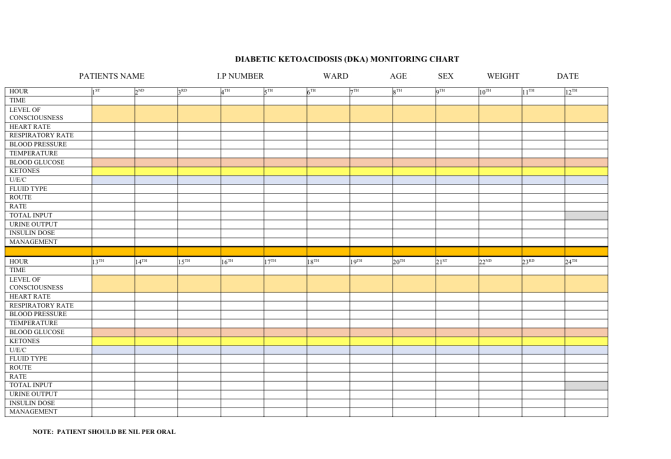

Slide 21
Complications of DKA Management
Cerebral Edema: Signs and Symptoms
Sudden and severe headache
Incontinence and/or vomiting
Combativeness, disorientation, agitation, change in mental status, posturing, seizure
Change in vital signs
  bradycardia, hypertension
  gasping/irregular respirations or periods of apnea
  hypothermia
Pupil changes (asymmetry, sluggish), papilledema
Once you suspect Cerebral oedema, always rule out hypoglycemia BGL <4 mmol/L

Slide 22
Treatment of Cerebral Edema
Date
Slide no 22
Reduce the rate of fluid administration by one-third.
Give mannitol 0.5-1 g/kg IV over 15 minutes. Repeat after 30 minutes if no response.
Hypertonic saline (3%), 2.5-5 ml/kg over 10-15minutes, may be an alternative to mannitol or addition to mannitol if no response within 30 min.
Elevate the head of the bed.
Intubation may be necessary for a patient with impending respiratory failure.
Consider brain imaging after stabilizing patient
Notes:
What can you do if cerebral oedema is suspected?
First check the blood glucose to exclude hypoglycaemia as a cause of the change in clinical state.
Reduce the rate of fluid administration by one-third.
Give mannitol 0.5-1 g/kg IV over 20 minutes and repeat if there is no initial response in 30 minutes to 2 hours.
Hypertonic saline (3%), 5 ml/kg over 30 minutes, may be an alternative to mannitol, especially if there is no initial response to mannitol.
Elevate the head of the bed.
Intubation may be necessary for a patient with impending respiratory failure.
c
The effect of mannitol should be apparent after 15 min and is expected to last about 120 min. If necessary, the dose can be repeated after 30 min.
22

Slide 23
Resolution of DKA
Criteria for resolved DKA:
  pH >7.3
  Bicarbonate >18
  Urinary ketones <2+
When ketoacidosis has resolved and oral intake is well tolerated, then transition to SC insulin.
The recommended insulin regimen is basal- bolus Insulin ( multiple daily injections).
Starting total insulin dose for transition to subcutaneous:
Pre-pubertal : 0.5 - 0.7 units/kg/day
Pubertal : 0.8 – 1.2 units/kg/day

Slide 24
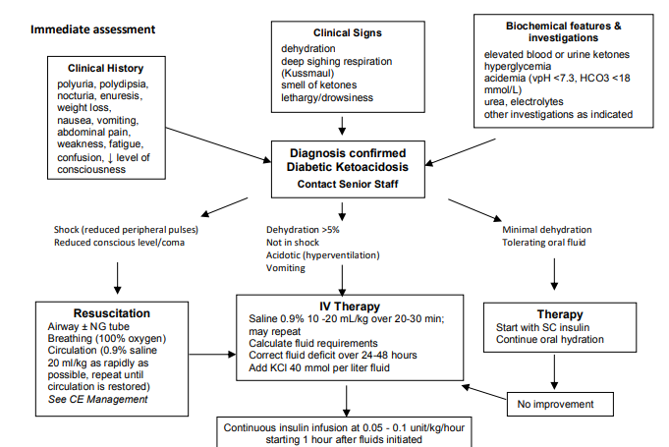
Algorithm for the management of diabetic ketoacidosis

Slide 25
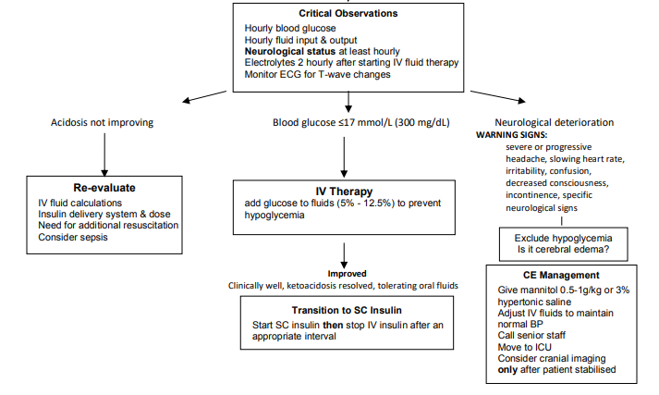

Slide 26
Questions?

Slide 27
Summary
It is a life-threatening acute complication of type 1 diabetes
Early diagnosis using clinical signs and symptoms and laboratory criteria is key
Management should be in ICU/HDU & entails fluid therapy, insulin, potassium replacement and treatment of underlying causes.
Transition to the recommended basal-bolus insulin once DKA has resolved
Written guidelines should be available at all levels of the healthcare system

Slide 28
Transition to Subcutaneous insulin

Slide 29
Objectives
Criteria of transition to subcutaneous insulin after DKA resolved
Recommended insulin regimen
Transition procedure

Slide 30
Criteria for transition
For a patient to be transitioned to subcutaneous insulin, they should:-
Have resolved DKA:
  pH >7.3
  Bicarbonate >18
  Urinary ketones <2+
Be able to tolerate oral intake.

Slide 31
Recommended insulin regimen
The recommended insulin regimen is basal- bolus Insulin ( multiple daily injections).
Starting total insulin dose for transition to subcutaneous:
Pre-pubertal : 0.5 - 0.7 units/kg/day
Pubertal : 0.8 – 1.2 units/kg/day

Slide 32
Transition to SC Insulin Injections after DKA
Choice of insulin for transition
Transition to Basal- bolus insulin at meal time 1.e before breakfast, lunch and dinner
  Overlap the insulin infusion(given during DKA mx) with the 1st dose of bolus insulin by around 30 Minutes (if using short acting insulin) and 15 minutes if using rapid acting insulin)
Bolus/Pre-meal insulin- (lowers sugars after taking a meal)
    Given before main meals
    Examples are: soluble/regular insulin, rapid acting or ultra-rapid acting
Basal insulin
    Given once or twice per day
    Examples are: intermediate-acting e.g NPH ; long-acting e.g glargine and Detemir.
Notes:
Soluble insulin examples- Actrapid
Rapid acting insulin e.gs- Novorapid insulin

Slide 33
Transition to basal bolus regimen Procedure
Calculate the total Daily insulin dose (TDD) per day.
Calculate amount of total basal insulin per day: 40-50% of Total Daily insulin dose.
Calculate the amount of total bolus /pre-meal insulin per day: 50- 60% of total insulin dose.
Then calculate the amount of bolus (pre-meal) insulin to be given before every meal (breakfast, lunch and dinner). Total daily bolus/pre- meal insulin divided by 3
Notes:
Use of pre-mixed insulin regimen is not recommended in children and adolescents with type 1 diabetes mellitus.

Slide 34
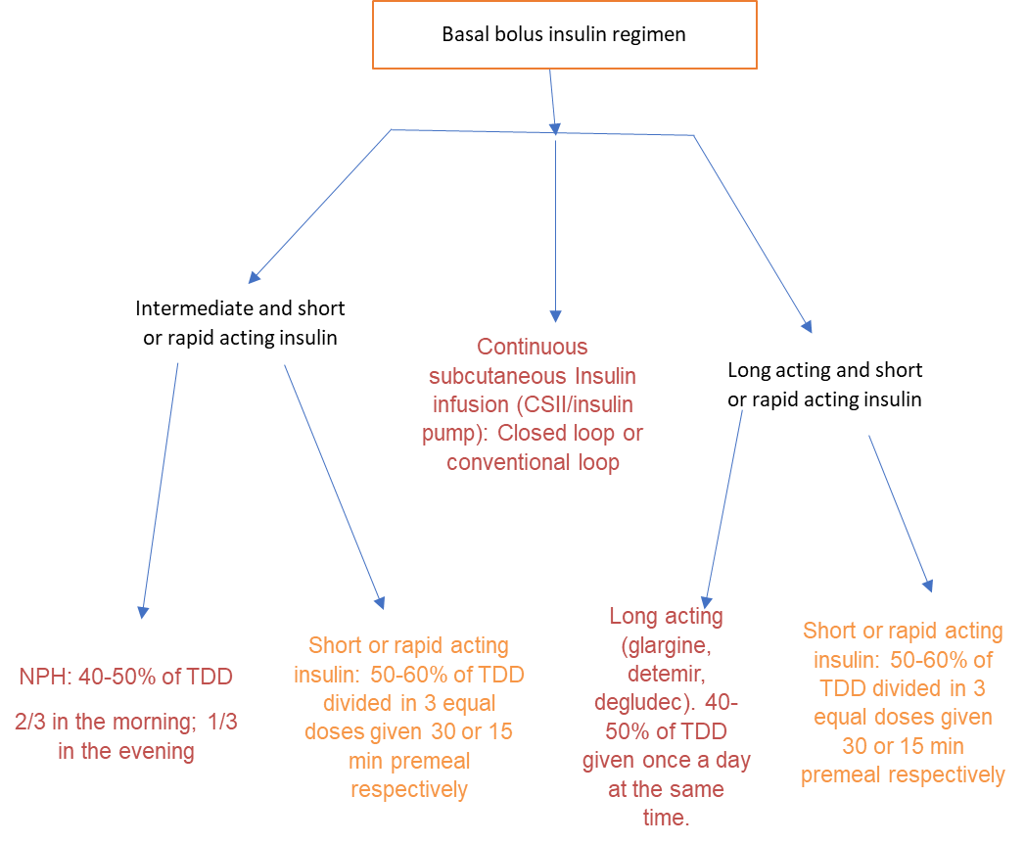
Transition to basal bolus regimen
NB: the soluble/rapid acting insulin dosing may change with Carbohydrate counting(it is not always fixed!)

Slide 35
Transitioning using long acting insulin Glargine(basal) and short/rapid acting insulin(bolus) as basal bolus regimen
Calculate Total Daily Dose(TDD) of insulin in units/kg/day
Calculate Total Daily basal dose: 40-50% as long acting insulin (glargine).
  given once daily at the same time every day e.g 8 p.m daily
Calculate Total Daily bolus dose:50-60 % as short or rapid acting insulin
  Divide the total daily bolus dose by 3 to get the amount of bolus insulin to be given before breakfast, before lunch and before dinner
  If using short acting insulin, give the dose 30 minutes before main meals
  If using rapid acting insulin give 10-15 minutes before main meals
NB: the soluble/rapid acting insulin dosing may change with Carbohydrate counting(it is not always fixed!)

Slide 36
Transitioning using long-acting insulin glargine (basal) and short/rapid acting insulin(bolus) as basal bolus regimen: Dose Calculation example
30 kg pre-pubertal child
Starting dose: 0.5 units/kg/day = 30 x 0.5
Calculate Total Daily Dose(TDD) of insulin = 15 units per day
Calculate Total Daily basal dose :40% long-acting basal insulin = 6 units SC given once daily at the same time every day
Calculate Total Daily bolus dose: 50-60 60% short/rapid acting insulin = 9 units divided by 3, given (15 minutes-rapid acting) or (30 minutes- short acting insulin) before meals.
  3 units before breakfast
  3 units before lunch
  3 units before dinner
NB: the soluble/rapid acting insulin dosing may change with Carbohydrate counting(it is not always fixed!)

Slide 37
Transitioning using long acting insulin Determir (basal) and short/rapid acting insulin(bolus) as basal bolus regimen
Calculate Total Daily Dose(TDD) of insulin in units/kg/day
Calculate Total Daily basal dose: 50% as long acting Detemir insulin.
  Give ½ of total basal in the morning and
  ½ of total basal in the evening
Calculate Total Daily bolus dose:50 % as short or rapid acting insulin
  Divide the total daily bolus dose by 3 to get the amount of bolus insulin to be given before breakfast, before lunch and before dinner
  If using short acting insulin, give the dose 30 minutes before main meals
  If using rapid acting insulin give 10-15 minutes before main meals
NB: the soluble/rapid acting insulin dosing may change with Carbohydrate counting(it is not always fixed!)

Slide 38
Transitioning using long acting insulin Determir (basal) and short/rapid acting insulin(bolus) as basal bolus regimen: Dose Calculation example
30 kg pre-pubertal child
Starting dose: 0.5 units/kg/day = 30 x 0.5
Total daily insulin dose = 15 units per day
Calculate Total Daily basal dose: 50% as long acting Detemir insulin= 7.5 units (round off to 8 units)
  Give ½ of total basal in the morning= 4 units
  ½ of total basal in the evening = 4 units
Calculate Total Daily bolus dose:50 % as short or rapid acting insulin
= 8 units divided by 3, given (15 minutes-rapid acting) or (30 minutes- short acting insulin) before main meals
  3 units before breakfast
  3 units before lunch
  2 units before dinner
NB: the soluble/rapid acting insulin dosing may change with Carbohydrate counting(it is not always fixed!)

Slide 39
Transitioning using intermediate (basal) and short/rapid acting insulin(bolus) as basal bolus regimen
Calculate Total Daily Dose(TDD) of insulin in units/kg/day
Calculate Total Daily basal dose: 40-50% as intermediate acting insulin.
  Give ⅔ of basal in the morning
  ⅓ in the evening
Calculate Total Daily bolus dose:50-60 % as short or rapid acting insulin
  Divide the total daily bolus dose by 3 to get the amount of bolus insulin to be given before breakfast, before lunch and before dinner
  If using short acting insulin, give the dose 30 minutes before main meals
  If using rapid acting insulin give 10-15 minutes before main meals
NB: the soluble/rapid acting insulin dosing may change with Carbohydrate counting(it is not always fixed!)

Slide 40
Transitioning using intermediate (basal) and short/rapid acting insulin(bolus) as basal bolus regimen: Dose Calculation example
30 kg pre-pubertal child
Starting dose: 0.5 units/kg/day = 30 x 0.5
Total daily insulin dose = 15 units per day
Calculate Total Daily basal dose: 40% intermediate = 6 units total
  ⅔ in the morning = 4 units
  ⅓ in the evening =2 units
Calculate Total Daily bolus dose: 60% short or rapid acting/ insulin = 9 units divided by 3, given (15 minutes-rapid acting) or (30 minutes- short acting insulin)
3 units before breakfast
  3 units before lunch
  3 units before dinner
NB: the soluble/rapid acting insulin dosing may change with Carbohydrate counting(it is not always fixed!)

Slide 41
Post- transition care 1
Monitor sugars and keep a diary.
Advise the clinical team and patient on target sugars
Correct high sugars using correction factor
Watch out for hypoglycemia
Advise on proper balanced diet and exercise

Slide 42
Post- transition care 2
Once patient is stable, start diabetes education while still in the ward and plan for discharge,
After discharge, continue with routine diabetes care at the diabetes clinic.

Slide 43
INSULIN THERAPY T1DM

Slide 44
Learning Objectives
By the end of this session, the participant should be able to:
Identify different classes of insulin
Describe pharmacokinetics of the 4 classes of insulin
Describe basal-bolus regimen of insulin therapy (recommended regimen)
Explain blood sugar monitoring and insulin dose adjustments
Describe insulin injection technique and Storage

Slide 45
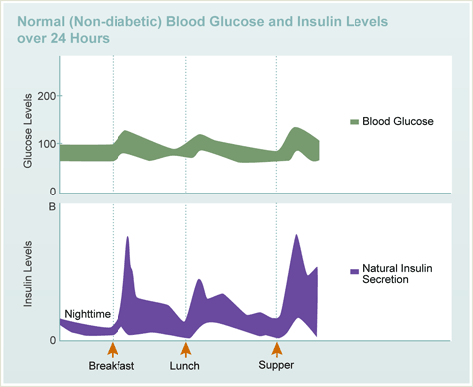
Natural Insulin Secretion Pattern
Insulin is secreted to match carbohydrate intake and maintain blood sugar during periods of starvation.
Basal secretion – continuous, whether fasting or eating.
Bolus secretion during feeding times
Jacobs DM Care 20:1279, 1997.

Slide 46
Pharmacokinetics of Insulin
Insulin Type | Onset of Action | Time to Peak Action | Duration of Action
Rapid-acting
Aspart | 5-15 min | 30-90 min | 4-6 hours
Glulisine | 20 min | 100 min | 4-6 hours
Lispro | 5-15 min | 30-90 min | 4-6 hours
Short-acting
Regular/Soluble | 30-60 min | 2-3 hours | 8-10 hours
Intermediate-acting
Neutral Protamine Hagedorn (NPH) | 2-4 hours | 8-10 hours | 12-18 hours
Long-acting
Detemir | 2-4 hours | relatively flat | 14-24 hours
Glargine | 2-4 hours | no pronounced peak | 24 hours
Degludec | 1-2 hours | no peak | up to 40 hours

Slide 47
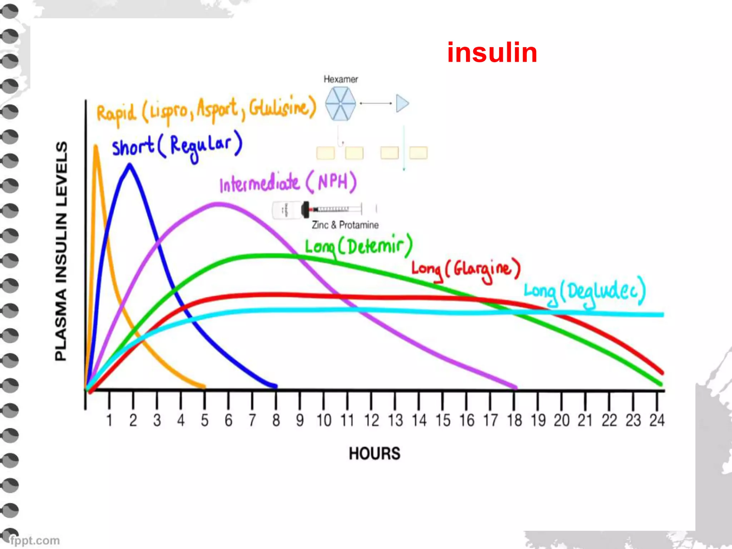
Insulin Profiles

Slide 48

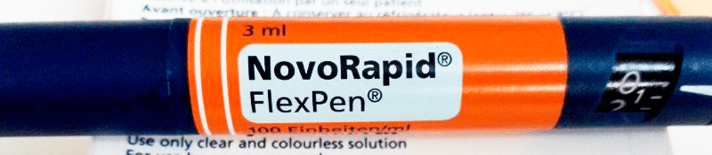
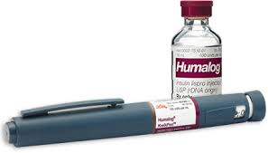
Rapid-acting Insulin
Rapid Acting
Lispro(Humalog).Aspart(novorapid),
Glulisine(apidra)

Slide 49
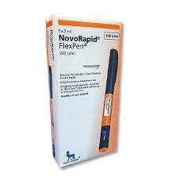
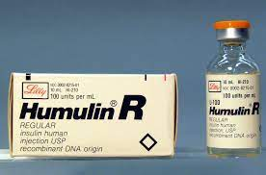
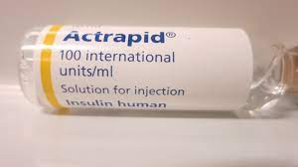
Short acting
These are given during the day three doses as premeal boluses.
Revisit

Slide 50
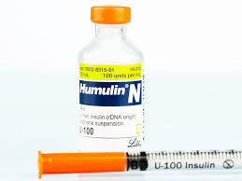
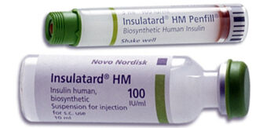
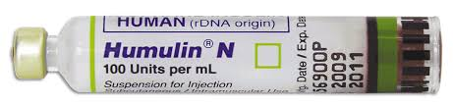
Intermediate-acting Basal Insulin
NPH (Humulin N, Insulatard)

Slide 51
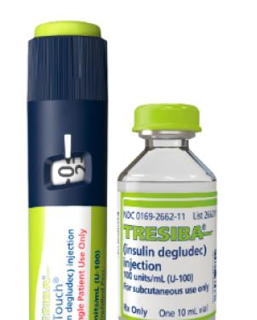
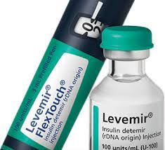

Basal/ Long-acting Insulin
Glargine (Lantus), Detemir (Levemir), Degludec (Tresiba)

Slide 52
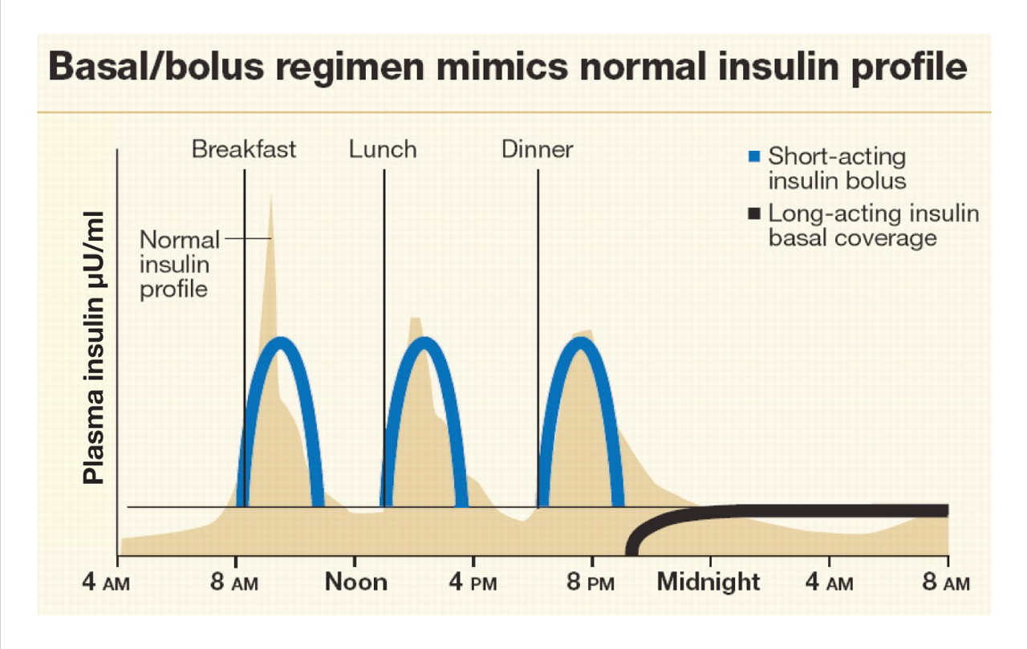
Types of insulin Regimen
1 Basal-bolus regimen
This is the preferred regimen
Mimics natural secretion of insulin
  Basal: long-acting once daily insulin injection
Meal boluses with short- or rapid-acting insulin
Meal doses are based on insulin:carbohydrate ratio
Carbohydrate-counting is a crucial part of this regimen
Long-acting insulin can be given at any time of the day but must be at the same time every day

Slide 53
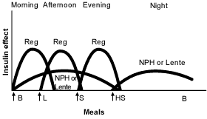
Insulin Regimens
2 Twice daily intermediate-acting (NPH) and thrice daily pre-meal boluses of short- or rapid-acting insulin

Slide 54
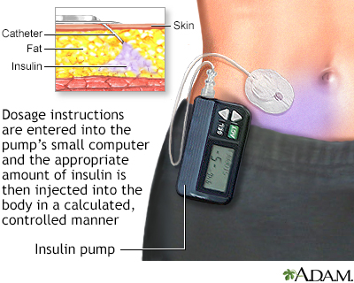
Insulin Regimens
Continuous Subcutaneous Insulin Infusion: CSII ( Insulin Pump)

Slide 55
Insulin Dosage
DKA – regular (soluble) insulin is preferred
  0.05 to 0.1 units per kg per hour – Given as IV infusion
  Insulin should be started 1-2 hours after fluid resuscitation
Switching to SC insulin - once DKA is resolved
  The following dosage is used:
    Prepubertal - 0.5 - 0.7 units/kg/day
    Pubertal - 0.8 – 1.2 units/kg/day
  Rapid-acting/ Regular insulin forms 50-60% the total daily insulin dose
  Basal insulin usually constitutes 40-50% of total daily insulin dose
  Start at the lowest dose during transition

Slide 56
Insulin Dosage
In a newly diagnosed patient with no DKA
  The following dosage is used:
    Prepubertal - 0.5 - 0.7 units/kg/day
    Pubertal - 0.8 – 1.2 units/kg/day
  Rapid-acting/ Regular insulin forms 50-60% the total daily insulin dose
  Basal insulin usually constitutes 40-50% of total daily insulin dose
  Start at the lowest dose during transition and titrate to maintain target sugars
Insulin intensification i.e Switching a patient on Pre- mix insulin to the currently recommended regimen of basal- bolus

Slide 57
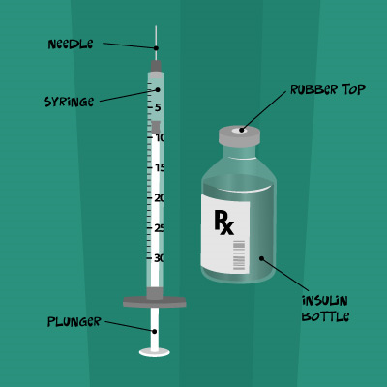
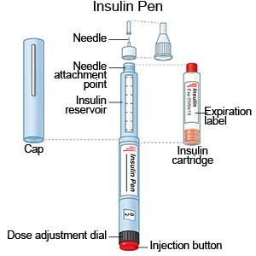
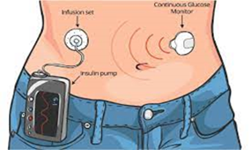
Devices for Insulin Administration
Insulin pumps
Syringe and needle
Insulin pens
Images: 1.How to give an insulin injection. https://kidshealth.org/en/parents/injection-graphic.html
2. Insulin pens. https://www.drugs.com/cg/insulin-pens-discharge-care.html

Slide 58
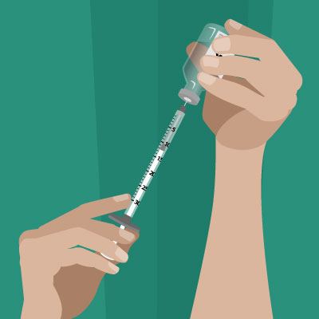
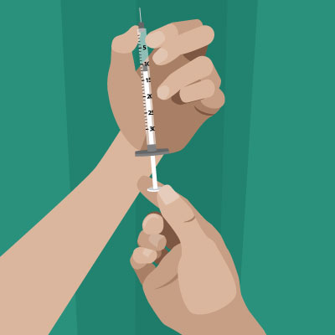
Drawing Up Insulin
Use U-100 syringes for U-100 insulin
Use small syringes with half or one unit per mark (e.g., 0.3 or 0.5 mL, 100 U/mL) for children, to make it possible to dose in half units
Use needle length of 4-6mm for children
Image: How to give an insulin injection. https://kidshealth.org/en/parents/injection-graphic.html

Slide 59
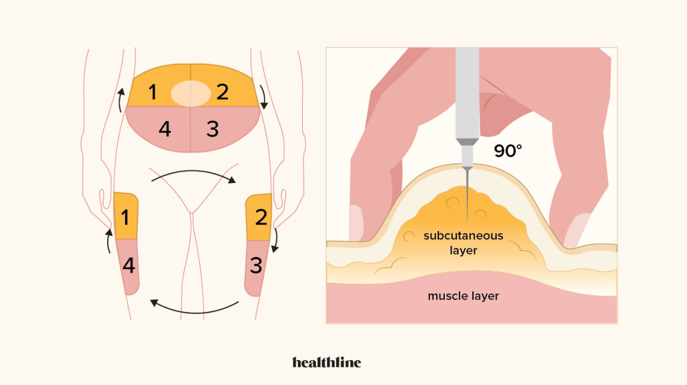
Injection Technique (1)
Insulin should be given subcutaneously.
Pinch up some skin and quickly insert the needle at a 90° angle.
No need to pinch up skin if using 4mm needle.
Keep the skin pinched to avoid having the insulin go into the muscle.
Push the plunger down all the way.
Hold the syringe and needle in place for 15 seconds.
Let go of the pinched skin and remove the needle from the skin.
If you see blood or clear fluid (insulin) where the needle went in, press on the area for 10 seconds.
Do not rub.
Image: Insulin injection sites: where and how to inject. https://www.healthline.com/health/diabetes/insulin-injection

Slide 60
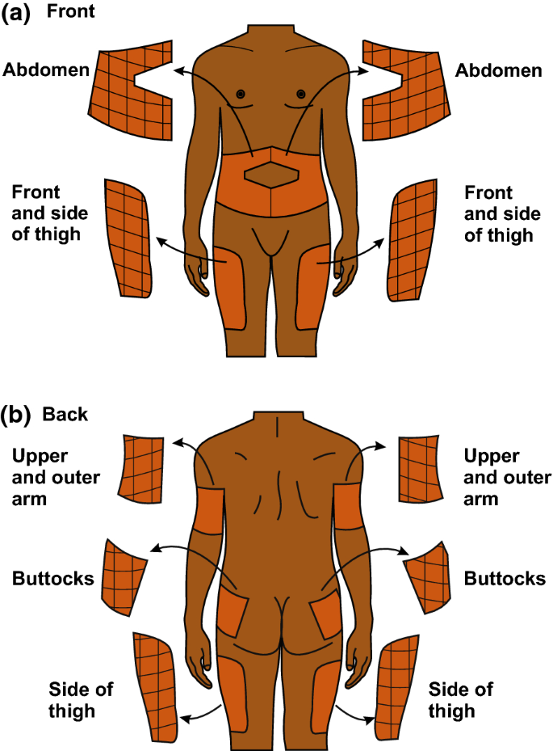
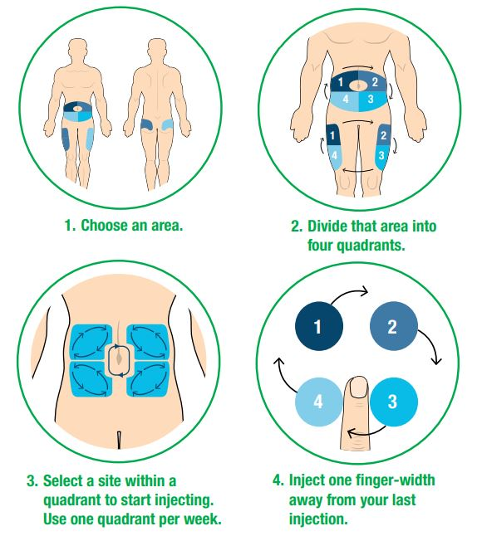
Sites for Injection & Rotation
Bahendeka S. et al. EADSG Guidelines: Insulin Storage and Optimisation of Injection Technique in Diabetes Management. Diabetes Ther 10, 341–366 (2019).

Slide 61
Blood Sugar Monitoring
Blood sugar monitoring at home is vital.
Tests frequency - depending on availability of resources, level of control, any other illness e.g. fever, gastroenteritis:
  Pre-meal
  Pre-meal and 2-3 hours post-meal
  Pre-meal, 2-3 hours post-meal, bedtime and 3 am
  Continuous glucose monitoring
Need to keep a chart for blood sugar, insulin dose and food taken - type and amount.

Slide 62
Interpretation of Blood Sugar reading;
Relevant Insulin Dose Adjustment or Other Intervention
Timing of test with high or low blood sugar | Relevant intervention or insulin dose to be adjusted
Fasting | Evening dose of intermediate or long-acting insulin
After breakfast | Rapid-acting insulin at breakfast or breakfast insulin:carbohydrate ratio
Before lunch | Rapid-acting insulin at breakfast, morning intermediate-acting insulin or mid-morning snack
After lunch | Rapid-acting insulin at lunch or lunchtime insulin:carbohydrate ratio
Before supper | Rapid-acting insulin at lunch, mid-afternoon snack or morning intermediate-acting insulin
After supper | Rapid-acting insulin at supper or suppertime insulin:carbohydrate ratio
All levels | Affected by snacks and exercise
Notes:
If a patient takes many blood glucose readings but does not know how to interpret them and does not change either the dose of insulin, the pattern of eating or activity in response to the glucose levels, then testing the glucose readings becomes a futile and wasteful exercise. Repeated daily testing at one time of day alone (eg for fasting glucose levels) is not recommended as it is not helpful.
This table suggests how you should interpret the different readings during the day. The fasting glucose level before breakfast helps to tell us if enough insulin was given the night before to compensate for the evening meal, and also whether the evening dose of long-acting insulin was too little or too much. The after breakfast level tells us about the dose of short/rapid-acting insulin given at breakfast. The after lunch level tells us about the dose of short/rapid-acting insulin given at lunch. The after supper level tells us about the dose of short/rapid-acting insulin given at breakfast. The pre-lunch level tells us about the dose of insulin given at breakfast, the effect of the mid-morning snack (if any) and the effect of the morning long-acting insulin. The pre-evening meal level tells us about the dose of insulin given for lunch, the effect of the afternoon snack (if any) and the effect of the morning long-acting insulin. All levels may be affected by snacks and exercise.
Records of insulin, food, activity and other factors that may affect the glucose levels are needed to help make decisions.

Slide 63
Dose Adjustments… cont
Bolus insulin - Each pre-meal insulin dose has 2 components:
  For the carbohydrate in the meal: carbohydrate counting
Formulae for insulin carbohydrate ratios:
      Rapid-acting insulin: 500/Total Daily Dose
      Regular insulin: 450/Total Daily Dose
  To correct pre-meal hyperglycemia - Use Insulin Sensitivity Factor (also called Correction Factor)
Formulae (for mmol/L):
      Rapid-acting insulin: 100/total daily dose
      Regular insulin: 83/total daily dose

Slide 64
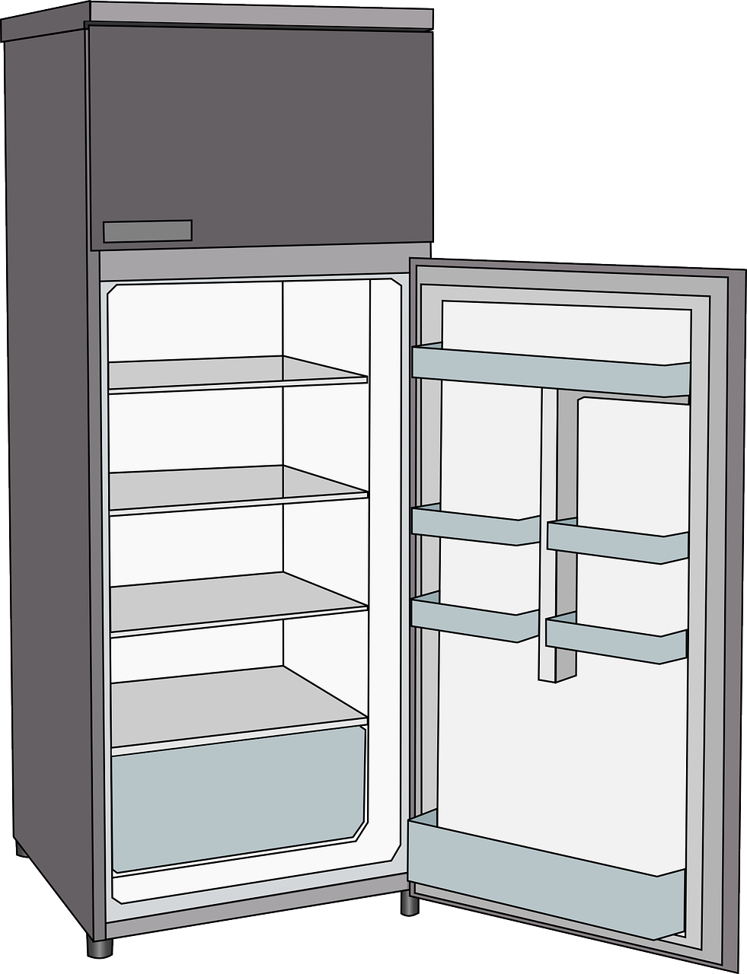
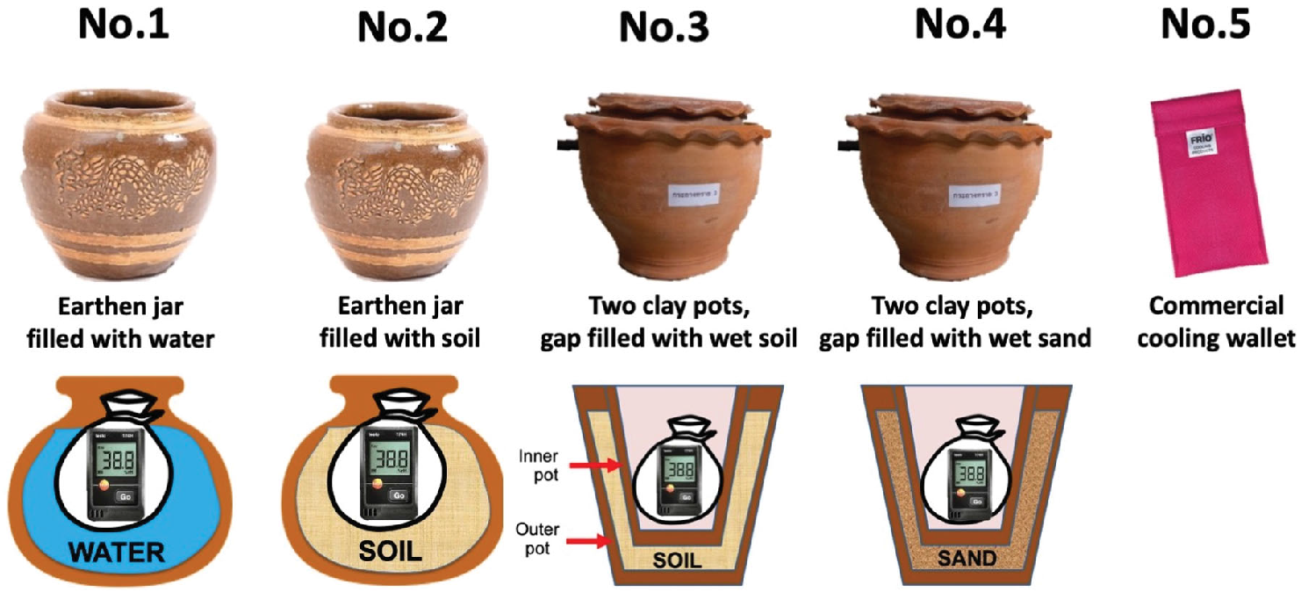
Insulin Storage
Kept at 2-8 degrees Celsius(avoid freezer section& door)
Pens - room temperature for a month
Use fridge, traditional methods
Annals Of Medicine 2022, VOL. 54, NO. 1, 1118–1125. https://doi.org/10.1080/07853890.2022.2067355
https://pixabay.com/vectors/refrigerator-fridge-cooling-cold-158634/

Slide 65
Key Messages
There are different classes (types) of insulin, with varying mode of action.
Several insulin regimens are available for management of diabetes.
The preferred insulin regimen is one that mimics physiological insulin-blood glucose interaction. Premix insulin (e.g. 30/70 or 25/75) is not recommended in type 1 diabetes
Blood sugar monitoring is essential for proper management of diabetes.
Correct injection techniques must be used to ensure proper administration of insulin.
Insulin must be stored properly for it to maintain its effectiveness.

Slide 66
Structured Diabetes Education Lecturette

Slide 67
Objectives
Outline structure diabetes education

Slide 68
Introduction
Diabetes education is a core component in management of Type 1 Diabetes.
Structured diabetes education is mainly done by the diabetes educator who should be the lead amongst all the others.
When effectively done it improves the management of children and young adults holistically.
Diabetes education can be done individually or in a group setting.

Slide 69
First Visit Education
This is done at the initial contact with the patient in the inpatient or outpatient setting.
The following topics are to be covered:
  1. Description of Type 1 diabetes and different types of diabetes.
  2. Self-monitoring of blood glucose, blood glucose targets, when to monitor, testing techniques and sites.
  3. How to maintain a blood glucose, insulin and food diary.

Slide 70
First Visit Education (2)
4. Management of hypoglycaemia:
  Signs and symptoms
  Correction (rule of 15).
  The role of a hypoglycemia kit (hypokit).
5. Management of hyperglycaemia:
  Signs and symptoms
  Management including correction factor, taking a lot of water and exercise.

Slide 71
First Visit Education (3)
6. Insulin:
  Different types and their role
  Multiple daily injections- Basal bolus insulin ( short/rapid-acting insulin and long-acting insulin)
  Insulin storage.
7. Nutrition and how to balance insulin with carbohydrates
8. Injection techniques:
  Sites, rotation, technique
  Safe use of both needles and injection pens to include number of times to reuse and proper disposal (not in dustbins).

Slide 72
Sample of Daily Food And Insulin Diary
 | Breakfast |  | Lunch |  | Dinner |  | Bedtime |  | Notes
Date: | before | 2 hrs after | before | 2 hrs after | before | 2 hrs after | 10pm | 2am
Blood Sugar
Insulin Dose
Carbs eaten
Exercise

Slide 73
Second Visit
This is in the outpatient clinic : 2 weeks after diagnosis or after initial contact with the patient:
The following is carried out:
  1. Recap of what was taught in visit 1
  2. Growth assessment (weight, height and BMI).
  3. Interpreting blood sugar results from the diary (what the current readings mean).
  4. Recap demonstration on blood glucose testing.
  5. Recap demonstration on insulin injection.

Slide 74
Second Visit (2)
6. Diet review and hypoglycaemia.
7. Nutrition and carbohydrate counting.
8. Hyperglycaemia signs and symptoms and management.
9. Diabetes and school
10. Importance of a picnic bag:
  components include: hypokit, glucometer, strips, lancet needles, insulin, water, lunch, a snack, a well-maintained diary.

Slide 75
Third Visit
Done 1 month after visit 1 or 6 weeks after diagnosis or initial contact which includes:
  1. Recap of previously taught topics
  2. Sick day rules to include ketone monitoring.
  3. Annual review: Explain the need for assessment of comorbidities, microvascular complications

Slide 76
Fourth Visit
Done 4 or 6 weeks after the previous visit and includes:
  Recap the previously taught topics to include demonstrations.
  Growth assessment.
  Diabetes and exercise.
  Nutrition and carbohydrate counting including practical

Slide 77
Fifth Visit
Done 1 or 2 months after the previous visit which includes;
  Recap the previously taught topics to include demonstrations.
  Diabetes care while travelling, on holidays and during camps
  Parties and festive seasons
  Diet and Exercise review
  State need for further investigations/ longterm complications/ cormorbidities screening

Slide 78
Sixth Visit/Home Visit
Home Visit
diabetes management at household
Carbohydrate counting to insulin matching is done practically.
Storage of insulin is assessed, and insulin injection is reviewed.
Provide linkage to community support.
Sixth Visit
Done 2 months from the previous visit and should address the following:
Foot care, dental and eye follow up
Lifestyle issues: address alcohol, smoking, drugs and sexual health
Ongoing dietary assistance

Slide 79
School Visit
It is important to have a school visit:
  to help the child incorporate back to school.
  to teach/ impact the school personnel on knowledge, skills and management of children with type 1 diabetes.
  to have practical skills training on hyperglycaemia, hypoglycaemia, sick days and exercise management.
Parents responsibility: supplies, supporting school especially with carbohydrate counting.
School responsibility: supervision and communicating with the whole family.

Slide 80
Summary
Diabetes education plays a key role in management of patients with type 1 diabetes.
Always treat the patient and family with dignity and respect.
Effective diabetes self management skills are critical to health and well being.
It is important to provide person centered care.
Always encourage and support participation in care by the patient, family and the multidisciplinary team.

Slide 81
Routine Management of Type 1 Diabetes

Slide 82
Learning Objectives
Understand the components of care of a child with type 1 diabetes.
Understand the role of nutrition in management of type 1 diabetes.
Describe the ways to assess glycemic control.
Understand the role of growth monitoring in diabetes.

Slide 83



Structure of Care
Overall goals
Individualized management plan
Access to multidisciplinary diabetes expertise
Limbert C, Tinti D, Malik F, et al. ISPAD Clinical Practice Consensus Guidelines 2022: The delivery of ambulatory diabetes care to children and adolescents with diabetes. Pediatr Diabetes. 2022;23(8): 1243‐1269.

Slide 84
Goals of Care
Good quality of life
Normal growth and development
Avoidance of complications
Good glycemia
Psychosocial adaptation and function
Early detection of comorbidities
Limbert C, Tinti D, Malik F, et al. ISPAD Clinical Practice Consensus Guidelines 2022: The delivery of ambulatory diabetes care to children and adolescents with diabetes. Pediatr Diabetes. 2022;23(8): 1243‐1269.

Slide 85
Person-Centred Paediatric Diabetes Care Model
Young person with type 1 diabetes and family
Primary Healthcare Provider (Paediatrician, Trained Medical Officer, Trained Clinical Officer)
Trained additional caregivers e.g peer support group team leaders
Paediatric Diabetes Medical Provider e.g endocrinologist
Diabetes Educator, Nurse Specialist, Dietician
Daycare and School support from nurses, teachers, coaches
Psychologist and/or Social Worker
Diabetes Technology Support
Each member of the team should have training in both paediatrics and diabetes.
Limbert C, Tinti D, Malik F, et al. ISPAD Clinical Practice Consensus Guidelines 2022: The delivery of ambulatory diabetes care to children and adolescents with diabetes. Pediatr Diabetes. 2022;23(8): 1243‐1269.

Slide 86
Aims of Individualized Diabetes Care
Ongoing diabetes & self-management education
Advice on insulin management, glucose and ketone monitoring
Monitoring for comorbidities and risk factors for / complications
Regular review of individualized goals (blood glucose targets, HbA1c)
Contact with support groups
Psychosocial screening and appropriate referral
Limbert C, Tinti D, Malik F, et al. ISPAD Clinical Practice Consensus Guidelines 2022: The delivery of ambulatory diabetes care to children and adolescents with diabetes. Pediatr Diabetes. 2022;23(8): 1243‐1269.

Slide 87
Assessment of General Wellbeing During Clinic Visits
Intercurrent health problems
Review of all medications and supplements
Assessment for autoimmune comorbidities (e.g. thyroid, adrenal, vitiligo)
Assess for disordered eating behaviours
Development, education, leisure, sports, psychosocial status
Limbert C, Tinti D, Malik F, et al. ISPAD Clinical Practice Consensus Guidelines 2022: The delivery of ambulatory diabetes care to children and adolescents with diabetes. Pediatr Diabetes. 2022;23(8): 1243‐1269.

Slide 88

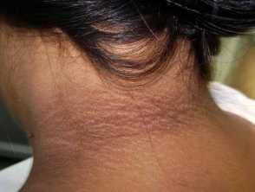
Routine Physical Examination
Height, weight, BMI, pubertal status
Blood pressure
Oral mucosa and dentition
Thyroid, cardiac, abdomen (hepatomegaly), foot examination, neurological function tests
Skin: lipodystrophy, acanthosis nigricans, hirsutism, acne
Limbert C, Tinti D, Malik F, et al. ISPAD Clinical Practice Consensus Guidelines 2022: The delivery of ambulatory diabetes care to children and adolescents with diabetes. Pediatr Diabetes. 2022;23(8): 1243‐1269.
Notes:
Photo of acanthosis and description

Slide 89
Blood Glucose Testing
Insulin regimen/doses
Pattern of eating
Activity/ Illness
Blood glucose level
Identify times when at risk for hyper- or hypoglycaemia
Blood glucose information is used to help patient and family learn – not done for staff!
Beware of doctored readings!
Pihoker C et al. ISPAD Clinical Practice Consensus Guidelines 2018: The delivery of ambulatory diabetes care to children and adolescents with diabetes. Pediatr Diabetes. 2018;19(Suppl. 27):84–104.
Notes:
Treating diabetes with insulin is completely dependent on having a clear picture of how the blood glucose changes for each patient throughout the day. The purpose of blood glucose testing is to help identify the times when the patient is at risk of either hyperglycaemia or hypoglycaemia. Blood glucose levels can be related to type and dose of insulin, pattern of eating, activity and illness.
Having this information is the basis for deciding how much insulin they need, of what type, and when it should be given.

Slide 90
Patterns of Testing are determined by
availability of strips
insulin regimen
level of glycemic control
patient factors
Patterns of testing may be increased to get more information
Needs patient records of food and insulin for readings to be valuable!
Pihoker C et al. ISPAD Clinical Practice Consensus Guidelines 2018: The delivery of ambulatory diabetes care to children and adolescents with diabetes. Pediatr Diabetes. 2018;19(Suppl. 27):84–104.
Notes:
As strips are expensive, very frequent testing may not be possible. The patterns of testing should be determined by availability of strips, insulin regimen, level of control, patient factors. Changing patterns of testing can be useful to get a more complete picture of glucose values. As mentioned previously, patient records of food and insulin are needed for readings to be valuable!!

Slide 91
Structured Blood Glucose Monitoring
7-point testing: Pre-meal, post-meal, at bedtime, and at 3 am.
5 tests a day: Pre-meals, at bedtime and at 3 am.
4 tests a day: Pre-meals and bedtime.
3 tests a day: Usually done pre-meal to allow for correction of pre-meal hyperglycemia.
Where availability of strips is a challenge: Tests can be modified to collect as much information as possible e.g., 7-point testing for 3 days in a row in one week and over the weekend the following week.
Pihoker C et al. ISPAD Clinical Practice Consensus Guidelines 2018: The delivery of ambulatory diabetes care to children and adolescents with diabetes. Pediatr Diabetes. 2018;19(Suppl. 27):84–104.
Notes:
Also test whenever symptoms of hypoglycemia occur or when a top-up dose of insulin is needed for extra food or during illness.

Slide 92
Record Keeping/ use of food and glucose diary
A monitoring diary to record patterns of glycemic control, insulin doses and amounts of carbohydrate consumed, and adjustments to treatment.
The record book is required at the time of consultation and should contain time and date of:
  Glucose levels
  Carbohydrate intake
  Insulin dosage

Slide 93
Record Keeping/ use of food and glucose diary cont,
Note of special events affecting glycemic control (e.g., illness, exercise, menses, alcohol intake)
Hypoglycemic episodes, description of severity, and potential alterations in the usual routine to help explain the cause for the event
Episodes of hyperglycemia, ketonuria/ketonemia
Glucose monitoring records should not be used judgmentally but as a vehicle for discussing the causes of variability and strategies for improving glycemic control.

Slide 94
Sample of Daily Food And Insulin Diary
 | Breakfast |  | Lunch |  | Dinner |  | Bedtime |  | Notes
Date: | before | 2 hrs after | before | 2 hrs after | before | 2 hrs after | 10pm | 2am
Blood Sugar
Insulin Dose
Carbs eaten
Exercise

Slide 95
Monitoring of Glycemic Management

Slide 96
Blood Glucose Targets
For fingerstick testing, recommended blood glucose target is 4 - 10 mmol/L.
Fasting (morning) target range: 4 - 8 mmol/L.
Bedtime target range: 7 - 10 mmol/L.
de Bock M, Codner E, Craig ME, et al. ISPAD Clinical Practice Consensus Guidelines 2022: Glycemic targets and glucose monitoring for children, adolescents, and young people with diabetes. Pediatr Diabetes. 2022;23(8): 1270‐1276.

Slide 97
Correction Factor
Also called insulin sensitivity factor for correction of hyperglycemia
Correction doses for mmol/L, use the “100 rule,” that is, divide 100 by total daily insulin dose to get the mmol/L that 1 unit of rapid-acting insulin will lower the blood glucose by.
For regular insulin, a “83-rule” for results in mmol/L.
Danne T, Phillip M, Buckingham BA, et al. ISPAD Clinical Practice Consensus Guidelines 2018: Insulin treatment in children and adolescents with diabetes. Pediatr Diabetes. 2018;19(Suppl. 27):115–135.

Slide 98
Correction Factor
  E.g if TDD is 20 units:
  Correction factor is 100/20=5 Mmols ( means – for that particular child 1 unit of rapid acting insulin lowers their blood sugar by 5 mmols.
  If child has RBS of 20 mmols with a target recommended level of 10 mmols. They will require an extra 2 units of insulin. (20-10 =10mmols needs 10/5=2)
For regular insulin, a “83-rule” for results in mmol/L.
Therefore 83/20 = 1: 4 ( 1 unit of insulin will lower the sugars by 4 mmol/l.

Slide 99
Hypoglycemia awareness and management
Self-management skills on how to recognize and manage hypoglycemia
  During every clinic visit, take history on hypoglycemic episodes, (RBS ≤ 3.9MMOL/L) .
  Find out if patient has awareness of symptoms of hypoglycemia and whether they have been educated on correction of hypoglycemia,
  Re-teach/ emphasise on identification and urgent treatment of hypoglycemia.

Slide 100
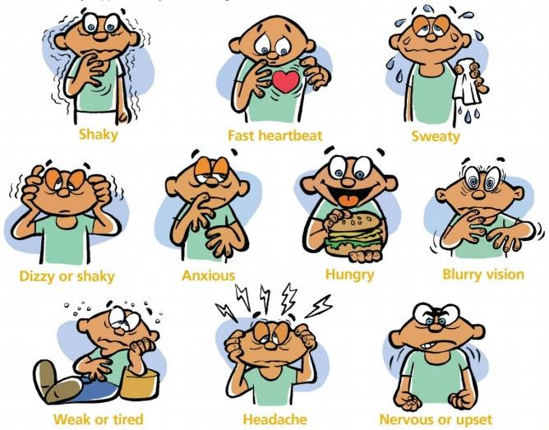
Symptoms:
Hypoglycemia
Symptoms of Hypoglycemia
Abraham MB et al. ISPAD Clinical Practice Consensus Guidelines 2018: Assessment and management of hypoglycemia in children and adolescents with diabetes. Pediatr Diabetes. 2018;19 (Suppl. 27):178–192.

Slide 101
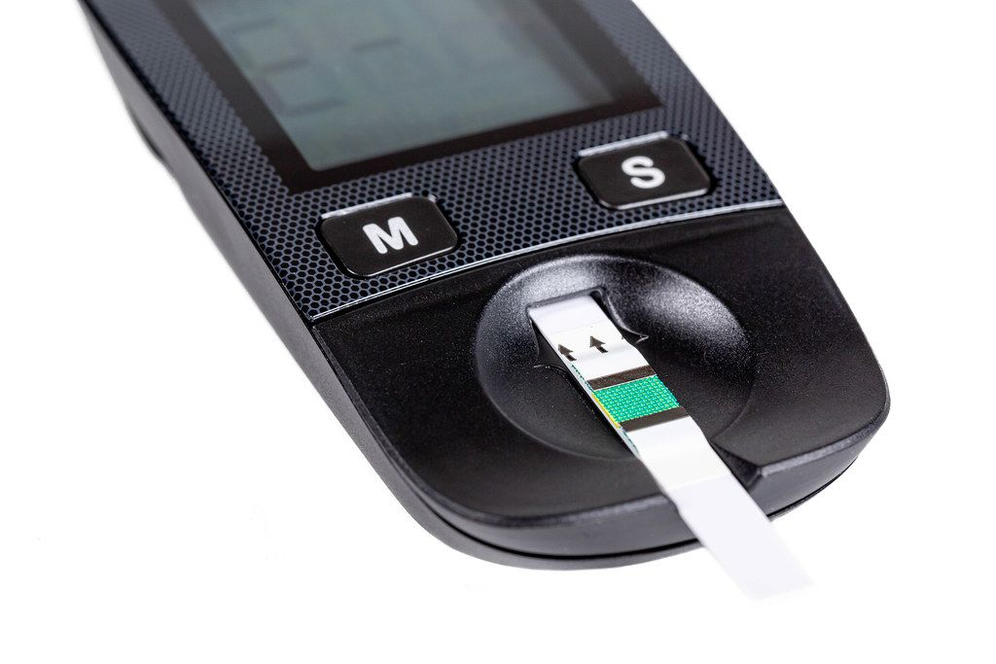





Treatment: Conscious/ Able to Swallow:
Rule of 15
Check blood glucose
Eat 15 grams of fast-acting carbohydrates
Wait for 15 minutes
Recheck blood sugar
Repeat Rule of 15 if RBS <3.9 mmol/L
If normal give a snack or meal

Slide 102
Examples of Fast acting Carbohydrates
Examples of Fast-Acting Carbohydrates
3 Teaspoons (15g) of glucose
3 Teaspoons (15g) of honey
½ glass (120ml) of fruit juice
½ glass of regular soda
3 Teaspoons (15g) of sugar
3 glucose tablets (Patco sweets)

Slide 103
Examples of follow up carbohydrate snack
1 slice of bread
1 cup of milk (250ml)
1 small banana or half a normal size banana
1 small orange
1 small apple
1 cup of watermelon

Slide 104
Treatment: Unconscious/ Unable to Swallow
1. Position on the side & maintain airway patent
2. Administer glucagon
  <25 kg: 0.5 mg
  >25 kg: 1 mg
3. Recheck after 15 minutes
4. If < 3.9 mmol/L unresponsive repeat glucagon
5. Responsive: Follow conscious pathway

Slide 105
Treatment: Unconscious & No Glucagon Available
Step 1: Position
Position on the side and maintain the airway
Step 2:
Apply
Apply a thick paste of glucose (glucose with a few drops of water) or crushed sugar under the tongue or in the dependent cheek
Step 3:
Retest
If <3.9 mmol/L and unresponsive repeat step 2
If responsive: follow the conscious pathway
Graz B, et al Sublingual sugar for hypoglycaemia in children with severe malaria: a pilot clinical study. Malar J. 2008 Nov 23;7:242. doi: 10.1186/1475-2875-7-242. PMID: 19025610; PMCID: PMC2605470
De Buck E, Borra V, Carlson JN, Zideman DA, Singletary EM, Djärv T. First aid glucose administration routes for symptomatic hypoglycaemia. Cochrane Database Syst Rev. 2019 Apr 11;4(4):CD013283. doi: 10.1002/14651858.CD013283.pub2. PMID: 30973639; PMCID: PMC6459163.

Slide 106
Hypoglycemia Kit
Hypoglycemia Kit
Hypoglycemia Kit consists of:
  Glucometer and blood glucose strips
  Fast-acting carbohydrate
  Snack
  Record book
Every patient with T1DM should be educated on the importance of the hypoglycemia kit.
The kit should be carried at all times.

Slide 107
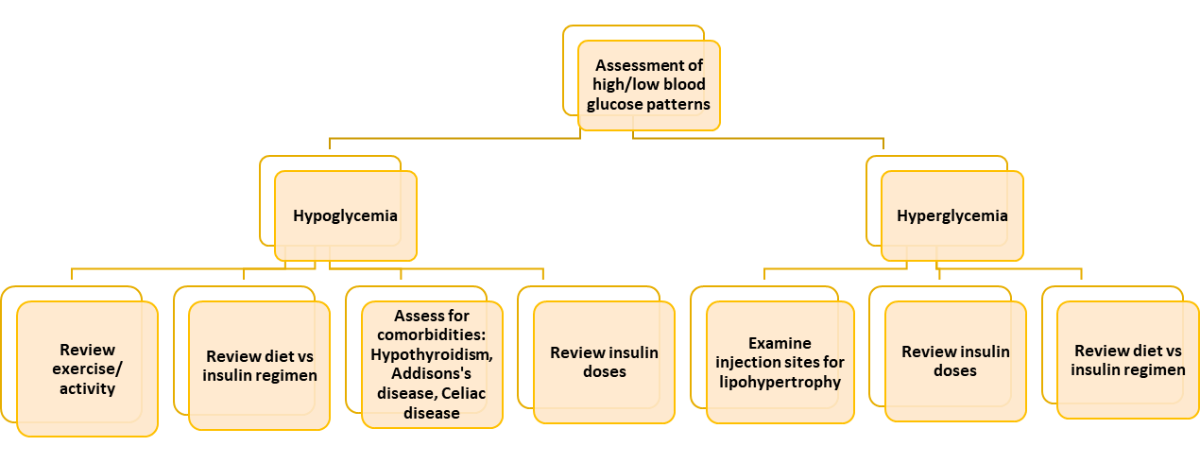
Expected interventions depending on various blood glucose readings (1)

Slide 108
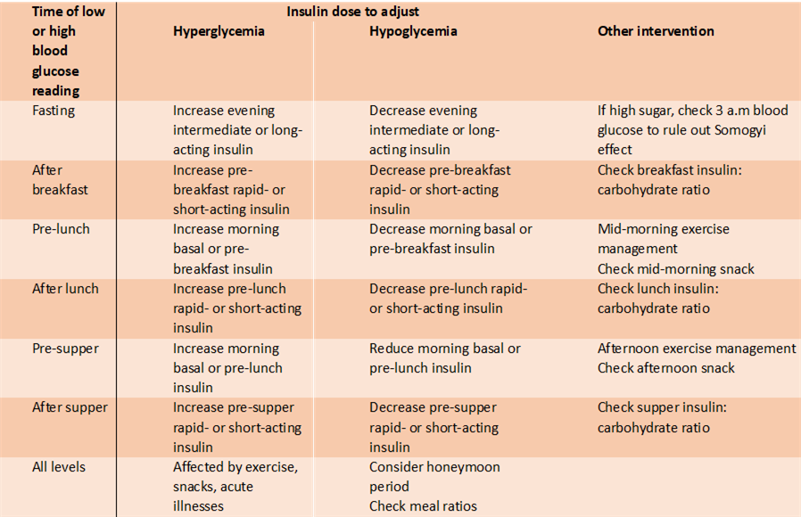
Expected interventions depending on various blood glucose readings (2)
Pihoker C et al. ISPAD Clinical Practice Consensus Guidelines 2018: The delivery of ambulatory diabetes care to children and adolescents with diabetes. Pediatr Diabetes. 2018;19(Suppl. 27):84–104.

Slide 109
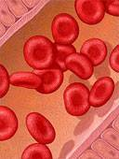
Glycated Haemoglobin (HbA1c)
Glucose attaches onto Haemoglobin (within red blood cells) ⇒ HbA1c
This is a slow and irreversible process
HbA1c reflects average blood glucose over 3 months
High glucose = increased HbA1c
HbA1c correlates with risk of long-term complications
Rising HbA1c requires action
A target of <7% is recommended for all young people with diabetes.
Pihoker C et al. ISPAD Clinical Practice Consensus Guidelines 2018: The delivery of ambulatory diabetes care to children and adolescents with diabetes. Pediatr Diabetes. 2018;19(Suppl. 27):84–104.

Slide 110
Growth Monitoring

Slide 111


Growth Monitoring in type 1 Diabetes
Growth: is a physical increase in the size of the body.
Development: increase in function and intellectual maturity of an individual.
Growth is determined by genetics, nutrition, general health, endocrine status, psychological factors and puberty.
Hermanussen M. Auxology: an update. Horm Res Paediatr. 2010;74(3):153-64.

Slide 112
Why growth monitoring in T1DM?
Early identification of growth failure: Monitoring the response to therapy
Poor control of T1DM causes growth failure.
Overdosing of insulin causes overweight and obesity.
Reduced insulin, reduced food may lead to poor growth even with normal glycemia.
Delayed puberty results mainly from poor control.
Mitchell D. Growth in patients with type 1 diabetes. Curr Opin Endocrinol Diabetes Obes. 2017 Feb;24(1):67-72.

Slide 113

What measurements are needed?
Height/ length
Weight
BMI
Growth velocity
Pubertal status
Record on medical chart and plot on growth chart.
Hermanussen M. Auxology: an update. Horm Res Paediatr. 2010;74(3):153-64.

Slide 114
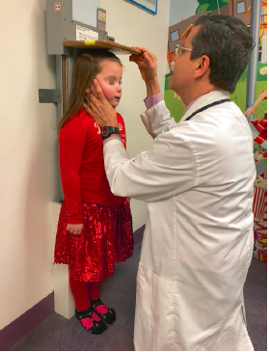
How do we take height measurement?
Performed using a stadiometer with a movable headboard.
Heels, calves, buttocks, upper back and occiput should be in contact with a vertical board.
The head needs to be placed against the board.
No shoes should be worn during measurement, and any hairdo that may have an impact on the measurement should be undone.
Hermanussen M. Auxology: an update. Horm Res Paediatr. 2010;74(3):153-64.
Notes:
A slight up pressure of the mandible allows for correction of the physiologic intervertebral disc compression that occurs throughout the day.

Slide 115
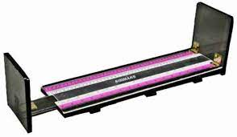
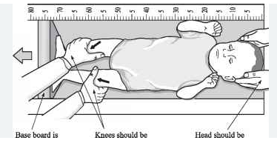
Length Measurement
Length measurement is done using a measuring table with a fixed headpiece and a movable foot piece (infantometer).
The measurement needs to be performed by 2 people.
One holds the head of the child in the Frankfurt plane against the fixed head block and the other ensures appropriate extension of lower extremities and neutral position of the ankles at a right angle.
Hermanussen M. Auxology: an update. Horm Res Paediatr. 2010;74(3):153-64.
Notes:
No shoes should be worn during measurement, and any hair-do that may have an impact on the measurement should be undone.

Slide 116
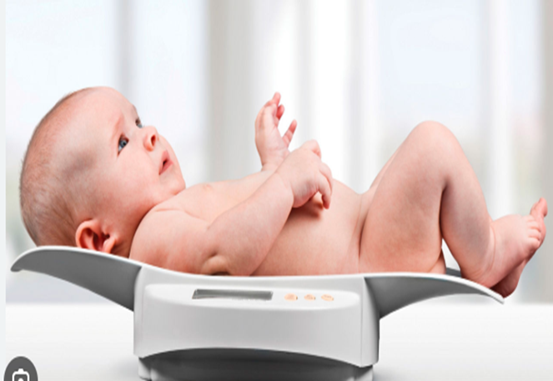
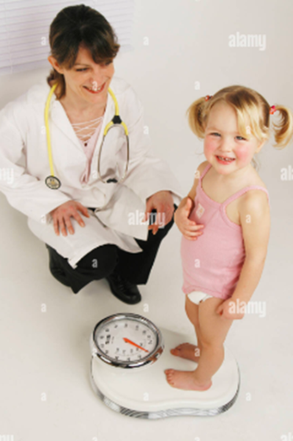
Weight
Weight measurements should be made on appropriately calibrated scales (infant/adult).
Use light clothing or only underwear, and make sure clothing pockets are emptied and shoes are removed.
Hermanussen M. Auxology: an update. Horm Res Paediatr. 2010;74(3):153-64.

Slide 117
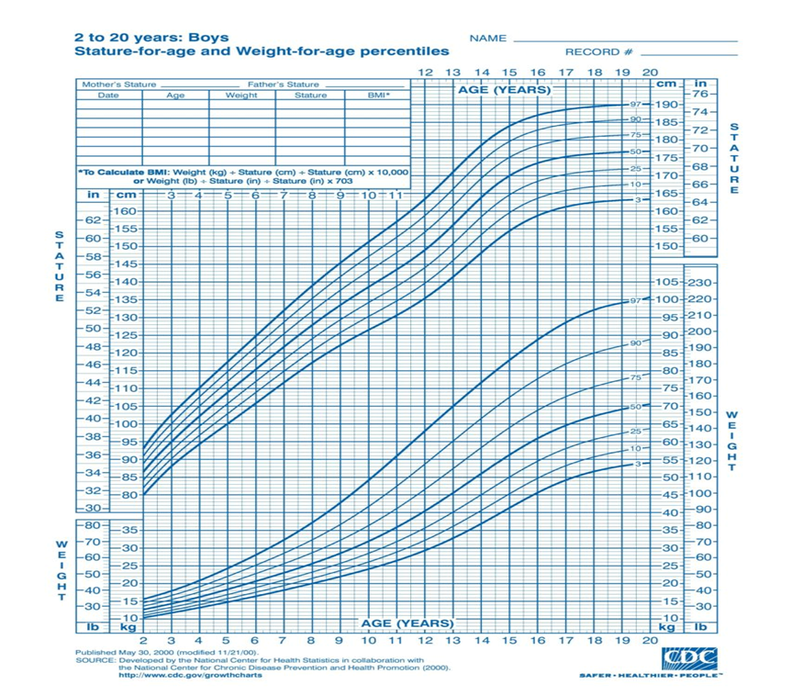
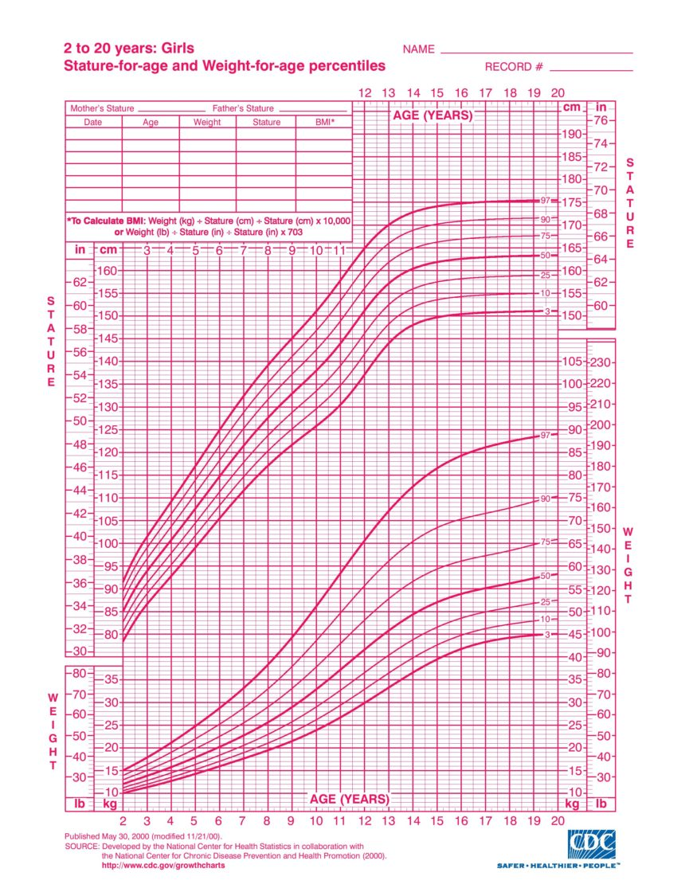
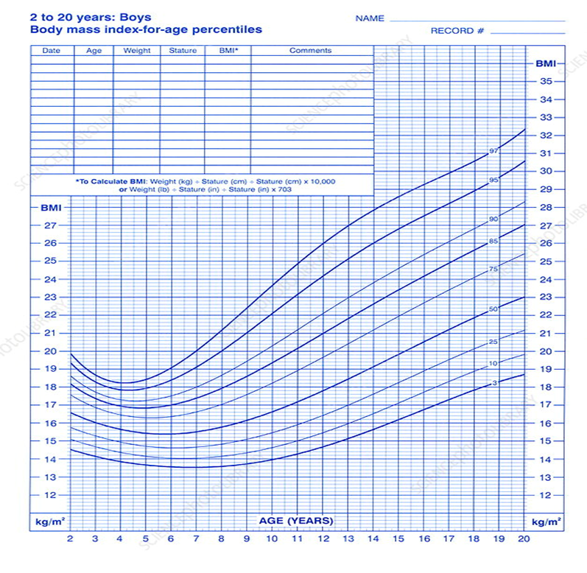
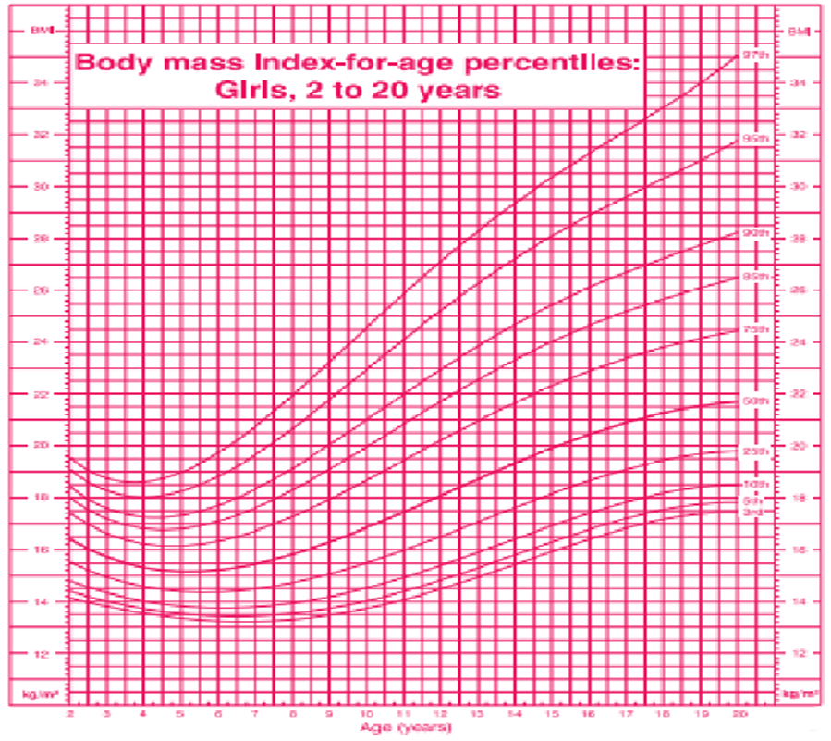
Use of Growth Charts

Slide 118
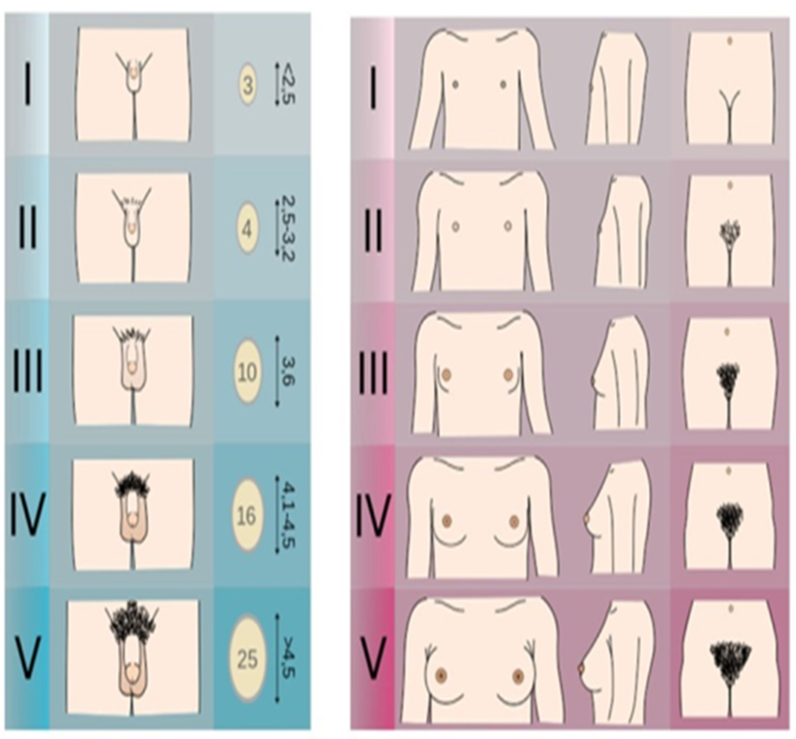
Pubertal Tanner staging

Slide 119
Nutritional Management in type 1 Diabetes

Slide 120

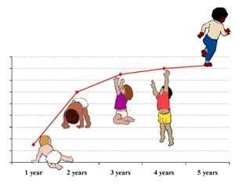
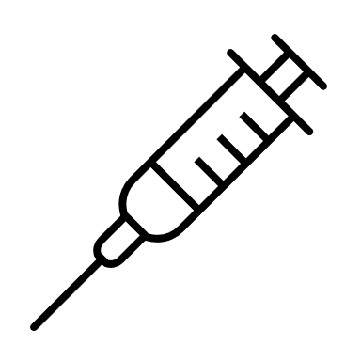



Nutrition Overview
Need to have a healthy diet, NOT DIABETIC DIET!
Amount and proportions appropriate for age and growth
Carbohydrate content of food matched with insulin regimen
Understanding of how to match insulin with food is key
Best done with the assistance of a dietician/ nutritionist trained in paediatrics and diabetes
Pihoker C et al. ISPAD Clinical Practice Consensus Guidelines 2018: The delivery of ambulatory diabetes care to children and adolescents with diabetes. Pediatr Diabetes. 2018;19(Suppl. 27):84–104.
Notes:
Best done by a dietician, but the unavailability of dieticians mean that you may have to help with this task. An overriding principle is that the child with diabetes needs to have a health diet (not a ‘diabetic diet’). The amount of food and proportions of different food groups should be appropriate for the age and growth of the child. The food choices should be matched with the insulin regimen. Therefore, understanding how to match insulin with food is important and a key to successful diabetes management. Dietary advice is best done with the assistance of a dietician.

Slide 121




Dietary Review
^{Taken at diagnosis}
Review regularly (every 3 months)
Correct food, correct amount and correct times
Review food patterns, activities and insulin regimen
Pihoker C et al. ISPAD Clinical Practice Consensus Guidelines 2018: The delivery of ambulatory diabetes care to children and adolescents with diabetes. Pediatr Diabetes. 2018;19(Suppl. 27):84–104.

Slide 122
Aims of Nutrition Management in Type 1 Diabetes
Provide adequate nutrients for normal growth and development
To maintain good glycemic control
Improve overall health through healthy food choices.
Achieve optimal blood pressure and lipid levels.
Prevent complications of diabetes
Address individual nutrition needs
Notes:
Check nutrition Recommended nutrient intake for different : Kenya National Clinical Nutrition and Dietetics Reference Manual, 2010

Slide 123
Age appropriate nutrition advice for children with T1DM
Infancy-Toddler and preschool children | School Age Children | Adolescents
Breastfeeding should continue until 2 years like any other child. Small meals spaced over the day promote improvements in glycemic outcomes and nutritional adequacy. | Carbohydrate intake to prevent hypoglycemia particularly for school events such as sports days, and camps Healthy food choices, portion size, and physical activity Sleepover and party advice should be discussed | They have more freedom on what to eat, when and how much. This can negatively affect their glycemic management and food choices. Re-educate on the importance of healthy eating, nutrition and diabetes self-management. Psychological issues e.g behavior disorders and depression may cause poor metabolic control

Slide 124
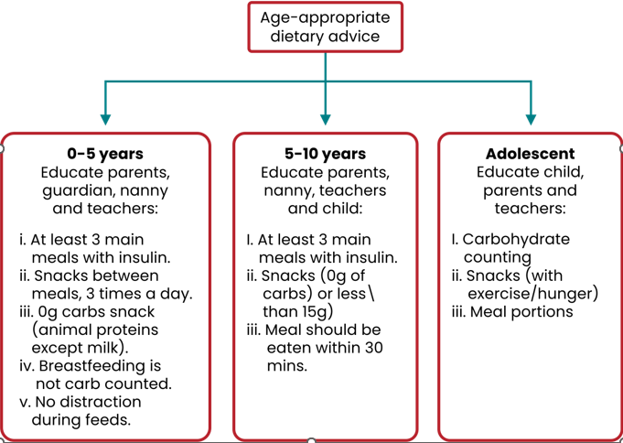
  Diet education

Slide 125
Insulin: carbohydrate ratio (ICR)
The amount of rapid acting or short-acting insulin needed to “cover” certain amount of carbohydrates eaten ( in grams.)
Calculated by:
  Fast acting insulin Regular Insulin
  500/Total Daily Dose 450/Total Daily Dose
First establish what the Total Daily Dosage (TDD) is. It’s derived by adding all basal or long-acting and all bolus or rapid-acting insulin that is taken in a 24-hour period.
    Pre-pubertal: 0.5 - 0.7 units/kg/day
    Pubertal: 0.8 – 1.2 units/kg/day
Weight determines the (TDD)

Slide 126
ICR (2)
Insulin-to-carb ratio is individualized for each child according to
    age
    weight
    pubertal status,
    duration of diagnosis
    physical activity
The regular /rapid -acting insulin dosing normally change with carb counting ( and is not constant) in all meals

Slide 127
Example:
Example using rapid-acting insulin in a child on total daily dose (TDD) of 50 units of insulin:
500/50 = 1:10 (1 unit of insulin given for 10 g of carbs)
Regular insulin for a child using TDD of 50 units of insulin:
Example: 450/50 = 1:9 (1 unit of insulin given for 9 g of carbs.)
HOW TO USE INSULIN: CARBOHYDRATE RATIO
Example: insulin to carb ratio: 1:10
1 cup (250ml) of rice = 45 g
1 cup (250ml) of beans = 30 g
1 cup (250ml) cooked vegetables = 10 g
Total = 85 g
10 g = 1 unit of insulin
85 g = How much insulin? = 85/10 = 8.5 units (round off to 9 units
The ratio can be fine-tuned by checking BG before and 2 hours after meals to maintain a BG in within the target

Slide 128
Screening for Comorbidities and Complications

Slide 129
Screening and Prevention Guidelines (1)
 | Evaluation | When to Screen
Glycemic Management | HbA1c Glucose values from meter, log, or CGM | Quarterly At each visit and in between visits as needed for insulin dose adjustments
Cardiovascular risk factors | Blood pressure Smoking status Lipids | Every visit Every visit Discourage smoking in youth who do not smoke and encourage smoking cessation in those who do Begin ≥11 years; if normal results are obtained; repeat every 3 years
Limbert C, Tinti D, Malik F, et al. ISPAD Clinical Practice Consensus Guidelines 2022: The delivery of ambulatory diabetes care to children and adolescents with diabetes. Pediatr Diabetes. 2022;23(8): 1243‐1269.

Slide 130
Screening and Prevention Guidelines (2)
 | Evaluation | When to Screen
Autoimmune screening | Thyroid function: TSH, total or free T4 (and thyroid autoantibodies if available) Celiac screening (TTG-IgA, if IgA normal) Addison's disease (primary adrenal insufficiency), autoimmune hepatitis, autoimmune gastritis, dermatomyositis, and myasthenia gravis | At or near diagnosis; Every 2 years: TSH (sooner if with symptoms or positive thyroid autoantibodies at diagnosis) At or near diagnosis; repeat at 2– 5 years intervals (sooner if symptomatic or first degree relative with celiac disease) As clinically indicated
Limbert C, Tinti D, Malik F, et al. ISPAD Clinical Practice Consensus Guidelines 2022: The delivery of ambulatory diabetes care to children and adolescents with diabetes. Pediatr Diabetes. 2022;23(8): 1243‐1269.

Slide 131
Screening and Prevention Guidelines (3)
 | Evaluation | When to Screen
Psychosocial screening | Diabetes distress, depression, disordered eating | Begin shortly after diagnosis; routinely (at least annually)
Anticipatory guidance | Pre-conception counseling, risk-taking behaviors, transition to adult care | Pre-conception counseling for girls of childbearing potential. Discussion about risk-taking behaviors and preparation for transition to adult care can begin in early adolescence and be revisited at least annually
Limbert C, Tinti D, Malik F, et al. ISPAD Clinical Practice Consensus Guidelines 2022: The delivery of ambulatory diabetes care to children and adolescents with diabetes. Pediatr Diabetes. 2022;23(8): 1243‐1269.

Slide 132
Screening and Prevention Guidelines (4)
 | Evaluation | When to Screen
Microvascular complications | Kidney disease: urine albumin: creatinine ratio Retinopathy: dilated eye exam Neuropathy: comprehensive foot exam | Start at puberty or from age 11 years, whichever is earlier, after 2–5 years diabetes duration; repeat annually for kidney disease and neuropathy; every 2–3 years for retinopathy
Limbert C, Tinti D, Malik F, et al. ISPAD Clinical Practice Consensus Guidelines 2022: The delivery of ambulatory diabetes care to children and adolescents with diabetes. Pediatr Diabetes. 2022;23(8): 1243‐1269.

Slide 133
Key Messages
Children and adolescents with type 1 diabetes require a multidisciplinary team for management.
Basic patient quality of care indicators should be measured at every visit.
Measure blood pressure for all patients.
Monitoring of growth is a very good indicator of the quality of care.
Each visit is an opportunity for repeated information and education.

