Slide 1

Infant and Family Centered Developmental Care

Slide 2
Objectives
Highlight the importance of nurturing care
Describe how Infant Family Centered Developmental Care (IFCDC) contributes to nurturing care
Discuss the components and goals of IFCDC
Discuss stress and pain management in newborns

Slide 3
Definition of IFCDC
This approach engages the infant, family and health care providers as partners in the care.
It is a collaborative approach to care giving and decision making including during planning and evaluation
IFCDC is working WITH babies and their families, rather than just doing “to” and “for” them.

Slide 4

Components of Nurturing Care
Good Health: refers to health and well-being of children and their caregivers
Adequate Nutrition: refers to maternal and child nutrition
Responsive Caregiving: refers to ability of caregiver to notice, understand and respond to the child’s signals in a timely and appropriate manner
Safety and Security: refers safe and secure environment for children and their families e.g. physical dangers, emotional stress etc.
Opportunities for Early Learning: refers to any opportunity for child to interact with person, place or object in their environment

Slide 5
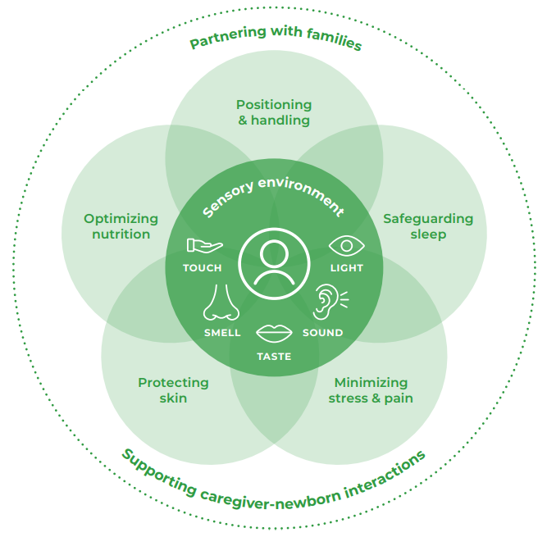
Components of Infant- and Family- Centered Developmental Care
Infant-centered
Sensory environment
The 5 developmentally supportive care elements supporting the sensory environment are key in
  Preventing disability
  Facilitating early discharge
Partnering with family in providing developmentally supportive care is Key in achieving IFCDC
Notes:
At the center is the baby, depicting the need to be infant centered
The sensory environment of touch, smell, taste, sound , sight and proprioception surround the baby. The sensory environment directly affects growth and development
To support the sensory environment, HCPs must provide developmentally supportive care and organize the baby’s environment for optimizing nutrition, positioning, handling carefully, protecting sleep and minimizing stress
Partnering with families to maintain the appropriate environment conducive for neurodevelopment

Slide 6
Core principles of enabling a nurturing care environment
Dignity and respect
Participation
Information sharing
Collaboration
Newborn and maternity services should be organized around these principles
Notes:
Partnering with families should be based on these principles
All principles should be implemented in simultaneously

Slide 7
Aspects of Effective communication
Active listening and empathy
Respectful communication
Clear and concise information
Collaborative decision making
Addressing language and comprehension differences.

Slide 8
Components of communication
Orientation to NBU
Information of baby’s condition– diagnosis, lab results, planned interventions
Daily updates– address mothers’ concerns
Consenting
Family involvement– conference
Breaking bad news
Psychosocial support

Slide 9
Pain and Stress in Neonates
Do Neonates feel pain? - Discuss
Notes:
Neonates feel more pain because they have a:
greater density per area of skin
slower conduction rate due to incomplete myelination
shorter length of pain receptor pathway.
Adaptive mechanisms that can modulate painful stimuli do not develop until 32 – 36 weeks of post conceptional age

Slide 10

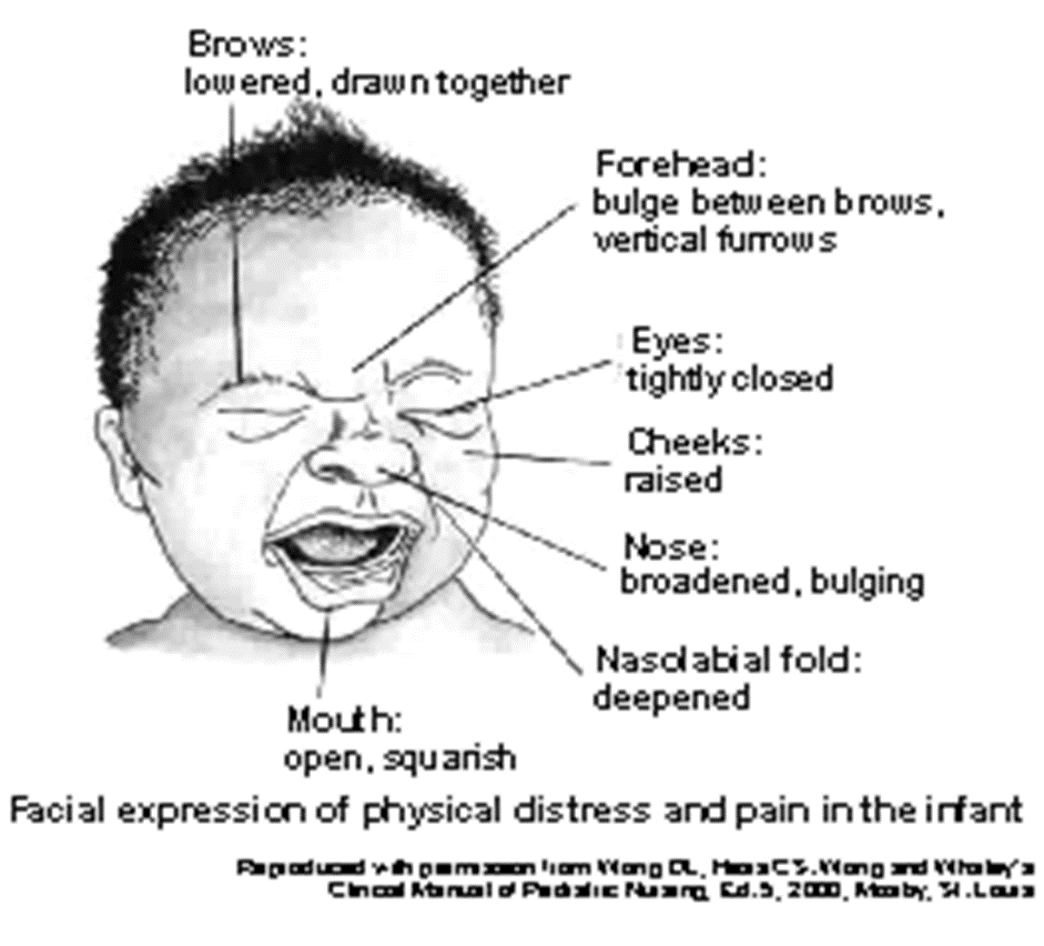
Expression of Pain and stress in the face of a Neonate

Slide 11
Non- Pharmacological Pain Management
Heath care providers can utilize neonatal sensory environment to provide non-pharmacological pain management
Touch
    Skin to skin contact
    Minimal handling
    Positive touch (cuddling)
    Proprioception
  Nesting and/or facilitated tucking
  Swaddling
Hearing and vison
Reduction of stimuli
Voice or singing and music therapy
    Taste
    Breastfeeding
Before, during and after procedure
If unable to breastfeed 2mls of EBM at least 2 min before procedure

Slide 12
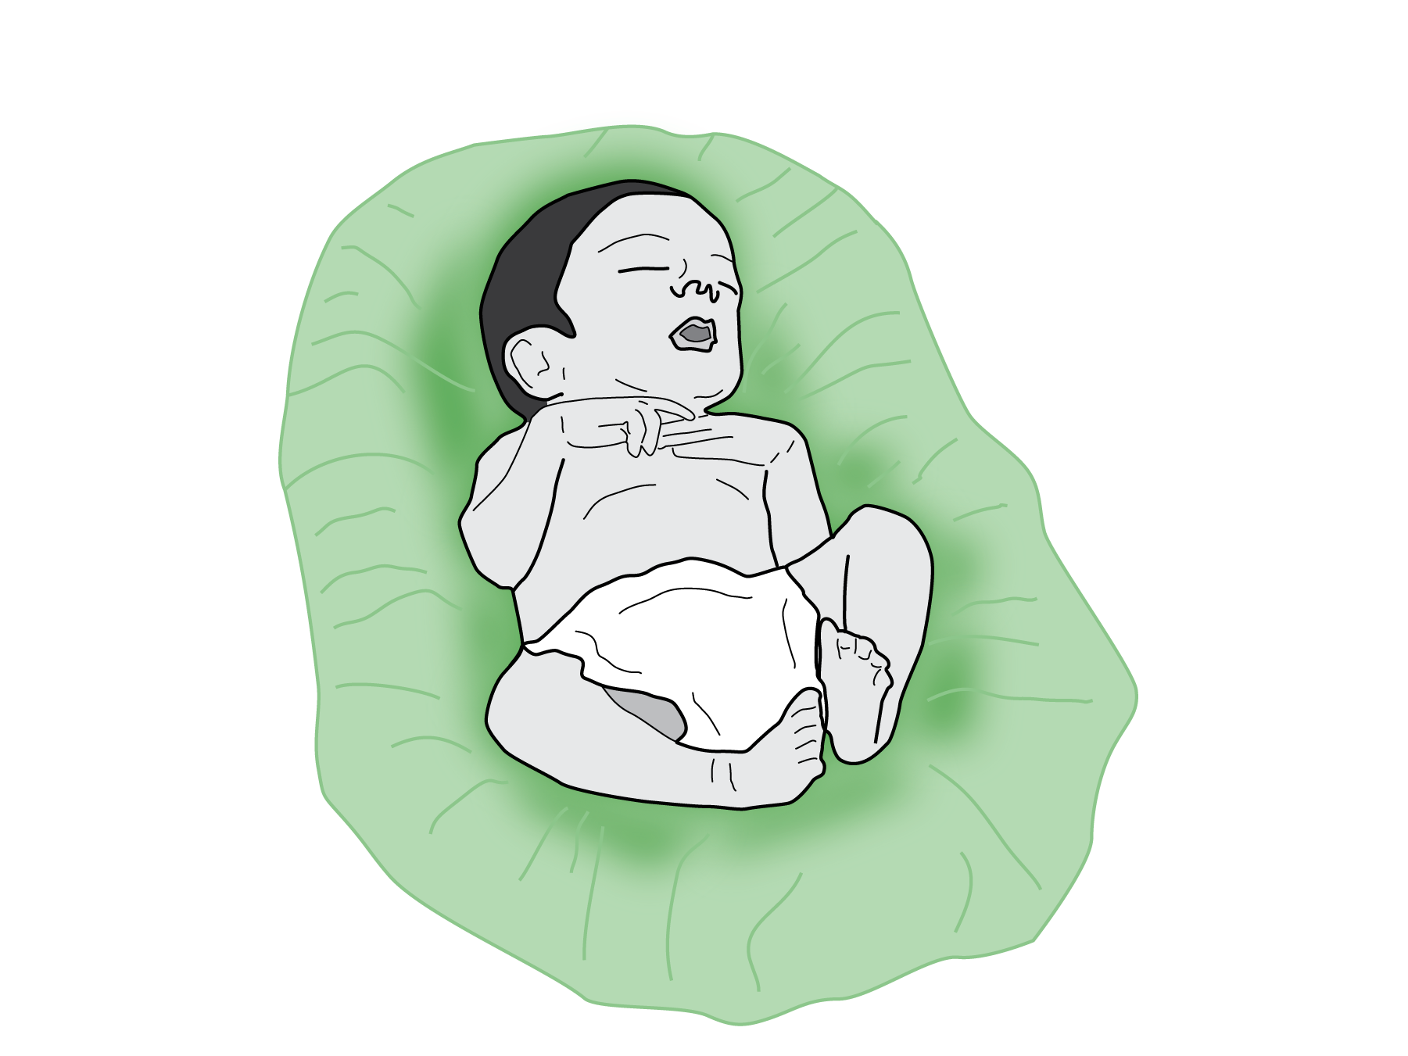
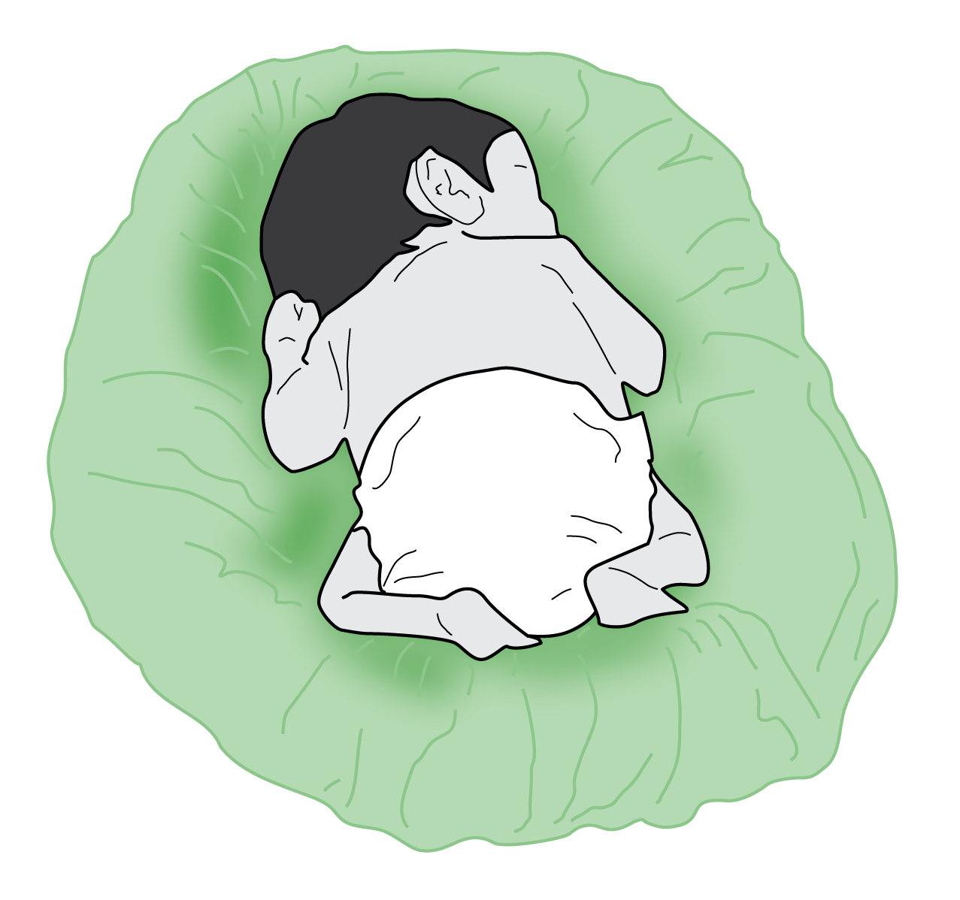

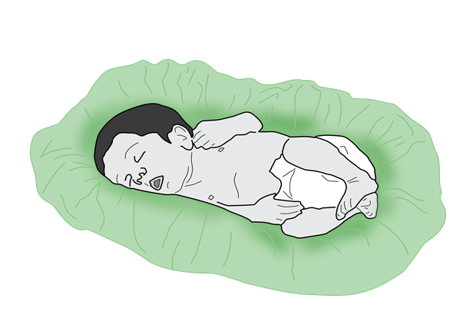
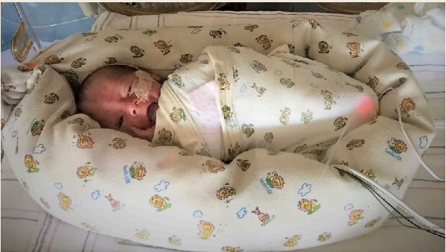
Nesting and swaddling
Physical handling

Slide 13
?
Questions?

Slide 14
Summary
IFCDC is an integral component of newborn care
Health care providers need to partner with caregivers to provide nurturing care through IFCDC
Identifying and responding to stress and pain in newborns is a critical part of nurturing care

