Slide 1


Introduction to care of the preterm infant

Slide 2
Introduction
A Preterm is a baby born alive before 37 completed weeks of pregnancy.
Classification of preterm birth, based on gestational age:
  Extremely preterm (<28 weeks)
  Very preterm (28 to <32 weeks)
  Moderate to late preterm (32 to <37 weeks).

Slide 3
Introduction cntd…
Prematurity contributes to low birth weight (birth weight <2500gms)
Classification of Low birth weight:
  Low birth weight 1500 to <2500gms.
  Very low birth weight 1000gms to 1499gms
  Extremely low birth weight < 1000gms

Slide 4
Key facts on prematurity
Every year, an estimated 13.4 million babies are born preterm globally.¹
In Sub Saharan Africa the numbers have been rising over the last decade
Of every 10 babies born, 1 is a preterm¹
Approximately 127,500 preterm babies are born in Kenya every year.
Prematurity is the leading cause of neonatal morbidity and mortality
1. World Health Organization, 2023. Born too soon: decade of action on preterm birth. World Health Organization.
Notes:
12 % preterm deliveries

Slide 5
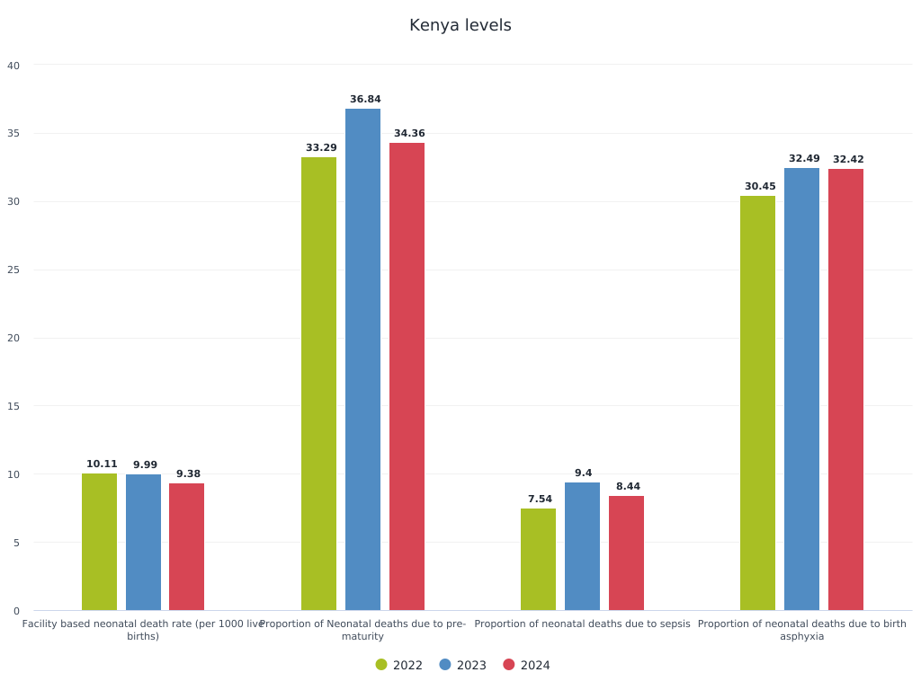
Causes of facility based neonatal deaths- KHIS

Slide 6
Common problems in pre-terms
Breathing problems (AOP, RDS)
Feeding problems
Hypoglycaemia
Hypothermia
Infections (neonatal sepsis)
Jaundice
Retinopathy of Prematurity
Anaemia of prematurity
Rickets of prematurity
IVH (intraventricular haemorrhage)
Hemodynamic instability

Slide 7
Prevention and management of prematurity related complications
Evidence based interventions exist to prevent and manage prematurity related complications
Gestational age assessment is important for timely preventive interventions
Early identification and prompt management of the complications improve outcomes
Interventions covered in this module include:
Ballard scoring to identify preterm newborns
Use of plastic wraps for newborns < 32 weeks
Use of prophylactic and rescue CPAP
Use of caffeine citrate for management of AOP
KMC including immediate KMC

Slide 8
Questions?
?

Slide 9

Summary
Prematurity related complications are the leading cause of neonatal mortality in Kenya
Prevention, early detection and management of these complications improve outcomes
Gestational age assessment allows for timely preventive interventions

