Slide 1
Module 9:
Introduction to diabetes

Slide 2

Objectives
Definition of Diabetes
Aetiology/Risk factors of T1DM
Epidemiology and risk factors of type 1 diabetes
Clinical presentation and diagnostic criteria of type 1 DM

Slide 3
Definition of diabetes
Diabetes is a complex metabolic disorder characterized by elevated blood glucose level as a result of either resistance to the action of insulin, insufficient insulin secretion, or both.

Slide 4
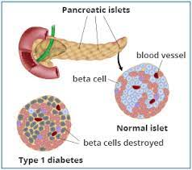
Type I Diabetes Mellitus
Describes a complex metabolic disorder characterized by persistent hyperglycemia resulting from impaired secretion of insulin from the beta cells of the pancreas
This is as a result of chronic immune-mediated destruction of pancreatic β-cells, leading to partial, or in most cases, absolute insulin deficiency.

Slide 5
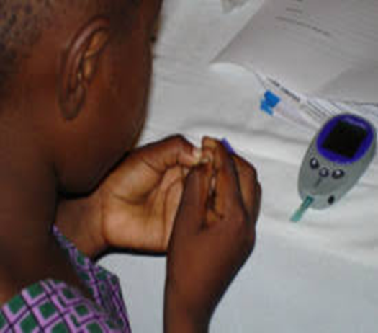
Epidemiology of type 1 DM
Worldwide, approximately 96,000 children under 15 years are estimated to develop T1DM annually.
Between 2011 - 2021, the Sub Sahara Africa recorded a five-fold rise.
Majority present between 6 months -18 years old, however it can present in adults
Peak age: 3-6 years & mid-teens

Slide 6
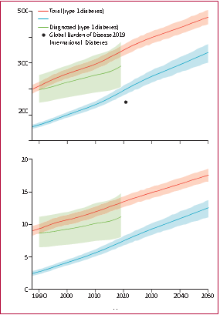
Projected global incidence of type 1 diabetes
The projected global incidence of type 1 diabetes (total and diagnosed) in children and adolescents aged 0–19 years.
The shaded areas indicate 95% uncertainty intervals.
Lancet Diabetes Endocrinol 2022; 10: 848–58 Published Online November 10, 2022 https://doi.org/10.1016/ S2213-8587(22)00276

Slide 7
Risk factors for T1DM
Genetic susceptibility: HLA and non-HLA genotypes
Environmental trigger/insult e.g., infections like enterovirus, rubella
Autoimmune response: T Helper 1 cells
Islet infiltration and cytokine release
Partial or absolute deficiency of insulin
Beta cell destruction
Risk factors of type 1 Diabetes
Type 1 Diabetes

Slide 8
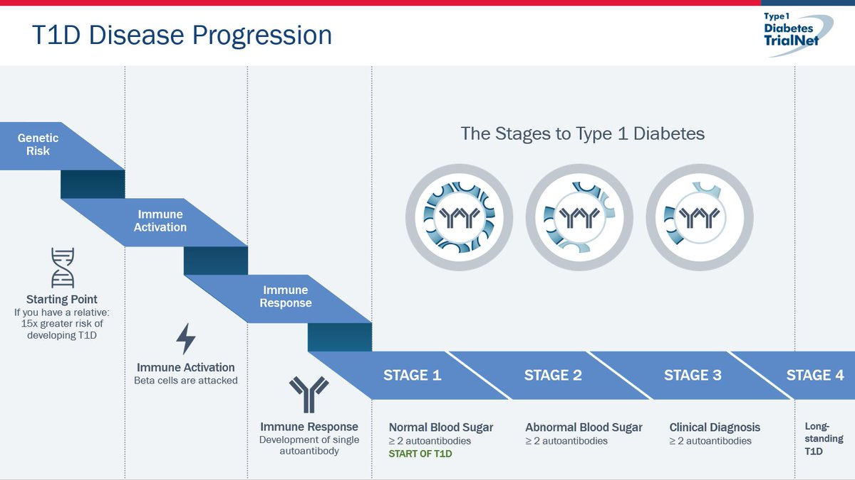
Stages of T1DM
Diabetes associated autoantibodies (GAD 65, IA2, IAA and ZnT8), are serological markers of β-cell autoimmunity.

Slide 9


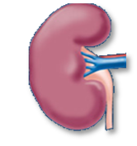

Pathophysiology: The key analogy
Increased urine
Dehydration
Thirst
Borrowed from CDiC slide

Slide 10
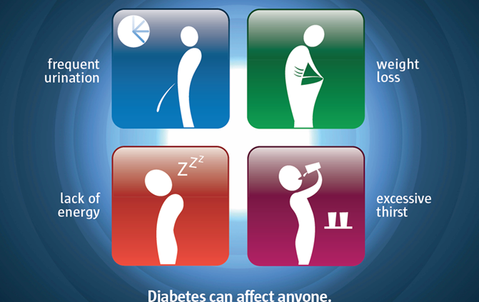
Signs and symptoms of Type 1 diabetes
Symptoms | Signs (DKA)
1. Polyuria | 1. Dehydration
2. Polydipsia | 2. Deep acidotic breathing
3. Weight loss | 3. Reduced consciousness level
4. Fatigue | 4. Acetone (fruity) smell
5. Recurrent infections (otitis media, pyogenic skin infections, monilial vaginitis, candida diaper rash) | 5. Shock
6. Secondary enuresis | 6. Coma
7. Nocturia
8. DKA symptoms (vomiting, abdominal pain)
9. Polyphagia (rare in type 1 diabetes)
N/B: Beware diabetes may present like pneumonia, acute abdomen, gastroenteritis, malaria, meningitis and malnutrition.
Every sick child should have a random blood sugar done because diabetes mimics common childhood illnesses

Slide 11
Diagnostic criteria
Classic symptoms of diabetes or hyperglycemic crisis with plasma glucose concentration ≥ 11.1 mmol/L.
Fasting plasma glucose ≥7.0 mmol/L.
Fasting is defined as no caloric intake for at least 8 hours
3. Two-hour post load glucose ≥11.1 mmol/L during an oral glucose tolerance test (OGTT): Only conduct an OGTT when Random blood glucose is between 7.8-11.1 mmol/L.
4. HbA1c ≥6.5%.
(It is glycosylated part of haemoglobin and represent sugar load over the last 3 month.)
Notes:
The OGTT should be performed using a glucose load containing the equivalent of 75 grams of anhydrous glucose dissolved in water or 1.75 grams/kg of body weight to a maximum of 75 grams

Slide 12
Diagnosis of diabetes cont
Islet antibodies testing can be very helpful as obesity affects a greater proportion of youth, it is possible to develop Type 1 diabetes and be obese causing confusion with Type 2 diabetes.
In such circumstances, any type of islet autoantibody positivity (ZnT8, GADA, IA-2A, IAA) establishes the diagnosis of Type 1 diabetes.

Slide 13

Summary
Prevalence of type 1 diabetes is increasing globally
Missed diagnosis is common
There are many childhood illnesses that mimic signs and symptoms of type 1 diabetes
Every sick child presenting to the hospital should be screened for type 1 diabetes (Do Random Blood Sugar)

