Slide 1

Infection Prevention & Control (IPC)

Slide 2

Objectives
Describe the chain of infection and how to break it
Describe hand hygiene
Discuss the decontamination of equipment
Describe waste management

Slide 3
Introduction
Infection prevention and control (IPC) is a discipline that aims to prevent or control the spread of infections in healthcare facilities and the community.
It is a universal discipline with relevance to all aspects of healthcare
Sepsis is one of the leading causes of neonatal mortality in low-resource settings.

Slide 4
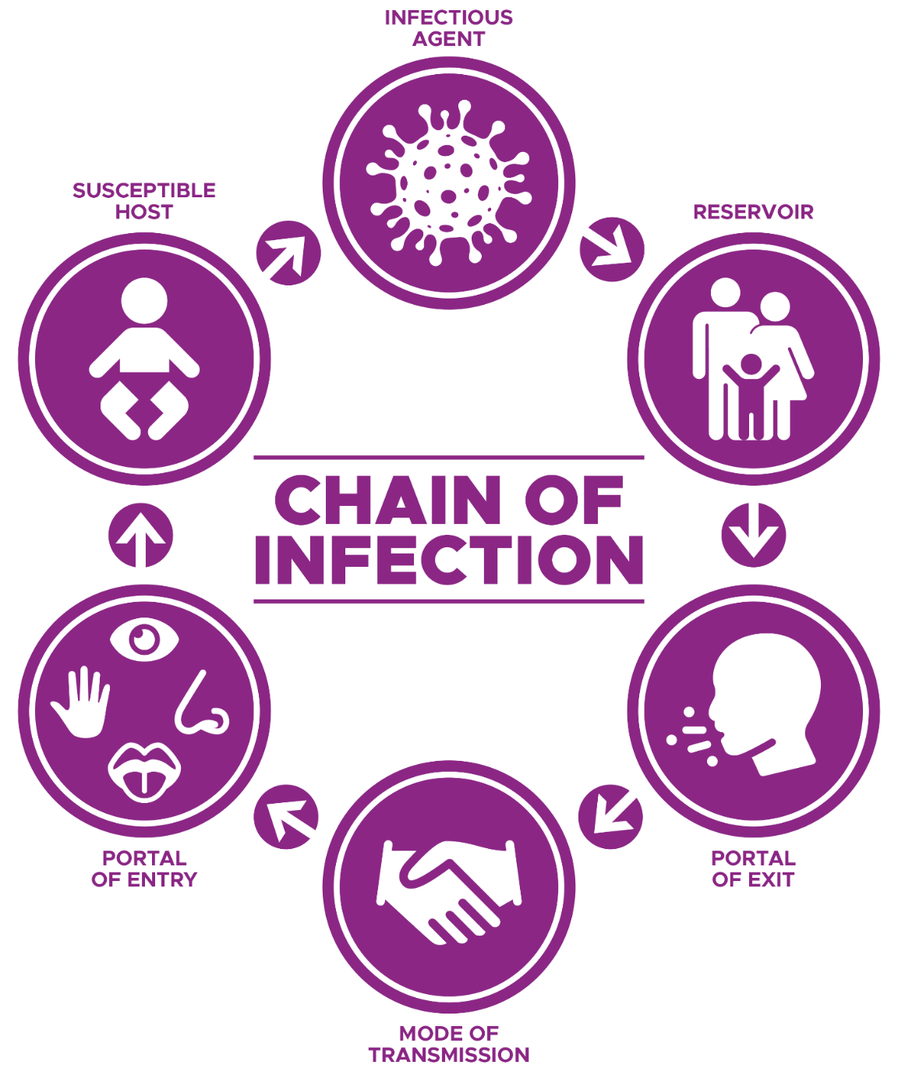
The Chain of Infection
Notes:
Resize the digram
Consists of 6 interlinked components;
The agent – micro organisms
The reservoir carrying the agent – people, equipment, environment,
A point of exit from the reservoir – the skin, the urinary tract, the respiratory system, decontamination processes, waste disposal
A mode of transmission to host – contact, droplet, air, water,
A point of entry on the host – procedures performed on susceptible host
The susceptible host – prematurity, low immunity, long stay in unit,

Slide 5
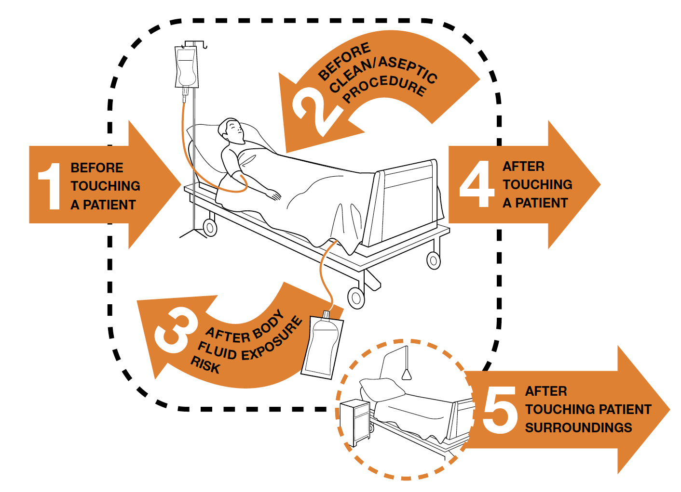
Hand Hygiene – The 5 Moments
Notes:
Clean/aseptic procedure - Any care activity that implies a direct or indirect contact with a mucous membrane, non intact skin or an invasive medial device. During such a procedure no germ should be transmitted.
Body fluids - Any substance/fluid from the body:
Blood
Excreted: urine, stools, vomit, meconium, lochia
Secreted: saliva, mucous, sperm, milk and
Colostrum, tears, wax, caseosa (until first bath)
trans-/ex-sudate: pleural fluid, cerebrospinal fluid, ascites fluid, synovial fluid, amniotic fluid, pus, with the exception of sweat
Any biological samples taken from the body (including tissue sample, placenta, cytological sample, organ, bone marrow)

Slide 6
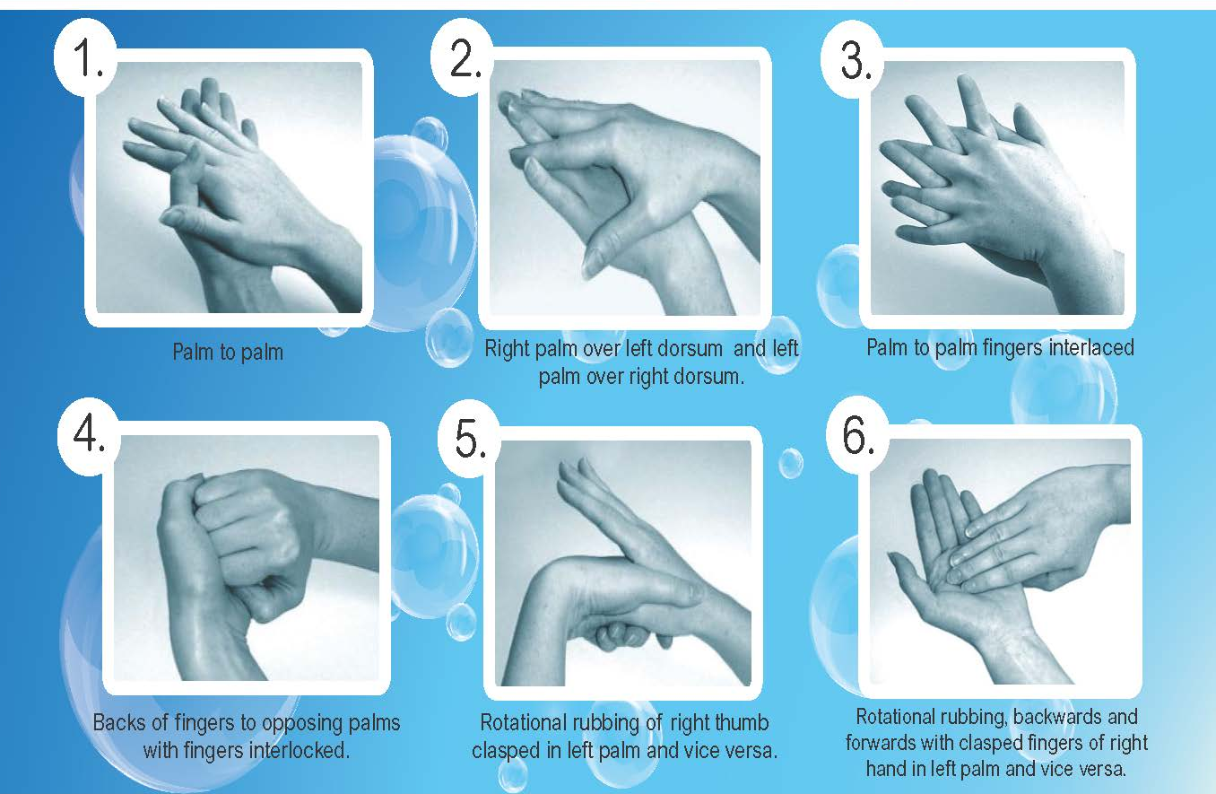
Hand Washing Technique
Notes:
Realign
6

Slide 7

Hand Hygiene Video – Scenario 1
https://youtu.be/XsfKM-YINOE?si=0StCXjuBEPlMvv6Y

Slide 8
Patient Care Items
Non - critical patient care items - those which come in contact with intact skin (hat, hat clips, blood pressure cuff, tape measure, neonatal pulse oximeter probe)
Semi - critical patient care items - typically contact mucous membranes or non intact skin (penguin sucker, Silicon CPAP nasal prongs)
Critical patient care items - penetrate or contact soft tissue, bone, bloodstream or normally sterile tissue (i.e. IV access, surgical instruments).
Anna M. Bonner & Petra Davidson (2020) Infection Prevention: 2020 Review and Update for Neurodiagnostic Technologists, The Neurodiagnostic Journal, 60:1, 11-35, DOI:10.1080/21646821.2020.1701341

Slide 9
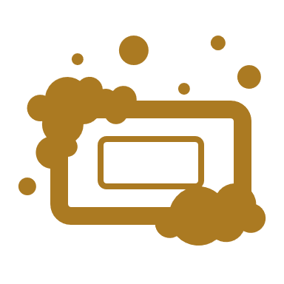
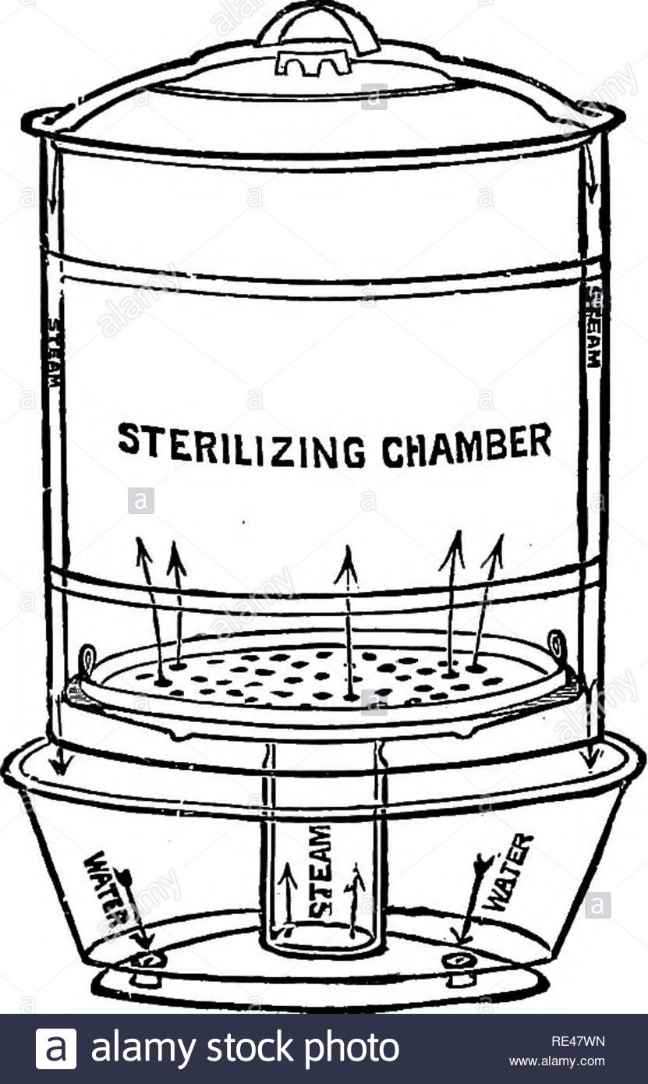
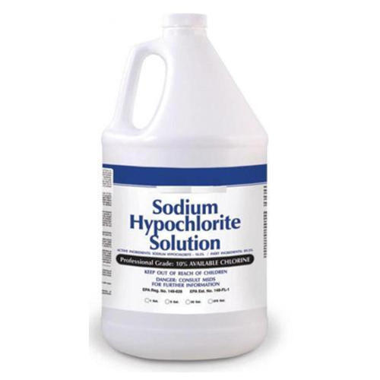
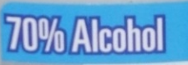
Decontamination
Removal of visible or non visible organic and inorganic material (e.g. blood, nasal secretions) using water and a detergent or enzymatic product. It’s the first level of decontamination.
Cleaning
Disinfection
Sterilization
Reduction in the number of viable pathogenic microbes using chemical agents to a level that they do not pose a threat to the normal host defenses.
A process that destroys all microorganisms including bacterial spores. E.g. autoclaving, sterilization in CSSD
Trevor Duke (2014) CPAP: a guide for clinicians in developing countries, Paediatrics and International Child Health, 34:1, 3-11, DOI: 10.1179/2046905513Y.0000000102
Anna M. Bonner & Petra Davidson (2020) Infection Prevention: 2020 Review and Update for Neurodiagnostic Technologists, The Neurodiagnostic Journal, 60:1, 11-35, DOI:10.1080/21646821.2020.1701341
Notes:
Following proper cleaning procedures, disinfection removes or destroys some pathogens that remain on an item but are not visible to the eye and is accomplished by exposure to a chemical or solution for a required amount of time.
The duration of exposure to a disinfectant is generally determined by the type and number of pathogens, which is tested by manufacturer and/or regulatory scientists in order to recommend instructions for use of the solution.
Sterilization is a step beyond disinfection. In a class by itself, sterilization is a process that destroys all microorganisms including bacterial spores. Generally accomplished in the hospital setting by the Central Sterile Supply department or Surgical Processing Department by means of steam, gas, chemicals or plasma techniques (STERRAD) (Rutala and Weber 2019).
Sterilization is for critical equipment and disinfection is for semi critical.

Slide 10
Properties of Sodium Hypochlorite
Used for disinfection
It is very unstable in heat and light
Inactivated by organic matter like blood, fecal material!
Reacts easily with other chemicals like detergents hence need for thorough rinsing
Corrosive to metals
Shelf life is only one year from date of manufacturing
If opened, concentration cannot be assured beyond 4 weeks.
Anna M. Bonner & Petra Davidson (2020) Infection Prevention: 2020 Review and Update for Neurodiagnostic Technologists, The Neurodiagnostic Journal, 60:1, 11-35, DOI:10.1080/21646821.2020.1701341

Slide 11
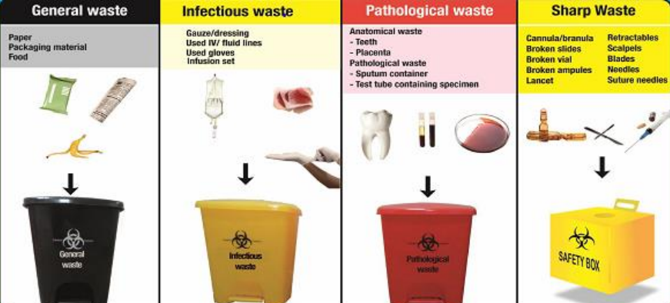
Waste Management
Prevention of needle stick injuries and risk of disease transmission starts with you!
It is the responsibility of Health Personnel to segregate waste immediately according to type
Health Care Waste management SOPs. First Edition Ministry of Health Government of Kenya, June 2016
Notes:
Health Care Waste management SOPs. First Edition Ministry of Health Government of Kenya, June 2016

Slide 12
Questions
?

Slide 13

Summary
Observe hand hygiene – 5 Moments & Steps
Clean, disinfect and sterilize equipment appropriately
Use appropriate colour coded bins for waste management
Anna M. Bonner & Petra Davidson (2020) Infection Prevention: 2020 Review and Update for Neurodiagnostic Technologists, The Neurodiagnostic Journal, 60:1, 11-35, DOI:10.1080/21646821.2020.1701341

