Slide 1

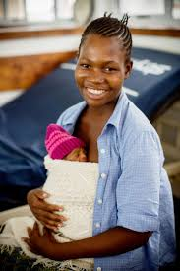
Kangaroo Mother Care

Slide 2

Objectives
Introduction
Immediate KMC
Elements of KMC
Care during KMC and discharge follow up

Slide 3

Introduction
KMC is an evidence-based intervention for the care of preterm/LBW newborns
Recommended for newborns <2500g
It involves continuous and prolonged skin-to-skin contact (8-24hrs/day) between a mother/surrogate and the preterm/ LBW infant
Includes support for exclusive breastfeeding or breastmilk feeding
Notes:
Surrogate; Fathers, partners and other family members who take on an active role in the care of preterm or LBW infants including offering KMC

Slide 4
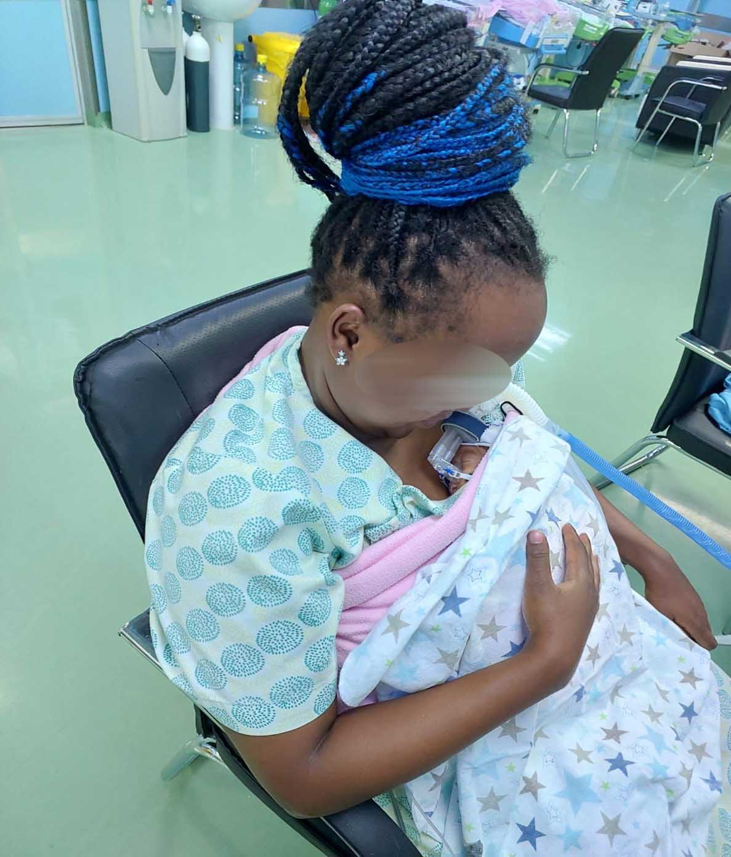
Immediate KMC (iKMC)
KMC initiated immediately after birth (within 2 hours) for LBW newborns with no contraindications
Initiated for both stable and unstable LBW newborns e.g. those on oxygen, CPAP etc
Contraindications for iKMC include:
  Inability to breathe spontaneously after resuscitation
  shock
  need for mechanical ventilation
iKMC improves neonatal survival by a further 25%, compared with KMC after stabilization.

Slide 5
iKMC operationalization
Initiation of KMC in labour ward/operation theater
Transportation to NBU in KMC
Creating the mother’s bed in NBU
Creating a mother, baby friendly infrastructure and processes in NBU

Slide 6
Benefits of KMC
Parasympathetic nervous system
Baby absorbs food better
Grows & gains weight faster
Stable heart rate
Stable breathing
Baby experiences less pain even during painful procedures
Skin to skin touch
Oxytocin
Baby sleeps better
Sleep cycles more organised
Less stressed
Quiet and calm when awake
Brain grows better
Baby develops faster
Does better at school
Baby able to breastfeed sooner
Faster wound healing, less inflammation
40% ↓in mortality compared to conventional care
iKMC ↑ survival by a further 25% compared to KMC after stabilization
Very little crying
Better relationship with one another and others
Better resistance against illnesses
Warm breast skin temperature keeps baby warm
Mother’s temperature responds to baby’s temparature
Mother forms a loving bond with her baby with response from the baby
Better survival

Slide 7
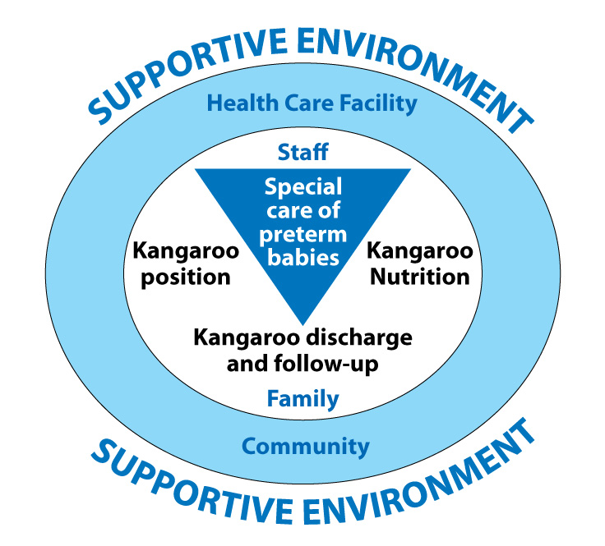
The four elements of KMC

Slide 8
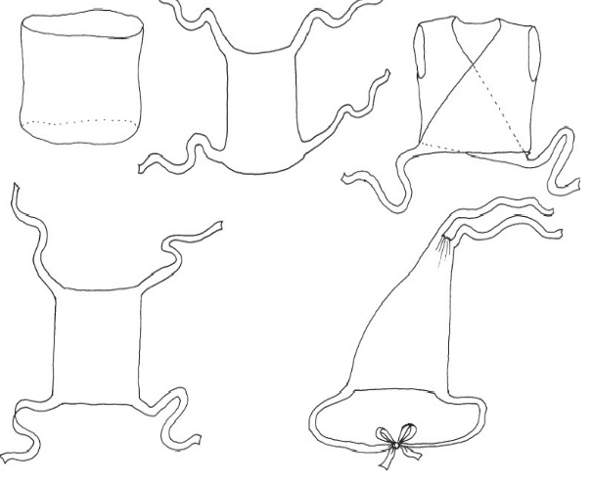
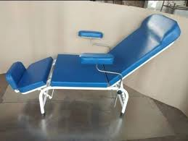
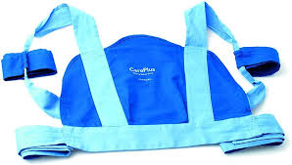
Basic Requirements for KMC
Willing mother or surrogate.
Eligible newborn.
  Stable/ unstable LBW infant with no contra indications.
KMC bed/ reclining chair
Wrap (Lesso/Kanga) for baby
Baby caps, socks, mittens
diapers/ nappies
KMC chair
KMC wrap
KMC wraps

Slide 9
Care of baby during KMC and discharge follow up
Care during KMC
IPC
Cord care
Daily clinical reviews
  Initiate supplements as per guidelines
  Screening (ROP, hearing, IVH, metabolic bone disease of prematurity)as indicated
Daily Monitoring
  Vital signs
  Feeds
  Growth- daily weight
KMC discharge and follow up
Consider baby, maternal and follow up factors before discharge (KMC daily score sheet)
Immunization before discharge
Newborns <2500g at discharge to continue KMC at home
Follow up at nearest facility- weekly till 2500g then monthly at POPC till 24 months
  Readmit if there is an indication
CHP follow up at home- need for linkage

Slide 10
KMC Daily Score Sheet
KMC Daily Score Sheet Based on the Intra-hospital KMC Training Programme in Bogotá, Colombia |  |  |  |  | Date ➔
Name: |  |  | Breastfeeding: |  | Started 24h KMC: | Day 1 | Day 2 | Day 3 | Day 4 | Day 5 | Day 6 | Day 7 | Day 8 | Day 9 | Day 10 | Day 11 | Day 12 | Day 13 | Day 14 | Day 15 | Day 16 | Day 17 | Day 18
Reg No: |  |  | Formula: |  | ......../......./.......
Evaluation |  | Score |  |  | Weight ➔
 | 0 | 1 |  | 2 | Remarks
Socio-economic support | No help or support | Occasional help or support |  | Good support system
Mother’s milk production | Expresses 0‑10 ml breast milk | Expresses 10‑20 ml breast milk |  | Expresses 20‑30 ml breast milk | Must score 2 before discharge. N/A for formula
Positioning and latching baby onto breast | Always needs assistance | Occasionally needs assistance |  | No assistance needed | Not applicable for formula feeding
Baby’s ability to suckle at the breast / bottle | Gets tired very quickly | Gets tired infrequently |  | Takes all feeds well
Confidence in handling baby i.e. feeding, bathing, changing | Always needs assistance | Occasionally needs assistance |  | No assistance needed
Baby’s weight gain per day | 0-10g | 10-20g |  | 20-30g | Must score 1 or 2 for a few days before discharge
Confidence in administering vitamin and iron drops | No confidence | Some confidence |  | Fully confident
Knowledge of KMC | No knowledge | Some knowledge |  | Knowledgeable
Acceptance & application of KMC | Does not accept or apply KMC method | Partly accepts & applies KMC method |  | Fully accepts and applies KMC method | Applies KMC without having to be told
Confidence in caring for baby at home | Does not feel sure or able | Feels slightly unsure & unable |  | Feels confident
TOTAL SCORE per day

Slide 11

KMC Video

Slide 12

Questions

Slide 13

Summary
KMC is simple and cost effective
It has been shown to reduce morbidity and mortality in preterm/LBW newborns
It should be initiated immediately after birth for stable/unstable newborns weighing< 2500g

