Slide 1

Module 5:
Management of an infant/child with respiratory distress ii) Asthma

Slide 2

Objectives
Correctly identify signs and symptoms of asthma
Correctly classify asthma
Management of asthma

Slide 3
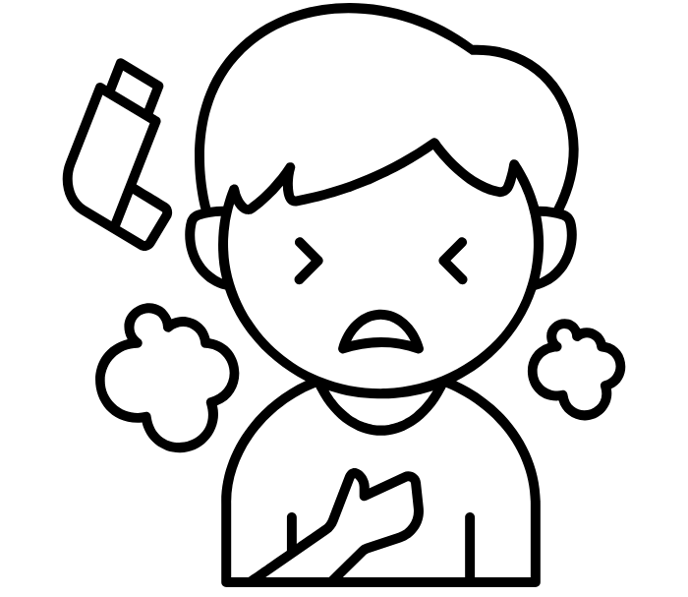
Asthma
Most children with asthma will have a wheeze in addition to the cough or difficulties in breathing
Severity of asthma is graded using just a few signs as for pneumonia
Degree of severity can change after the initial dose of bronchodilators – reassess frequently.
Consider other causes of wheeze for atypical presentation.

Slide 4
Wheeze – how severe is the asthma?
Central cyanosis or oxygen Saturation<90%?
Unable to drink?
Reduced level of consciousness?
Grunting ?
YES
Severe Asthma
Lower chest wall indrawing?
OR Fast breathing?
(RR ≥ 50 aged 2 –11 months
RR ≥ 40 aged 12 – 59months)
YES
Mild/moderate asthma
Notes:
As a result of this research the WHO proposes a classification of pneumonia based on key signs – this is part of the IMCI (and previously the ARI) programme.
Working from the severe end downwards one can check for only a few signs in a child with cough and difficulty breathing and classify into one of four categories that provide a measure of the severity of the child’s disease.
Once the severity is classified it becomes easier to decide who should be in hospital – only those with severe pneumonia.
There is evidence that this classification works to identify those at greatest risk of death and thus most in need of hospital care (see pneumonia severity of disease summary).

Slide 5
Asthma
– treat and reassess and decide about antibiotics
Oxygen
Bronchodilator – Nebulise with 2.5 mg salbutamol or 6 puffs via inhaler, spacer and mask. Repeat every 20 minutes for up to 3 doses if needed.
Prednisolone 1-2mg/kg 24 hourly for 3 days
Severe Asthma
Mild / moderate asthma
Bronchodilator - Nebulise with 2.5 mg salbutamol or 2 puffs via inhaler, spacer and mask. Repeat every 20 minutes for up to 3 doses if needed.
Severe Pneumonia
Reassess after 20 mins and reclassify pneumonia severity
Pneumonia
Notes:
When teaching this slide take the participant through the Asthma protocol page 48
So a child with possible asthma can be classified and treatment initiated in OPD rapidly – including the steroids!
What route of salbutamol and how many doses are used will depend on severity of illness (see protocol booklet)
There may be a rapid response to bronchodilators – some children may change classification down to severe or even mild – and the mild ones can then go home after being shown how to use and prescribed INHALED bronchodilator
So antibiotic decisions should be made after this reassessment

Slide 6
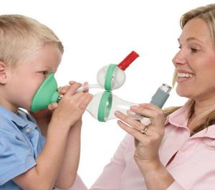
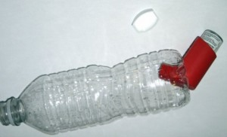
Providing Salbutamol
Inhaler, spacer + mask
Mask should be used in all aged < 3 years
4-5yrs mouthpiece or mask
Severe asthma – 6 puffs every 20min for one hour if needed
Mild/moderate asthma – 2 puffs every 20minutes for one hour if needed
Notes:
If nebuliser does not use oxygen then may need to give if can and certainly need to make sure goes on oxygen as soon as drug finished
Bottle spacer with mask an alternative – note need good seal where MDI enters bottle

Slide 7
Insert video demonstration for MDI use

Slide 8
Summary
A few signs in a child with cough and /or difficulty in breathing and wheeze can be used to assess and classify the severity of asthma
Prompt treatment of severe asthma with a short acting bronchodilator and a steroid is a life saving intervention

