Slide 1
Module 8:
Meningitis and malaria

Slide 2
OBJECTIVES
Identify clinical signs and symptoms of meningitis and malaria
Indications for lumbar puncture
Diagnosis and management of meningitis and malaria

Slide 3
Cerebral Malaria vs Acute Bacterial Meningitis/Encephalitis
Cerebral Malaria
Acute Bacterial Meningitis or Encephalitis
Stiff neck
Bulging Fontanelle
Arching of the back
Convulsions
Pallor
Confusion
Clinically you cannot make a certain diagnosis – Lumbar puncture and malaria test are critical
Notes:
Although some of these signs tend to make people think of either cerebral malaria or meningitis NONE are only found in one of the conditions and so none are specific.
The key to diagnosis is often a good HISTORY... Particularly for CHRONIC illness

Slide 4
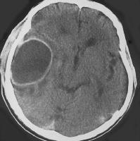
Indications for lumbar puncture
At a minimum, if you want to avoid missing meningitis (and deaths and handicap from it), and avoid wasting antibiotics, at least LP those with history of fever and one of:
  Bulging fontanelle
  Stiff neck
  Fits if age <6 months or > 6 yrs
  Partial or focal fits
  Reduced consciousness
CT scan Brain abscess
Notes:
1) If we want to avoid missing meningitis and the deaths and disability that it causes (the CT scan is a cerebral abscess in a child who did not have their meningitis recognised or treated properly) then should do an LP in children with ANY ONE of the signs listed on the slide.

Slide 5
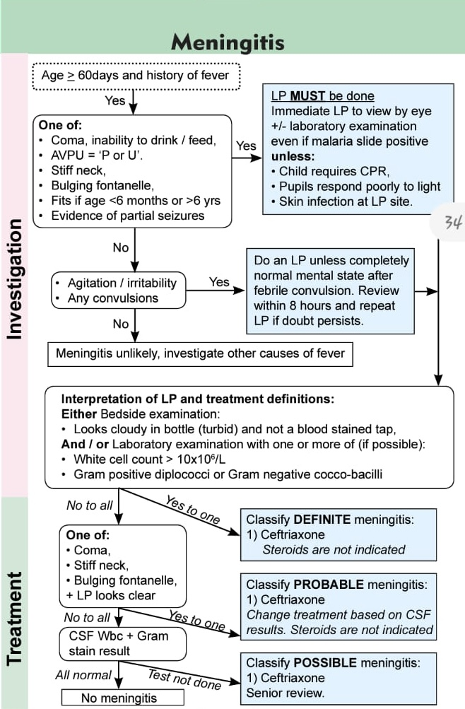
Management of meningitis
To avoid overuse of Ceftriaxone an LP must be done to confirm diagnosis of meningitis
Ceftriaxone Dose: 100mg/kg in 2 divided doses
Reference the Basic Paediatric Protocol 2022

Slide 6
Severe malaria
Cerebral malaria
  Strictly Coma = AVPU < P (AVPU = U)
  In practice if AVPU < A or unable to drink
Severe Malaria with Respiratory Distress
  Deep, acidotic breathing & usually indrawing
  Typically associated with anaemia / severe anaemia.
Severe Anaemia
  Hb < 5g/dl (<50g/L) or PCV / Haematocrit < 15%
  As many as 40-50% of children with severe anaemia will NOT have respiratory distress
Plus positive diagnostic test (repeat up to 3 times if good quality slide test is negative)

Slide 7
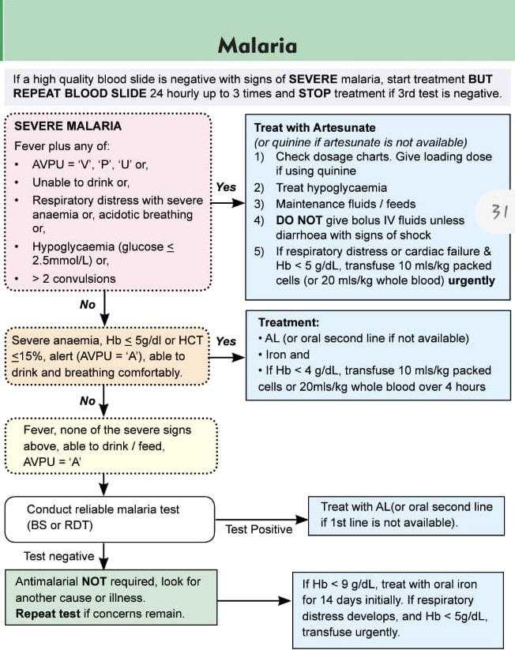
Children < 20 kg give artesunate 3mg/kg/dose
Children> 20kg and adults give artesunate 2.4 mg/kg/dose
Prevent hypoglycemia by feeding and fluids

Slide 8

Summary
LP should be done in all cases of suspected meningitis for cell count and microscopy results to guide treatment
Ceftriaxone is the treatment of choice in Kenya for proven meningitis
Diagnostic test for malaria should be done in all suspected cases before starting treatment.
Artesunate is the treatment of choice in severe malaria

