Slide 1


Neonatal Hypoglycemia

Slide 2

Introduction
Objectives
Define hypoglycemia
Highlight risk factors associated with neonatal hypoglycemia
Discuss the management of hypoglycemia

Slide 3
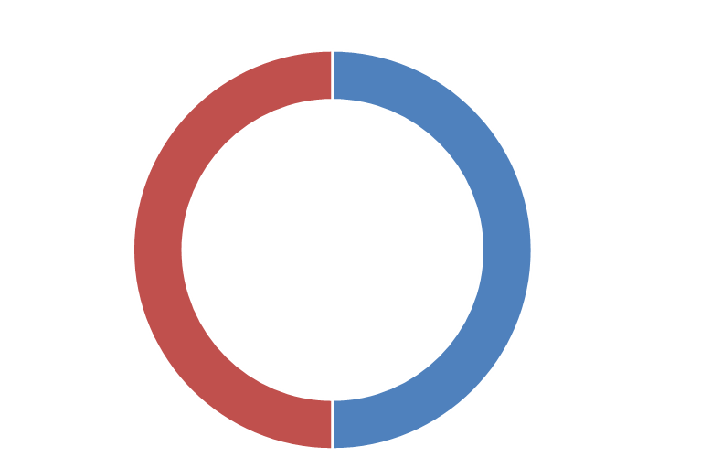

Definition
Neonatal Hypoglycemia is defined as
Kenya and WHO
RBS <2.6mmol/L

Slide 4
Signs and Symptoms of Hypoglycemia
Mild – Moderate
Severe
CNS – Jitteriness, Irritability, High pitched cry, Lethargy, Hypotonia, Tremors, Hypothermia
CVS – Tachycardia, Sweating
Respiratory - Tachypnoea
GIT - Poor Feeding, Vomiting
CNS – Seizures, Coma, Sudden Death
CVS – Pallor, Circulatory Collapse
Respiratory – Apnoea, Cyanosis
Notes:
No studies could be identified that evaluated the reliability of specific symptoms and hypoglycaemia.- based on consensus recommendation
Mild-moderate – unlikely to lead to long term sequalae
Severe – likely to lead to long term impairment – treatment must be provided immediately
Basic Paediatric Protocol 2022 pg 63

Slide 5

Neonatal Risk factors for Hypoglycaemia
Prematurity <37wks
SGA & IUGR
Perinatal asphyxia
Infection
Congenital heart disease
Cesarean delivery
Delayed start of breastfeeding
LGA
Abramowski A, Hamdan AH. Neonatal Hypoglycemia. [Updated 2020 Jan 16]. In: StatPearls [Internet]. Treasure Island (FL): StatPearls Publishing; 2020 Jan-. Stomnaroska O, Petkovska E, Jancevska S, Danilovski D. Neonatal Hypoglycemia: Risk Factors and Outcomes. Pril (Makedon Akad Nauk Umet Odd Med Nauki).
Notes:
Maternal diabetes causing transient hyperinsulinism in the baby
Glucose infusions during labour
Maternal administration of B sympathomimetics used to suppress preterm labour may cause maternal hyperglycemia and associated fetal hyperinsulinism-

Slide 6
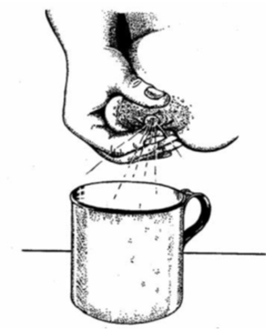
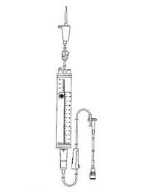



Prevention of Hypoglycemia
Breastfeeding and skin to skin contact immediately after birth (within 1 hour)
Neonates of mothers not available to give breastmilk and for the unstable babies - should receive supplementary feeding NO LATER than ONE HOUR after birth
Breastfeeding- Best option
EBM: Cup feed or NGT
Human donor milk/ formula feeds
IVF
Queensland Clinical Guidelines. Neonatal hypoglycaemia 2018; Wackernagel D, et al. Swedish national guideline for prevention and treatment of neonatal hypoglycaemia in newborn infants with gestational age ≥35 weeks. Acta Paediatr. 2020; 109: 31– 44

Slide 7
Prevention of Hypoglycemia
Keep warm – prevent hypothermia
Postpone the first bath by 24 hours
After first feed, babies breastfed as per newborn hunger cues/signal and at least every 2-3hrs
Queensland Clinical Guidelines. Neonatal hypoglycaemia 2018; Wackernagel D, et al. Swedish national guideline for prevention and treatment of neonatal hypoglycaemia in newborn infants with gestational age ≥35 weeks. Acta Paediatr. 2020; 109: 31– 44

Slide 8
Management of Hypoglycemia
Do blood glucose for all high risk neonates and all sick neonates
Hypoglycemia Blood Sugar <2.6 mmol/l
Asymptomatic
Symptomatic OR BG <1.8mmol/l
0.4ml/kg 50% oral glucose & NGT
0.4ml/kg 50% oral glucose & IV line
Immediate EBM via NGT at 3hrly feed volume and CT regular 3hrly feeds
10% Dextrose 2ml/kg mini-bolus over 3mins & immediate maintenance IVF. Start EBM as tolerated
BG after 1-2hrs then prior to the 3hrly feed
BG 30minutes after the mini-bolus then 3hrly
If BG remains low
Do a blood sugar prior to each feed until 3 NORMAL readings are obtained.

Slide 9

Taking heel blood sample

Slide 10
Questions?
?

Slide 11

Summary
Prevent hypoglycemia by feeding (or initiating IV 10% dextrose if indicated) as soon as possible after birth
RBS monitoring should be done for all newborns at risk of hypoglycemia
Ensure timely management of hypoglycemia

