Slide 1

Neonatal Jaundice

Slide 2

Objectives
Identify and investigate appropriately a neonate with jaundice
Use the nomograms to determine the appropriate management
Prepare a baby for phototherapy and initiate phototherapy with the appropriate irradiance

Slide 3
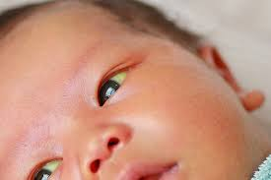

Introduction
Jaundice is a yellowish discoloration of the skin, sclerae, and mucous membranes caused by tissue deposition of pigmented bilirubin
Neonatal jaundice - usually observed in first week of life when total serum bilirubin level reaches 86 micromol/L (5 mg/dL)¹.
> 60%
> 80%
Term neonates²
Preterm neonates²
1.Willy T, Hansen R. Core Concepts . Bilirubin Metabolism.NeoReviews: 2010;11(6).
2.Bhutani VK, et al .Predischarge screening for severe neonatal hyperbilirubinemia identifies infants who need phototherapy. J Pediatr.
Notes:
Jaundice is one of the most common conditions requiring medical attention in newborn babies
The term jaundice, derived from the French word jaune, meaning yellow - is a sign of elevated levels of bilirubin in the blood.
Term and preterm neonates will develop NNJ within the first week of life

Slide 4
Causes of Jaundice
Physiological
Pathological
Due to normal physiological breakdown of large red blood cell mass.
Immature liver enzymes
Haemolytic disease - blood group (Rhesus and ABO) incompatibility.
Serious bacterial infection.
Congenital syphilis or other
intrauterine infections.
Liver disease - hepatitis or biliary atresia.
Hypothyroidism.
Asphyxia.
Birth injuries.
4
Notes:
Realign fonts etc

Slide 5
Types of jaundice
Physiological
Pathological
Due to normal physiological breakdown of large red blood cell mass.
Immature liver enzymes
Haemolytic disease - blood group (Rhesus and ABO) incompatibility.
Serious bacterial infection.
Congenital syphilis or other intrauterine infections.
Liver disease - hepatitis or biliary atresia.
Hypothyroidism.
Asphyxia.
Birth injuries.

Slide 6
Types of Jaundice
Physiological
Pathological
Babies remains completely well
Sets in on day 2 to 3 after birth.
Disappears within 2 weeks.
Common in newborn especially in pre-term.
Actions:
Educate mother/caregiver to watch out for severity and any other danger signs.
Continue breastfeeding
Jaundice starts on the first day of life.
Jaundice lasts >14 days in term baby, 21 days in preterm infants.
Jaundice accompanied with fever or other signs of illness.
Deep jaundice -- palms and soles of the baby are deep yellow.
Actions:
Look for the cause and treat accordingly.

Slide 7
Assessment of Neonatal Jaundice
Assessment can be done in three ways:
Using the Kramer’s scale
Visual estimation of cephalocaudal progression
1
Transcutaneous bilirubin measurement (TcB)
2
Total serum bilirubin levels(TSB)- GOLD STANDARD
3
Objective assessment by means of a TcB or TSB measurement

Slide 8
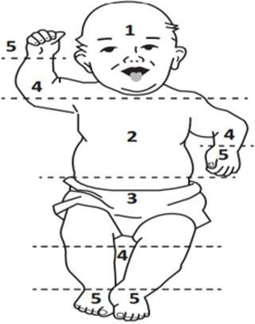
Kramer’s scale
The Kramer's scale is based on a 1969 study of 108 full term infants which found that bilirubin concentrations. were correlated to five specific dermal zones. At 24 and 48 hours, the infant's skin was blanched using thumb.
Assessment of Neonatal Jaundice
Area of body | levels | Range of serums bilirubin μmol/l
Head and neck | 1 | 68-133
Upper trunk(above umbilicus) | 2 | 85-204
Lower trunk and thighs(below umbilicus | 3 | 136-272
Arms and lower legs | 4 | 187-306
Palms and soles | 5 | ≥306
Check baby in bright and preferably natural light
Kramer LI. Advancement of Dermal Icterus in the Jaundiced Newborn. Am J Dis Child. 1969;118(3):454–458. doi:10.1001/archpedi.1969.02100040456007
Notes:
Mother to check eyes only

Slide 9
Phototherapy
Before initiating phototherapy;
Assess neonate for jaundice
Measure total serum bilirubin (TSB) levels for patients with jaundice
Determine if TSB levels are within phototherapy threshold using available nomograms
Nomograms help determine need for phototherapy & irradiance mode to use based on the neonate’s;
Total serum bilirubin
Postnatal age (hours)
Presence of risk factors
Gestational age
Weight (for those less than 35 weeks)
Notes:
Risk factors for bilirubin encephalopathy lower the threshold for phototherapy & blood exchange.
They include;
Dehydration
Preterm births
Respiratory distress
Sepsis
Hypoxia
Seizures
Acidosis
Fast rate of increase of bilirubin level.

Slide 10
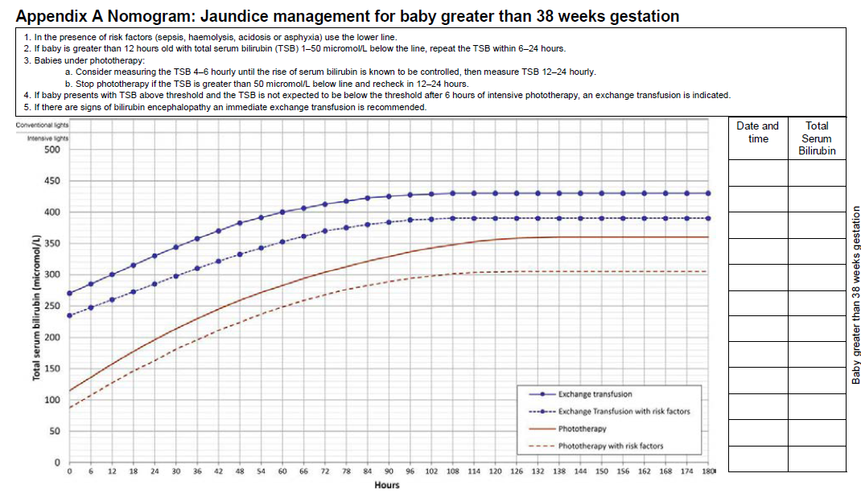
Using Nomograms
Nomogram A: Jaundice Management for a baby greater than 38 weeks gestation
Irradiance threshold for a baby who is term, 36 hours old with risk factors
Exchange transfusion
<50μmol/l
Intensive photo Therapy
Standard Photo Therapy
<50μmol/l
No Photo. Repeat TSB within 6 -24 hours
No Photo Therapy
Notes:
Change the colour of the fonts to black

Slide 11
Using bilirubin levels to determine management
>50μmol/l below photo level | Monitor the baby, there is low risk for kernicterus
<50μmol/l below photo threshold | Repeat TSB 6-24 Hours
At phototherapy level | Start standard phototherapy
<50μmol/l below exchange level | Start intensive phototherapy
At and above exchange level | Do exchange transfusion, initiate intensive photo as you prepare

Slide 12
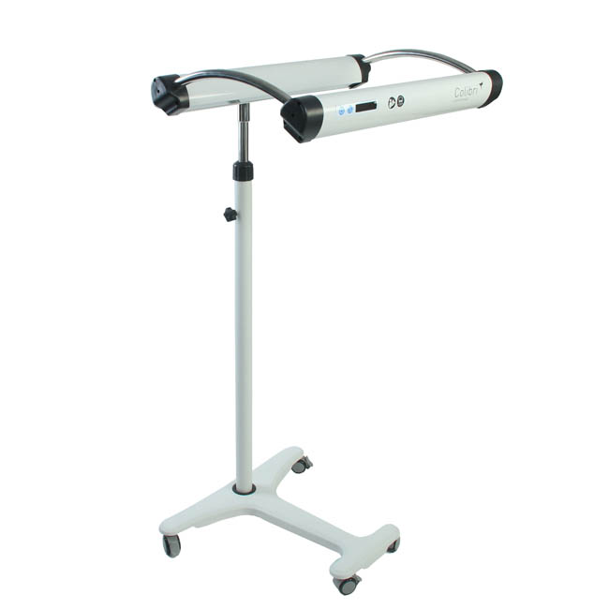
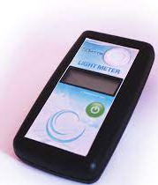
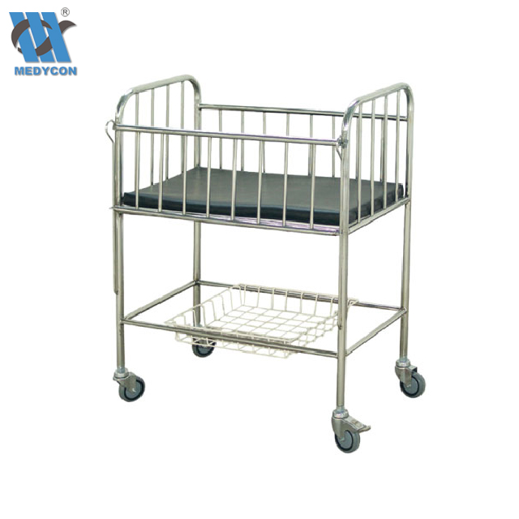

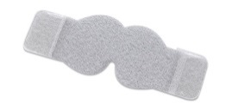

Phototherapy – Requirements
Phototherapy lamp
Light meter
Cot/Incubator/Radiant warmer
Room Thermometer
Linen
Eye shields
Images source: NEST Clinical Modules www.nest360⁰.org
Notes:
Cot can be incubator or warming crib. A radiant warmer may be used if the phototherapy machine can avoid heat

Slide 13
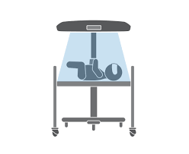

Management of Neonatal Jaundice
Role of Filtered Sunlight
Filtered sunlight
Phototherapy
Do not recommend the use unfiltered sunlight
  Risks- UV radiation, hyperthermia and sun burn¹.
Role of filtered sunlight – where Film canopies are used to Filter out most Ultraviolet A,B and C and infrared (heat) radiation.
After filtering allows passage of therapeutic blue light 400-520 nm
Filtered sunlight provides above the threshold of intensive phototherapy(at least 30uW/cm²/nm)
Filtered sunlight is noninferior to conventional phototherapy for the treatment of neonatal hyperbilirubinemia²
. A Randomized Trial of Phototherapy with Filtered Sunlight in African Neonates. N Engl J Med. 2015;373(12):1115-1124.² doi:10.1056/NEJMoa1501074
Notes:
By avoiding endotracheal intubation and mechanical
ventilation, the constant distending pressure maintained in
the lung by CPAP may also provide some physiologic
benefits regarding lung protection and development. In
utero the transpulmonary pressure of the fluid-filled developing
lung is approximately 3–4 cm H2O.51 Coincidently,
CPAP at 5 cm H2O results in nasal pharyngeal
distending pressure of approximately 2–3 cm H2O.52 In
theory, spontaneous breathing, at a constant “low” distending
pressure, as provided by CPAP, would seem to be
more likely to provide some mechanical similarities to the
lungs in the intrauterine environment, promoting lung
growth/development and protection, than would mechanical
ventilation, which uses relatively high inflation pressure.
Much of the experimental evidence used to evaluate
these physiologic effects has been limited to a few studies
using animal models of prematurity

Slide 14
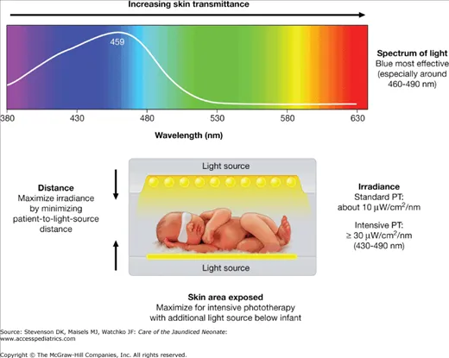
Phototherapy – Monitoring
Monitor vitals every 3 hours
Maintain 3 hourly breastfeeding for standard therapy or NGT feeding for intensive therapy
Reposition the baby every 3 hours
Monitor urine output - Four or more wet nappies per day
Weigh the baby on alternate days
Check for potential signs of bilirubin encephalopathy
Watch out for potential complications
Repeat TSB level 6 hrs after starting phototherapy
Skin Exposure
Expose as much skin as possible and cover the eyes
Vassilios F., Michele M., Antonio., Bo S., Dorret I. B., Gavino F., Antonio G. "Phototherapy in the newborn: what’s new?" Journal of Pediatric and Neonatal Individualized Medicine 2015;4(2):e040255 doi: 10.7363/040255 & Eileen M., Eileen T., regina K. 2018.Phototherapy nursing guideline. Ret. From https://www.olchc.ie/Healthcare-Professionals/Nursing-Practice-Guidelines/Phototherapy-2018.pdf
http://pediatrics.aappublications.org/content/128/4/e1046
Notes:
Observe for signs of potential side effects:
Neonatal
Hypo- or hyperthermia
skin rashes(benign)
Bronze baby syndrome
Dehydration
Electrolyte disturbances
Loose watery stools
Hypocalcemia
Retinal damage
Healthcare worker/caregiver/Mother
Nausea
Eye irritation
headache
After stopping phototherapy Continue monitoring feeding, vitals, potential side effects, look out for rebound jaundice

Slide 15
Questions?
?

Slide 16

Summary
Screening and early recognition of neonatal jaundice is important in prevention of bilirubin encephalopathy
Use the appropriate normograms to determine phototherapy treatment
Use light meter to determine irradiance based on the serum bilirubin level

