Slide 1

Neonatal Resuscitation

Slide 2

Objectives
To outline approach to newborn resuscitation.
To discuss the neonatal resuscitation algorithm
To describe post neonatal resuscitation care

Slide 3
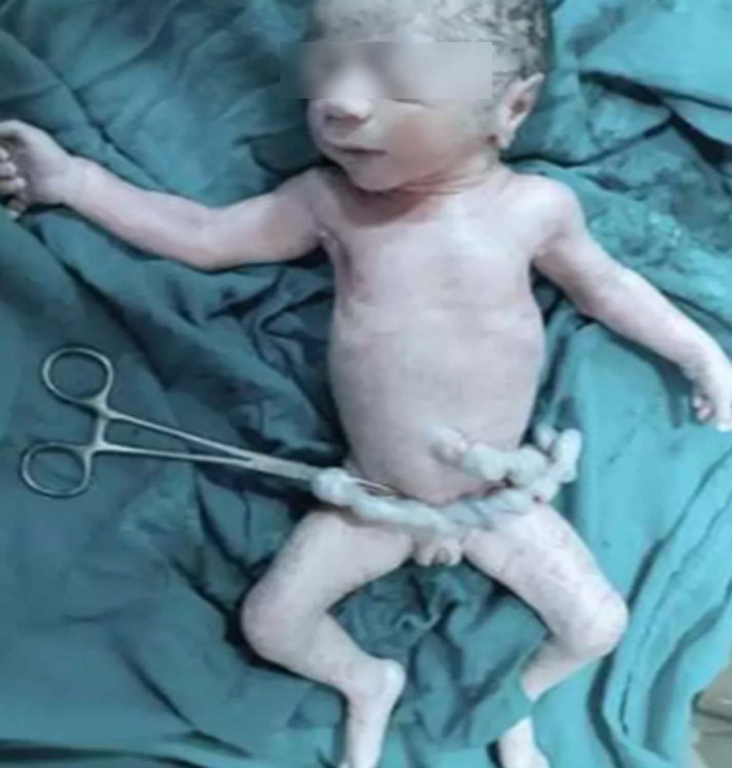
What is neonatal resuscitation
Refers to the interventions necessary to revive a newborn with inadequate breathing and or cardiac activity.
Any neonate can have breathing difficulties.
It is important to anticipate and be prepared for these eventualities.

Slide 4
Interventions required by newborns at Birth
10% of the 1.5 million babies born in Kenya annually, will require more than routine care.
We will focus on the 10% (330 neonates/day)
Assessment at birth and routine care
80 - 90%
Drying, stimulation, warmth, positioning & clearing airway
Ventilation must start within 1 min of birth (1st golden min)
8 -10 %
Bag and mask ventilation
3 - 6%
< 1%
Chest compressions & medications
Notes:
10% is approximately 330 neonates/day

Slide 5
Resuscitation check list
Warmth
A
Airway
Penguin Sucker
6F or 8F suction catheter
Prewarmed radiant warmer with a temperature probe
Warm and sterile towels or blankets
Hat
Plastic bag or plastic wrap (<32 weeks’ gestation)
Thermal mattress (<32 weeks’ gestation)
B
Breathing
Bag-valve device - size 200–300 mL for neonates <5kg
Masks: Different sizes (00, 0,1,2)
Oxygen supply & Pulse ox
C
Circulation
Stethoscope
D
Drugs
IV epinephrine at 0.2 ml/kg of 1:10,000 followed by iv 3ml normal saline flush
Normal saline
Blood transfusion
Notes:
Cling film is also an option
To make 1:10 000 adrenaline, take 1 ml of 1:1000 adrenaline and add 9mls of NS

Slide 6
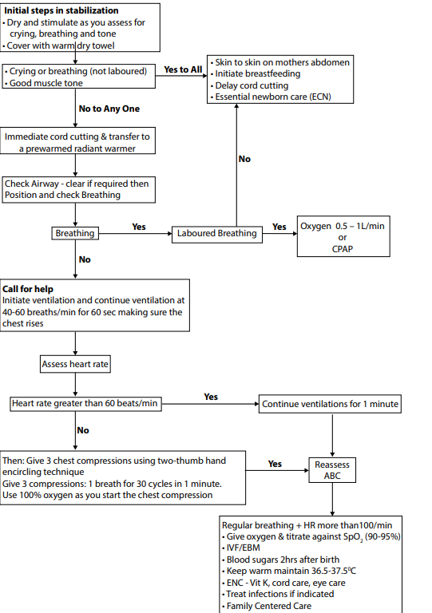
Refer to BPP or CNC protocol
Resuscitation Algorithm
MAINTAIN
TEMPERATURE
Anticipation and preparation
Golden minute

Slide 7

What is the Golden Minute concept?
The Golden Minute refers to the first 60 seconds when the whole body is delivered and is allocated to:
  Completing the initial steps of stabilization
  Assessment (crying/breathing, tone, term)
  Beginning ventilation if required
Within one minute of birth, a baby should be breathing well or should be well ventilated with a bag and mask.
ILCOR: Neonatal Resuscitation- Part 11 2010 AND 2010 American Heart Association Guidelines for Cardiopulmonary Resuscitation and Emergency Cardiovascular Care John Kattwinkel, Co-Chair*; Jeffrey M. Perlman, Co-Chair*; Khalid Aziz
Notes:
Within one minute of birth, a baby should be breathing well or should be ventilated with a bag and mask.
International Liaison Committee on Resuscitation (ILCOR) emphasized the importance of the first minute of life using the term the Golden Minute
The Golden Minute identifies the steps that a birth attendant must take immediately after birth to evaluate the baby and stimulate breathing
A baby is born when the whole body is out, and that is when the clock is started and the Golden Minute begins.

Slide 8
The ABC of Neonatal Resuscitation
AIRWAY
  Check the airway and clear any secretions
  Position into sniffing position
BREATHING
  Look, listen and feel for 5 sec
  If no breathing (or gasping)..
    Start ventilation; 40-60 ventilations/min
CIRCULATION
  Check umbilical pulse for 5 sec
  If pulse <60bpm
    Connect to 100% oxygen
    Start chest compression (ratio 3:1), note the landmarks
RE-ASSESS AIRWAY, THEN BREATHING AND CIRCULATION TOGETHER

Slide 9
Target preductal saturations at birth
Time after birth | Oxygen saturations
1 min | 60-65%
2 mins | 65-70%
3 mins | 75-80%
4 mins | 80-85%
5 mins | 85-90%
10 mins | 90-95%
Khalid Aziz. Circulation. Part 5: Neonatal Resuscitation: 2020 American Heart Association Guidelines for Cardiopulmonary Resuscitation and Emergency Cardiovascular Care, Volume: 142, Issue: 16_suppl_2, Pages: S524-S550, DOI: (10.1161/CIR.0000000000000902)
Notes:
Pre-ductal is the right upper limb

Slide 10
When to stop resuscitation
The decision to discontinue neonatal resuscitation should be individualized based on:
  Gestational age,
  Fetal conditions,
  Resources
  Parents' wishes.
When all these steps of resuscitation are effectively completed and there is no heart rate response by 20 minutes, redirection of care should be discussed with the team and family.

Slide 11
Post-Resuscitation Care
Assess ABCDE fully with frequent reassessment every 2 minutes
Airway:
  Patency, correct positioning
      Breathing:
        Assess adequacy of breathing:
            Check RR, nasal flaring, grunting, central cyanosis, sternal and intercostal recession, lower chest wall indrawing.
            Start relevant respiratory support and Target SpO₂ 90 to 95%
Circulation:
  Asses for adequacy: pulse rate, capillary refill time and pallor
Disability:
  manage hypo/hyperglycemia
Exposure:
  Thermo-control target 36.5°C-37.5°C
  Head to toe exam
Treatment plan e.g. Antibiotics if needed
Essential newborn care - Vit K, TEO, CHX
IFCDC

Slide 12
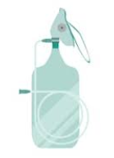
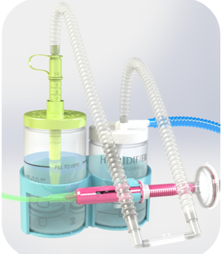
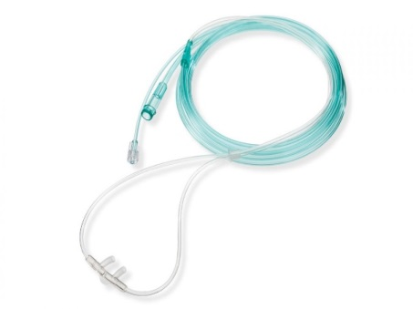
How to deliver oxygen after resuscitation
Non-Rebreather mask
Delivers 85-100% oxygen
Nasal prongs
Delivers 30-45% oxygen
CPAP
Indications:
Post resuscitation
If develops apnea/ gasping - PPV using BVM
Indications
Labored breathing and patient is able to meet target SpO₂ using this FiO₂
If develops apnea/ gasping - PPV using Bag and valve device
Indications
No response to oxygen therapy
Sp0₂ remains low despite conventional 0₂ therapy or there is increased work of breathing

Slide 13
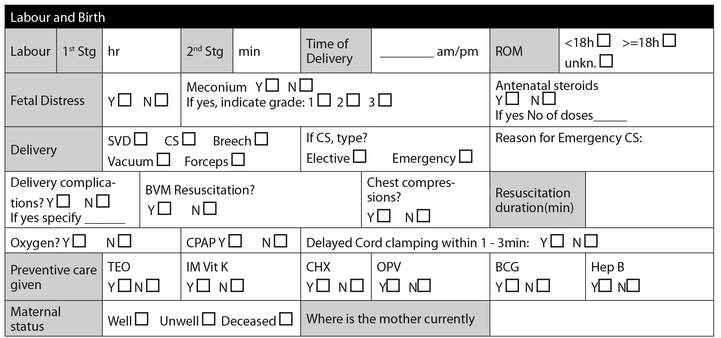
Newborn transfer form

Slide 14
Questions
?

Slide 15
Resuscitation Algorithm
MAINTAIN
TEMPERATURE
Anticipation and preparation

Slide 16

Summary
To achieve good resuscitation we need;
  Good clinical judgement
  Practice evidence based care
  Correct and proper use of equipment
All clinical procedure must be performed correctly

