Slide 1

Neonatal Thermoregulation

Slide 2

Objectives
  Define thermoregulation
  Explain ways through which babies lose heat
  Discuss the prevention of hypothermia
  Discuss the management of hypothermia
2

Slide 3
Introduction
Thermoregulation is the ability to balance heat production and heat loss in order to maintain body temperature within a certain temperature range.
Normal body temp for a newborn is 36. 5⁰ to 37. 5⁰ C.
Hypothermia is defined as a core body temp < 36.5°C
Hyperthermia is defined as a core body temp of > 37.5°C
Nyandiko, W.M., Kiptoon, P. and Lubuya, F.A., 2021. Neonatal hypothermia and adherence to World Health Organisation thermal care guidelines among newborns at Moi Teaching and Referral Hospital, Kenya. PloS one, 16(3), p.e0248838
3
Notes:
Newborn infant regulates body temp less efficiently than older children/adults
Thermal protection refers to the measures taken at birth and during the first days to ensure that the baby does not go into hypothermia or hypothermia

Slide 4
Temperature Classification
Classification | Temperature range | Reaction
Hyperthermia | >37.5⁰C | DANGER,CAUSE FOR CONCERN
Normal | 36.5- 37.5⁰C | Maintain preventive strategies
Cold stress | 36.0-36.4⁰C | CAUSE FOR CONCERN
Moderate hypothermia | 32.0 - 35.9⁰ C | DANGER, CAUSE FOR CONCERN
Severe hypothermia | <32.0 ⁰C | OUTLOOK GRAVE, SKILLED CARE URGENTLY NEEDED
4

Slide 5
Hypothermia
5

Slide 6
Risk factors
Environmental factors
The room is cold < 25° C .
The baby is exposed to cold draught.
The baby is placed on a cold surface or near cold wall.
Inadequate or wet clothing
Inappropriate thermal provision appliances
Inadequate thermal protection during neonatal transport
Delayed skin to skin/KMC
Lack of rooming in.
Neonatal Factors
  Prematurity/LBW
  Delayed initiation of breastfeeding/poor feeding.
  Other associated medical conditions e.g. sepsis, asphyxia.
  Hypoglycemia
6

Slide 7
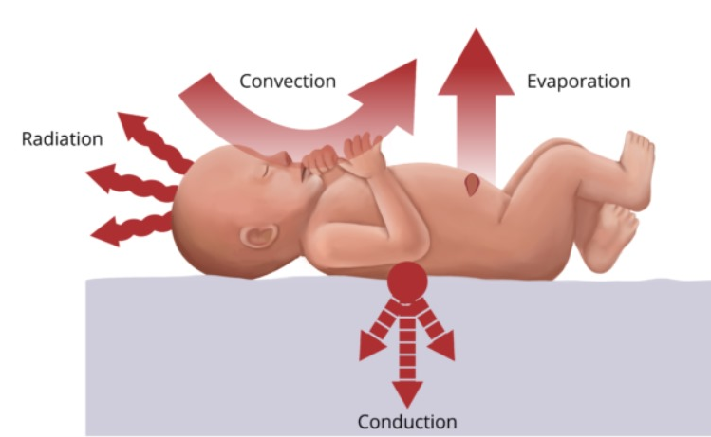
Mechanisms of heat loss to the environment
7

Slide 8
Complications of Hypothermia
Metabolic acidosis
Respiratory distress
Neonatal sepsis
﻿Sclerema
﻿Pulmonary hemorrhage
﻿Impaired cardiac function
Coagulopathy,
﻿Sudden infant death syndrome
Delayed growth and development,
Mental retardation
8

Slide 9
Prevention of hypothermia
10 steps of the Warm chain
Warm delivery room (25-28⁰C)
Immediate drying at childbirth
Warm resuscitation
Skin-to-skin contact at birth (≥ 1 hour for term baby) or iKMC for infants <2500g)
Early initiation of breastfeeding
Appropriate warm clothing including hat
Delayed bathing for at least 24 hours after child birth
Mother and baby together(rooming in)
Warm transportation
Training & awareness raising on hypothermia risk
Ensure skin to skin contact during neonatal transport
9

Slide 10
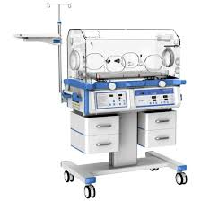
Use of an Incubator
10

Slide 11
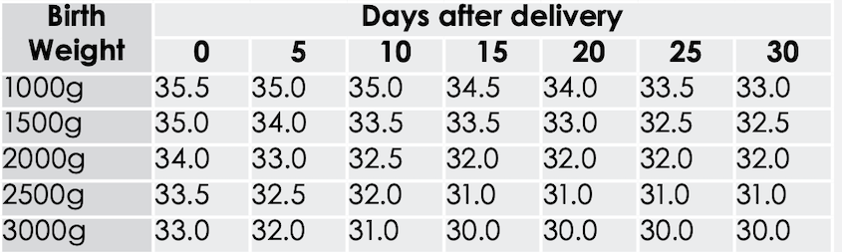
Incubator temperature setting
11
Notes:
Temperatures are set for incubators that don’t have servo mode or a temperature probe

Slide 12
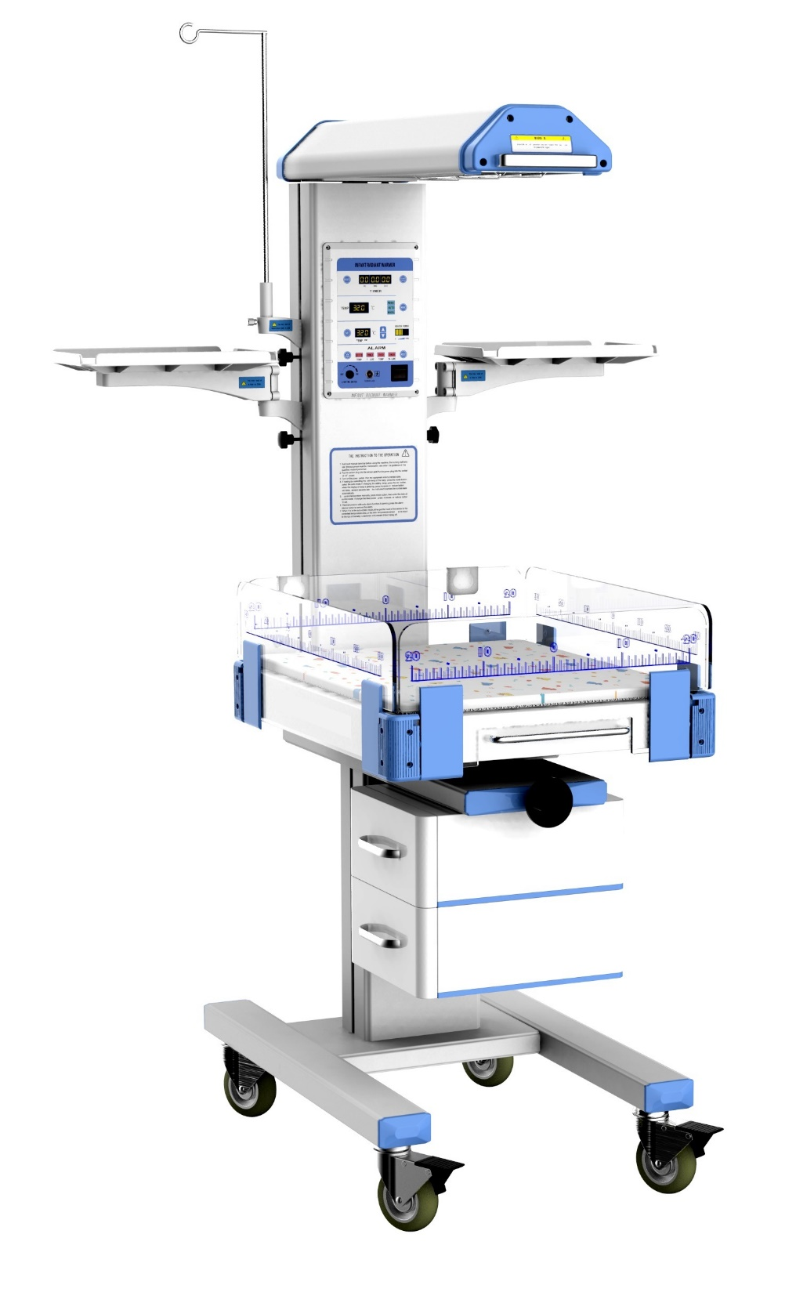
Use of a radiant warmer
12

Slide 13
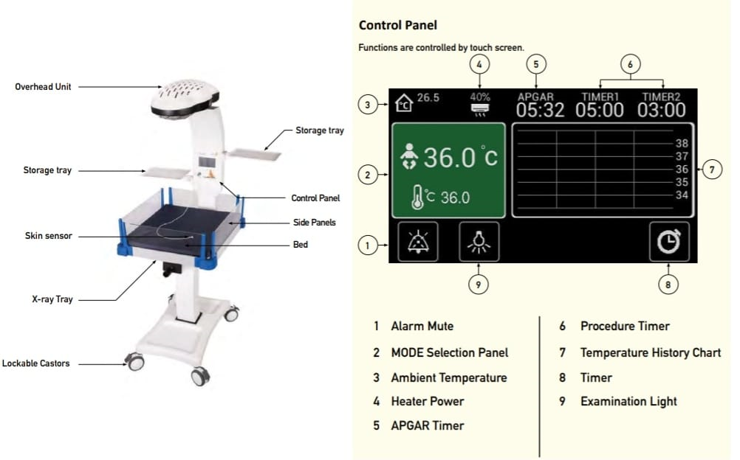
Radiant Warmer
13

Slide 14
?
Questions?
14

Slide 15

Summary
Thermoregulation is important in neonates
Hypothermia is a common problem in our set up
For every 1°C decrease from the normal temperature at admission the risk of mortality increases by 28%.
Prevention of hypothermia/hyperthermia is key to saving our neonates
Hypothermia should be treated urgently.
15

