Slide 1
Module 1:Triage

Slide 2

Definition of Triage
Identify and act on the ABCD for emergency signs.
Objectives
Identify and act on 3Ts, 3Ps, 3Rs and MOB for priority signs.

Slide 3
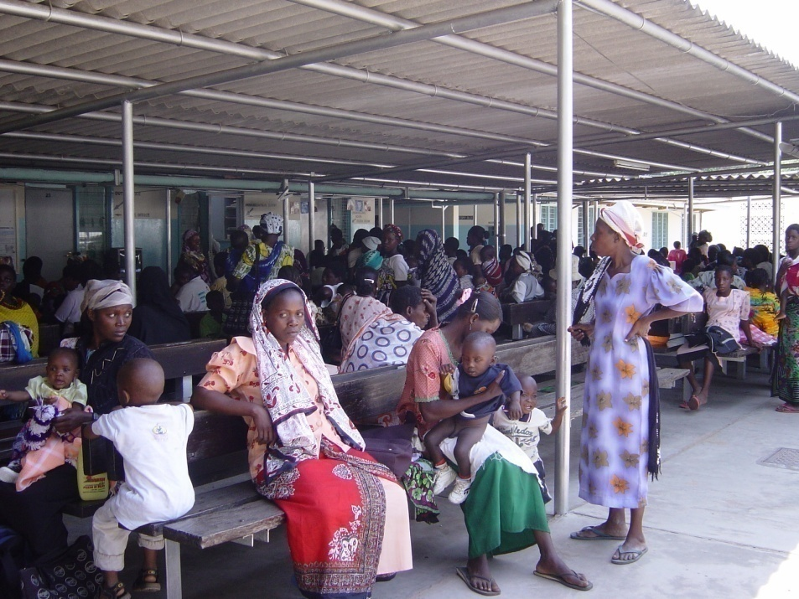
What is triage?
Triage is sorting and prioritizing patients based on the severity of their conditions.
It ensures that those needing immediate medical attention receive it promptly

Slide 4
Why triage?
Some children will die waiting to be seen
Of all the children dying in hospital >50% will die within 24 hours.
Some children can only be saved if treatment starts immediately.

Slide 5

Who can do triage?
Anyone:
  Doctor / Clinician
  Nurse
  Nutritionist
  Community Health Promoter
  Cleaner
  Askari
  Records Clerk

Slide 6
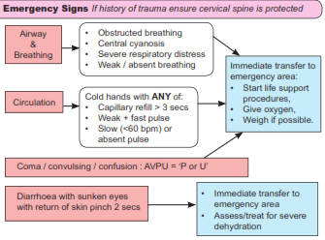
Emergency signs
Immediate Action
Take to emergency area
Clinician / Nurse sees NOW

Slide 7

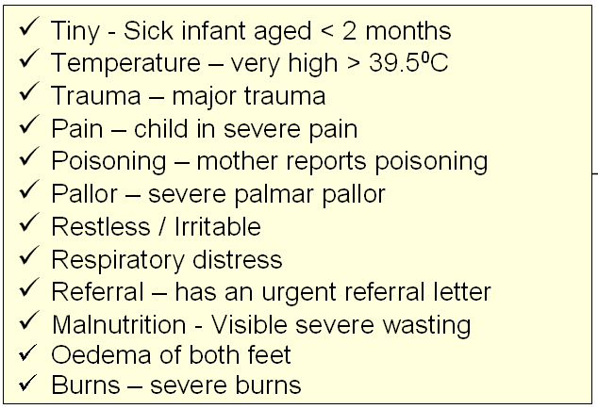
Priority signs
Emergency Care
Send to the front of the queue
  Clinician review as soon as possible
  Weigh
  Baseline observations
3 Ts
3 Ps
3 Rs
MOB

Slide 8
Non- urgent signs
Emergency Care
Priority Care
Non-urgent – Wait in the queue

Slide 9
Summary
Triage is SORTING only. Diagnosis and treatment is not the responsibility of the person doing triage
In a busy department it is a continuous / frequent process
Departments need to be organised so that emergencies and priorities can be appropriately handled

Slide 10
Module 2:
Basic Life Support: Infant and child
(ABCs in a collapsed infant/child)

Slide 11
To describe the structured ABC approach to BLS for infants and children
Objectives
Review basic emergency drugs used in resuscitation

Slide 12




Being prepared.
Who is responsible?
    Who comprises the team? Specific roles?
    How are they alerted?
Who?
Where?
Where will Life Support take place?
    Special area or Bedside?
Equipment?
  Responsibility?
What?
Knowledge & Skills/Competence (guidelines)?
  Training and Orientation?
How?

Slide 13


What are the most common causes of ‘collapse / arrest’ in children?
Respiratory failure
    Pneumonia
Circulatory failure
  Severe anaemia
  Dehydration
  Septic shock.
  (Pump failure – adults and children with CHD)

Slide 14

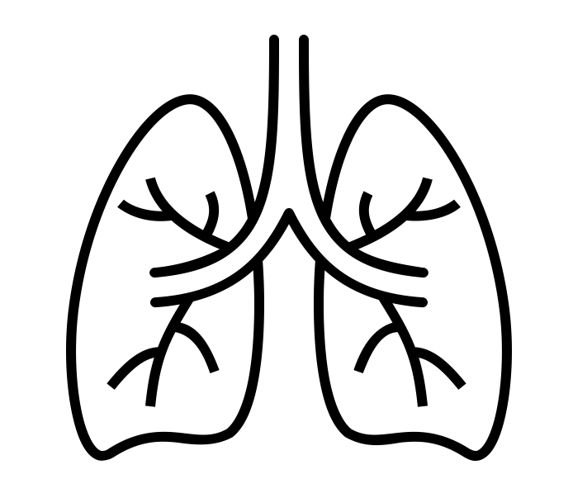
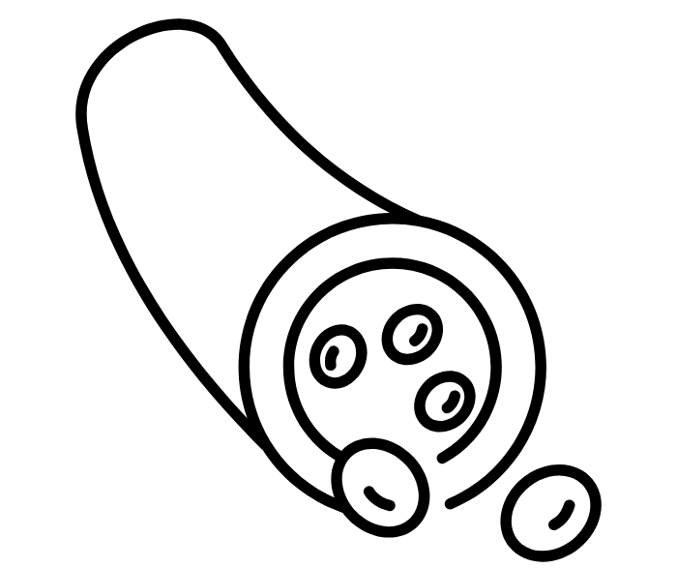
The collapsed child - A structured approach
Safe, Stimulate, Shout, Setting
Airway-patency, position
Breathing-Child IS NOT breathing Or only gasping
5 rescue breaths with Bag and Mask device, Attach 100% oxygen to BVM device
Circulation-Heart Rate < 60 bpm, 15 compressions to every two Ventilations
Aim for 6 – 7 cycles of 15:2 per minute (for 2 minutes)
Reassess ABC after every two minutes
Notes:
.

Slide 15

Drugs in Resuscitation
Consider IO/IV line insertion when a 3rd helper arrives
Get samples for random blood sugar, Hb and GXM.
Consider IO/IV Adrenaline (0.1ml/kg 1:10,000) as rapid push plus a flush of 2-5mls normal saline
How to make 1:10,000 adrenaline:
Mix 1 ml of 1:1,000 adrenaline with 9mls of water for injection, to make 10mls of adrenaline 1:10,000
Manage hypoglycemia with IO/IV 10%dextrose
Notes:
In Kenya’s paediatric guidelines, the dose for managing hypoglycemia is 5mls/kg of 10% dextrose. In newborns, this is 2.5mls/Kg.

Slide 16


Post-Resuscitation Care
Assess ABCDE fully with frequent reassessment every 2 minutes
  Airway: correct positioning, consider airway adjuncts
Decide on admission care for definitive and supportive care
  Breathing: Oxygen at 10-15L/min NRM and titrate flow depending on oxygen sats. Target SpO2 94-98%
  Circulation: maintain normal blood pressure to perfuse end organs (brain, heart, kidneys)
  Disability: manage hypo/hyperglycemia
  Exposure: Thermo-control, ?antibiotics ?other issues

Slide 17




Summary – The Collapsed Infant
4 S- Safe, stimulate, shout for help, change setting
Airway: Clear? Position?
Breathing: Is BVM needed? (add oxygen to bag)
Circulation: Are chest compressions needed (no signs of life)
Reassess A then B&C (together) after every two minutes

Slide 18
Module 3:
Assessment and management of a sick infant/child with signs of life (no trauma)

Slide 19
To learn how to make the initial rapid assessment of a sick child with signs of life
To identify life threating emergencies using ABCDE approach
Objectives
To learn how to make immediate decisions on life saving emergency interventions using ABCDE approach .

Slide 20


The ABCDE Approach
Ensure Safe approach
A - Airway
Observe to determine initial level of alertness
  For alert babies, consider assessing while with the parents
  S - Gentle Stimulation-tactile and verbal ( if not obviously alert)
  S - Shout (or other system) for help if unresponsiveness to initial stimulation
  S - Consider change of Setting to an emergency area (E.g if in the waiting bay)
B - Breathing
C - Circulation
D -Disability (Neurological status)
E - Exposure

Slide 21
1. Rapid assessment for airway patency
Airway
Is the airway adequate ?
Assess for airway obstruction
  Assess the child while with parent
  Listen: stridor/airway noises
If alert
Place the child in resuscitation couch
Look in the mouth/nose - foreign body, Secretions, vomitus
If not alert

Slide 22
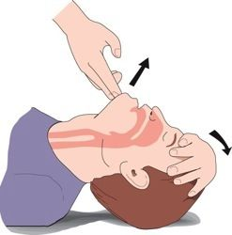
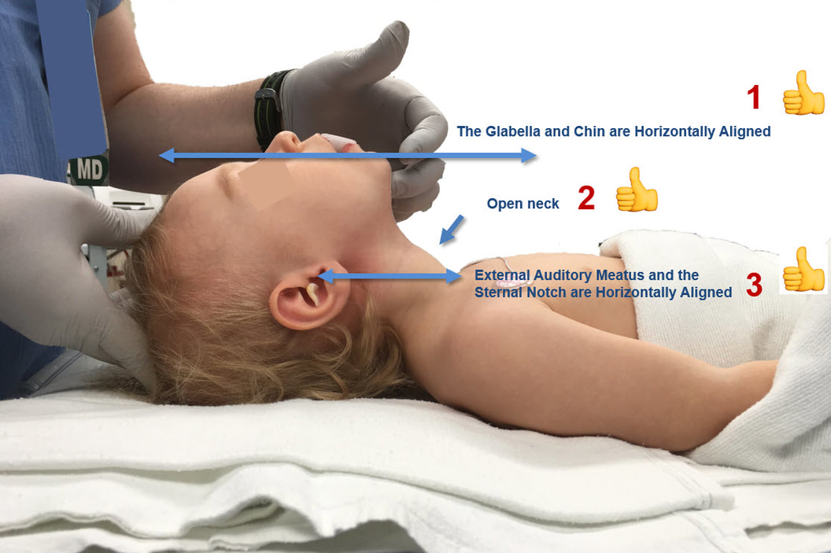
Airway- positioning
Use the head-tilt, chin-lift maneuver
In trauma, use jaw thrust
Position to a sniffing position
Image from kidzAid Australia; kidzaid.com.au
Pediatric anesthesia digital handbook
Notes:
Head tilt chin lift- form a C with the non dominant hand and place it on the forehead, then the index and middle finger of the dominant hand on the bony part of the chin tilt the chin upwards while pushing backwards on the forehead avoid the soft tissues of the neck/throat
Index and middle finger perpendicular to the horizontal planes
In the sniffing position the tip of the nose is the highest point the glabella and chin are horizontally aligned,neck is wide open forming a 145degree angle and the external meatus and and suprasternal notch are aligned
Open airway
- Position airway in a sniffing position-
Sniffing position enlarges both retropalatal and retroglossal airways.
- AVPU =U use oropharyngeal airway - Prevent tongue to fall back against posterior pharyngeal wall

Slide 23
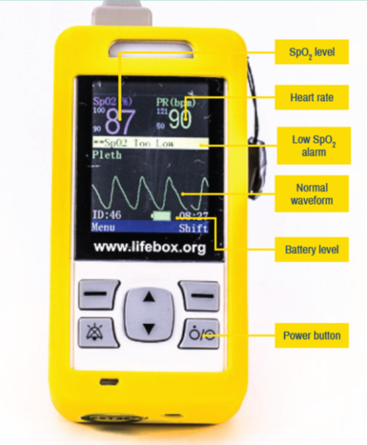
Rapidly assess adequacy of breathing
Breathing
Central Cyanosis?
Pulse oximetry
Work of breathing
  Respiratory rate: Very Fast?
  Grunting?
  Head nodding / bobbing?
  Severe chest Indrawing?
  Deep / acidotic breathing?
  (Symmetrical movement?)
-If signs of respiratory distress listen-
Wheeze (bronchodilators)
Saturation <90% give oxygen
NB: gasping require BVM ventilation
Very slow breathing may require BVM ventilation
Notes:
Before arrest the respiratory rate may slow considerably because of exhaustion or narcosis caused by very high CO2 levels.
There are no precise accepted levels of breathing being too slow, 20 may be too slow for an infant but enough for a large child
A pulse oximeter should not miss from any hospital
Grunting is most useful in infants
Head nodding is a sign of effort
May want to ask why we are concerned about deep acidotic breathing, or wheeze or whether the chest moves symmetrically

Slide 24


Emergency intervention for inadequate breathing
  SpO₂ <90% or
  Signs of increased work of breathing
  Increased Respiratory Rate?
  Grunting?
  Head nodding / bobbing?
  Deep / acidotic breathing?
N
Oxygen
therapy
Is there a wheeze?
Y
Bronchodilators + Oxygen therapy
Notes:
Live saving interventions for life threatening conditions

Slide 25
Circulation
Rapid Assessment of Circulation – If there are signs of life there is a pulse
Also check for
Large pulse (very fast?)
Peripheral pulse (present/weak)?
Temperature gradient?
Capillary Refilling Time?
Sunken eyes / skin pinch
Pallor?
Severe wasting / oedema?
Monitor oxygen saturation, heart rate and blood pressure
2016 WHO Paediatric Emergency, Triage, assessment and Treatment
Notes:
How do we know when there is an impaired circulation or a severely impaired circulation (perhaps best not to talk about compensated, decompensated any more)
Signs in the pink box tell us something about the circulation (as well as the respiration and whether alert).
If a hospital has a monitor then use it! Check pulse, blood pressure etc.
Signs in the blue box are those we need to know about to help make decisions on fluid / blood use – the next two slides focus on what to do if there either of these underlying conditions, severe dehydration or severe anaemia are present.
Simple clinical signs can be very helpful in rapidly assessing the circulatory system
Rapidly feeling the hands, feet and limbs to see if they are cold gives an early clue – cold hands and feet with coldness extending to the upper arm or upper leg is very worrying (clearly some account has to be made of the environment and degree of recent exposure)
The presence / absence or strength of the pulse at the wrist and centrally are also useful.
Pulse rate is of some value, perhaps more so if it is very slow for a child
Capillary refilling is also a rapid assessment that can help identify circulatory failure, especially if the refilling is prolonged >3secs and the child is in a warm environment.

Slide 26



To make decisions on use of fluids and blood to use in severely impaired circulation
 | Is the problem likely to be caused by diarrhoea and / or vomiting? (ask from history)
 | Is there severe acute malnutrition? (check)
 | Is there severe anemia? (check)
Also note that trauma, burns, and anaphylaxis must be identified and that care may be different in a child with chronic heart disease etc
2016 WHO Paediatric Emergency, Triage, assessment and Treatment

Slide 27
Fluid summary – no trauma
Diarrhoea and / or vomiting with severely impaired circulation: Hypovolemic shock (no Severe Acute Malnutrition, No anaemia)
  Fast bolus of 20mls/kg Ringer’s lactate in 15 minutes
Severely impaired circulation, no diarrhoea and / or vomiting, no severe anaemia, and with or without severe malnutrition
  20mls/kg of Ringer’s lactate over 2 hours (Ringers/5% dextrose in SAM)
Severely impaired circulation, severe anaemia, and respiratory distress
  Urgent blood transfusion of 10mls/kg of PRBCs
  Maintenance fluids as you wait for blood (Ringers lactate in 5% dextrose – page 24 BPP)
Impaired circulation with no severe anaemia, no diarrhoea and / or vomiting, and with or without severe malnutrition
  Maintenance fluids (Ringers lactate in 5% dextrose – page 24 BPP)

Slide 28
4. Disability
Assess neurological status (AVPU scale)
  A straightforward scale to rapidly grade a patient's gross level of consciousness, responsiveness, or mental status.
  Check what is appropriate responses for different ages
For alert children (AVPU at A), assess ability to feed/drink
For young infants, check for irritability, activity and tone
Assess tone and posture for all children
Check random blood sugar (consider 10%D bolus if AVPU <A and cant check sugar)
Notes:
Mention to the participants that there will be a lecture on hypoglycemia which is also been combined with convulsions

Slide 29
Exposure
Maintain dignity during exposure
Keep warm (as is necessary)
Look for other non-obvious signs
  Head to toe examination (rashes, wounds, bleeding, drains)
Take the core temperature
Reassess

Slide 30

Actions after life saving interventions
Full history and examination.
Document all interventions given and the time they were done
Reassess ABCDE
Continue observing patient as clerkship continues.
Plan for definitive care
Seek expert help as appropriate
Hand-over care (using SBAR tool)

Slide 31




Summary
ABCDE approach is a structured, rapid assessment to identify urgent issues and intervene (2-3 minutes if no problems)
Intervene at every stage before moving to the next
Document all interventions and time.
Take history and do a full clinical examination
Observe patient as clerkship continues
Consider early expert help
Proper hand-over

Slide 32
Module 4: Oxygen therapy

Slide 33
Indications of oxygen therapy
Detection of hypoxaemia
Objectives
Oxygen delivery methods
Monitoring of oxygen therapy
Complications of hypoxia and hyperoxia

Slide 34

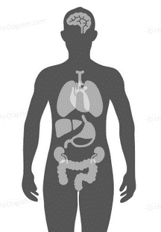
Conditions associated with hypoxaemia
Neonates
  Respiratory Distress Syndrome
  Neonatal pneumonia
  Transient tachypnoea of newborn
Children
  Pneumonia
  Interstitial lung disease
  Severe asthma
  Pulmonary edema
Neonates
  Severe Birth asphyxia
  Sepsis
  Congenital heart defects
Children
  Shock
  Meningitis
  Perioperative emergencies
  Trauma
  Carbon monoxide poisoning
WHO Oxygen therapy for children 2016

Slide 35


How to detect hypoxaemia
Clinical Signs
It is important for health workers to be able to identify clinical signs of hypoxaemia
Combination of clinical signs increases the chances of detecting hypoxaemia
Pulse Oximetry
Computerized unit and a sensor probe, which is attached to the patient
Displays the SpO₂ with an audible signal for each pulse beat and the pulse rate
Hypoxaemia is SpO₂<90%
Blood Gas Analysis
Measures the partial pressure of oxygen (PaO₂)and carbon dioxide in blood
Also measures blood pH and the concentrations of the main electrolytes
Hypoxaemia is PaO₂< 60mmHg
WHO 2016: Oxygen therapy for children: a manual for health workers
Notes:
If oximetry is not available, the following clinical signs could be used to determine use of oxygen therapy:
• central cyanosis
• nasal flaring
• inability to drink or feed (when due to respiratory distress)
• grunting with every breath
• depressed mental state (i.e. drowsy, lethargic)
In some situations, and depending on the overall clinical condition, children with the following less specific signs may also need oxygen:
• severe lower chest wall indrawing
• respiratory rate ≥ 70/min
• head nodding

Slide 36
Pulse oximetry in detection of hypoxaemia
Most accurate non­invasive method for detecting hypoxaemia
Measures the percentage of oxygenated haemoglobin in arterial blood (SpO₂)
What it measures
Clinical use
Performed on all patients requiring admission
In the outpatient department for children with fast RR & LCWI.
Reliable monitor for hypoxaemia- 5th Vital sign
Detects 20–30% more children with hypoxaemia than clinical signs alone
Non –invasive and painless unlike blood gas analysis
Easy to use
Inexpensive and widely available
Advantages
All health facilities should have a pulse oximeter with a neonatal & paediatric probe!
WHO 2016: Oxygen therapy for children: a manual for health workers
Notes:
pulse oximetry measures oxygen saturation by illuminating the skin and measuring changes in light absorption of oxygenated (oxyhemoglobin) and deoxygenated blood (reduced hemoglobin) using two light wavelengths: 660 nm (red) and 940 nm (infrared) .

Slide 37
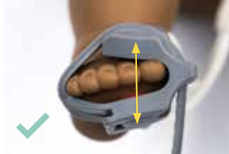
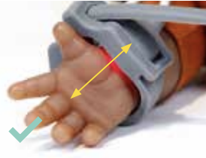

Using the Pulse Oximeter
a)
Attach probe to pulse oximeter
Press the power button to turn on the pulse oximeter
Ensure the probe has a red light and the settings are appropriate
Choose a well perfused site to attach probe
Attach the probe making sure the light source and sensor line up
Allow a normal trace to establish
Read the oxygen saturation
d)
c)
b)
e)

Slide 38
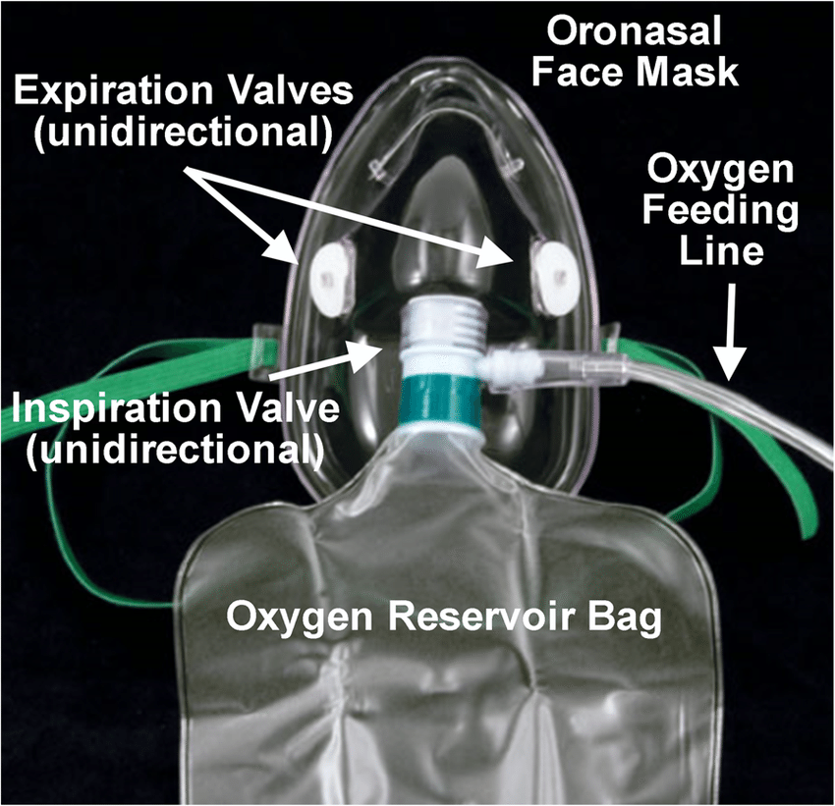
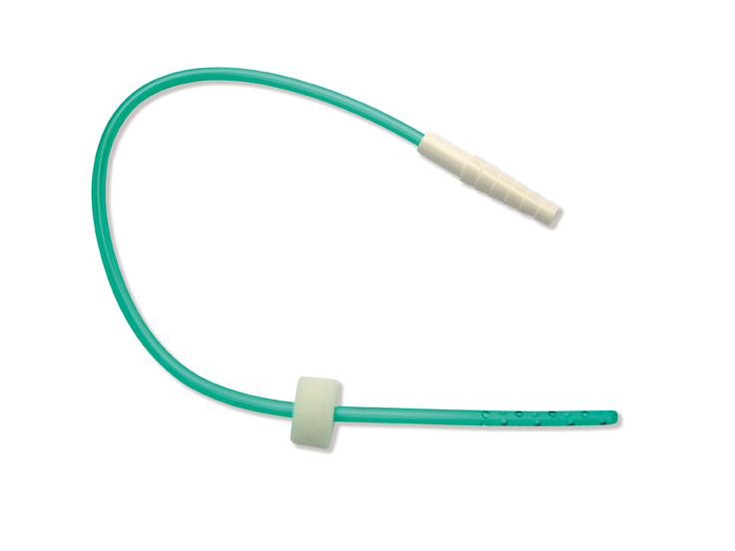
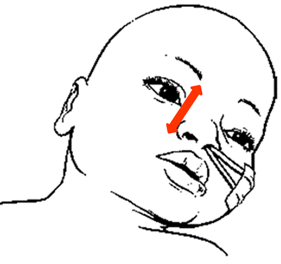
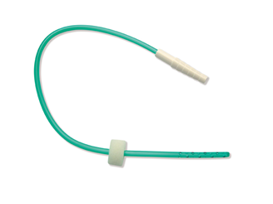
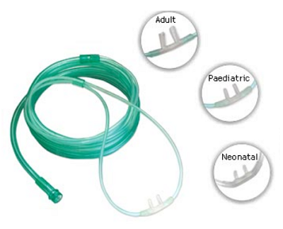
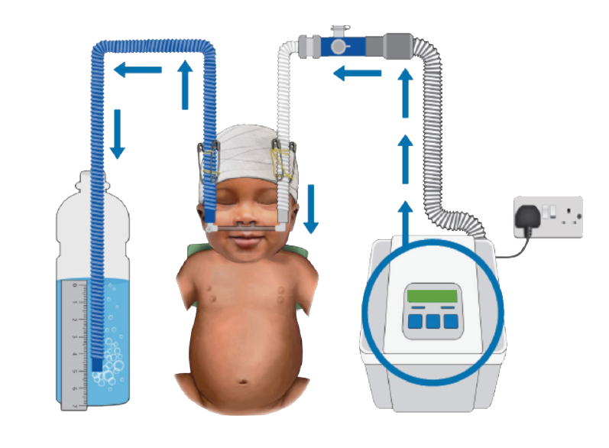
Oxygen Delivery Methods
Non-Rebreather Mask)
Nasal Catheter
Nasal Prongs
bCPAP
Kenyan Pediatric protocol 2016; WHO oxygen therapy for children 2016 : https://www.who.int/maternal_child_adolescent/documents/child-oxygen-therapy/en/

Slide 39
Titrating & Stopping Oxygen (Refer to BPP 2022 Page 28)
When Oxygen is started, titrate every 15-30mins by 0.5L/min until SpO₂ is 90-96%
Change the oxygen delivery methods (nasal prongs, catheter or NRM) and flow rates based on need
Stop titrating and begin close monitoring if clinically stable (no emergency signs, SpO₂ > 90% and no increase WoB)
Wean off oxygen every 15 –30 min and carefully examine for changes in WoB and SpO₂ to assess whether supplemental oxygen is still required.
Once oxygen is stopped, recheck SpO₂ after 1h, as late desaturation can sometimes occur.
Discharge only if child has been stable with SpO₂ ≥ 90% and no increased WoB on room air for at least 24hrs
WHO oxygen therapy for children 2016 : Sources and delivery of oxygen; page 32-33

Slide 40


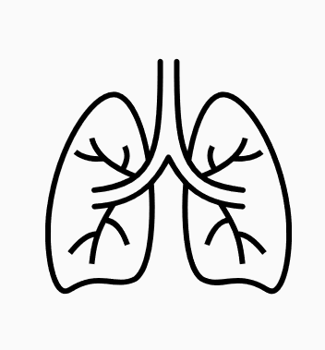
Complications of oxygen therapy a) O₂ toxicity (Hyperoxia, overdose >96%)
Peripheral vessels
CNS
Respiratory system
Makes them constrict which reduces blood supply to the organs
Produces toxic substances that destroys nerves making a patient present with symptoms e.g. convulsions
Can cause chest pain and irritation of the airway.
In the term long term can cause lung stiffness (fibrosis)
Helmerhorst, H.J.F., Schultz, M.J., van der Voort, P.H.J. et al. Bench-to-bedside review: the effects of hyperoxia during critical illness. Crit Care 19, 284 (2015). https://doi.org/10.1186/s13054-015-0996-4

Slide 41

Complications of oxygen therapy
b) Hypoxia (underdose <90%)
All body organs
Respiratory system
Makes all cells in the body function abnormally leading to organ failure and death
Makes the vessels in the lungs constrict and if they constrict for long this can cause high pressure in the lungs (pulmonary hypertension)
Michiels C. (2004). Physiological and pathological responses to hypoxia. The American journal of pathology, 164(6), 1875–1882. https://doi.org/10.1016/S0002-9440(10)63747-9

Slide 42
Summary
  Use of clinical signs should be augmented by use of objective measures e.g. by use of pulse oximeters
O₂
  Oxygen is a medicine, therefore it should be measured, given at the right dose and only when indicated.
Correctly identify and administer oxygen to patients who need oxygen

Slide 43
Module 5: Management of an infant/child with respiratory distress i) Pneumonia

Slide 44
Correctly identify Signs and symptoms of pneumonia
Objectives
Correctly classify pneumonia
Management of pneumonia.

Slide 45
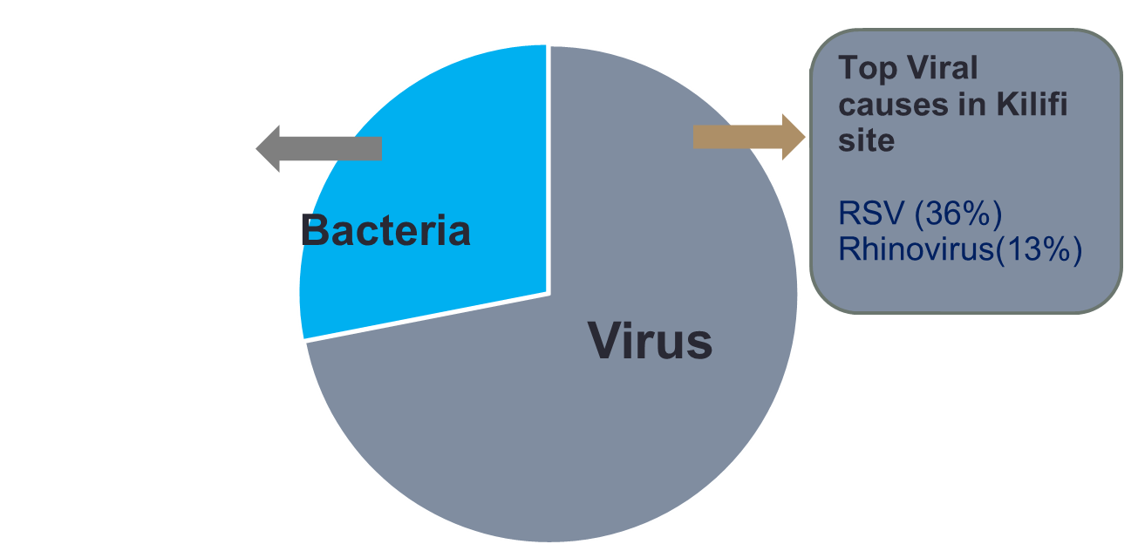
Childhood Pneumonia etiology in Kenya
Studies have shown that pneumonia in children is mostly caused by viruses.
However, bacterial causes account for the highest mortality and hence all children diagnosed with pneumonia should be treated with an antibiotic
27.3%
Top Bacterial causes in Kilifi site
H. Influenzae (5.7%)
S. Pneumoniae (5.1%)
M. Tuberculosis (1.9%)
61.4%
Notes:
M. tuberculosis should ALWAYS be ruled out in tuberculosis endemic areas.
Pneumocystis pneumonia is commonest cause of fungal pneumonia among HIV infected children.
PERCH-Pneumonia, Etiology, Research, for Childhood Hospitalization

Slide 46
Six signs used in classification of the severity of illness in a child with cough and difficulty breathing < 14 days
Danger signs for pneumonia
Hypoxemia
Lethargy or unconscious
If alert: inability to breastfeed or drink
Grunting
Lower chest wall indrawing
Fast respiratory rate
  RR ≥50/min (Age 2 - 11mo)
  RR ≥40/min (Age 12 - 59mo)

Slide 47
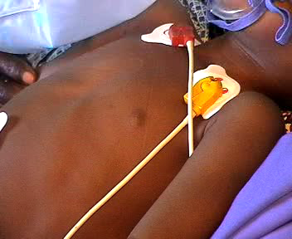
Lower Chest wall Indrawing
Lower chest wall indrawing is the inward movement of the lower chest wall when the child breaths in.
It does not refer to the inward movement of the soft tissue between the ribs.
It signifies increased work of breathing but is not a danger sign by itself alone.
Notes:
Clip Named Videos_Work/Indrawing Present
This clip clearly shows a child with lower chest wall indrawing – the RIBS are sucked in as the child breathes in because the diaphragm is working so hard. This is a much more useful sign than intercostal recession or subcostal recession which refer to the movement of soft tissues. It signifies increased work of breathing but is not a danger sign in itself alone. Therefore look for other signs – AVPU, cyanosis/oxygen saturation, grunting, inability to drink

Slide 48
Pneumonia classification and treatment
History of cough and/ or difficulty in breathing
Danger signs
(SpO₂<90% or cyanosis, not alert, unable to drink, grunting )
Penicillin & Gentamicin
supportive treatment e.g. oxygen, feeds
Will require in-patient care
SEVERE PNEUMONIA
High Dose Amoxicillin DT (40mg/kg/dose 12 hourly)
Does NOT require supplemental oxygen
Can feed does NOT require NGT or IVF
Is alert
May not require in-patient care.
NO danger signs
but has
Lower chest wall in- drawing OR fast breathing
PNEUMONIA
(Non-Severe Pneumonia)
NB! If child does not respond to medical treatment, consider treatment failure and adjust management appropriately ( BPP page 48)
Notes:
Syndromic classification – based on the clinical signs
In the 4th (2016) and 5th (2022) Edition Basic Paediatric Protocol pneumonia is simply classified into 2 classifications on if there are danger signs or not
If there are danger signs then that is Severe pneumonia
If not danger signs then its is ‘pneumonia ‘–non severe. Thus patients who have in-drawing OR fast breathing with no danger signs is classified as PNEUMONIA .
Also mention that there is an ongoing Pragmatic Trial: Supportive Care and Antibiotic Therapy in Pneumonia Children, SEARCH, investigating the performance of Xpen-Gentamycin against Ceftriaxone and Amoxi-clav as well as comparing IVF versus NGT feeding in sick children with Pneumonia

Slide 49
Pneumonia classification and treatment
History of cough and/ or difficulty in breathing
NO danger signs
No Lower chest wall in- drawing OR fast breathing
Home based care/ safe remedies
Encourage oral intake and breastfeeding
DO NOT GIVE COUGH SYRUPS
No pneumonia/ cough/ cold
Notes:
Syndromic classification – based on the clinical signs
In the 4th (2016) and 5th (2022) Edition Basic Paediatric Protocol pneumonia is simply classified into 2 classifications on if there are danger signs or not
If there are danger signs then that is Severe pneumonia
If not danger signs then its is ‘pneumonia ‘–non severe. Thus patients who have in-drawing OR fast breathing with no danger signs is classified as PNEUMONIA .
Also mention that there is an ongoing Pragmatic Trial: Supportive Care and Antibiotic Therapy in Pneumonia Children, SEARCH, investigating the performance of Xpen-Gentamycin against Ceftriaxone and Amoxi-clav as well as comparing IVF versus NGT feeding in sick children with Pneumonia

Slide 50
Summary
Correct assessment is key.
2. Correct classification
3. Correct treatment- including specific and supportive

Slide 51
Module 5: Management of an infant/child with respiratory distress ii) Asthma

Slide 52
Correctly identify signs and symptoms of asthma
Objectives
Correctly classify asthma
Management of asthma.

Slide 53
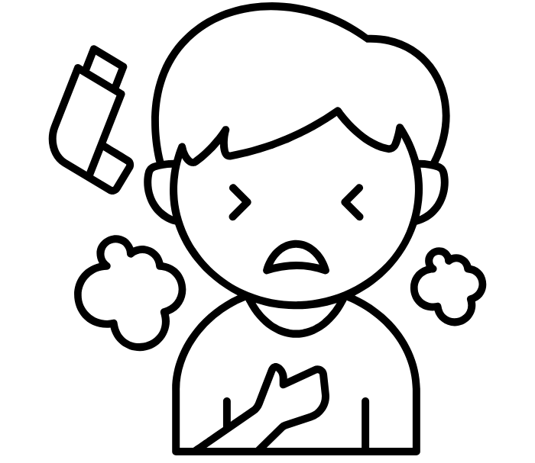
Asthma
Most children with asthma will have a wheeze in addition to the cough or difficulties in breathing
Severity of asthma is graded using just a few signs as for pneumonia
Degree of severity can change after the initial dose of bronchodilators – reassess frequently.
Consider other causes of wheeze for atypical presentation.

Slide 54
Wheeze – how severe is the asthma?
Central cyanosis or oxygen Saturation<90%?
Unable to drink?
Reduced level of consciousness?
Grunting ?
Y
Severe Asthma
Lower chest wall indrawing?
OR Fast breathing?
(RR ≥ 50 aged 2 –11 months
RR ≥ 40 aged 12 – 59months)
Y
Mild/moderate asthma
Notes:
As a result of this research the WHO proposes a classification of pneumonia based on key signs – this is part of the IMCI (and previously the ARI) programme.
Working from the severe end downwards one can check for only a few signs in a child with cough and difficulty breathing and classify into one of four categories that provide a measure of the severity of the child’s disease.
Once the severity is classified it becomes easier to decide who should be in hospital – only those with severe pneumonia.
There is evidence that this classification works to identify those at greatest risk of death and thus most in need of hospital care (see pneumonia severity of disease summary).

Slide 55
Asthma – treat and reassess and decide about antibiotics
Oxygen
Bronchodilator – Nebulise with 2.5 mg salbutamol or 6 puffs via inhaler, spacer and mask. Repeat every 20 minutes for up to 3 doses if needed.
Prednisolone 1-2mg/kg 24 hourly for 3 days
Severe Asthma
Mild / moderate asthma
Bronchodilator - Nebulise with 2.5 mg salbutamol or 2 puffs via inhaler, spacer and mask. Repeat every 20 minutes for up to 3 doses if needed.
Severe Pneumonia
Reassess after 20 mins and reclassify pneumonia severity
Pneumonia
Notes:
When teaching this slide take the participant through the Asthma protocol page 48
So a child with possible asthma can be classified and treatment initiated in OPD rapidly – including the steroids!
What route of salbutamol and how many doses are used will depend on severity of illness (see protocol booklet)
There may be a rapid response to bronchodilators – some children may change classification down to severe or even mild – and the mild ones can then go home after being shown how to use and prescribed INHALED bronchodilator
So antibiotic decisions should be made after this reassessment

Slide 56
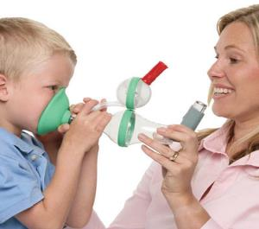
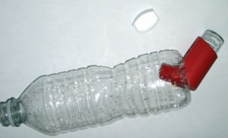
Providing Salbutamol
Inhaler, spacer + mask
Mask should be used in all aged < 3 years
4-5yrs mouthpiece or mask
Severe asthma – 6 puffs every 20min for one hour if needed
Mild/moderate asthma – 2 puffs every 20minutes for one hour if needed
Notes:
If nebuliser does not use oxygen then may need to give if can and certainly need to make sure goes on oxygen as soon as drug finished
Bottle spacer with mask an alternative – note need good seal where MDI enters bottle

Slide 57
Insert video demonstration for MDI use

Slide 58
Summary
A few signs in a child with cough and /or difficulty in breathing and wheeze can be used to assess and classify the severity of asthma
Prompt treatment of severe asthma with a short acting bronchodilator and a steroid is a life saving intervention.

Slide 59
Module 5: Management of an infant/child with respiratory distress iii) Child with TB

Slide 60
Risk factors of Childhood TB
Correctly assess and classify childhood TB
Objectives
Correct management of childhood TB
Complications of TB

Slide 61
Risk factors for TB infection and disease in children
For TB infection
•Contact with source case
  –Closeness of contact
  –Duration of contact
•Source case
  –Smear positivity
  –Cavities on CXR
•Increased exposure
  –Living in high TB endemic communities
  –Children of families living with HIV
For TB disease
•Young age
–Especially 0-2 years
•HIV infection
–Risk of infection and disease
•Other immunosuppression
–Malnutrition
–Post-measles
•Not BCG vaccinated
–Risk of disseminated disease

Slide 62
QUICK SCREENING OF A CHILD FOR POSSIBLE TB
At triage, ask if child has any of the following symptoms suggestive of TB (ACF at every service delivery point):
  Cough
  Hotness of body/Fever
  Weight loss /poor weight gain/ clothes not fitting (check growth chart)
  Lethargy, less playful than usual
If the answer is yes for any of these questions, evaluate the child for TB using the new diagnostic algorithms for TB diagnosis in children
Notes:
Service delivery points- OPD, IPD, MCH, CCC, Nutrition clinic

Slide 63
History taking in a child suspected to have PTB
a- Respiratory symptoms suggestive of TB include
All Children:
Cough > 2 weeks
• Or breathing faster than usual
• Or wheeze not responding to salbutamol
....persisting > 2 weeks.
b - History of contact – ask if there is an individual with known TB or chronic cough who:
If contact with known TB is identified. Currently lives in the same household as child (*80% of children have no household contact with TB) OR
Who has visited the home and spent time in the home in contact with a child in the preceding 12 months (e.g. relative, maid, driver, worker) OR
For school-going children – an individual in the same school classroom or dormitory with TB or chronic cough OR
Pre-school children – if they spend time in a day care centre within the community OR
All children – if they have spent significant time in a hospital/health facility setting in the preceding months (high risk of exposure to patients with TB in a hospital setting)
Notes:
Facilitator to explain the first part of the algorithm

Slide 64
History taking in a child suspected to have PTB
c) Check weight / poor weight gain includes:
• Weight loss OR
• Weight for age Z-score (WAZ) or weight for height z-score (WHZ) below -2. OR
• Poor weight gain:-flattening of the growth curve (chart) or documented crossing of percentile preceding months OR
• Older child (or parent) reports they have noticed that their child) has lost weight /become thinner in recent weeks to months
  Consider DR TB in children who are contacts of a person with confirmed DR TB, or contacts of a person who had respiratory illness and died.

Slide 65
PTB Diagnosis
PTB diagnosis
Where investigations are available, conduct:
Chest X-ray (where accessible) to aid diagnosis
Mantoux test/IGRA may be done where applicable to determine exposure to TB
Sample collection for laboratory investigations (see algorithm)-
NB/ use of Stool sample for under 5 years

Slide 66
PTB Clinical Diagnosis
Where investigations are not available, or likely delay in obtaining results, a clinical diagnosis is used for treatment decisions
Bacteriological confirmation is low due to the paucibacillary nature (low bacillary load) of TB in children (remember the progression of disease slides above)
A clinical diagnosis of PTB may be made by combining;
suggestive presenting symptoms & Signs and Any one of the following;
  Positive contact history in the last 12 months
  Abnormal respiratory exam
  Abnormal CXR
  Positive Mantoux or IGRA
Making a decision on treating children is URGENT!

Slide 67
Tuberculosis treatment regimens for Kenya for children 10 years and below
Note: All children less than 1 year of age will require the 6-month regimen
Criteria | Eligibility for 4-month regimen (Non-severe TB) | Eligibility for 6-month regimen (Severe TB) | Eligibility for 12 months
Age | ≥1 year to 10 years | All infants (<12 months) Above 10 years (11 to <15years)
Type of TB | PTB Uncomplicated TB Lymphadenitis | Extra-Pulmonary TB Complicated TB Lymphadenitis
Clinical Status (At the point of diagnosis) | Stable enough to be managed as an outpatient at the point of diagnosis No danger signs | All hospitalized patients or require admission Severely ill at diagnosis with any danger sign. (Difficulty in breathing with associated central cyanosis, Grunting, Oxygen saturation <90%, ; Increased respiratory rate (age 0-2months >60/min; 2-12months >50/min; 1-5yr >40/min; 6-10yr >30/min) ; unable to drink/breastfeed; Weak or absent pulse; Coma/convulsing/confusion; Not responding to pain or unresponsive) | TB Meningitis & Ostoearticular TB

Slide 68
Tuberculosis treatment regimens for Kenya for children 10 years and below
Note: All children less than 1 year of age will require the 6-month regimen
Criteria | Eligibility for 4-month regimen (Non-severe TB) | Eligibility for 6-month regimen (Severe TB) | Eligibility for 12 months
Immune status | HIV negative, No severe acute malnutrition (SAM) No other immunosuppressive condition | HIV positive, Severe acute malnutrition (SAM) Any immunosuppressed child (Cancer, DM etc)
Bacteriologic status | Clinically diagnosed | Bacteriologically confirmed
 | If ALL the above criteria have been met | If ANY of the above criteria have been met
Treatment regimen | 4 months - 2RHZE / 2RH | 6 months - 2RHZE / 4RH | 12 months- 2RHZE / 10RH
Lymphadenitis must be categorized as either complicated (Severe disease) or non-complicated (Non severe disease). Complicated Lymphadenitis has a leaking sinus / associated abscess or causing nerve / nearby structure compression or TB spread to any other organ.

Slide 69
Tuberculosis treatment regimens for Kenya for children 10 years and below
In children, 1-10 years with non-severe TB, a Shorter 4-month treatment regimen (2RHZ(E)/2RH) (NEW) has been adopted in Kenya, 1st Jan 24

Slide 70
Forms of PTLD
Post TB lung disease may present as the following:
  Lung scarring (fibrosis)
  Bronchiectasis
  Chronic Obstructive Pulmonary Disease (COPD)
  Lung abscess
  Aspergillus-related lung disease
  Spontaneous Pneumothorax

Slide 71

Questions?

Slide 72
Summary
High index of Suspicion
2. Correct classification
3. Correct treatment- including specific and supportive

Slide 73
Module 6:
Fluid Therapy In Dehydration Due To Diarrhoea

Slide 74
1
To understand the classification of dehydration
2
To explain fluid plans
Objectives
3
To highlight additional treatments
4
To demonstrate intraosseous needle insertion and use

Slide 75
Diagnosis and Treatment of hypovolaemic shock
  Hypovolaemic Shock
  All of the four (4) below are present:
  Not alert, AVPU < A
  Weak or absent peripheral pulse
  Cold periphery and temperature gradient
  Capillary refill > 3 secs
  PLUS sunken eyes and skin pinch > 2 secs
Transfuse urgently if Hb <5g/dl
Treat hypoglycaemia if present
Establish IV /IO access.
20mls/kg Ringer’s bolus (<15min)
Reassess ABCD, give max 2 boluses, then
Plan C step 2

Slide 76
Diagnosis and Treatment of severe dehydration
Severe dehydration
AVPU < A plus / unable to drink PLUS Sunken Eyes and Skin pinch ≥ 2 secs
Step 1* | 30 mls / kg RL over 30 mins if age ≥12 months (over 60mins if age <12months)
Step 2 | 70 mls / kg RL over 2.5 hours if age ≥12 months (over 5 hours if age < 12 months)
NGT rehydration-120ml/kg ORS over 6hours can be used instead of steps 1 and 2 Re-assess at least hourly and after 3-6hrs, reclassify as severe, some or no dehydration and treat accordingly
.
Give 5ml/kg/hr of ORS once the child can drink
* Go to step 2 if child has received bolus for shock
Notes:
Severe dehydration is treated in two phases, a rapid ‘rescue’ phase, step 1 and a less rapid replacement phase, step 2.
Young children should have fluids given more slowly.
The ideal fluid to give in Ringer’s as it contains Potassium and body potassium is often depleted in diarrhoea. (The lactate is not a risk although most severely dehydrated children will be acidotic the lactate is metabolised to produce HCO3-).
It is critical that after receiving these fluids children are re-assessed. You CANNOT write a 24 hour fluid plan for a severely dehydrated child and walk off!
When the child is re-assessed they are re-classified as severe, some or no-dehydration and treated appropriately – there is no need to continue iv fluids if the child is drinking.
NOTE giving these high volumes of fluids to a child who is not severely dehydrated may be dangerous……it is very important that people classify severe dehydration correctly.
Give oral fluids as soon as drinking, provides some glucose and more potassium
This is equivalent to correcting 10% dehydration in 3 – 6 hours

Slide 77

Diagnosis and Treatment of some dehydration
Able to drink plus ≥ 2 of:
Sunken Eyes
Skin pinch 1 - 2 secs
Restlessness / Irritability
75 mls / kg of ORS over 4 hours.
Continue breastfeeding as tolerated
After 4 hours reassess and reclassify;
  Severe, Some or no dehydration?
Counselling the mother / caretaker
  What do you tell the mother of an 8kg child?
Notes:
If a child can drink….even if you think they might not drink fast enough then we will classify them as some dehydration
The same signs are used for some dehydration but the skin pinch may return a little faster and they may be restless / irritable although they can drink. If they can drink even if they are a not obviously thirsty they can be resuscitated with oral or nasogastric ORS.
Refer to the BPP and emphasize on Plan A for diarrhoea with no dehydration

Slide 78
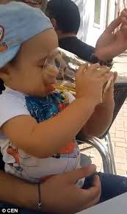
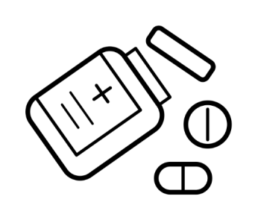
Diagnosis and management of diarrhea without dehydration
ORS 10ml/kg for every loose stool
In a child with diarrhea and NO dehydration give usual foods (appropriate for nutritional status ) and fluids & breastfeeds more frequently
      PLUS
10ml/kg after every loose stool.
Zinc should be given to all children with diarrhoea as it speeds resolution of symptoms:
  10mg od (half tab) for 14 days if age <6 months
  20mg od (one tab) for 14 days if age >=6 months
N/B! Children with diarrhea might develop complications such as acute kidney injury and electrolyte imbalkance . Kidney function testing is vital in these children
Notes:
10ml/kg is the approximate fluid lost in a loose stool. ORS replaces all the electrolytes lost. This should be done the child is hydrated, diarrhea does not stop abruptly, so prevent further dehydration by replacing the on going looses. All children with diarrhea should therefore have Plan A. and all must have Zinc
Plan A should not be prescribed together with Plan B or C- Should be done once rehydration therapy is completed, ie when reassessed and no dehydration.

Slide 79
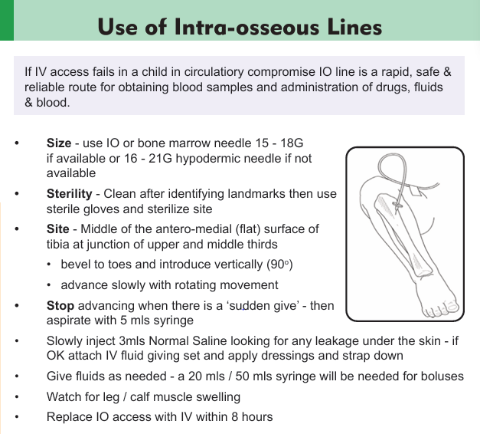

Slide 80

Complications of intraosseous access
Tibial fracture:
Prevented by careful technique and avoided excessive pressure during insertion, either manual or drill associated. Feel for a give.
1
Lower extremity compartment syndrome:
Severe extravasation of drugs can be prevented by ensuring line is patent. Ensure back-flow or can draw blood without resistance
2
Osteomyelitis:
Prevented by not extending usage of intra-osseous line for more than 8 hours, using aseptic technique & sterile dressing.
3
4
Local effects on bone marrow & bone growth:
Prevention: minimal handling of IO line, correct insertion technique, avoid prolonged usage & preventing other complications

Slide 81
Questions?

Slide 82
Summary
A small number of signs are most useful in classifying the severity of dehydration.
IV fluids only used to treat children who cannot drink.
ORS is often more safe and effective even in hospital.
Give Zinc to all
Reassess response to treatment.

Slide 83
Module 7:
Severe Acute Malnutrition 1 – Recognition And Early Treatment
Mortality is often above 45%

Slide 84
Classify acute malnutrition
U
Understand the pathophysiology of acute malnutrition
Objectives
Manage the acute medical problems present in children with severe wasting and nutritional oedema (Severe acute malnutrition)

Slide 85
Classification of Acute Malnutrition
 | MUAC cm (6-59 months) | WHZ
None | >13.5 | >-1
At Risk | 12.5 to 13.4 | ≥-2 to < -1
Moderate | ≥11.5 to <12.5 | ≥-3 to <-2
Severe | <11.5 | <-3
 | Kwashiorkor(oedema of both feet)
N/B! Screen for HIV / TB for all children with malnutrition
Notes:
MUAC is a single linear measurement that does not require arithmetic, table look-up or plotting data on growth charts. The colour coded MUAC tapes are simple to use and allow instant classification of nutritional status.
Neither MUAC nor WHZ is the ideal predictors of mortality; however MUAC appears to show consistently better predictive power.
MUAC is the best anthropometric predictor of mortality currently available.
Use of both WFH and MUAC together does not appear to increase the predictive power over MUAC alone.
MUAC is a better predicator of death than any of the other measurement –H/A, W/A, W/H Score.
MUAC appears to show consistently better predictive power.
Correcting MUAC for age or weight is not superior to MUAC alone in predicting mortality.
Combining MUAC with other anthropometric measurement does not increase the predictive power
MUAC-based and WHZ-based malnutrition diagnosis correlates poorly. Diagnosis made consistently in 40% of the SAM
However, MUAC-based and WHZ-based malnutrition diagnosis correlates poorly, a puzzling observation for two indicators of severe wasting. It was reported that only about 40% of children identified as SAM by one indicator is also diagnosed as such by the other (2).

Slide 86

Indications for hospital admission
Acute Medical complications
  Shock
  SPO2 <90%
  Pneumonia with LCWI or fast breathing
  Dehydration
  Severe persistent diarrhea
  Severe anaemia
  Severe complicatred measles
  Open or infected skin lesions associated with nutritional oedema
  Very severe febrile illness (malaria, meningitis)
  Mastoiditis
  Hypothermia/ high fever
2. IMCI danger signs
  Convulsions
  Unconciousness
  Inability to feed/drink
  Vomits everything
3. Failed appetite test

Slide 87
Reductive adaptation in severe acute malnutrition (SAM)
Body systems slow down in order to survive with limited calories (reductive adaptation)
SAM causes physiology and metabolic changes in every cell, organ and system requiring the child to be treated differently
During treatment the systems must be awakened slowly to ‘learn’ to function again

Slide 88
 | Effect of reductive adaptation | Action in mnx
Infections. | Body has limited energy to mount local and systemic inflammatory responses eg fever, inflammation | Presume and treat infection in all
Iron | Make less Hb than usual. Unused iron stored. Giving iron early leads to ‘free iron’- formation of free radicals & promotes bacterial growth | No supplemental iron during the initial period of treatment. (1st 7 days)
Sodium & potassium | Na/K pump slows down in SAM. Sodium level in cells rises while potassium leaks out and lost in the urine. Results in high total body sodium & low potassium | Diarrhea – use fluid with Na↓ & K ↑
 |  | Give foods with Low Na & supplement K
Notes:
1. In SAM because of wasting, body requires less haemoglobin than usual
2. Na/K pump uses 30% of basal metabolic energy. The pump maintains sodium in the extracellular space and potassium intracellular. In SAM pump slow down so sodium leaks into the intracellular fluid. So serum sodium low but total body sodium high. Similarly potassium leaks into the ECF and lost in the urine and diarrhea. The total body potassium is very low and may not be reflected by serum potassium, it is in the wrong place!

Slide 89
Reduction in function capacity of organs
 | Effect of reductive adaptation | Action at the beginning of the treatment
Liver | Less able to make glucose Less able to excrete dietary proteins and toxin | Avoid Intravenous fluids Calories (100Kcal/kg/day) and proteins (1gm/kg/day) just to meet basic need, sufficient to halt catabolic process and to avoid stress to vital organs and system Increase calorie & protein intake once metabolic machinery & physiology improves.
Kidney | Less able to excrete excess fluid and sodium
Heart | Smaller and weaker and has reduced output
Gut | Less acid, small amount of enzymes, villi flattened and motility reduce
Reduction in functions of major organs - little margin for error.

Slide 90
Things not to do and why in children with SAM
Things NOT to do | Why
Do NOT give diuretics in children to treat oedema | The oedema is partly due to sodium overloading and will resolve with proper feeding. Giving a diuretic will worsen the child’s electrolyte imbalance and cause death
Do NOT give iron during the stabilization phase | Giving iron early in treatment may worsen the toxic effects and worsen the infection
Do NOT give high protein formula/ diet | Too much protein could overload the liver, heart and kidneys and may cause death.
Do NOT give IV fluids routinely | IV fluids can cause fluid overload and heart failure. Only give IV fluids in children with hypovolaemic shock

Slide 91
General principles of care for a child with SAM
The management of medical complications are accomplished in 2 phases:
  An initial stabilization phase (phase 1)
  A longer transition and rehabilitation phase (phase 2)
Phase 1 focusses on treating complications and initiating nutritional rehabilitation
During transition, intensive feeding is given to recover most of the lost weight, emotional and physical stimulation is increased.
Rehabilitation is characterized by rapid weight gain (catch up growth ) and preparation for discharge

Slide 92
10 Step Approach (Refer to BPP page 43)
Prevent and treat Hypoglycaemia
Prevent and treat Hypothermia
Initial monitoring should be done using the critical care pathway chart
Prevent and treat Dehydration
Correct Electrolyte imbalance
Presumptive treatment of Infection
Correct Micronutrient deficiencies
Initiate cautious feeding
Monitor Catch-up growth
Sensory stimulation
Discharge preparation and follow up
Phase 1 stabilization
Phase 2 – transition and rehabilitation
Notes:
The treatment approach that has been outlined within the lectures is summarise in the 10 step approach.
Red bars are the areas that need considering in the acute or rescue phase of admission, grey bars become relevant as the recovery phase is entered.
Throughout monitoring is essential – although can be scaled down as the child improves.

Slide 93
Management of dehydration and shock in SAM
Misdiagnosis and inappropriate treatment of dehydration is the most common cause of death in malnourished children.
The preferred solution for treatment of dehydration Is ReSoMal. However, if ReSoMal is not available, low osmolarity ORS can be used.
During rehydration, the child with SAM needs to be monitored for:
  Clinical signs of improvement such as alertness
  Clinical signs of overhydration (engorged veins, rapid pulse and resp distress)
In children with SAM, IV fluids should not be used unless a diagnosis of hypovolaemic shock is made.

Slide 94
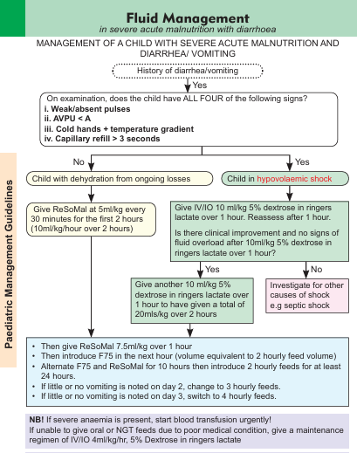
Monitor vital signs.
If increases in pulse Rate by 25 and respiratory rates by 5 are both confirmed, they are a danger sign.
Together, these increases suggest an infection, or heart failure from overhydration due to feeding or rehydrating too fast.
Stop feeds and rehydration solution for malnutrition (ReSoMal), and slow fluids.
Call the Clinician for immediate review or refer.

Slide 95
Prescription of ReSoMal of 5kg child, no oedema
Time | ReSoMal | F75
On admission (9am) | 50ml
10am | 50ml
11am | 37ml
12MD |  | 54ml
1pm | 37ml
2pm |  | 54ml
3pm | 37ml
4pm |  | 54ml
5pm | 37ml
6pm |  | 54ml
7pm | 37ml
8pm |  | 54ml
The at 10pm F75 54mls every 2hrly. Give 50mls ReSoMal for every loose stool
Supplemental Zinc not required – ReSOMal & F75/100 contains Zinc
Notes:
Let the participants confirm its so form the BPP booklets.
Preferably move from the slides and calculate with the participants on a flip chart at the front to break monotony of the long lecture

Slide 96
Questions?

Slide 97
Summary.
The risk of death in children with severe malnutrition is very high.
Children with SAM undergo reductive adaptation that affect every cell, organ and system.
The children have many acute medical problems and each needs treating.
The 10 steps approach allows each problem to be treated

Slide 98
Module 7:
Severe Acute Malnutrition 2 - Nutritional Treatment.

Slide 99
1
Rationale for phased nutritional therapy in children with SAM
2
Consider the priorities and aims of immediate nutritional management.
Objectives
3
Non-nutritional management is considered elsewhere.

Slide 100
Rationale for phased nutritional therapy in children with SAM
Feeding must be started cautiously; in frequent, small amounts.
If feeding is started too aggressively or if feeds contain too much protein or sodium, the child’s systems may be overwhelmed and the child may die.
To prevent death, feeding should begin as soon as possible with F75 (Starter formula) until the child is stabilized.
  F75 is low in protein and sodium and high in carbohydrate.
When the child is stabilized, the catch up formula F100 is used to rebuild the tissues.
  F100 contains more calories and protein.

Slide 101
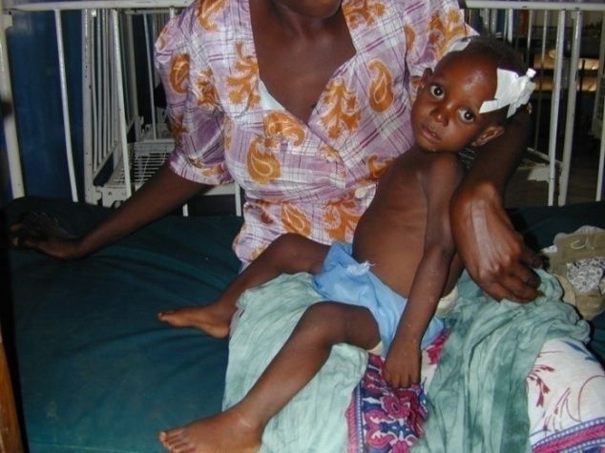
Cautious feeding (stabilization phase)
Feed the child a small amount of F75 every 2 hours on day 1 (including night feeds)
Severe acute malnutrition with no or moderate oedema
  130 ml/kg/day start-up feed
Severe acute malnutrition with severe oedema (of the face):
  100 mls/kg/day start-up feed
Vomiting is NOT a contraindication to feeding.
  If vomiting, profuse diarrhea or poor appetite, continue 2 hourly feeds
  If little or no vomiting/ diarrhea and finishing most feeds, switch to 3 hourly feeds
Feeds are the ‘drug’ to cure malnutrition, they are a priority (after correction of dehydration if required).
Notes:
As well as what to feed there are practical challenges of how to feed. The critical point is that the disease is malnutrition and the ‘cure’ is nutrition…therefore providing some feed is urgent!
For physical reasons as well as physiological small frequent feeds are desirable. Ideally these should be 2 hourly early on, if this cannot be managed they should be no more than 3 hourly.
Just because a child is vomiting does not mean they cannot be fed (or have an ngt) – only if they are vomiting everything, need immediate correction of dehydration or have a surgical abdomen should feeds be withheld.
It is often difficult with limited staff and mothers who are often emotionally and physically drained as well to feed a lethargic, anorexic child. Many places find it easier to put an ngt in all children and only take it out if it is clear the child can feed rather than waste 12-24 hours trying oral feeding and failing.

Slide 102
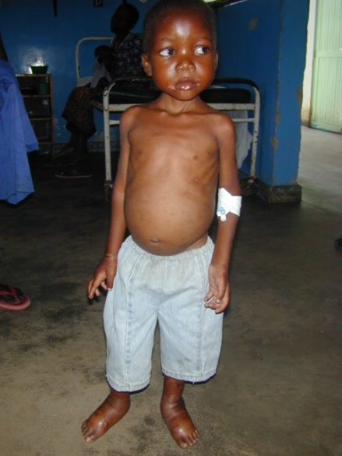
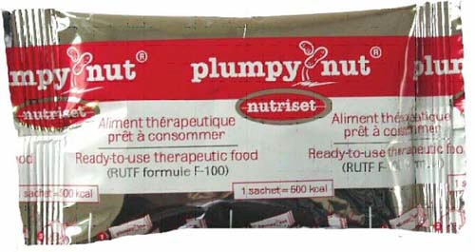
When to change from F75 ? (Transition phase)
Return of appetite after starting on F75:
  Usually between 2 – 7 days
  Transition to F100 or RUTF if available
Oedema:
  You do not have to wait for resolution of oedema before changing if the child has a good appetite.
F75 feeding is usually NOT associated with weight gain
Weight loss may even occur in children whose oedema is improving
Notes:
Appetite is the most important criterion in choosing feeds. If the appetite is clearly very good then use F100 from admission – but ask yourself if this child needs to be in hospital – rehabilitation at home is probably safer!
When to change from ‘rescue feeding’ with a formula such as F75 is not a precise science and standard rules for numbers of days are not very helpful. The most useful indication that a child is ready for an increase in calorie and protein content of feeds is the recovery of their appetite. Thus, in general it is likely that:
In marasmus and in a child who was not critically ill at admission that the transition to recovery feeding can be made after 2-3 days.
In those who were severely ill this transition may take somewhat longer, up to 7 days
In the case of oedema it is not necessary for complete resolution of oedema before making the transition if the child has a good appetite.
At the stage of transition the child should be able to feed with a cup and soon or themselves with a cup.
A sachet of The RUFT- plumpy nut weighs 92 gm and has 500Kcal. Appr 20gm provide 100kcal.

Slide 103
Rehabilitation
The objective is to achieve catch up growth and resolve micronutrient deficiencies.
After transition, the child can feed freely on F100
Increase each feed by 10mls per feed as long as the child is finishing the feeds, to a maximum of 220mls/kg/day.
Once the child is completing all the milk provided, gradually replace some milk with RUTF.
Discharge the child on RUTF to the Outpatient
Note! RUTF already contains adequate iron
Notes:
Slowly solid food can be introduced, increasing to 5 meals a day. Make sure the mother is aware what kinds of foods the child should be taking. Pure maize porridge is inadequate.
Let the child feed in between meals.
Continue breast feeding throughout and mineral supplements for at least the first 2 weeks.
1 week after admission, if the child is now feeding well iron and mebendazole can be introduced. Iron is not introduced before as it has a tendency to encourage bacterial growth which may predispose the child to infection in their weakened early state.
Monitoring progress is critical (to follow)
The child should by now be much more lively and interactive (ie normal!). This should be encouraged ideally by providing toys and an environment in which the child can play. This is an important part of recovery that is frequently ignored in hospitals and particularly by doctors who are more interested in the prescription chart.
As the child is showing signs of recovery it is also very important to being to educate the mother about nutritional care of children and begin the process of preparation for discharge.

Slide 104
A feeding plan
Appetite recovers
Good appetite, clinically stable
Admission
F100 increasing by 10mls per feed to a max of 220mls/kg/day then transition to RUTF 150 -185kcal /kg/day
F100 or RUTF
F75
5kg child
(5X130ml)8
54ml F75, 2hrly
80ml of F100
3hrly
For 2-3days
Increase each 3hrly F100 feed by 10ml; ie 90, 100, 110mls
130 or 100 mls/kg/day as 2 hourly feeds, for 2 -7 days
RUTF 150 -185kcal /kg/day
F100 at same volume as F75
Discharge home on RUTF 150 -185kcal /kg/day
Notes:
If the a child remains clinically stable with a good appetite after 2-3 days of F100 at starting volumes then the total volume of feed can be increased.
This increase can be achieved by:
On about the 3rd day increase each feed by 10mls (so if fed 3 hourly (8 feeds/day) the feed volume could go up by a maximum of 80mls over 24 hours)
Check if the child finishes all the feed – they should no longer be tube fed. If the child fails to complete a feed then the volume stopped at is the volume to offer each time the child is fed.
If the child starts to finish these new volume feeds then offer more.
The process of offering more can be repeated as the child now regulates their own intake, usually a maximum of 200ml/kg.
Thus during the initial re-feeding aim at giving 100kcal/kg/day and protein 1-1.5g/kg/day. After the transition period aim at giving 150-220kcal/kg/day and protein 4-6g/kg/day.

Slide 105
Monitoring 1
Fever / Hypothermia
Glucose
Respiration
Heart Rate
Weight
Oedema
Fever / Hypothermia
Respiration
Heart Rate
Weight
Oedema
Vital signs
Weight
Rescue
Transition
Rehabilitation
Notes:
As the child moves through to the phase of rehabilitation (after maximum feeds are established) then they should be ‘de-medicalised’. They mainly require feeding and workload can be reduced by reducing the number of observations unless they still have another illness (ie pneumonia or presumed TB).
The same anthropometric indicator that is used to confirm severe acute malnutrition should also be used to assess if a child has reached nutritional recovery (NB there is a difference between criteria for ward discharge and discharge form the nutritional programme!!!!).
Infants aged <6 months should be discharged (nutritional recovery reached) when their WHZ is at least ≥ -2 and they have had no oedema for 2 weeks
Children aged 6-59mo months should be discharged (nutritional recovery reached) their MUAC is ≥ 125mm and they have had no oedema for 2 weeks.

Slide 106
Monitoring 2
Feed intake must be monitored throughout.
  Check feeding charts daily!
If there is concern for fluid overload, reduce feed amount / volumes for 24 hours.
Weight gain in recovery/rehabilitation phases:
  Poor, <5g/kg/day, full re-assessment
  Moderate, 5 – 10g/kg/day, check intake adequate, is there untreated infection
  Good, >10g/kg/day
Notes:
To provide effective care of severe malnutrition both doctors and nurses must appreciate the need to:
1) Monitor feed intake accurately
2) Make sure the child is not being overloaded
3) Appreciate the value of weight gain and know what is to be expected. Failure to make good weight gain needs investigating not ignoring!
a) Is it inadequate intake?
b) Is it a new or missed infection?
c) Is it a specific nutrient deficiency?

Slide 107
When to discharge to outpatient therapeutic care
No danger signs for atleast 24-48 hours
Medical complications have resolved
Good appetite and gaining weight
Oedema has reduced to grade 1 and is resolving
Appropriate support in the community or home
Mother / carer:
  Available
  Understands child’s needs
  Able to supply needs
Notes:
When to discharge a patient will depend on the facilities available as well as other factors.
If there is a convalescent area or feeding centre then a child can be discharged from hospital as soon as medical treatments are completed.
Other factors to consider are whether the home environment can support continued care – in particular the mother or carer must understand the child’s needs and be able to provide for them
In hospital the malnourished child is vulnerable to contracting a new disease – so the decision to discharge is a balance between the risk of remaining and the risk of leaving.

Slide 108
Questions?

Slide 109
Summary
The stabilization phase of nutritional support requires gentle introduction of calories and small amounts of protein.
Pre-manufactured F75, F100 and RUTF are used because they contain adequate potassium, vitamins and ideally other minerals.
Recovery feeding starts as the appetite returns and is gradually scaled up.
Notes:
Emphasise these summary points and close.

Slide 110
Module 8:
Altered consciousness and convulsions

Slide 111
OBJECTIVES
Assessment of a child with altered consciousness
Assessing for and managing convulsions
Differential diagnoses of convulsions
Assessment and management of hypoglycemia

Slide 112
ASSESSING ALTERED CONSCIOUSNESS (AVPU)
Severity and duration of symptoms
Convulsions (duration, type & frequency)
Ability to feed?
A | Alert | Eye contact
V | Responds to Voice | Carer’s call - name
P | Responds to Pain | Over sternum - Localises
U | Unconscious | Inappropriate response to pain

Slide 113
Assessing altered consciousness (Blantyre coma scale)
Motor response | Verbal response | Eye response
☐ Localises pain =2 | ☐ Normal response =2 | ☐ Following objects =1
☐ Withdraws to pain =1 | ☐ Inappropriate =1 | ☐ Not following =0
☐ No response =0 | ☐ No response =0
Blantyre Coma Score = ________________________

Slide 114
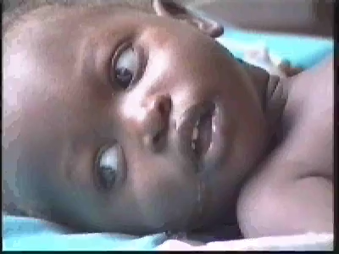
Presentation of seizures
Convulsions can present overtly as generalized tonic clonic seizures.
However, it must be noted that they can present as subtle seizures

Slide 115
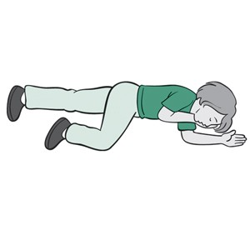
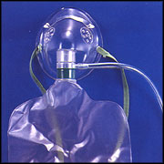
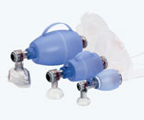
Assessment and Management of seizures
A
Airway
  Left lateral positioning
  Suction if indicated
  Support after seizure
Breathing
  Start Oxygen via NRM
Circulation
  Temperature gradient?
  Severe Pallor?
Disability
  Check Rbs, give glucose?
  What drugs have been used?
Need for anticonvulsants?
  Recovery position
  (Left lateral positioning)
B
Notes:
Most attention in a convulsion is focused on the drugs.
Equally important is the supportive care offered.
Children with convulsions are often not breathing adequately and it is possible that the reduced oxygen supply in long seizures is as damaging as the electrical aspects of the seizure in the brain.
Therefore for every seizure attention must be paid to the A,B & C.
During the seizure it is hard to open the airway – and this should not be forced – but oxygen can be given.
After the seizure (and treatment) the loss of muscle tone may mean that the airway is blocked by the tongue so the airway needs to be taken care of. Occasionally a child will become apnoeic after a seizure and its treatment and need bag and mask ventilation for a few minutes.
These measures are important! How often have you seen a child given a dose of diazepam slumped in a bed while everyone walks off because the (exciting) seizure has stopped.

Slide 116
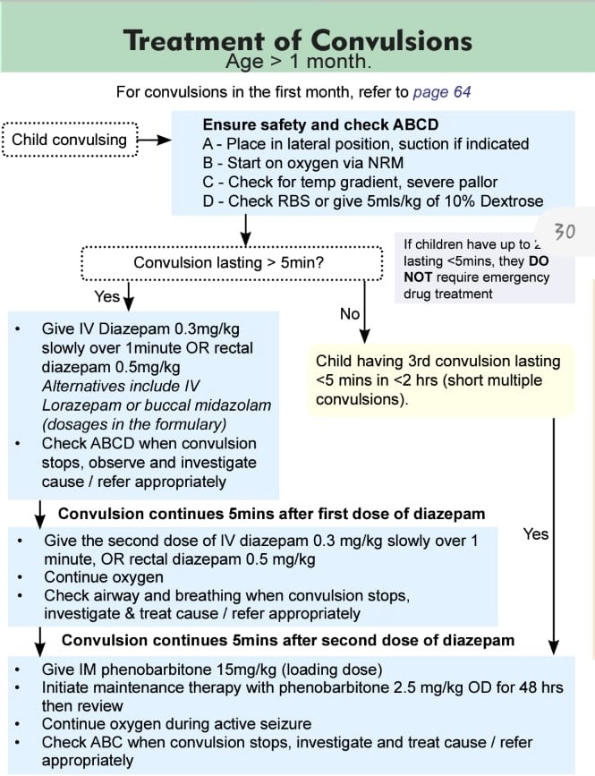
(BPP page 31)
DO NOT give more than 2 doses of diazepam in 24hours once phenobarbitone is given
DO NOT give a phenobarbitone loading dose to an epileptic on maintenance phenobarbitone
Phenytoin, levetiracetam and IV sodium valproate are alternatives to phenobarbitone

Slide 117
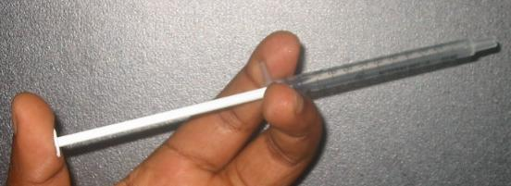
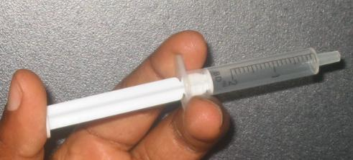
Giving rectal diazepam
4 – 5 cm inside the anal margin All of the barrel of a 2mls syringe and nearly all of a 1ml syringe
Notes:
Whatever method is used the drug must be placed at least 4 cm internally from the anal margin – this is all of the barrel of the syringe essentially.
If it is not placed this far in the drug will be lying on the cornified epithelium of the anus – this will be like drug trying to get drug absorbed across the palm of your hand! It is only in the rectum that the blood vessels are accessible across the relatively permeable mucosa.

Slide 118
Differential diagnosis of convulsions
Hypoglycemia
Meningitis
Severe malaria
Electrolyte imbalance
Febrile convulsions
Convulsive disorders

Slide 119

HYPOGLYCAEMIA
BG less than 2.5 mmol/l (~45mg/dl)
There are no reliable signs of hypoglycaemia
Blood glucose should be measured in all severely ill newborns and children
If rapid measurement is not possible it is appropriate to treat with a dextrose bolus if :
  Altered consciousness AVPU < A
  Inability to drink / breastfeed
BG less than 3.0 mmol/l (~54mg/dl), in children with severe acute malnutrition.
Notes:
In published research definitions of hypoglycaemia vary, accounting for some of the variation in reported frequency. American texts tend to refer to 2.5mmol/l
There is considerable physiological evidence that in the first few hours of life in a well, term baby, a blood glucose < 2.2mmol/l is of little significance as the newborn is adapted to use alternative fuels.
If the baby is sick, pre-term or small for gestational age the situation is different and hypoglycaemia may not be benign.
Bedside glucose test-strips can be unreliable for measuring low blood glucose – they tend to overestimate the commonness of hypoglycaemia.

Slide 120
If the blood glucose result is rapidly available in a sick child
Infants and children | if glucose <2.5mmol/L | Treat with iv 10% dextrose 5mls/kg if unable to drink
Severe Acute Malnutrition | if glucose <3.0mmol/L | Treat with iv 10% dextrose 5ml/kg if AVPU = P or U Treat with immediate feed if AVPU = V or A
Giving 50% glucose is NO LONGER recommended

Slide 121
SUMMARY
Remember hypoglycaemia in all convulsions.
Diazepam and phenobarbitone when used appropriately are safe and usually effective.
Use 10% glucose/dextrose for treatment of hypoglycemia

Slide 122
Module 8: meningitis and malaria

Slide 123
OBJECTIVES
Identify clinical signs and symptoms of meningitis and malaria
Indications for lumbar puncture
Diagnosis and management of meningitis and malaria

Slide 124
Cerebral Malaria vs Acute Bacterial Meningitis/Encephalitis
Cerebral Malaria
Acute Bacterial Meningitis or Encephalitis
Stiff neck
Bulging Fontanelle
Arching of the back
Convulsions
Pallor
Confusion
Clinically you cannot make a certain diagnosis – Lumbar puncture and malaria test are critical
Notes:
Although some of these signs tend to make people think of either cerebral malaria or meningitis NONE are only found in one of the conditions and so none are specific.
The key to diagnosis is often a good HISTORY... Particularly for CHRONIC illness

Slide 125
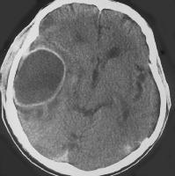
Indications for lumbar puncture
At a minimum, if you want to avoid missing meningitis (and deaths and handicap from it), and avoid wasting antibiotics, at least LP those with history of fever and one of:
  Bulging fontanelle
  Stiff neck
  Fits if age <6 months or > 6 yrs
  Partial or focal fits
  Reduced consciousness
CT scan Brain abscess
Notes:
1) If we want to avoid missing meningitis and the deaths and disability that it causes (the CT scan is a cerebral abscess in a child who did not have their meningitis recognised or treated properly) then should do an LP in children with ANY ONE of the signs listed on the slide.

Slide 126
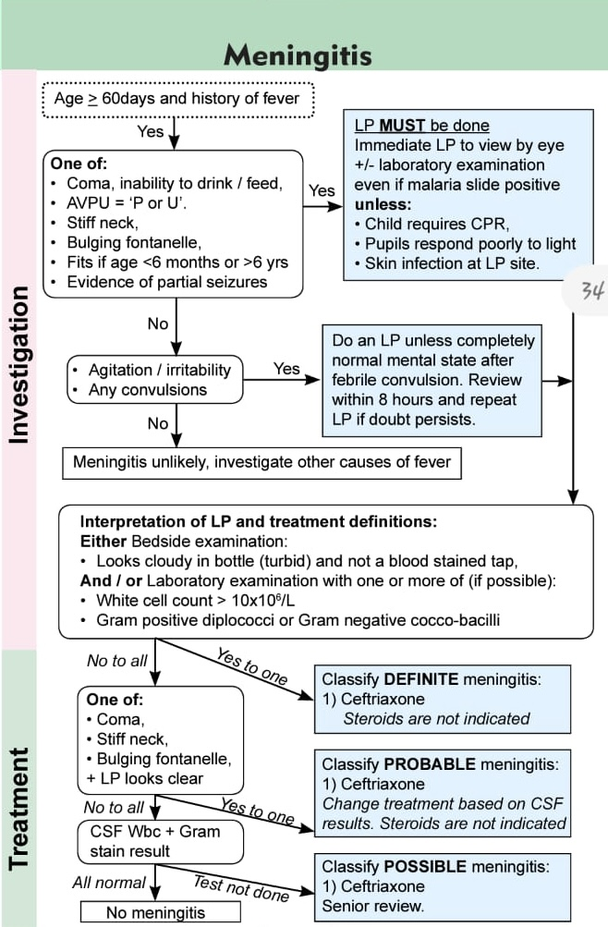
MANAGEMENT OF MENINGITIS
To avoid overuse of Ceftriaxone an LP must be done to confirm diagnosis of meningitis
Ceftriaxone Dose: 100mg/kg in 2 divided doses
Reference the Basic Paediatric Protocol 2022

Slide 127
SEVERE MALARIA
Cerebral malaria
  Strictly Coma = AVPU < P (AVPU = U)
  In practice if AVPU < A or unable to drink
Severe Malaria with Respiratory Distress
  Deep, acidotic breathing & usually indrawing
  Typically associated with anaemia / severe anaemia.
Severe Anaemia
  Hb < 5g/dl (<50g/L) or PCV / Haematocrit < 15%
  As many as 40-50% of children with severe anaemia will NOT have respiratory distress
Plus positive diagnostic test (repeat up to 3 times if good quality slide test is negative)

Slide 128
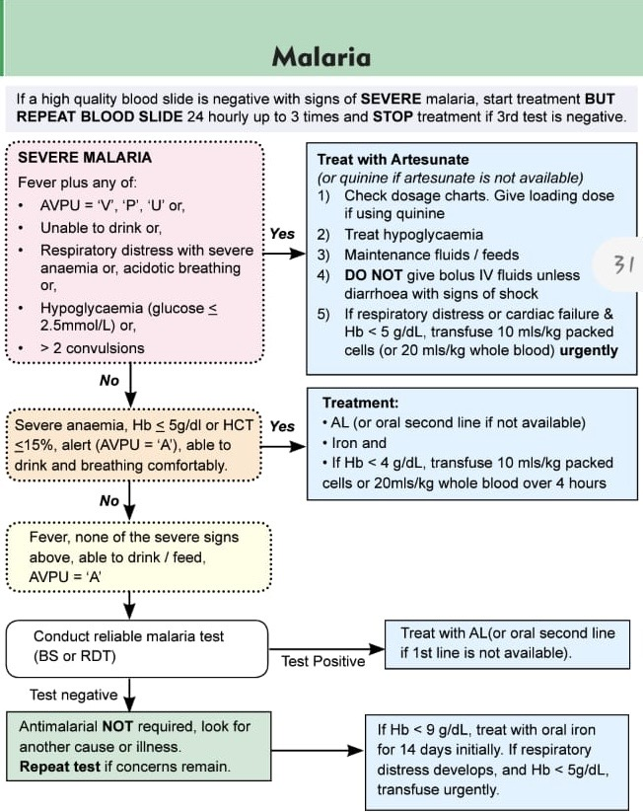
Children < 20 kg give artesunate 3mg/kg/dose
Children> 20kg and adults give artesunate 2.4 mg/kg/dose
Prevent hypoglycemia by feeding and fluids

Slide 129
SUMMARY
LP should be done in all cases of suspected meningitis for cell count and microscopy results to guide treatment
Ceftriaxone is the treatment of choice in Kenya for proven meningitis
Diagnostic test for malaria should be done in all suspected cases before starting treatment.
Artesunate is the treatment of choice in severe malaria

Slide 130
Module 9: Introduction to diabetes

Slide 131
Learning objectives
Definition of Diabetes
Aetiology/Risk factors of T1DM
Epidemiology and risk factors of type 1 diabetes
Clinical presentation and diagnostic criteria of type 1 DM

Slide 132
DEFINITION OF DIABETES
Diabetes is a complex metabolic disorder characterized by elevated blood glucose level as a result of either resistance to the action of insulin, insufficient insulin secretion, or both.

Slide 133
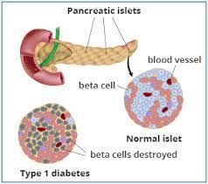
Type I Diabetes Mellitus
Describes a complex metabolic disorder characterized by persistent hyperglycemia resulting from impaired secretion of insulin from the beta cells of the pancreas
This is as a result of chronic immune-mediated destruction of pancreatic β-cells, leading to partial, or in most cases, absolute insulin deficiency.

Slide 134
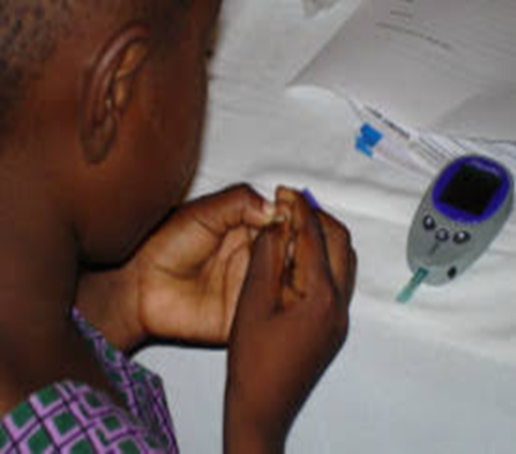
Epidemiology of type 1 DM
Worldwide, approximately 96,000 children under 15 years are estimated to develop T1DM annually.
Between 2011 - 2021, the Sub Sahara Africa recorded a five-fold rise.
Majority present between 6 months -18 years old, however it can present in adults
Peak age: 3-6 years & mid-teens

Slide 135
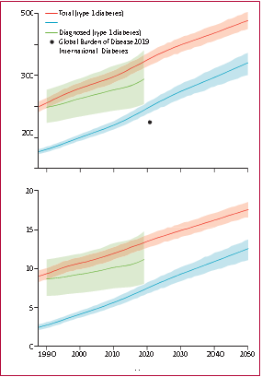
Projected global incidence of type 1 diabetes
The projected global incidence of type 1 diabetes (total and diagnosed) in children and adolescents aged 0–19 years.
The shaded areas indicate 95% uncertainty intervals.
Lancet Diabetes Endocrinol 2022; 10: 848–58 Published Online November 10, 2022 https://doi.org/10.1016/ S2213-8587(22)00276

Slide 136
Risk factors for T1DM
Genetic susceptibility: HLA and non-HLA genotypes
Environmental trigger/insult e.g., infections like enterovirus, rubella
Autoimmune response: T Helper 1 cells
Islet infiltration and cytokine release
Beta cell destruction
Partial or absolute deficiency of insulin
Risk factors of type 1 Diabetes
Type 1 Diabetes

Slide 137
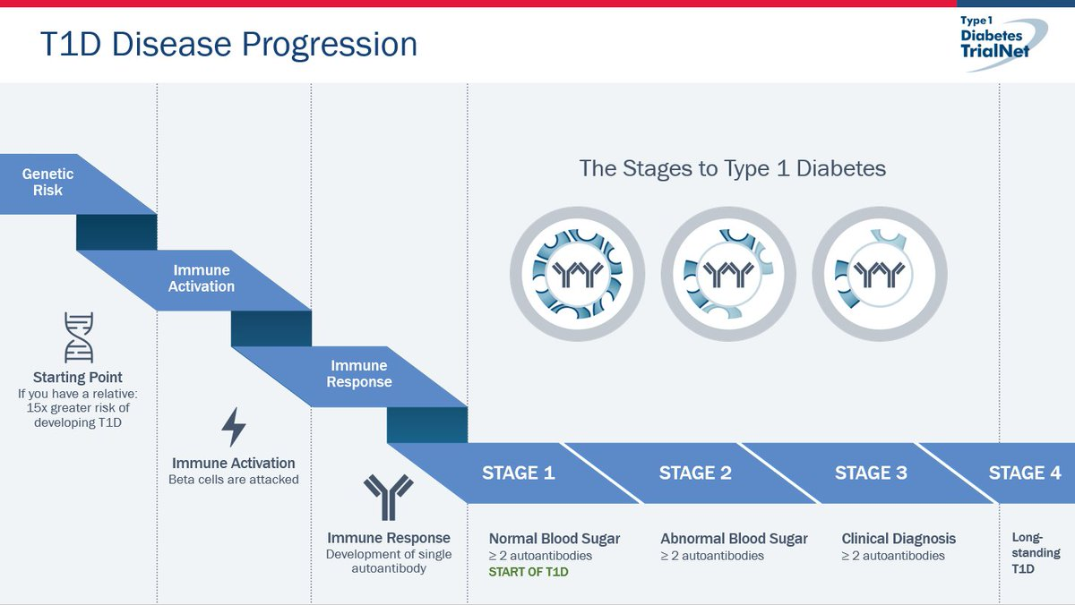
STAGES OF T1DM
Diabetes associated autoantibodies (GAD 65, IA2, IAA and ZnT8), are serological markers of β-cell autoimmunity.

Slide 138



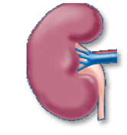
Pathophysiology: The key analogy
Increased urine
Dehydration
Thirst
Borrowed from CDiC slide

Slide 139
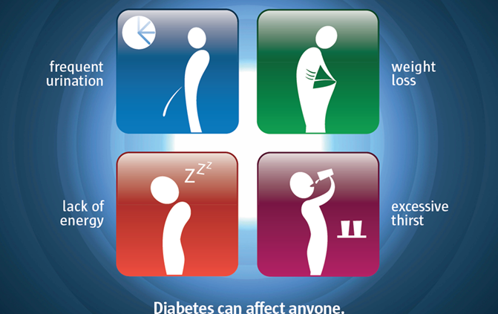
Signs and symptoms of Type 1 diabetes
Symptoms | Signs (DKA)
1. Polyuria | 1. Dehydration
2. Polydipsia | 2. Deep acidotic breathing
3. Weight loss | 3. Reduced consciousness level
4. Fatigue | 4. Acetone (fruity) smell
5. Recurrent infections (otitis media, pyogenic skin infections, monilial vaginitis, candida diaper rash) | 5. Shock
6. Secondary enuresis | 6. Coma
7. Nocturia
8. DKA symptoms (vomiting, abdominal pain)
9. Polyphagia (rare in type 1 diabetes)
N/B: Beware diabetes may present like pneumonia, acute abdomen, gastroenteritis, malaria, meningitis and malnutrition.
Every sick child should have a random blood sugar done because diabetes mimics common childhood illnesses

Slide 140
Diagnostic criteria
Classic symptoms of diabetes or hyperglycemic crisis with plasma glucose concentration ≥ 11.1 mmol/L.
Fasting plasma glucose ≥7.0 mmol/L.
Fasting is defined as no caloric intake for at least 8 hours
3. Two-hour post load glucose ≥11.1 mmol/L during an oral glucose tolerance test (OGTT): Only conduct an OGTT when Random blood glucose is between 7.8-11.1 mmol/L.
4. HbA1c ≥6.5%.
(It is glycosylated part of haemoglobin and represent sugar load over the last 3 month.)
Notes:
The OGTT should be performed using a glucose load containing the equivalent of 75 grams of anhydrous glucose dissolved in water or 1.75 grams/kg of body weight to a maximum of 75 grams

Slide 141
DIAGNOSIS OF DIABETES cont
Islet antibodies testing can be very helpful as obesity affects a greater proportion of youth, it is possible to develop Type 1 diabetes and be obese causing confusion with Type 2 diabetes.
In such circumstances, any type of islet autoantibody positivity (ZnT8, GADA, IA-2A, IAA) establishes the diagnosis of Type 1 diabetes.

Slide 142
Summary
Prevalence of type 1 diabetes is increasing globally
Missed diagnosis is common
There are many childhood illnesses that mimic signs and symptoms of type 1 diabetes
Every sick child presenting to the hospital should be screened for type 1 diabetes (Do Random Blood Sugar)

Slide 143
Module 9: Diabetic Ketoacidosis (DKA)

Slide 144
Objectives
By the end of this module, you should be able to:
Define DKA
Outline the criteria for diagnosing DKA
Identify the clinical presentation of DKA
Classify DKA
Discuss the management of DKA
Transition to subcutaneous insulin after DKA resolved

Slide 145
Definition of DKA
Is a major life threatening complication of type 1 diabetes characterized by:
Diabetes: Random blood sugar >11mmol/l (~200 mg/dl)
Ketosis (blood ß-hydroxybuyrate ≥3 mmol/L) or moderate or large ketonuria(2+).
Acidosis: Venous pH <7.3 or bicarbonate <18 mmol/l
Notes:
“euglycemic ketoacidosis”

Slide 146
Risk factors for DKA
IN NEWLY DIAGNOSED DIABETICS
IN KNOWN DIABETICS
Younger patients <2 yrs
Delayed diagnosis
Lower Socioeconomic status
Countries with low prevalence of type 1 DM
Insulin omission
Poor control of sugars
Previous DKA episodes
Acute GE with persistent vomiting and inability to maintain hydration
Peripubertal and adolescent girls/ eating disorders
Limited access to health services
Insulin pump failures
Binge alcohol consumption

Slide 147
Diagnosis: Clinical/ laboratory
Clinical Signs and Symptoms
Laboratory
Polydipsia, polyuria, weight loss, vomiting
Dehydration
Fruity” smell to breath (acetone)
Kussmaul respirations( deep sighing breathing pattern)
Abdominal pain (can mimic surgical abdomen)
Signs of infection
RBS >11mmol/l (~200 mg/dl)
Blood ketones- ß-hydroxybuyrate ≥3 mmol/L)
Urinalysis- moderate or large ketonuria(2+).
BGA-Venous pH <7.3 or bicarbonate <18 mmol/l
Other tests; UECS, Septic screen
Kussmaul breathing Video link
https://youtu.be/TG0vpKae3Js

Slide 148
Classification of DKA
Severity Grading | Venous pH | Bicarbonate level (mmol/L)
Mild | 7.2 - <7.3 | 10 - <18
Moderate | 7.1 - <7.2 | 5 - <10
Severe | <7.1 | <5

Slide 149
Principles of DKA Management
Date
Slide no 149
Restoration of volume status: Correction of Shock and dehydration
Correction of hyperglycemia and Ketoacidosis ( insulin Therapy)
Correction of electrolyte imbalances
Management of precipitating factors
Note that the patient should be Nil per mouth until DKA resolves
Notes:
149

Slide 150
Where Should a patient with DKA be Managed?
Children in DKA should be managed in an Intensive Care Unit(ICU) or High dependency Unit (HDU)
If no ICU or HDU, manage in the Acute room/ emergency room of the ward
Need:
  Clinical team well trained in management of DKA.
  laboratory support
  Written DKA guidelines
Notes:
At list they need to have a video call with experts. These patients need very close monitoring.

Slide 151
Initial Assessment
• Weigh the child.
• Measure blood glucose (both blood glucose meter and laboratory measurement if possible).
Measure ketones by urine dipstick (and blood ketone measurement if possible).
BGA- Venous pH and bicarbonate
HbA1c,
Urea, electrolytes and creatinine,
Full hemogram. Venous pH and bicarbonate
Microbiological samples
Carry out a clinical assessment including history and
examination. Be careful to include:
a. Severity of dehydration. If uncertain about this, assume 10% dehydration in significant DKA
b. Level of consciousness
c. Evidence of infection

Slide 152
Initial Resuscitation
Life support (ABC)
Airway: check airway patency/ position airway
If in shock, Give fluid (0.9% Saline or Ringers Lactate) at 20ml/kg over 15 minutes, repeat boluses upto maximum of 40ml/kg (2 boluses).
Breathing: Give oxygen to children with impaired circulation and/or shock.
Circulation: Assess for shock/ dehydration and Insert 2 IV cannula as you draw blood samples. If no intravenous access, insert an intra-osseous line.
If not in shock give 10-20 mls/kg (0.9% Saline or Ringers Lactate) over 1 hour.
Wolfsdorf JI et al. ISPAD Clinical Practice Consensus Guidelines 2018: Diabetic ketoacidosis and the hyperglycemic hyperosmolar state. Pediatr Diabetes. 2022;19(Suppl. 27):155–177.

Slide 153
Rehydration Principles
Date
Slide no 153
1. Correction of shock or decreased peripheral circulation – quick phase
If in shock,
  Bolus with Normal saline 20 ml/kg over 15 minutes
    Reassess hydration status after each bolus
    Maximum bolus x 2 (subtract the amount from total fluid)
If not in shock- Normal saline 10-20 mls/kg over 1 hour.
2. Correction of dehydration – slow phase
DO NOT START INSULIN UNTIL INITIAL FLUID RESCUSCITATION HAS BEEN DONE
Notes:
153

Slide 154
Rehydration Principles: Slow Phase
Calculate fluid Requirement over 48 hours (0.9% saline/ ringers lactate)
Maintenance fluid over 48 hrs + Deficit
48 hrs (Time taken for rehydration)
To prevent hypoglycemia,
Once the blood glucose is less than 17 mmol/L, use 0.9% sodium chloride in 5% dextrose.
Once the blood glucose is <10mmol/L, use 0.9% sodium chloride in 10% dextrose.
Wolfsdorf JI et al. ISPAD Clinical Practice Consensus Guidelines 2018: Diabetic ketoacidosis and the hyperglycemic hyperosmolar state. Pediatr Diabetes. 2022;19(Suppl. 27):155–177.
Notes:
To make 0.9% sodium chloride in 5% dextrose- Take 50 mls out of 500 mls of 0.9% sodium chloride and add 50 mls of 50 % dextrose
To make 0.9% sodium chloride in 10% dextrose- Take 100 mls out of 500 mls of 0.9% sodium chloride and add 100 mls of 50 % dextrose

Slide 155
Rehydration Principles: Slow Phase
Calculate fluid Requirement over 48 hours=
Maintenance fluid over 48 hrs + Deficit
48 hrs (Time taken for rehydration)
    Deficit Fluid calculation (litres) = % dehydration x body weight (kg) x 10
    Maintenance Fluid Calculation- use holliday segar method: 1st 10 kgs :-100mls/kg, 2nd 10 kgs :-50mls/kg, Any weight above the 20kgs :-20mls/kg (NB: to get maintenance fluid over 48 hours, multiply by 2)
    Choice of fluid:- Normal saline, if not available use ringers lactate

Slide 156
Maintenance fluids calculation example
Holliday- Segar Method
Calculate maintenance fluids for a period of 24 hours
The 1st 10kgs - 100mls/kg
Next 10kgs – 50mls/kg
Any weight above the 20kgs -20mls/kg
NB: to get maintenance fluid over 48 hours, multiply by 2
Example :
Calculate maintenance fluids for a 20kg child
(100x10) + (50x10) =1500mls in 24hours
1500x2= 3000mls in 48 hours
KDHS 2014

Slide 157
Correction of deficit fluid - Example
  A child who is 20kg with 10% dehydration
  How much fluid would be given to correct the deficit?
  Formula=% dehydration x weight (kgs) x 10 (constant)
  10x20x10 = 2000mls of IVF to be given over 48 hours as deficit correction
Notes:
In patients in shock, always assume 10% dehydration. If in doubt of percentage dehydration, always assume 10 % dehydration.
This is because most children in our setting are more likely to present late with shock or severe dehydration

Slide 158
IV fluids calculation - Example
8year old child, 20kgs, RBS of 28mmol/l and urine ketones+++, with 10% dehydration. Calculate the amount of fluid to be given hourly over a period of 48hours.
Rescusitation fluid : 20x20 = 400
Deficit : 10x20x10 = 2000 in 48hours
Maintenance : (100x10) + (50x10)=1500 in 24hours
  1500x2=3000 in 48 hours
Total fluid = (2000 + 3000)- (subtract initial resuscitation fluid)400 =4600mls in 48hrs
Hourly rate for the next 48hours = 4600/48 = 96mls per hour = 96 drops per minute if using a soluset
Notes:
Reassess clinical hydration regularly.
Once the blood glucose is less than 17 mmol/L, use 0.9% sodium chloride in 5% dextrose.
Once the blood glucose is <10mmol/L, use 0.9% sodium chloride in 10% dextrose.
This prevents hypoglycemia
In a soluset, 1 ml = 60 drops

Slide 159
Insulin Therapy
Date
Slide no 159
Start insulin infusion therapy one hour after initiation of fluids.
Continous soluble/regular Insulin infusion starting dose:
  children =>5 years 0.1 U/kg/hour,
  <5 years 0.05 U/kg/hour.
If there is no infusion pump,:-
  E.g. For a 30 kg child, put 30 units of insulin in 100mls of sodium chloride and run the infusion at 10 mls/ hour to administer 0.1 Units/kg hour or run the infusion at 5 mls/ hour to administer 0.05 Units/kg/hour
Do not give insulin as IV bolus. (can increase risk of cerebral edema)
DO NOT GIVE BICARBONATE- it can increase the risk of Cerebral edema
Notes:
Plasma glucose concentration should fall at a rate of <5mmol/L/h.
If the rate of fall is very fast (> 5mmol/L/h, change to 0.9% sodium chloride in 5% dextrose (DNS).
Can increase dextrose concentration up to 12.5% if using peripheral line.
159

Slide 160
Potassium Replacement
In DKA the total body potassium is low and should be replaced
Hypokalemia: If potassium is <3 mmol/L | Start replacement at the time of initial resuscitation/ volume expansion (during 1st one hour) and before starting insulin therapy at a doseof 40 mmol of KCL per every litre of IV fluid given
Normokalemia: If potassium 3.5-5.5 mmol/L | Start replacing after initial volume expansion (after 1st one hour) and concurrent with starting insulin therapy at a dose of 40 mmol of KCL for every litre of fluid given
Hyperkalemia: If potassium >5.5 mmol/L | Delay initiation of potassium until there is urine output. Start KCL infusion when potassium is < 5.5 mmol/l
Notes:
Insulin given as a bolus increases the risk of cerebral edema
160

Slide 161
Monitoring
During management of DKA, the child needs to be carefully monitored as follows:
Record hourly: heart rate, blood pressure, respiratory rate,
level of consciousness, glucose meter reading
1
2
Monitor urine ketones in every sample of urine passed
3
Record fluid intake, insulin therapy and urine output
Repeat blood urea and electrolytes every 2-4 hours
4
5
Measure blood ketones (β-hydroxybutyrate) if possible

Slide 162
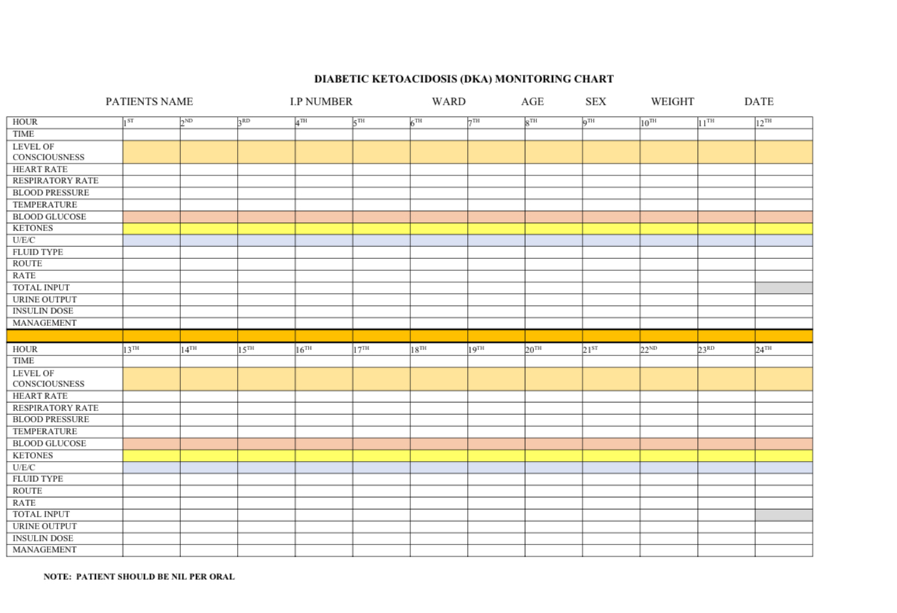

Slide 163
Complications of DKA Management
Cerebral Edema: Signs and Symptoms
Sudden and severe headache
Incontinence and/or vomiting
Combativeness, disorientation, agitation, change in mental status, posturing, seizure
Change in vital signs
  bradycardia, hypertension
  gasping/irregular respirations or periods of apnea
  hypothermia
Pupil changes (asymmetry, sluggish), papilledema
Once you suspect Cerebral oedema, always rule out hypoglycemia BGL <4 mmol/L

Slide 164
Treatment of Cerebral Edema
Date
Slide no 164
Reduce the rate of fluid administration by one-third.
Give mannitol 0.5-1 g/kg IV over 15 minutes. Repeat after 30 minutes if no response.
Hypertonic saline (3%), 2.5-5 ml/kg over 10-15minutes, may be an alternative to mannitol or addition to mannitol if no response within 30 min.
Elevate the head of the bed.
Intubation may be necessary for a patient with impending respiratory failure.
Consider brain imaging after stabilizing patient
Notes:
What can you do if cerebral oedema is suspected?
First check the blood glucose to exclude hypoglycaemia as a cause of the change in clinical state.
Reduce the rate of fluid administration by one-third.
Give mannitol 0.5-1 g/kg IV over 20 minutes and repeat if there is no initial response in 30 minutes to 2 hours.
Hypertonic saline (3%), 5 ml/kg over 30 minutes, may be an alternative to mannitol, especially if there is no initial response to mannitol.
Elevate the head of the bed.
Intubation may be necessary for a patient with impending respiratory failure.
c
The effect of mannitol should be apparent after 15 min and is expected to last about 120 min. If necessary, the dose can be repeated after 30 min.
164

Slide 165
Resolution of DKA
Criteria for resolved DKA:
  pH >7.3
  Bicarbonate >18
  Urinary ketones <2+
When ketoacidosis has resolved and oral intake is well tolerated, then transition to SC insulin.
The recommended insulin regimen is basal- bolus Insulin ( multiple daily injections).
Starting total insulin dose for transition to subcutaneous:
Pre-pubertal : 0.5 - 0.7 units/kg/day
Pubertal : 0.8 – 1.2 units/kg/day

Slide 166
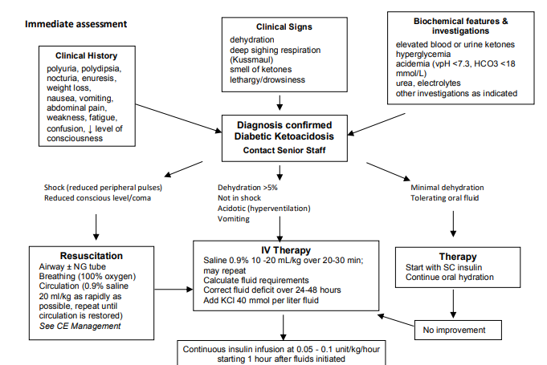
Algorithm for the management of diabetic ketoacidosis

Slide 167
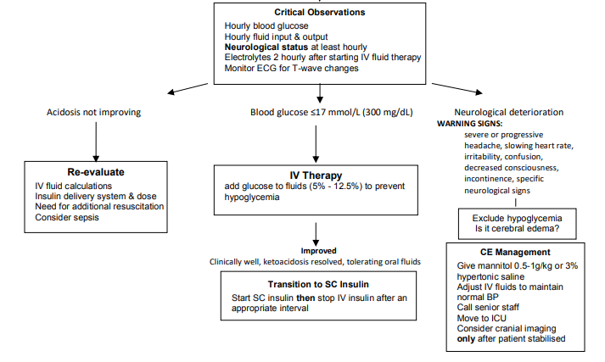

Slide 168
Questions?

Slide 169
Summary
It is a life-threatening acute complication of type 1 diabetes
Early diagnosis using clinical signs and symptoms and laboratory criteria is key
Management should be in ICU/HDU & entails fluid therapy, insulin, potassium replacement and treatment of underlying causes.
Transition to the recommended basal-bolus insulin once DKA has resolved
Written guidelines should be available at all levels of the healthcare system

Slide 170
Transition to Subcutaneous insulin

Slide 171
Objectives
Criteria of transition to subcutaneous insulin after DKA resolved
Recommended insulin regimen
Transition procedure

Slide 172
Criteria for transition
For a patient to be transitioned to subcutaneous insulin, they should:-
Have resolved DKA:
  pH >7.3
  Bicarbonate >18
  Urinary ketones <2+
Be able to tolerate oral intake.

Slide 173
Recommended insulin regimen
The recommended insulin regimen is basal- bolus Insulin ( multiple daily injections).
Starting total insulin dose for transition to subcutaneous:
Pre-pubertal : 0.5 - 0.7 units/kg/day
Pubertal : 0.8 – 1.2 units/kg/day

Slide 174
Transition to SC Insulin Injections after DKA
Choice of insulin for transition
Transition to Basal- bolus insulin at meal time 1.e before breakfast, lunch and dinner
  Overlap the insulin infusion(given during DKA mx) with the 1st dose of bolus insulin by around 30 Minutes (if using short acting insulin) and 15 minutes if using rapid acting insulin)
Bolus/Pre-meal insulin- (lowers sugars after taking a meal)
    Given before main meals
    Examples are: soluble/regular insulin, rapid acting or ultra-rapid acting
Basal insulin
    Given once or twice per day
    Examples are: intermediate-acting e.g NPH ; long-acting e.g glargine and Detemir.
Notes:
Soluble insulin examples- Actrapid
Rapid acting insulin e.gs- Novorapid insulin

Slide 175
Transition to basal bolus regimen Procedure
Calculate the total Daily insulin dose (TDD) per day.
Calculate amount of total basal insulin per day: 40-50% of Total Daily insulin dose.
Calculate the amount of total bolus /pre-meal insulin per day: 50- 60% of total insulin dose.
Then calculate the amount of bolus (pre-meal) insulin to be given before every meal (breakfast, lunch and dinner). Total daily bolus/pre- meal insulin divided by 3
Notes:
Use of pre-mixed insulin regimen is not recommended in children and adolescents with type 1 diabetes mellitus.

Slide 176
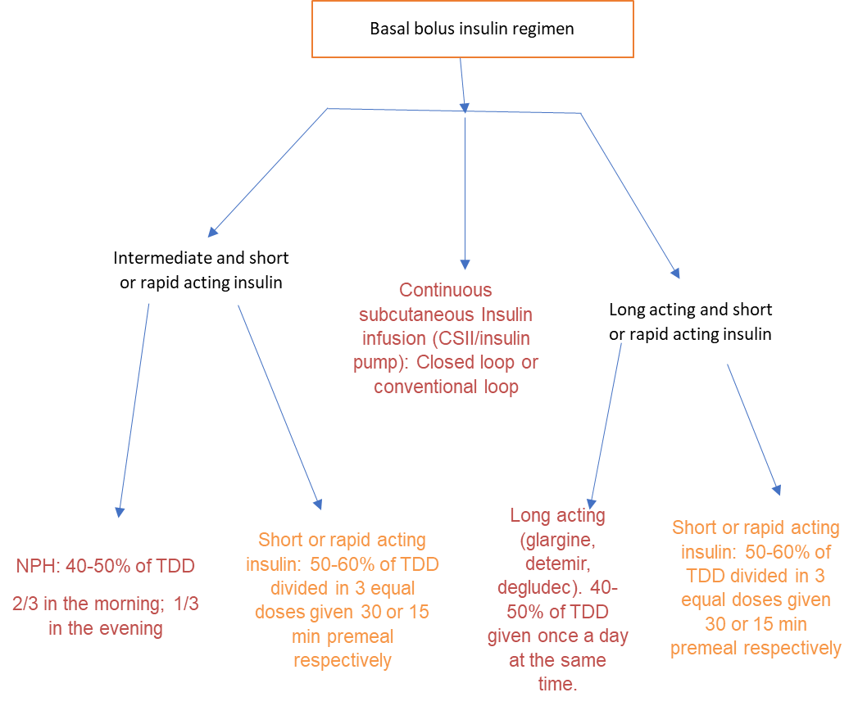
Transition to basal bolus regimen
NB: the soluble/rapid acting insulin dosing may change with Carbohydrate counting(it is not always fixed!)

Slide 177
Transitioning using long acting insulin Glargine(basal) and short/rapid acting insulin(bolus) as basal bolus regimen
Calculate Total Daily Dose(TDD) of insulin in units/kg/day
Calculate Total Daily basal dose: 40-50% as long acting insulin (glargine).
  given once daily at the same time every day e.g 8 p.m daily
Calculate Total Daily bolus dose:50-60 % as short or rapid acting insulin
  Divide the total daily bolus dose by 3 to get the amount of bolus insulin to be given before breakfast, before lunch and before dinner
  If using short acting insulin, give the dose 30 minutes before main meals
  If using rapid acting insulin give 10-15 minutes before main meals
NB: the soluble/rapid acting insulin dosing may change with Carbohydrate counting(it is not always fixed!)

Slide 178
Transitioning using long-acting insulin glargine (basal) and short/rapid acting insulin(bolus) as basal bolus regimen: Dose Calculation example
30 kg pre-pubertal child
Starting dose: 0.5 units/kg/day = 30 x 0.5
Calculate Total Daily Dose(TDD) of insulin = 15 units per day
Calculate Total Daily basal dose :40% long-acting basal insulin = 6 units SC given once daily at the same time every day
Calculate Total Daily bolus dose: 50-60 60% short/rapid acting insulin = 9 units divided by 3, given (15 minutes-rapid acting) or (30 minutes- short acting insulin) before meals.
  3 units before breakfast
  3 units before lunch
  3 units before dinner
NB: the soluble/rapid acting insulin dosing may change with Carbohydrate counting(it is not always fixed!)

Slide 179
Transitioning using long acting insulin Determir (basal) and short/rapid acting insulin(bolus) as basal bolus regimen
Calculate Total Daily Dose(TDD) of insulin in units/kg/day
Calculate Total Daily basal dose: 50% as long acting Detemir insulin.
  Give ½ of total basal in the morning and
  ½ of total basal in the evening
Calculate Total Daily bolus dose:50 % as short or rapid acting insulin
  Divide the total daily bolus dose by 3 to get the amount of bolus insulin to be given before breakfast, before lunch and before dinner
  If using short acting insulin, give the dose 30 minutes before main meals
  If using rapid acting insulin give 10-15 minutes before main meals
NB: the soluble/rapid acting insulin dosing may change with Carbohydrate counting(it is not always fixed!)

Slide 180
Transitioning using long acting insulin Determir (basal) and short/rapid acting insulin(bolus) as basal bolus regimen: Dose Calculation example
30 kg pre-pubertal child
Starting dose: 0.5 units/kg/day = 30 x 0.5
Total daily insulin dose = 15 units per day
Calculate Total Daily basal dose: 50% as long acting Detemir insulin= 7.5 units (round off to 8 units)
  Give ½ of total basal in the morning= 4 units
  ½ of total basal in the evening = 4 units
Calculate Total Daily bolus dose:50 % as short or rapid acting insulin
= 8 units divided by 3, given (15 minutes-rapid acting) or (30 minutes- short acting insulin) before main meals
  3 units before breakfast
  3 units before lunch
  2 units before dinner
NB: the soluble/rapid acting insulin dosing may change with Carbohydrate counting(it is not always fixed!)

Slide 181
Transitioning using intermediate (basal) and short/rapid acting insulin(bolus) as basal bolus regimen
Calculate Total Daily Dose(TDD) of insulin in units/kg/day
Calculate Total Daily basal dose: 40-50% as intermediate acting insulin.
  Give ⅔ of basal in the morning
  ⅓ in the evening
Calculate Total Daily bolus dose:50-60 % as short or rapid acting insulin
  Divide the total daily bolus dose by 3 to get the amount of bolus insulin to be given before breakfast, before lunch and before dinner
  If using short acting insulin, give the dose 30 minutes before main meals
  If using rapid acting insulin give 10-15 minutes before main meals
NB: the soluble/rapid acting insulin dosing may change with Carbohydrate counting(it is not always fixed!)

Slide 182
Transitioning using intermediate (basal) and short/rapid acting insulin(bolus) as basal bolus regimen: Dose Calculation example
30 kg pre-pubertal child
Starting dose: 0.5 units/kg/day = 30 x 0.5
Total daily insulin dose = 15 units per day
Calculate Total Daily basal dose: 40% intermediate = 6 units total
  ⅔ in the morning = 4 units
  ⅓ in the evening =2 units
Calculate Total Daily bolus dose: 60% short or rapid acting/ insulin = 9 units divided by 3, given (15 minutes-rapid acting) or (30 minutes- short acting insulin)
3 units before breakfast
  3 units before lunch
  3 units before dinner
NB: the soluble/rapid acting insulin dosing may change with Carbohydrate counting(it is not always fixed!)

Slide 183
Post- transition care 1
Monitor sugars and keep a diary.
Advise the clinical team and patient on target sugars
Correct high sugars using correction factor
Watch out for hypoglycemia
Advise on proper balanced diet and exercise

Slide 184
Post- transition care 2
Once patient is stable, start diabetes education while still in the ward and plan for discharge,
After discharge, continue with routine diabetes care at the diabetes clinic.

Slide 185
INSULIN THERAPY T1DM

Slide 186
Learning Objectives
By the end of this session, the participant should be able to:
Identify different classes of insulin
Describe pharmacokinetics of the 4 classes of insulin
Describe basal-bolus regimen of insulin therapy (recommended regimen)
Explain blood sugar monitoring and insulin dose adjustments
Describe insulin injection technique and Storage

Slide 187

Natural Insulin Secretion Pattern
Insulin is secreted to match carbohydrate intake and maintain blood sugar during periods of starvation.
Basal secretion – continuous, whether fasting or eating.
Bolus secretion during feeding times
Jacobs DM Care 20:1279, 1997.

Slide 188
Pharmacokinetics of Insulin
Insulin Type | Onset of Action | Time to Peak Action | Duration of Action
Rapid-acting
Aspart | 5-15 min | 30-90 min | 4-6 hours
Glulisine | 20 min | 100 min | 4-6 hours
Lispro | 5-15 min | 30-90 min | 4-6 hours
Short-acting
Regular/Soluble | 30-60 min | 2-3 hours | 8-10 hours
Intermediate-acting
Neutral Protamine Hagedorn (NPH) | 2-4 hours | 8-10 hours | 12-18 hours
Long-acting
Detemir | 2-4 hours | relatively flat | 14-24 hours
Glargine | 2-4 hours | no pronounced peak | 24 hours
Degludec | 1-2 hours | no peak | up to 40 hours

Slide 189

Insulin Profiles

Slide 190



Rapid-acting Insulin
Rapid Acting
Lispro(Humalog).Aspart(novorapid),
Glulisine(apidra)

Slide 191



Short acting
These are given during the day three doses as premeal boluses.
Revisit

Slide 192



Intermediate-acting Basal Insulin
NPH (Humulin N, Insulatard)

Slide 193



Basal/ Long-acting Insulin
Glargine (Lantus), Detemir (Levemir), Degludec (Tresiba)

Slide 194

Types of insulin Regimen
1 Basal-bolus regimen
This is the preferred regimen
Mimics natural secretion of insulin
  Basal: long-acting once daily insulin injection
Meal boluses with short- or rapid-acting insulin
Meal doses are based on insulin:carbohydrate ratio
Carbohydrate-counting is a crucial part of this regimen
Long-acting insulin can be given at any time of the day but must be at the same time every day

Slide 195

Insulin Regimens
2 Twice daily intermediate-acting (NPH) and thrice daily pre-meal boluses of short- or rapid-acting insulin

Slide 196

Insulin Regimens
Continuous Subcutaneous Insulin Infusion: CSII ( Insulin Pump)

Slide 197
Insulin Dosage
DKA – regular (soluble) insulin is preferred
  0.05 to 0.1 units per kg per hour – Given as IV infusion
  Insulin should be started 1-2 hours after fluid resuscitation
Switching to SC insulin - once DKA is resolved
  The following dosage is used:
    Prepubertal - 0.5 - 0.7 units/kg/day
    Pubertal - 0.8 – 1.2 units/kg/day
  Rapid-acting/ Regular insulin forms 50-60% the total daily insulin dose
  Basal insulin usually constitutes 40-50% of total daily insulin dose
  Start at the lowest dose during transition

Slide 198
Insulin Dosage
In a newly diagnosed patient with no DKA
  The following dosage is used:
    Prepubertal - 0.5 - 0.7 units/kg/day
    Pubertal - 0.8 – 1.2 units/kg/day
  Rapid-acting/ Regular insulin forms 50-60% the total daily insulin dose
  Basal insulin usually constitutes 40-50% of total daily insulin dose
  Start at the lowest dose during transition and titrate to maintain target sugars
Insulin intensification i.e Switching a patient on Pre- mix insulin to the currently recommended regimen of basal- bolus

Slide 199



Devices for Insulin Administration
Insulin pumps
Syringe and needle
Insulin pens
Images: 1.How to give an insulin injection. https://kidshealth.org/en/parents/injection-graphic.html
2. Insulin pens. https://www.drugs.com/cg/insulin-pens-discharge-care.html

Slide 200


Drawing Up Insulin
Use U-100 syringes for U-100 insulin
Use small syringes with half or one unit per mark (e.g., 0.3 or 0.5 mL, 100 U/mL) for children, to make it possible to dose in half units
Use needle length of 4-6mm for children
Image: How to give an insulin injection. https://kidshealth.org/en/parents/injection-graphic.html

Slide 201

Injection Technique (1)
Insulin should be given subcutaneously.
Pinch up some skin and quickly insert the needle at a 90° angle.
No need to pinch up skin if using 4mm needle.
Keep the skin pinched to avoid having the insulin go into the muscle.
Push the plunger down all the way.
Hold the syringe and needle in place for 15 seconds.
Let go of the pinched skin and remove the needle from the skin.
If you see blood or clear fluid (insulin) where the needle went in, press on the area for 10 seconds.
Do not rub.
Image: Insulin injection sites: where and how to inject. https://www.healthline.com/health/diabetes/insulin-injection

Slide 202


Sites for Injection & Rotation
Bahendeka S. et al. EADSG Guidelines: Insulin Storage and Optimisation of Injection Technique in Diabetes Management. Diabetes Ther 10, 341–366 (2019).

Slide 203
Blood Sugar Monitoring
Blood sugar monitoring at home is vital.
Tests frequency - depending on availability of resources, level of control, any other illness e.g. fever, gastroenteritis:
  Pre-meal
  Pre-meal and 2-3 hours post-meal
  Pre-meal, 2-3 hours post-meal, bedtime and 3 am
  Continuous glucose monitoring
Need to keep a chart for blood sugar, insulin dose and food taken - type and amount.

Slide 204
Interpretation of Blood Sugar reading;
Relevant Insulin Dose Adjustment or Other Intervention
Timing of test with high or low blood sugar | Relevant intervention or insulin dose to be adjusted
Fasting | Evening dose of intermediate or long-acting insulin
After breakfast | Rapid-acting insulin at breakfast or breakfast insulin:carbohydrate ratio
Before lunch | Rapid-acting insulin at breakfast, morning intermediate-acting insulin or mid-morning snack
After lunch | Rapid-acting insulin at lunch or lunchtime insulin:carbohydrate ratio
Before supper | Rapid-acting insulin at lunch, mid-afternoon snack or morning intermediate-acting insulin
After supper | Rapid-acting insulin at supper or suppertime insulin:carbohydrate ratio
All levels | Affected by snacks and exercise
Notes:
If a patient takes many blood glucose readings but does not know how to interpret them and does not change either the dose of insulin, the pattern of eating or activity in response to the glucose levels, then testing the glucose readings becomes a futile and wasteful exercise. Repeated daily testing at one time of day alone (eg for fasting glucose levels) is not recommended as it is not helpful.
This table suggests how you should interpret the different readings during the day. The fasting glucose level before breakfast helps to tell us if enough insulin was given the night before to compensate for the evening meal, and also whether the evening dose of long-acting insulin was too little or too much. The after breakfast level tells us about the dose of short/rapid-acting insulin given at breakfast. The after lunch level tells us about the dose of short/rapid-acting insulin given at lunch. The after supper level tells us about the dose of short/rapid-acting insulin given at breakfast. The pre-lunch level tells us about the dose of insulin given at breakfast, the effect of the mid-morning snack (if any) and the effect of the morning long-acting insulin. The pre-evening meal level tells us about the dose of insulin given for lunch, the effect of the afternoon snack (if any) and the effect of the morning long-acting insulin. All levels may be affected by snacks and exercise.
Records of insulin, food, activity and other factors that may affect the glucose levels are needed to help make decisions.

Slide 205
Dose Adjustments… cont
Bolus insulin - Each pre-meal insulin dose has 2 components:
  For the carbohydrate in the meal: carbohydrate counting
Formulae for insulin carbohydrate ratios:
      Rapid-acting insulin: 500/Total Daily Dose
      Regular insulin: 450/Total Daily Dose
  To correct pre-meal hyperglycemia - Use Insulin Sensitivity Factor (also called Correction Factor)
Formulae (for mmol/L):
      Rapid-acting insulin: 100/total daily dose
      Regular insulin: 83/total daily dose

Slide 206


Insulin Storage
Kept at 2-8 degrees Celsius(avoid freezer section& door)
Pens - room temperature for a month
Use fridge, traditional methods
Annals Of Medicine 2022, VOL. 54, NO. 1, 1118–1125. https://doi.org/10.1080/07853890.2022.2067355
https://pixabay.com/vectors/refrigerator-fridge-cooling-cold-158634/

Slide 207
Key Messages
There are different classes (types) of insulin, with varying mode of action.
Several insulin regimens are available for management of diabetes.
The preferred insulin regimen is one that mimics physiological insulin-blood glucose interaction. Premix insulin (e.g. 30/70 or 25/75) is not recommended in type 1 diabetes
Blood sugar monitoring is essential for proper management of diabetes.
Correct injection techniques must be used to ensure proper administration of insulin.
Insulin must be stored properly for it to maintain its effectiveness.

Slide 208
Structured Diabetes Education Lecturette

Slide 209
Objectives
Outline structure diabetes education

Slide 210
Introduction
Diabetes education is a core component in management of Type 1 Diabetes.
Structured diabetes education is mainly done by the diabetes educator who should be the lead amongst all the others.
When effectively done it improves the management of children and young adults holistically.
Diabetes education can be done individually or in a group setting.

Slide 211
First Visit Education
This is done at the initial contact with the patient in the inpatient or outpatient setting.
The following topics are to be covered:
  1. Description of Type 1 diabetes and different types of diabetes.
  2. Self-monitoring of blood glucose, blood glucose targets, when to monitor, testing techniques and sites.
  3. How to maintain a blood glucose, insulin and food diary.

Slide 212
First Visit Education (2)
4. Management of hypoglycaemia:
  Signs and symptoms
  Correction (rule of 15).
  The role of a hypoglycemia kit (hypokit).
5. Management of hyperglycaemia:
  Signs and symptoms
  Management including correction factor, taking a lot of water and exercise.

Slide 213
First Visit Education (3)
6. Insulin:
  Different types and their role
  Multiple daily injections- Basal bolus insulin ( short/rapid-acting insulin and long-acting insulin)
  Insulin storage.
7. Nutrition and how to balance insulin with carbohydrates
8. Injection techniques:
  Sites, rotation, technique
  Safe use of both needles and injection pens to include number of times to reuse and proper disposal (not in dustbins).

Slide 214
Sample of Daily Food And Insulin Diary
 | Breakfast |  | Lunch |  | Dinner |  | Bedtime |  | Notes
Date: | before | 2 hrs after | before | 2 hrs after | before | 2 hrs after | 10pm | 2am
Blood Sugar
Insulin Dose
Carbs eaten
Exercise

Slide 215
Second Visit
This is in the outpatient clinic : 2 weeks after diagnosis or after initial contact with the patient:
The following is carried out:
  1. Recap of what was taught in visit 1
  2. Growth assessment (weight, height and BMI).
  3. Interpreting blood sugar results from the diary (what the current readings mean).
  4. Recap demonstration on blood glucose testing.
  5. Recap demonstration on insulin injection.

Slide 216
Second Visit (2)
6. Diet review and hypoglycaemia.
7. Nutrition and carbohydrate counting.
8. Hyperglycaemia signs and symptoms and management.
9. Diabetes and school
10. Importance of a picnic bag:
  components include: hypokit, glucometer, strips, lancet needles, insulin, water, lunch, a snack, a well-maintained diary.

Slide 217
Third Visit
Done 1 month after visit 1 or 6 weeks after diagnosis or initial contact which includes:
  1. Recap of previously taught topics
  2. Sick day rules to include ketone monitoring.
  3. Annual review: Explain the need for assessment of comorbidities, microvascular complications

Slide 218
Fourth Visit
Done 4 or 6 weeks after the previous visit and includes:
  Recap the previously taught topics to include demonstrations.
  Growth assessment.
  Diabetes and exercise.
  Nutrition and carbohydrate counting including practical

Slide 219
Fifth Visit
Done 1 or 2 months after the previous visit which includes;
  Recap the previously taught topics to include demonstrations.
  Diabetes care while travelling, on holidays and during camps
  Parties and festive seasons
  Diet and Exercise review
  State need for further investigations/ longterm complications/ cormorbidities screening

Slide 220
Sixth Visit/Home Visit
Home Visit
diabetes management at household
Carbohydrate counting to insulin matching is done practically.
Storage of insulin is assessed, and insulin injection is reviewed.
Provide linkage to community support.
Sixth Visit
Done 2 months from the previous visit and should address the following:
Foot care, dental and eye follow up
Lifestyle issues: address alcohol, smoking, drugs and sexual health
Ongoing dietary assistance

Slide 221
School Visit
It is important to have a school visit:
  to help the child incorporate back to school.
  to teach/ impact the school personnel on knowledge, skills and management of children with type 1 diabetes.
  to have practical skills training on hyperglycaemia, hypoglycaemia, sick days and exercise management.
Parents responsibility: supplies, supporting school especially with carbohydrate counting.
School responsibility: supervision and communicating with the whole family.

Slide 222
Summary
Diabetes education plays a key role in management of patients with type 1 diabetes.
Always treat the patient and family with dignity and respect.
Effective diabetes self management skills are critical to health and well being.
It is important to provide person centered care.
Always encourage and support participation in care by the patient, family and the multidisciplinary team.

Slide 223
Routine Management of Type 1 Diabetes

Slide 224
Learning Objectives
Understand the components of care of a child with type 1 diabetes.
Understand the role of nutrition in management of type 1 diabetes.
Describe the ways to assess glycemic control.
Understand the role of growth monitoring in diabetes.

Slide 225



Structure of Care
Overall goals
Individualized management plan
Access to multidisciplinary diabetes expertise
Limbert C, Tinti D, Malik F, et al. ISPAD Clinical Practice Consensus Guidelines 2022: The delivery of ambulatory diabetes care to children and adolescents with diabetes. Pediatr Diabetes. 2022;23(8): 1243‐1269.

Slide 226
Goals of Care
Good quality of life
Normal growth and development
Avoidance of complications
Good glycemia
Psychosocial adaptation and function
Early detection of comorbidities
Limbert C, Tinti D, Malik F, et al. ISPAD Clinical Practice Consensus Guidelines 2022: The delivery of ambulatory diabetes care to children and adolescents with diabetes. Pediatr Diabetes. 2022;23(8): 1243‐1269.

Slide 227
Person-Centred Paediatric Diabetes Care Model
Young person with type 1 diabetes and family
Primary Healthcare Provider (Paediatrician, Trained Medical Officer, Trained Clinical Officer)
Trained additional caregivers e.g peer support group team leaders
Paediatric Diabetes Medical Provider e.g endocrinologist
Diabetes Educator, Nurse Specialist, Dietician
Daycare and School support from nurses, teachers, coaches
Psychologist and/or Social Worker
Diabetes Technology Support
Each member of the team should have training in both paediatrics and diabetes.
Limbert C, Tinti D, Malik F, et al. ISPAD Clinical Practice Consensus Guidelines 2022: The delivery of ambulatory diabetes care to children and adolescents with diabetes. Pediatr Diabetes. 2022;23(8): 1243‐1269.

Slide 228
Aims of Individualized Diabetes Care
Ongoing diabetes & self-management education
Advice on insulin management, glucose and ketone monitoring
Monitoring for comorbidities and risk factors for / complications
Regular review of individualized goals (blood glucose targets, HbA1c)
Contact with support groups
Psychosocial screening and appropriate referral
Limbert C, Tinti D, Malik F, et al. ISPAD Clinical Practice Consensus Guidelines 2022: The delivery of ambulatory diabetes care to children and adolescents with diabetes. Pediatr Diabetes. 2022;23(8): 1243‐1269.

Slide 229
Assessment of General Wellbeing During Clinic Visits
Intercurrent health problems
Review of all medications and supplements
Assessment for autoimmune comorbidities (e.g. thyroid, adrenal, vitiligo)
Assess for disordered eating behaviours
Development, education, leisure, sports, psychosocial status
Limbert C, Tinti D, Malik F, et al. ISPAD Clinical Practice Consensus Guidelines 2022: The delivery of ambulatory diabetes care to children and adolescents with diabetes. Pediatr Diabetes. 2022;23(8): 1243‐1269.

Slide 230


Routine Physical Examination
Height, weight, BMI, pubertal status
Blood pressure
Oral mucosa and dentition
Thyroid, cardiac, abdomen (hepatomegaly), foot examination, neurological function tests
Skin: lipodystrophy, acanthosis nigricans, hirsutism, acne
Limbert C, Tinti D, Malik F, et al. ISPAD Clinical Practice Consensus Guidelines 2022: The delivery of ambulatory diabetes care to children and adolescents with diabetes. Pediatr Diabetes. 2022;23(8): 1243‐1269.
Notes:
Photo of acanthosis and description

Slide 231
Blood Glucose Testing
Insulin regimen/doses
Pattern of eating
Activity/ Illness
Blood glucose level
Identify times when at risk for hyper- or hypoglycaemia
Blood glucose information is used to help patient and family learn – not done for staff!
Beware of doctored readings!
Pihoker C et al. ISPAD Clinical Practice Consensus Guidelines 2018: The delivery of ambulatory diabetes care to children and adolescents with diabetes. Pediatr Diabetes. 2018;19(Suppl. 27):84–104.
Notes:
Treating diabetes with insulin is completely dependent on having a clear picture of how the blood glucose changes for each patient throughout the day. The purpose of blood glucose testing is to help identify the times when the patient is at risk of either hyperglycaemia or hypoglycaemia. Blood glucose levels can be related to type and dose of insulin, pattern of eating, activity and illness.
Having this information is the basis for deciding how much insulin they need, of what type, and when it should be given.

Slide 232
Patterns of Testing are determined by
availability of strips
insulin regimen
level of glycemic control
patient factors
Patterns of testing may be increased to get more information
Needs patient records of food and insulin for readings to be valuable!
Pihoker C et al. ISPAD Clinical Practice Consensus Guidelines 2018: The delivery of ambulatory diabetes care to children and adolescents with diabetes. Pediatr Diabetes. 2018;19(Suppl. 27):84–104.
Notes:
As strips are expensive, very frequent testing may not be possible. The patterns of testing should be determined by availability of strips, insulin regimen, level of control, patient factors. Changing patterns of testing can be useful to get a more complete picture of glucose values. As mentioned previously, patient records of food and insulin are needed for readings to be valuable!!

Slide 233
Structured Blood Glucose Monitoring
7-point testing: Pre-meal, post-meal, at bedtime, and at 3 am.
5 tests a day: Pre-meals, at bedtime and at 3 am.
4 tests a day: Pre-meals and bedtime.
3 tests a day: Usually done pre-meal to allow for correction of pre-meal hyperglycemia.
Where availability of strips is a challenge: Tests can be modified to collect as much information as possible e.g., 7-point testing for 3 days in a row in one week and over the weekend the following week.
Pihoker C et al. ISPAD Clinical Practice Consensus Guidelines 2018: The delivery of ambulatory diabetes care to children and adolescents with diabetes. Pediatr Diabetes. 2018;19(Suppl. 27):84–104.
Notes:
Also test whenever symptoms of hypoglycemia occur or when a top-up dose of insulin is needed for extra food or during illness.

Slide 234
Record Keeping/ use of food and glucose diary
A monitoring diary to record patterns of glycemic control, insulin doses and amounts of carbohydrate consumed, and adjustments to treatment.
The record book is required at the time of consultation and should contain time and date of:
  Glucose levels
  Carbohydrate intake
  Insulin dosage

Slide 235
Record Keeping/ use of food and glucose diary cont,
Note of special events affecting glycemic control (e.g., illness, exercise, menses, alcohol intake)
Hypoglycemic episodes, description of severity, and potential alterations in the usual routine to help explain the cause for the event
Episodes of hyperglycemia, ketonuria/ketonemia
Glucose monitoring records should not be used judgmentally but as a vehicle for discussing the causes of variability and strategies for improving glycemic control.

Slide 236
Sample of Daily Food And Insulin Diary
 | Breakfast |  | Lunch |  | Dinner |  | Bedtime |  | Notes
Date: | before | 2 hrs after | before | 2 hrs after | before | 2 hrs after | 10pm | 2am
Blood Sugar
Insulin Dose
Carbs eaten
Exercise

Slide 237
Monitoring of Glycemic Management

Slide 238
Blood Glucose Targets
For fingerstick testing, recommended blood glucose target is 4 - 10 mmol/L.
Fasting (morning) target range: 4 - 8 mmol/L.
Bedtime target range: 7 - 10 mmol/L.
de Bock M, Codner E, Craig ME, et al. ISPAD Clinical Practice Consensus Guidelines 2022: Glycemic targets and glucose monitoring for children, adolescents, and young people with diabetes. Pediatr Diabetes. 2022;23(8): 1270‐1276.

Slide 239
Correction Factor
Also called insulin sensitivity factor for correction of hyperglycemia
Correction doses for mmol/L, use the “100 rule,” that is, divide 100 by total daily insulin dose to get the mmol/L that 1 unit of rapid-acting insulin will lower the blood glucose by.
For regular insulin, a “83-rule” for results in mmol/L.
Danne T, Phillip M, Buckingham BA, et al. ISPAD Clinical Practice Consensus Guidelines 2018: Insulin treatment in children and adolescents with diabetes. Pediatr Diabetes. 2018;19(Suppl. 27):115–135.

Slide 240
Correction Factor
  E.g if TDD is 20 units:
  Correction factor is 100/20=5 Mmols ( means – for that particular child 1 unit of rapid acting insulin lowers their blood sugar by 5 mmols.
  If child has RBS of 20 mmols with a target recommended level of 10 mmols. They will require an extra 2 units of insulin. (20-10 =10mmols needs 10/5=2)
For regular insulin, a “83-rule” for results in mmol/L.
Therefore 83/20 = 1: 4 ( 1 unit of insulin will lower the sugars by 4 mmol/l.

Slide 241
Hypoglycemia awareness and management
Self-management skills on how to recognize and manage hypoglycemia
  During every clinic visit, take history on hypoglycemic episodes, (RBS ≤ 3.9MMOL/L) .
  Find out if patient has awareness of symptoms of hypoglycemia and whether they have been educated on correction of hypoglycemia,
  Re-teach/ emphasise on identification and urgent treatment of hypoglycemia.

Slide 242

Symptoms:
Hypoglycemia
Symptoms of Hypoglycemia
Abraham MB et al. ISPAD Clinical Practice Consensus Guidelines 2018: Assessment and management of hypoglycemia in children and adolescents with diabetes. Pediatr Diabetes. 2018;19 (Suppl. 27):178–192.

Slide 243






Treatment: Conscious/ Able to Swallow:
Rule of 15
Check blood glucose
Eat 15 grams of fast-acting carbohydrates
Wait for 15 minutes
Recheck blood sugar
Repeat Rule of 15 if RBS <3.9 mmol/L
If normal give a snack or meal

Slide 244
Examples of Fast acting Carbohydrates
Examples of Fast-Acting Carbohydrates
3 Teaspoons (15g) of glucose
3 Teaspoons (15g) of honey
½ glass (120ml) of fruit juice
½ glass of regular soda
3 Teaspoons (15g) of sugar
3 glucose tablets (Patco sweets)

Slide 245
Examples of follow up carbohydrate snack
1 slice of bread
1 cup of milk (250ml)
1 small banana or half a normal size banana
1 small orange
1 small apple
1 cup of watermelon

Slide 246
Treatment: Unconscious/ Unable to Swallow
1. Position on the side & maintain airway patent
2. Administer glucagon
  <25 kg: 0.5 mg
  >25 kg: 1 mg
3. Recheck after 15 minutes
4. If < 3.9 mmol/L unresponsive repeat glucagon
5. Responsive: Follow conscious pathway

Slide 247
Treatment: Unconscious & No Glucagon Available
Step 1: Position
Position on the side and maintain the airway
Step 2:
Apply
Apply a thick paste of glucose (glucose with a few drops of water) or crushed sugar under the tongue or in the dependent cheek
Step 3:
Retest
If <3.9 mmol/L and unresponsive repeat step 2
If responsive: follow the conscious pathway
Graz B, et al Sublingual sugar for hypoglycaemia in children with severe malaria: a pilot clinical study. Malar J. 2008 Nov 23;7:242. doi: 10.1186/1475-2875-7-242. PMID: 19025610; PMCID: PMC2605470
De Buck E, Borra V, Carlson JN, Zideman DA, Singletary EM, Djärv T. First aid glucose administration routes for symptomatic hypoglycaemia. Cochrane Database Syst Rev. 2019 Apr 11;4(4):CD013283. doi: 10.1002/14651858.CD013283.pub2. PMID: 30973639; PMCID: PMC6459163.

Slide 248
Hypoglycemia Kit
Hypoglycemia Kit
Hypoglycemia Kit consists of:
  Glucometer and blood glucose strips
  Fast-acting carbohydrate
  Snack
  Record book
Every patient with T1DM should be educated on the importance of the hypoglycemia kit.
The kit should be carried at all times.

Slide 249

Expected interventions depending on various blood glucose readings (1)

Slide 250

Expected interventions depending on various blood glucose readings (2)
Pihoker C et al. ISPAD Clinical Practice Consensus Guidelines 2018: The delivery of ambulatory diabetes care to children and adolescents with diabetes. Pediatr Diabetes. 2018;19(Suppl. 27):84–104.

Slide 251

Glycated Haemoglobin (HbA1c)
Glucose attaches onto Haemoglobin (within red blood cells) ⇒ HbA1c
This is a slow and irreversible process
HbA1c reflects average blood glucose over 3 months
High glucose = increased HbA1c
HbA1c correlates with risk of long-term complications
Rising HbA1c requires action
A target of <7% is recommended for all young people with diabetes.
Pihoker C et al. ISPAD Clinical Practice Consensus Guidelines 2018: The delivery of ambulatory diabetes care to children and adolescents with diabetes. Pediatr Diabetes. 2018;19(Suppl. 27):84–104.

Slide 252
Growth Monitoring

Slide 253


Growth Monitoring in type 1 Diabetes
Growth: is a physical increase in the size of the body.
Development: increase in function and intellectual maturity of an individual.
Growth is determined by genetics, nutrition, general health, endocrine status, psychological factors and puberty.
Hermanussen M. Auxology: an update. Horm Res Paediatr. 2010;74(3):153-64.

Slide 254
Why growth monitoring in T1DM?
Early identification of growth failure: Monitoring the response to therapy
Poor control of T1DM causes growth failure.
Overdosing of insulin causes overweight and obesity.
Reduced insulin, reduced food may lead to poor growth even with normal glycemia.
Delayed puberty results mainly from poor control.
Mitchell D. Growth in patients with type 1 diabetes. Curr Opin Endocrinol Diabetes Obes. 2017 Feb;24(1):67-72.

Slide 255

What measurements are needed?
Height/ length
Weight
BMI
Growth velocity
Pubertal status
Record on medical chart and plot on growth chart.
Hermanussen M. Auxology: an update. Horm Res Paediatr. 2010;74(3):153-64.

Slide 256

How do we take height measurement?
Performed using a stadiometer with a movable headboard.
Heels, calves, buttocks, upper back and occiput should be in contact with a vertical board.
The head needs to be placed against the board.
No shoes should be worn during measurement, and any hairdo that may have an impact on the measurement should be undone.
Hermanussen M. Auxology: an update. Horm Res Paediatr. 2010;74(3):153-64.
Notes:
A slight up pressure of the mandible allows for correction of the physiologic intervertebral disc compression that occurs throughout the day.

Slide 257


Length Measurement
Length measurement is done using a measuring table with a fixed headpiece and a movable foot piece (infantometer).
The measurement needs to be performed by 2 people.
One holds the head of the child in the Frankfurt plane against the fixed head block and the other ensures appropriate extension of lower extremities and neutral position of the ankles at a right angle.
Hermanussen M. Auxology: an update. Horm Res Paediatr. 2010;74(3):153-64.
Notes:
No shoes should be worn during measurement, and any hair-do that may have an impact on the measurement should be undone.

Slide 258


Weight
Weight measurements should be made on appropriately calibrated scales (infant/adult).
Use light clothing or only underwear, and make sure clothing pockets are emptied and shoes are removed.
Hermanussen M. Auxology: an update. Horm Res Paediatr. 2010;74(3):153-64.

Slide 259




Use of Growth Charts

Slide 260

Pubertal Tanner staging

Slide 261
Nutritional Management in type 1 Diabetes

Slide 262






Nutrition Overview
Need to have a healthy diet, NOT DIABETIC DIET!
Amount and proportions appropriate for age and growth
Carbohydrate content of food matched with insulin regimen
Understanding of how to match insulin with food is key
Best done with the assistance of a dietician/ nutritionist trained in paediatrics and diabetes
Pihoker C et al. ISPAD Clinical Practice Consensus Guidelines 2018: The delivery of ambulatory diabetes care to children and adolescents with diabetes. Pediatr Diabetes. 2018;19(Suppl. 27):84–104.
Notes:
Best done by a dietician, but the unavailability of dieticians mean that you may have to help with this task. An overriding principle is that the child with diabetes needs to have a health diet (not a ‘diabetic diet’). The amount of food and proportions of different food groups should be appropriate for the age and growth of the child. The food choices should be matched with the insulin regimen. Therefore, understanding how to match insulin with food is important and a key to successful diabetes management. Dietary advice is best done with the assistance of a dietician.

Slide 263




Dietary Review
^{Taken at diagnosis}
Review regularly (every 3 months)
Correct food, correct amount and correct times
Review food patterns, activities and insulin regimen
Pihoker C et al. ISPAD Clinical Practice Consensus Guidelines 2018: The delivery of ambulatory diabetes care to children and adolescents with diabetes. Pediatr Diabetes. 2018;19(Suppl. 27):84–104.

Slide 264
Aims of Nutrition Management in Type 1 Diabetes
Provide adequate nutrients for normal growth and development
To maintain good glycemic control
Improve overall health through healthy food choices.
Achieve optimal blood pressure and lipid levels.
Prevent complications of diabetes
Address individual nutrition needs
Notes:
Check nutrition Recommended nutrient intake for different : Kenya National Clinical Nutrition and Dietetics Reference Manual, 2010

Slide 265
Age appropriate nutrition advice for children with T1DM
Infancy-Toddler and preschool children | School Age Children | Adolescents
Breastfeeding should continue until 2 years like any other child. Small meals spaced over the day promote improvements in glycemic outcomes and nutritional adequacy. | Carbohydrate intake to prevent hypoglycemia particularly for school events such as sports days, and camps Healthy food choices, portion size, and physical activity Sleepover and party advice should be discussed | They have more freedom on what to eat, when and how much. This can negatively affect their glycemic management and food choices. Re-educate on the importance of healthy eating, nutrition and diabetes self-management. Psychological issues e.g behavior disorders and depression may cause poor metabolic control

Slide 266

  Diet education

Slide 267
Insulin: carbohydrate ratio (ICR)
The amount of rapid acting or short-acting insulin needed to “cover” certain amount of carbohydrates eaten ( in grams.)
Calculated by:
  Fast acting insulin Regular Insulin
  500/Total Daily Dose 450/Total Daily Dose
First establish what the Total Daily Dosage (TDD) is. It’s derived by adding all basal or long-acting and all bolus or rapid-acting insulin that is taken in a 24-hour period.
    Pre-pubertal: 0.5 - 0.7 units/kg/day
    Pubertal: 0.8 – 1.2 units/kg/day
Weight determines the (TDD)

Slide 268
ICR (2)
Insulin-to-carb ratio is individualized for each child according to
    age
    weight
    pubertal status,
    duration of diagnosis
    physical activity
The regular /rapid -acting insulin dosing normally change with carb counting ( and is not constant) in all meals

Slide 269
Example:
Example using rapid-acting insulin in a child on total daily dose (TDD) of 50 units of insulin:
500/50 = 1:10 (1 unit of insulin given for 10 g of carbs)
Regular insulin for a child using TDD of 50 units of insulin:
Example: 450/50 = 1:9 (1 unit of insulin given for 9 g of carbs.)
HOW TO USE INSULIN: CARBOHYDRATE RATIO
Example: insulin to carb ratio: 1:10
1 cup (250ml) of rice = 45 g
1 cup (250ml) of beans = 30 g
1 cup (250ml) cooked vegetables = 10 g
Total = 85 g
10 g = 1 unit of insulin
85 g = How much insulin? = 85/10 = 8.5 units (round off to 9 units
The ratio can be fine-tuned by checking BG before and 2 hours after meals to maintain a BG in within the target

Slide 270
Screening for Comorbidities and Complications

Slide 271
Screening and Prevention Guidelines (1)
 | Evaluation | When to Screen
Glycemic Management | HbA1c Glucose values from meter, log, or CGM | Quarterly At each visit and in between visits as needed for insulin dose adjustments
Cardiovascular risk factors | Blood pressure Smoking status Lipids | Every visit Every visit Discourage smoking in youth who do not smoke and encourage smoking cessation in those who do Begin ≥11 years; if normal results are obtained; repeat every 3 years
Limbert C, Tinti D, Malik F, et al. ISPAD Clinical Practice Consensus Guidelines 2022: The delivery of ambulatory diabetes care to children and adolescents with diabetes. Pediatr Diabetes. 2022;23(8): 1243‐1269.

Slide 272
Screening and Prevention Guidelines (2)
 | Evaluation | When to Screen
Autoimmune screening | Thyroid function: TSH, total or free T4 (and thyroid autoantibodies if available) Celiac screening (TTG-IgA, if IgA normal) Addison's disease (primary adrenal insufficiency), autoimmune hepatitis, autoimmune gastritis, dermatomyositis, and myasthenia gravis | At or near diagnosis; Every 2 years: TSH (sooner if with symptoms or positive thyroid autoantibodies at diagnosis) At or near diagnosis; repeat at 2– 5 years intervals (sooner if symptomatic or first degree relative with celiac disease) As clinically indicated
Limbert C, Tinti D, Malik F, et al. ISPAD Clinical Practice Consensus Guidelines 2022: The delivery of ambulatory diabetes care to children and adolescents with diabetes. Pediatr Diabetes. 2022;23(8): 1243‐1269.

Slide 273
Screening and Prevention Guidelines (3)
 | Evaluation | When to Screen
Psychosocial screening | Diabetes distress, depression, disordered eating | Begin shortly after diagnosis; routinely (at least annually)
Anticipatory guidance | Pre-conception counseling, risk-taking behaviors, transition to adult care | Pre-conception counseling for girls of childbearing potential. Discussion about risk-taking behaviors and preparation for transition to adult care can begin in early adolescence and be revisited at least annually
Limbert C, Tinti D, Malik F, et al. ISPAD Clinical Practice Consensus Guidelines 2022: The delivery of ambulatory diabetes care to children and adolescents with diabetes. Pediatr Diabetes. 2022;23(8): 1243‐1269.

Slide 274
Screening and Prevention Guidelines (4)
 | Evaluation | When to Screen
Microvascular complications | Kidney disease: urine albumin: creatinine ratio Retinopathy: dilated eye exam Neuropathy: comprehensive foot exam | Start at puberty or from age 11 years, whichever is earlier, after 2–5 years diabetes duration; repeat annually for kidney disease and neuropathy; every 2–3 years for retinopathy
Limbert C, Tinti D, Malik F, et al. ISPAD Clinical Practice Consensus Guidelines 2022: The delivery of ambulatory diabetes care to children and adolescents with diabetes. Pediatr Diabetes. 2022;23(8): 1243‐1269.

Slide 275
Key Messages
Children and adolescents with type 1 diabetes require a multidisciplinary team for management.
Basic patient quality of care indicators should be measured at every visit.
Measure blood pressure for all patients.
Monitoring of growth is a very good indicator of the quality of care.
Each visit is an opportunity for repeated information and education.

