Slide 1

Module 4:
Oxygen therapy

Slide 2

Objectives
Indications of oxygen therapy
Detection of hypoxaemia
Oxygen delivery methods
Monitoring of oxygen therapy
Complications of hypoxia and hyperoxia

Slide 3
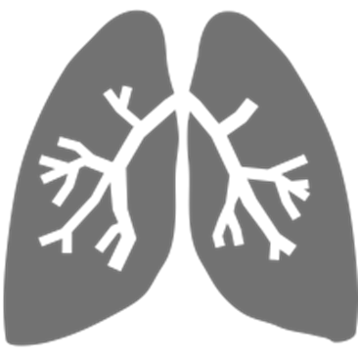
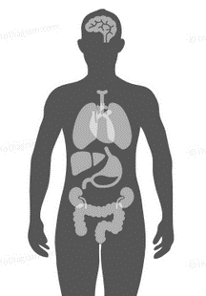
Conditions associated with hypoxaemia
Neonates
  Respiratory Distress Syndrome
  Neonatal pneumonia
  Transient tachypnoea of newborn
Children
  Pneumonia
  Interstitial lung disease
  Severe asthma
  Pulmonary edema
Neonates
  Severe Birth asphyxia
  Sepsis
  Congenital heart defects
Children
  Shock
  Meningitis
  Perioperative emergencies
  Trauma
  Carbon monoxide poisoning
WHO Oxygen therapy for children 2016

Slide 4

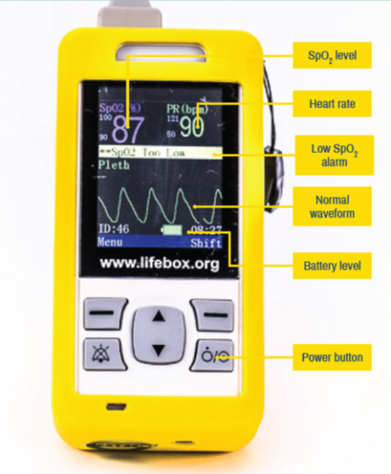

How to detect hypoxaemia
Clinical Signs
It is important for health workers to be able to identify clinical signs of hypoxaemia
Combination of clinical signs increases the chances of detecting hypoxaemia
Pulse Oximetry
Computerized unit and a sensor probe, which is attached to the patient
Displays the SpO₂ with an audible signal for each pulse beat and the pulse rate
Hypoxaemia is SpO₂<90%
Blood Gas Analysis
Measures the partial pressure of oxygen (PaO₂)and carbon dioxide in blood
Also measures blood pH and the concentrations of the main electrolytes
Hypoxaemia is PaO₂< 60mmHg
WHO 2016: Oxygen therapy for children: a manual for health workers
Notes:
If oximetry is not available, the following clinical signs could be used to determine use of oxygen therapy:
• central cyanosis
• nasal flaring
• inability to drink or feed (when due to respiratory distress)
• grunting with every breath
• depressed mental state (i.e. drowsy, lethargic)
In some situations, and depending on the overall clinical condition, children with the following less specific signs may also need oxygen:
• severe lower chest wall indrawing
• respiratory rate ≥ 70/min
• head nodding

Slide 5
Pulse oximetry in detection of hypoxaemia
What it measures
Most accurate non­invasive method for detecting hypoxaemia
Measures the percentage of oxygenated haemoglobin in arterial blood (SpO₂)
Clinical use
Performed on all patients requiring admission
In the outpatient department for children with fast RR & LCWI.
Reliable monitor for hypoxaemia- 5th Vital sign
Advantages
Detects 20–30% more children with hypoxaemia than clinical signs alone
Non –invasive and painless unlike blood gas analysis
Easy to use
Inexpensive and widely available
All health facilities should have a pulse oximeter with a neonatal & paediatric probe!
WHO 2016: Oxygen therapy for children: a manual for health workers
Notes:
pulse oximetry measures oxygen saturation by illuminating the skin and measuring changes in light absorption of oxygenated (oxyhemoglobin) and deoxygenated blood (reduced hemoglobin) using two light wavelengths: 660 nm (red) and 940 nm (infrared) .

Slide 6
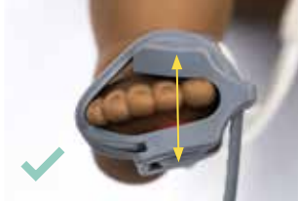
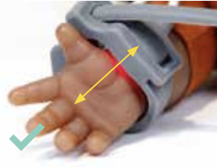
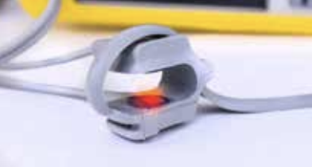
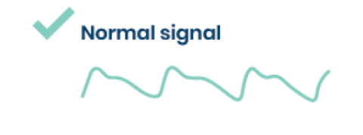
Using the Pulse Oximeter
a)
Attach probe to pulse oximeter
Press the power button to turn on the pulse oximeter
Ensure the probe has a red light and the settings are appropriate
Choose a well perfused site to attach probe
Attach the probe making sure the light source and sensor line up
Allow a normal trace to establish
Read the oxygen saturation
d)
c)
b)
e)

Slide 7
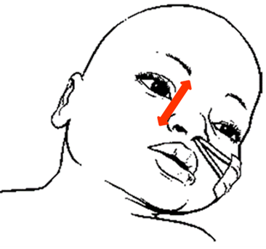
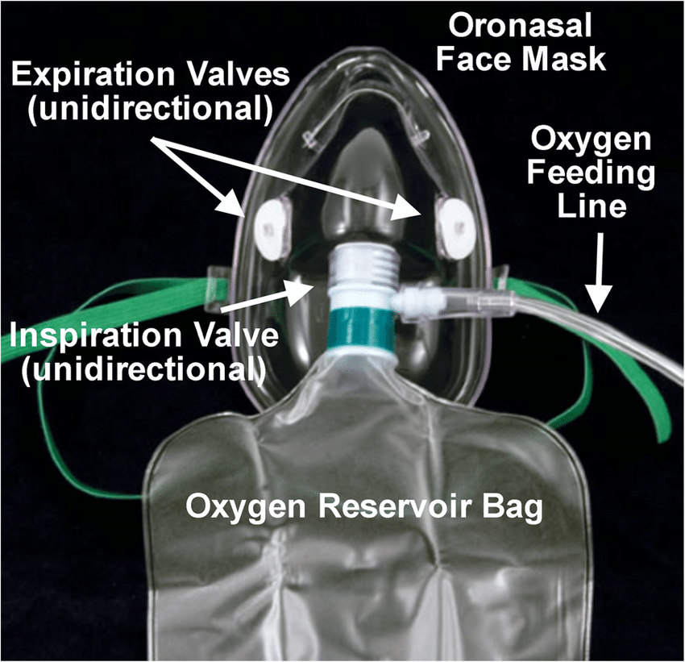
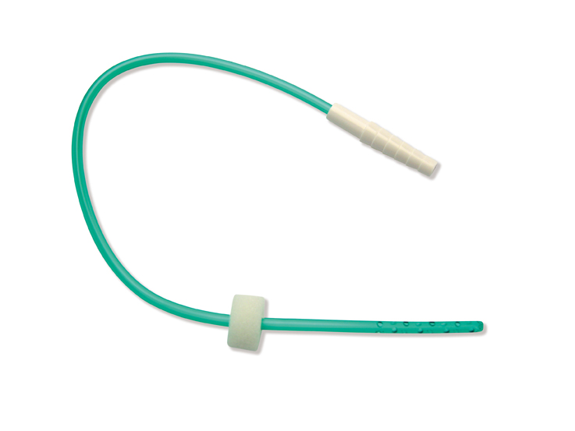
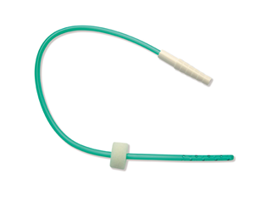
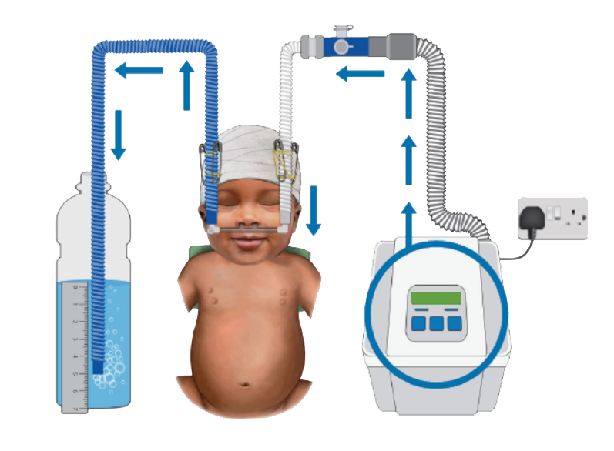
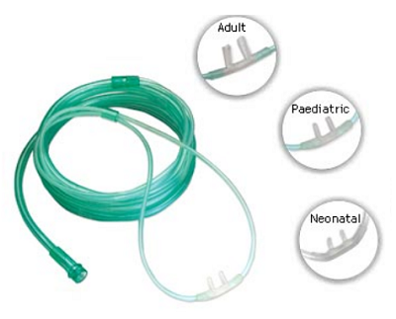
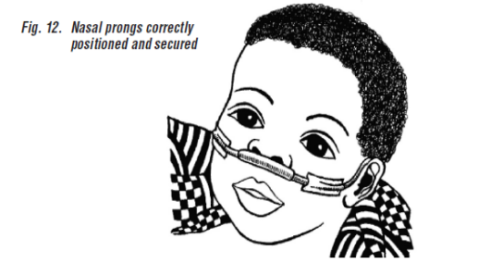
Oxygen Delivery Methods
Nasal Catheter
Non-Rebreather Mask)
Nasal Prongs
bCPAP
Kenyan Pediatric protocol 2016; WHO oxygen therapy for children 2016 : https://www.who.int/maternal_child_adolescent/documents/child-oxygen-therapy/en/

Slide 8
Titrating & Stopping Oxygen
(Refer to BPP 2022 Page 28)
When Oxygen is started, titrate every 15-30mins by 0.5L/min until SpO₂ is 90-96%
Change the oxygen delivery methods (nasal prongs, catheter or NRM) and flow rates based on need
Stop titrating and begin close monitoring if clinically stable (no emergency signs, SpO₂ > 90% and no increase WoB)
Wean off oxygen every 15 –30 min and carefully examine for changes in WoB and SpO₂ to assess whether supplemental oxygen is still required.
Once oxygen is stopped, recheck SpO₂ after 1h, as late desaturation can sometimes occur.
Discharge only if child has been stable with SpO₂ ≥ 90% and no increased WoB on room air for at least 24hrs
WHO oxygen therapy for children 2016 : Sources and delivery of oxygen; page 32-33

Slide 9

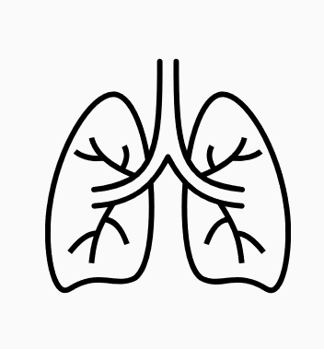

Complications of oxygen therapy a) O₂ toxicity (Hyperoxia, overdose >96%)
Peripheral vessels
CNS
Respiratory system
Makes them constrict which reduces blood supply to the organs
Produces toxic substances that destroys nerves making a patient present with symptoms e.g. convulsions
Can cause chest pain and irritation of the airway.
In the term long term can cause lung stiffness (fibrosis)
Helmerhorst, H.J.F., Schultz, M.J., van der Voort, P.H.J. et al. Bench-to-bedside review: the effects of hyperoxia during critical illness. Crit Care 19, 284 (2015). https://doi.org/10.1186/s13054-015-0996-4

Slide 10

Complications of oxygen therapy
b) Hypoxia (underdose <90%)
All body organs
Respiratory system
Makes all cells in the body function abnormally leading to organ failure and death
Makes the vessels in the lungs constrict and if they constrict for long this can cause high pressure in the lungs (pulmonary hypertension)
Michiels C. (2004). Physiological and pathological responses to hypoxia. The American journal of pathology, 164(6), 1875–1882. https://doi.org/10.1016/S0002-9440(10)63747-9

Slide 11

Summary
  Use of clinical signs should be augmented by use of objective measures e.g. by use of pulse oximeters
  Oxygen is a medicine, therefore it should be measured, given at the right dose and only when indicated.
  Correctly identify and administer oxygen to patients who need oxygen
O₂

