Slide 1

Oxygen Therapy

Slide 2

Objectives
Outline the indications of oxygen therapy
Describe the diagnosis and management of hypoxemia
Describe oxygen delivery methods
2

Slide 3
Conditions associated with Hypoxemia in Neonates
Respiratory system:
  RDS
  Aspiration e.g. meconium
  Neonatal pneumonia
  Transient tachypnoea of newborn
Neurological;
  Severe birth asphyxia
  Apnoea of prematurity
  IVH
Systemic
  Sepsis
  Metabolic disturbances
Cardiovascular
  Congenital heart defects
  PPHN
  Shock
3
Notes:
PPHN – Persistent Pulmonary Hypertension of the Newborn
IVH – Intraventricular Haemorrhage

Slide 4
How to detect hypoxaemia
1. Clinical Signs
2. Pulse oximetry
3. Blood gas analysis
Nasal flaring
Central cyanosis, Grunting with every breath
intercostal and sternal retraction
Severe lower chest wall indrawing
Respiratory rate ≥ 70/min
Non-invasive, painless method for detecting hypoxaemia
Measures the % of SpO₂ and PR
Hypoxaemia is fatal if not quickly detected and treated
Pulse oximeter is also necessary for oxygen therapy monitoring.
Measures the arterial oxygen saturation (SaO₂).
Also measures blood pH, PaO₂, PCO₂, HCO3 and the concentrations of the main electrolytes.
4
WHO 2016: Oxygen therapy for children: a manual for health workers

Slide 5
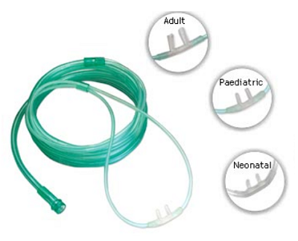
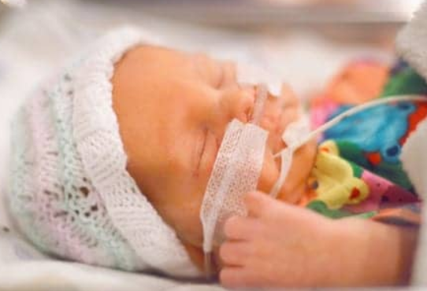
Oxygen Delivery devices
1. Nasal Prongs
Proper Use
Ensure airway is clear – suction if necessary and position
Instill 2 drops of normal saline into nostrils before inserting the prongs
Place prongs 2mm from nasal septum (Neonatal Nasal Prongs)
Secure on both cheeks with transpore adhesive, run the tubing to the back
Adjust flow rate
Kenyan Pediatric protocol 2016; WHO oxygen therapy for children 2016 : https://www.who.int/maternal_child_adolescent/documents/child-oxygen-therapy/en/
5

Slide 6
Flow Rates – Nasal Prongs
Flow Rate | Age Group | Volume | FIO₂
Standard | Preterm | 0.5L/min | 30 - 35%
 | Term | 1L/min | 30 -35%
High | Preterm | 1L/min | 45 - 55%
 | Term | 2L/min | 45 - 55%
N/B. Whenever possible blend oxygen to avoid giving 100% Oxygen
Kenyan Pediatric protocol 2016; WHO oxygen therapy for children 2016 : https://www.who.int/maternal_child_adolescent/documents/child-oxygen-therapy/en/
6

Slide 7
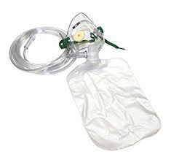

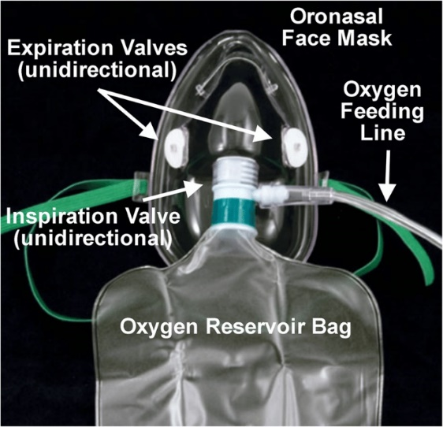
2. Non Rebreather Mask
Proper Use
Mostly used post resuscitation in babies requiring CPR
Ensure the airway is clear – suction if necessary and position
Ensure the reservoir is filled with oxygen before placing the mask on the newborn
Ensure the correct size of mask: covers nose and mouth –Neonatal Size
Adjust flow rate to 10 - 15L/min to achieve target SpO₂
Delivers 80 to 95% FIO₂
7

Slide 8
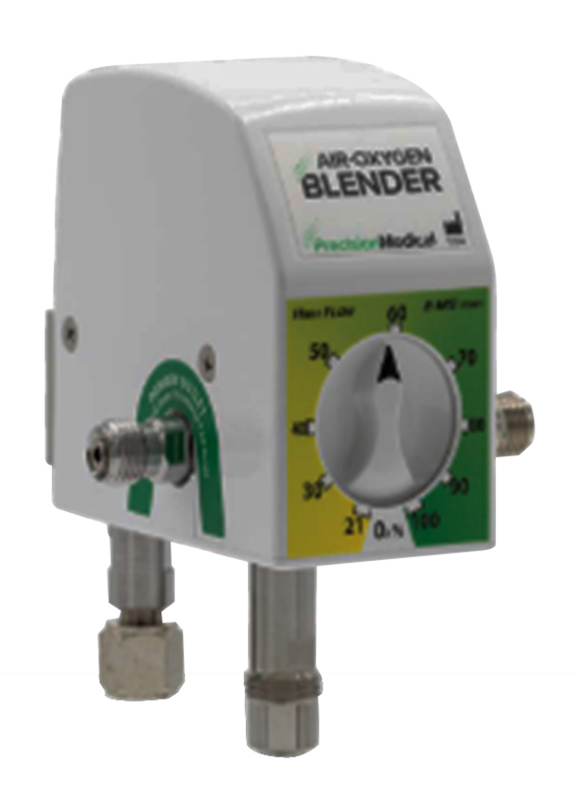
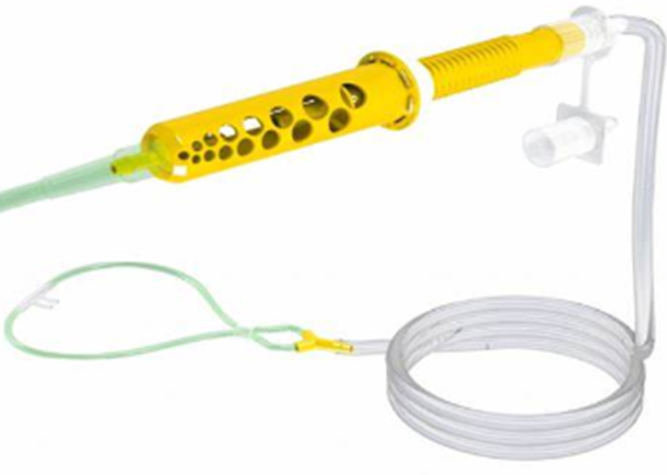
Introduction to oxygen blending
Oxygen blending involves mixing oxygen with room air/medical air to achieve a specific concentration (FiO₂) using an Oxygen blender
Ensures newborns receive the optimal level of oxygen for their needs
FiO₂ can not be determined if oxygen delivery devices e.g. nasal prongs are connected directly to the oxygen source.
Best way to control FiO₂ is using oxygen blenders
8

Slide 9
Why is oxygen blending crucial
Precise Oxygen Delivery: Avoids hyperoxia and hypoxia
Supports Development: Helps in the proper development of lungs and other organs.
Prevents Oxygen Toxicity:
Blender Device: Mixes oxygen and air to the desired FiO₂.
Flow Meter: Controls the flow rate of the oxygen/air mixture.
Delivery Interface: Nasal cannulas, masks.

Slide 10
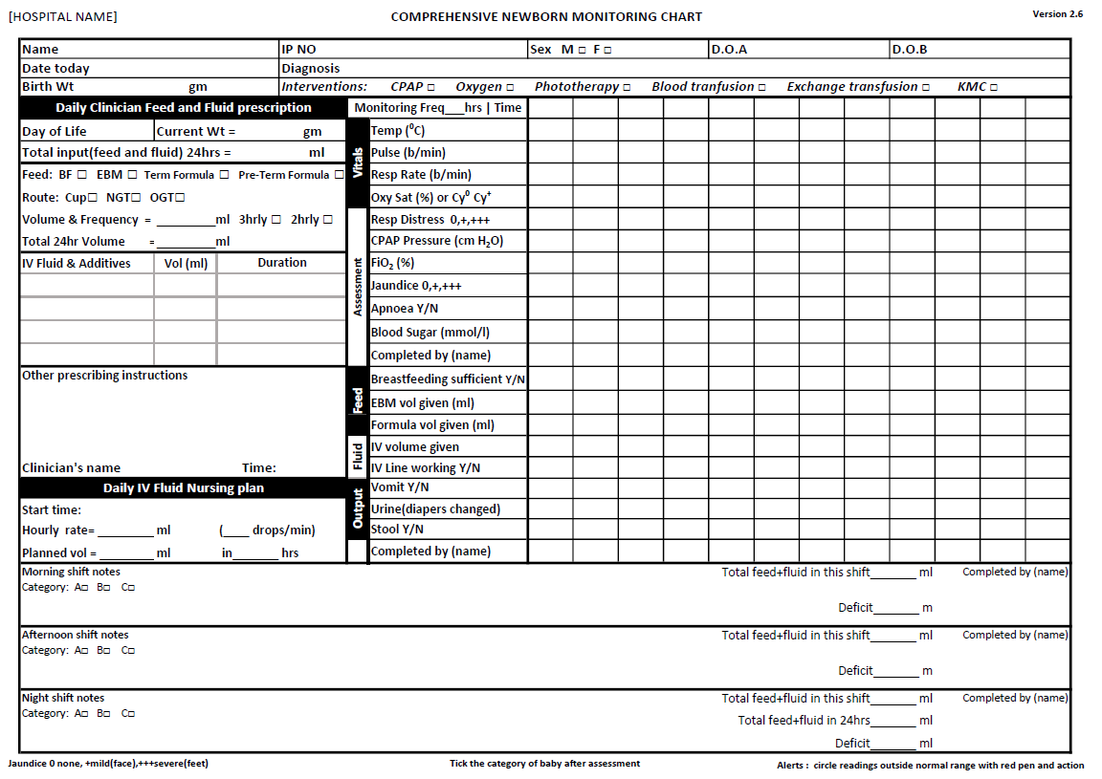
Monitoring Oxygen Therapy
10

Slide 11
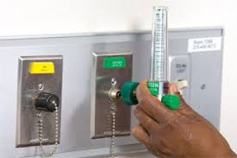
Titration of oxygen
Titration: Increase flow rates by 0.5 l/min every 15-30 mins until Spo2 is 90-95%
If using a blender titrate the FiO₂
Change the oxygen delivery methods (nasal prongs or NRM) & flow rates based on need
Stop titrating and begin close monitoring if:
  Clinically stable (no emergency signs)
  SpO₂ > 90%
  No increased Work of breathing
11

Slide 12
Weaning off oxygen
With clinical improvement wean off O₂ by decreasing flow by 0.5 l/min every 15- 30 minutes
Determine if oxygen therapy is still required based on SpO₂ and work of breathing.
Once oxygen is stopped recheck the SpO₂ after 1 hour (late desaturation can occur)
Discharge only if the newborn has SpO₂ > 90% and no laboured breathing on room air for at least 24 hours to ensure no late decompensation
12

Slide 13
Oxygen Therapy Complications
Hypoxia
SpO₂ - <90%
Increases mortality
Neurodevelopmental impairment
NEC
Hyperoxia
SPO₂ - > 95%
Free radicals that cannot be metabolized by immature antioxidant systems.
Chronic lung disease - BPD
Eye Injury - ROP
Prevention of oxygen complications
Monitor SpO₂
Aim for O₂ saturation of 90-95%
Titrate/wean off the O₂ based on the FiO₂ and/or SpO₂
13
Walsh BK, Smallwood CD. Pediatric Oxygen Therapy: A Review and Update. Respir Care. 2017;62(6):645‐661. doi:10.4187/respcare.05245
Notes:
Premature infants are at particular risk from oxidative stress because both endogenous and passively acquired exogenous antioxidant defense systems do not accelerate in maturation until late in the third trimester.
Saugstad- has suggested the term oxygen radical disease of neonatology to encompass a variety of newborn diseases whose pathogenesis involves oxidative stress and injury, which include retinopathy of prematurity, bronchopulmonary dysplasia (BPD), necrotizing enterocolitis, and intraventricular hemorrhage.
BPD- bronchopulmonary dysplasia
ROP-retinopathy of prematurity

Slide 14

?
Questions
14

Slide 15

Summary
Oxygen is a drug, therefore it should be properly prescribed, administered and monitored.
Correctly identify and administer oxygen to patients who need oxygen.
Use of oxygen blender helps to prevent oxygen toxicity
15

