Slide 1


Pulse Oximetry

Slide 2

Objectives
Outline the role of pulse oximetry
Describe the indications of pulse oximetry
Outline the advantages of using a pulse oximeter
2

Slide 3

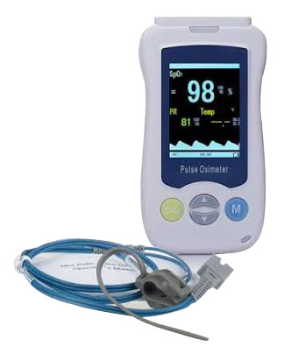
Pulse Oximetry
Non-invasive, painless method for detecting hypoxaemia
Measures the % of oxygenated haemoglobin in arterial blood (SpO₂) and PR
Should be performed on all patients requiring admission
Hypoxaemia is fatal if not quickly detected and treated
Pulse oximeter is also necessary for oxygen therapy monitoring.
3
Notes:
Pulse oximetry is considered to be the 5th Vital Sign
Pulse Oximetry : Is a test used to measure the oxygen levels (oxygen saturation) of the blood. It is a non-invasive, painless and easy measure of how well oxygen is being sent to parts of the body farthest to the heart, such as the arms and legs- John Hopkins
How is Pulse Oximetry Conducted: A pulse oximeter is used. This is a medical device used to measure the % of the blood that is carrying oxygen (oxygen saturation) as well as a reading on the heart rate. A probe with light beams is attached to the finger, ear lobe or toe to measure the oxygen saturation. The readings of both oxygen saturation and pulse rate is displayed on the monitor part of the pulse oximeter device
Interpreting the pulse oximeter Readings: Oxygen saturation reading ≥ 95% is considered to be normal while oxygen saturation  90% is considered low (hypoxaemia) and requires oxygen therapy/supplementation.

Slide 4
Indications for using pulse oximetry
Used to monitor newborns post-delivery, during and after resuscitation
During Triage – SpO₂ is a vital sign
To determine the need for O₂ therapy
Monitoring when on O₂ therapy
Screening for Critical Congenital Heart Diseases
Monitoring of PR and O₂ saturation of admitted neonates
4

Slide 5
Advantages of using a Pulse Oximeter
  Detects 20–30% more babies with hypoxemia than clinical signs alone
  Non – invasive and painless unlike blood gas analysis
  Easy to use
  Inexpensive and widely available
All health facilities should have pulse oximeters with neonatal probes!
5
WHO 2016: Oxygen therapy for children: a manual for health workers

Slide 6
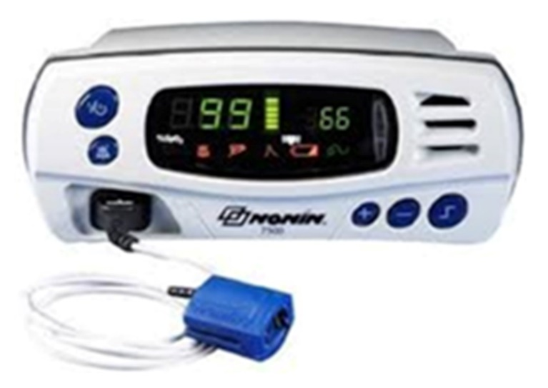
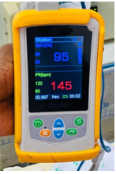
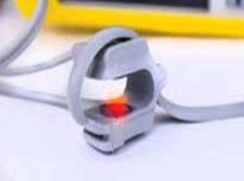
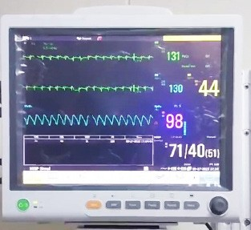
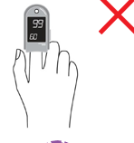
Devices used for pulse oximetry
Neonatal probe
Recommended for Newborns
Bench Pulse Oximeter
Handheld Pulse Oximeter
Not Recommended for Newborns
Cardiac monitor
Finger tip pulse oximeter
6

Slide 7
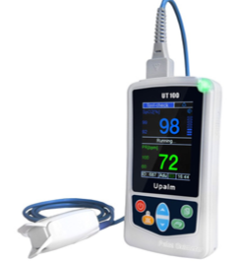


Components of a handheld pulse oximeter
Status Indicator Light
Scroll Button
LCD Display
Menu Button
On/Off button
Menu Button
SpO₂ probe
Silence Button
Ideal for neonates
Wide variety exists; each manufacturer has different specifications
7

Slide 8

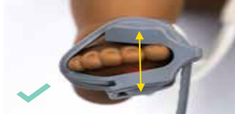
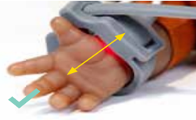
Neonatal Probe
Ideal for newborns (finger or toe is too small to attach a clip).
Wrapped around the palm or foot.
Are flexible bands, or sensors held on by a small wrap
Extra care should be taken on neonatal skin, which is quite thin and sensitive.
Probes should be repositioned every 3 hours if affixed for continuous monitoring
8

Slide 9

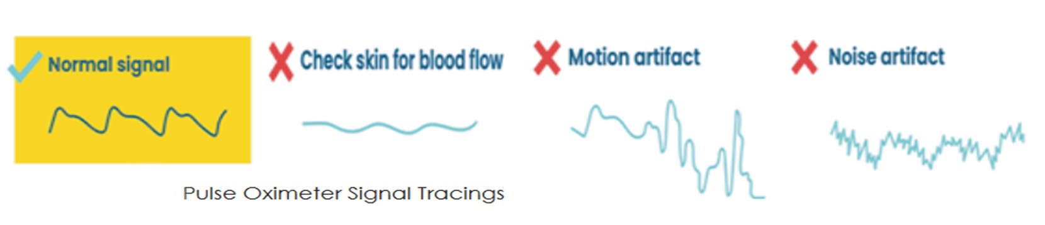
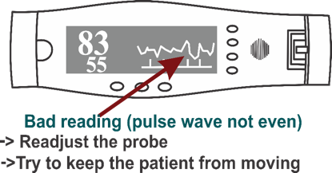
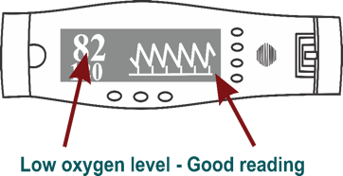
Oxygen saturation reading interpretation – pulse wave
9
Notes:
Indicate that you can still get a reading with SPO2 when the wave is not adequate eg when the patient is moving. Its important that you have the right wave

Slide 10
What conditions would give inaccurate readings
  Severe hypotension or anemia
  Venous congestion of the limbs
  Exposure to intense external light energy (as in phototherapy)
  Hypothermia
  Patient movement
  Skin hyperpigmentation
  Carbon monoxide poisoning
  Tissue injury at probe site
10
Notes:
Tissue injury may occur at the measuring site as a result of probe misuse (e.g., pressure sores from prolonged application

Slide 11

?
Questions
11

Slide 12


Summary
Pulse oximetry is a non-invasive, painless method to detect oxygen saturation (SpO₂) and Pulse rate.
For newborns use a neonatal probe (finger or toe is too small to attach a clip).
12

