Slide 1

Module 1:Triage

Slide 2

Objectives
Definition of Triage
Identify and act on the ABCD for emergency signs.
Identify and act on 3Ts, 3Ps, 3Rs and MOB for priority signs

Slide 3
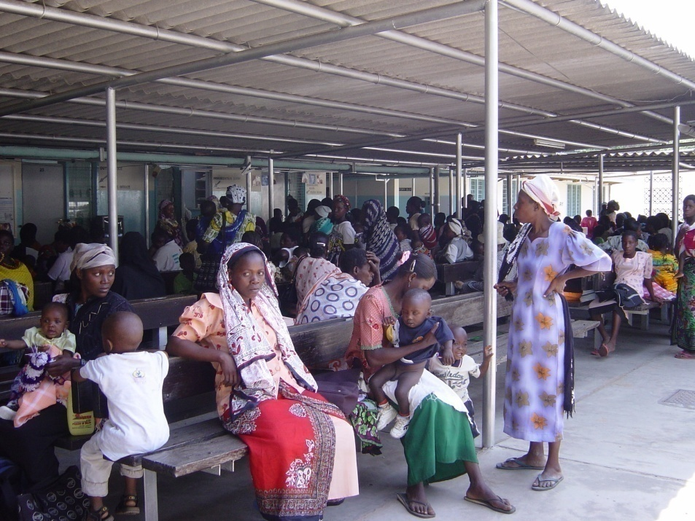
What is triage?
Triage is sorting and prioritizing patients based on the severity of their conditions.
It ensures that those needing immediate medical attention receive it promptly

Slide 4
Why triage?
Some children will die waiting to be seen
Of all the children dying in hospital >50% will die within 24 hours.
Some children can only be saved if treatment starts immediately.

Slide 5

Who can do triage?
Anyone:
  Doctor / Clinician
  Nurse
  Nutritionist
  Community Health Promoter
  Cleaner
  Askari
  Records Clerk

Slide 6
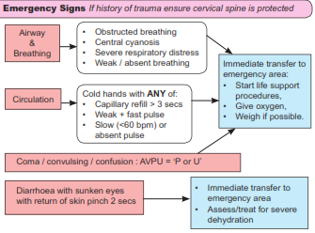
Emergency signs
Immediate Action
Take to emergency area
Clinician / Nurse sees NOW

Slide 7

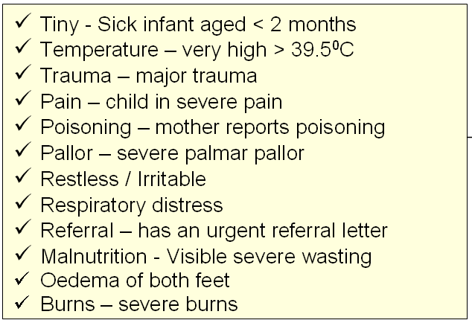
Priority signs
Emergency Care
Send to the front of the queue
Clinician review as soon as possible
Weigh
Baseline observations
3 Ts
3 Ps
3 Rs
MOB

Slide 8
Non- urgent signs
Emergency Care
Priority Care
Non-urgent
– Wait in the queue

Slide 9

Summary
Triage is SORTING only. Diagnosis and treatment is not the responsibility of the person doing triage
In a busy department it is a continuous / frequent process
Departments need to be organised so that emergencies and priorities can be appropriately handled

