Slide 1

Use of a plastic bags/wraps in preterm newborns

Slide 2

Objective
Rationale for use of plastic wraps in preterm infants <32 weeks
Steps to follow when using a plastic wrap
Removing the plastic wrap
2

Slide 3
Introduction
Hypothermia immediately after birth is common in newborns especially in preterm infants
Occurs due to challenges in transition to extrauterine life
Causes of poor thermoregulation in preterm infants
Thin skin/ immature skin barrier
Large surface area to volume ratio
Lack of subcutaneous fat
Limited metabolic response to cold e.g. shivering
Impact of hypothermia
Associated with
  Complications e.g. respiratory distress, hypoglycemia, metabolic acidosis & sepsis
  Death-Each 1°C drop below 36.5°C,at admission, increases mortality risk by 28%
3
Laptook AR, Salhab W, Bhaskar B. Admission temperature of low-birth-weight infants: Predictors and associated morbidities. Pediatrics. 2007;119(3):e643–9. 10.1542/peds.2006-0943. [PubMed]
Notes:
Hypothermia increases the risk of:
Respiratory distress
Hypoglycemia
Metabolic acidosis
Sepsis
Death

Slide 4
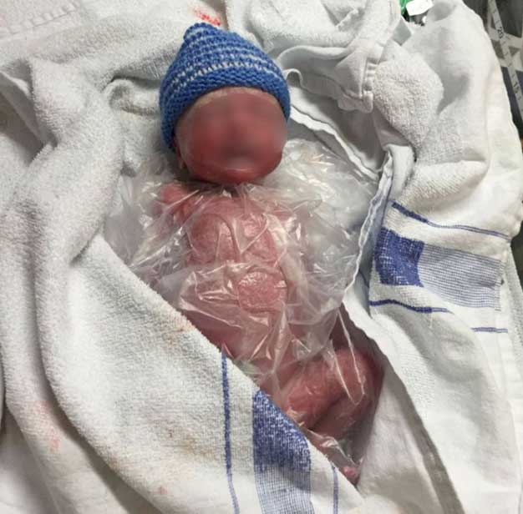
Rationale for use of plastic bag/wrap at delivery
Reduces the incidence of hypothermia in preterm newborns
Reduces heat loss through evaporation and convection
Current recommendation
Use of plastic bags/ wraps recommended for preterm babies below 32 weeks.
4
McCall EM, Alderdice F, Halliday HL, Vohra S, Johnston L. Interventions to prevent hypothermia at birth in preterm and/or low birth weight infants. Cochrane Database of Systematic Reviews. 2018(2)
Notes:
Use of plastic wraps in addition to routine thermal care at delivery reduces the incidence of hypothermia on admission and up to 2 hours

Slide 5
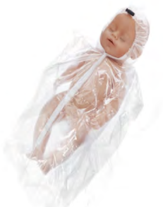
Steps to follow when using a plastic bag/wrap
Preparation for warmth prior to delivery of a prem <32 weeks
Warmth
Warm, draught-free room (temp 25-28%)
Prewarmed radiant warmer
2 dry towels and hat( prewarmed under radiant warmer)
Plastic wrap/bag- do not allow to overheat if under radiant warmer
Neo HeLP heat loss bag
Notes:
Bring out that it can be used during transport

Slide 6
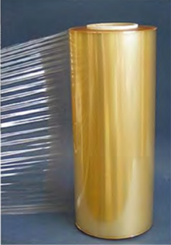
Steps to follow when using a plastic bag/wrap
Initial stabilization
After delivery:
Receive & carefully place the newborn in the plastic bag/ on the occlusive plastic wrap without drying
Cover the baby’s entire body excluding the head
Dry the head(assess need for resuscitation) and cover it with a hat
If resuscitation is needed, immediately clamp & cut cord, if not required practice delayed cord clamping
Transfer baby to radiant warmer- perform assessment/resuscitation if needed through the plastic wrap/bag
Attach temp probe on baby’s skin, change to baby mode, maintain temp at 36.5-37.5 ⁰C
Remove the plastic wrap/bag once baby is stable and an alternative method of keeping baby warm e.g. KMC is available
Food Grade Plastic Wrap (Alternative)

Slide 7
Removing the plastic wrap
Ensure warm room and availability of other methods of thermal care
Gently open the plastic bag/tear off the plastic wrap from the baby’s body
Dry the baby’s body
Immediately institute other thermal care methods e.g. KMC or incubator care
Check baby’s temperature 30 minutes after removing the plastic bag/wrap
Ensure normothermia is maintained.
Discard the plastic wrap

Slide 8

Questions

Slide 9

Summary
Preterm newborns have an increased risk of developing hypothermia
Each 1°C drop below 36.5°C,at admission, increases mortality risk by 28%
Use of plastic wraps at birth reduces the incidence of hypothermia at admission
It is recommended for all newborns <32 weeks gestation

