Slide 1

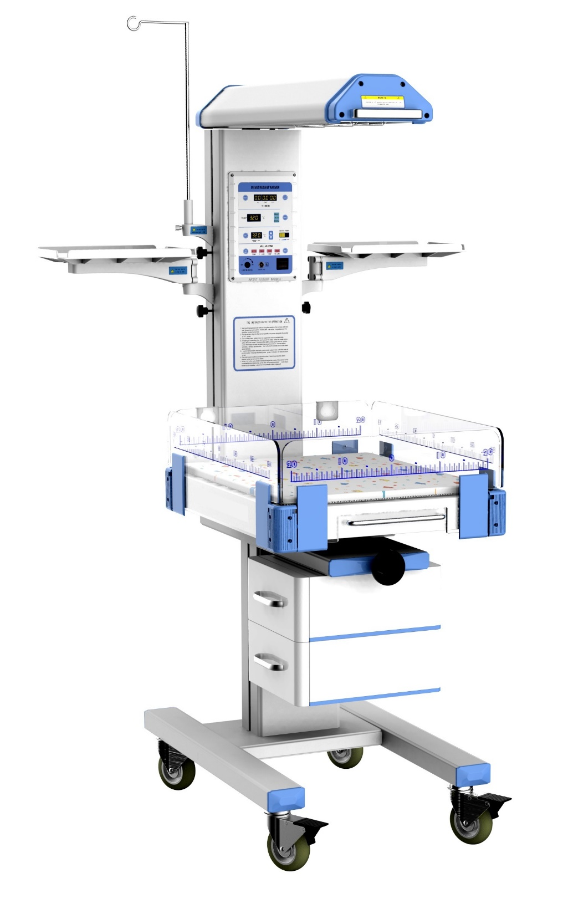
Use of a radiant warmer

Slide 2

Objectives
  Illustrate different parts of radiant warmer
  Discuss different modes of radiant warmer
  Highlight advantages of radiant warmer
  Discuss the care of the radiant warmer
2

Slide 3
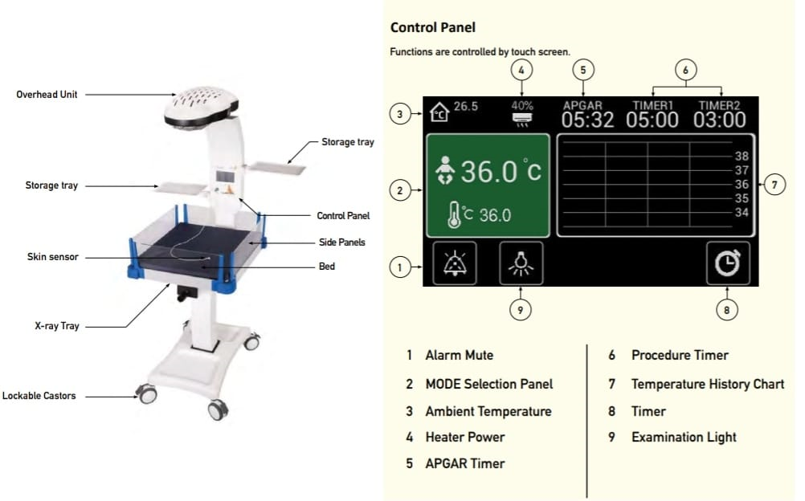
Radiant Warmer

Slide 4
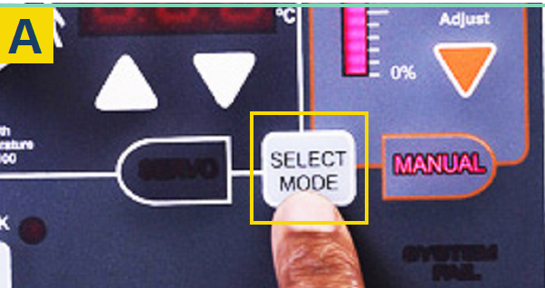
The Radiant Warmer - Modes
Prewarm (25% power): Provides constant low heat to warm cot bedding before placing baby on the device
Automatic (Servo or baby mode): Adjusts heating to maintain baby’s temperature within normal range. Should always be used with a temperature probe.
Manual: Provided constant heat set by the user.
4

Slide 5
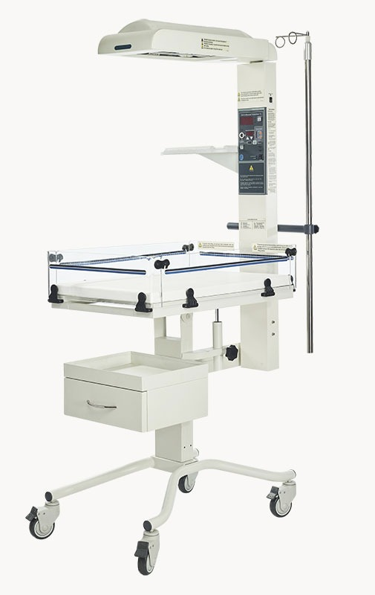
Control Panel
Baby’s Temp.
Alarm mute
Low Temperature
Set temperature
Adjust output
Heater output
Temp probe
Select mode
Power button
Heating element
5

Slide 6
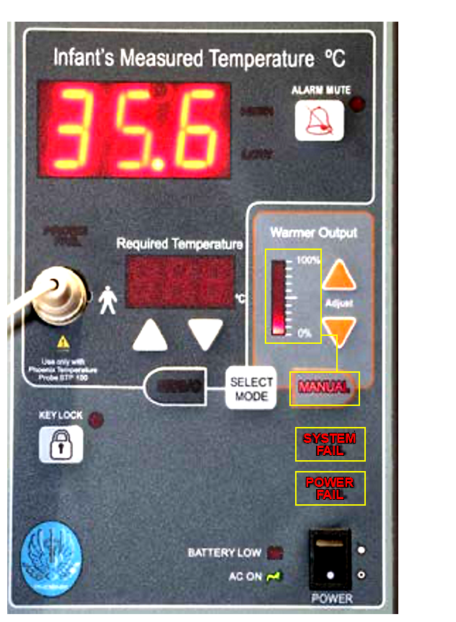
The Radiant Warmer - Alarms
High temperature (>0.5°C difference in baby mode and >38°C when in manual mode)
Low infant temperature (<0.5°C difference in baby mode)
Sensor disconnect alarm – when sensor is unplugged or faulty when in baby mode
Power failure alarm
Time out Manual mode alert alarm (every 15min)
Error alarm
6

Slide 7
The Radiant Warmer - Caution
All preterms require strict temperature regulation & monitoring while under the radiant warmer during resuscitation.
Switch from prewarm mode to baby/servo mode after stabilizing the baby.
For asphyxiated babies maintain normothermia
7

Slide 8




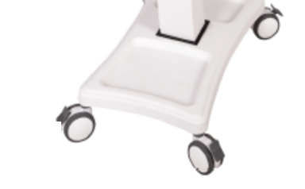
The Radiant Warmer - Preparation
1. Know the type of radiant warmer, its parts and how to use them
4. Observe hand hygiene and wear PPE
2. Assemble all necessary items for resuscitation
5. Clean temperature probe with 70% alcohol and attach to warmer
3. Lock the radiant warmer castors to secure it in place
6. Switch the warmer on and set Prewarm mode
8

Slide 9


Preparation Requirements
Direct power source
Temp sensor (probe)
Clean mattress
Linen to cover the mattress
Cotton swabs with 70% alcohol Items for the specific procedure
Alcohol based hand rub
Medical adhesive tape
A thermometer
Plastic Wrap (if below 32 weeks GA)
Items for the specific procedure
FCC!
9

Slide 10
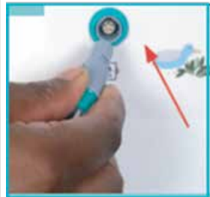

The Radiant Warmer Connecting to Peripherals
Connecting Temperature Probe
Connecting Power Cable
While plugging in the probe make sure the ridge is slotted in the groove of the port.
Plug in the power cable at the power port located at the backside of the warmer.
Wallaby radiant warmer user manual (2019) www.mtts-asia.com
10

Slide 11
The Radiant Warmer advantages
Permits the radiant heat to reach the baby
Allows full visualization
Allows easy access to the baby without excessive heat loss
11

Slide 12
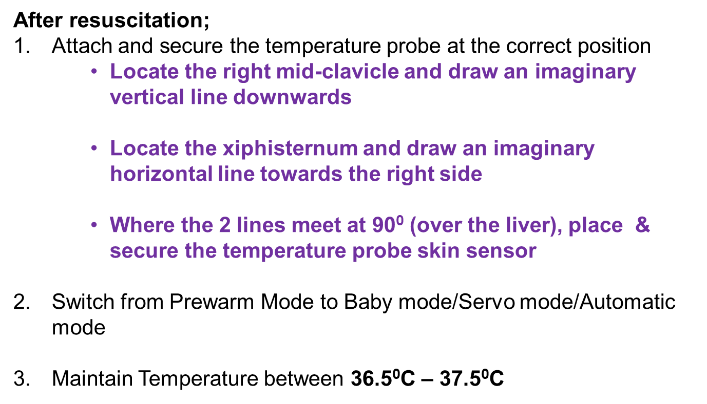
The Radiant Warmer – Probe Use
12
Notes:
Create new slide and remove the sentence after resuscitation

Slide 13
The Radiant Warmer – Function Check
In order to verify the operation of auditory and visual alarms, perform the following procedure:
  Select Baby mode and unplug the temperature probe.
  Check for alarm on the display and an audible alarm sound
  Switch off power from the wall socket.
  Check for power failure audible alarm sounds from the warmer.
NB: If alarms are not activated while doing the above, the warmer is faulty and should not be used.
13

Slide 14
The Radiant Warmer – Do Not!
Cover the overhead unit when in use.
Move the warmer while the brakes are engaged.
Move the warmer by holding the side panels use the mounting arm.
Pull the temperature probe in an attempt to unplug it, without engaging its latch.
Pull the temperature probe cable while cleaning.
Place anything beyond 5kgs on the side trays.
Clean the infant radiant warmer’s heating element.
Operate the warmer where there is direct heat from the sun.
14

Slide 15
?
Questions?

Slide 16

Summary
Pre warm mode provides constant low temperature used before placing the baby on the bed
All preterm require strict temperature regulation & monitoring while under the radiant warmer during resuscitation
For asphyxiated babies maintain normothermia
16

