Slide 1

Use of Continuous Positive Airway Pressure (CPAP) in newborns

Slide 2

Objectives
Outline indications for CPAP
Discuss timing and initiation of CPAP
Discuss monitoring of a patient on CPAP therapy

Slide 3

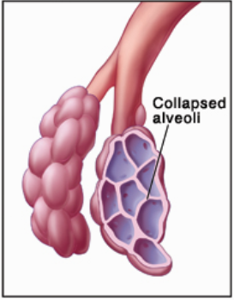
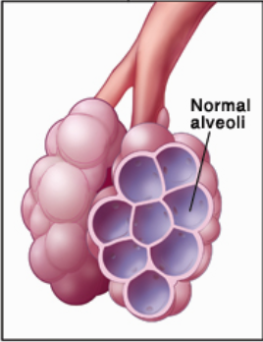
Introduction
CPAP is a non- invasive method of respiratory support
Benefits of CPAP
CPAP
Improves oxygenation
Continuous distending pressure which keeps alveoli open
Promotes Lung growth and development.
Promote surfactant production
Image borrowed from https://newbornsbaby.blogspot.com/2019/01/premature-baby-lung-complications.html
3
Notes:
An important aspect of understanding FRC (and the respiratory cycle in general) is knowledge of the forces involved. There are 2 main mechanical forces throughout the breathing cycle: the force of the chest wall and the force of the lungs. Without the necessary physiological pressures, the chest wall would expand outward, and the lungs would collapse. This is what occurs when the vacuum is disrupted such as with a stab wound leading to a pneumothorax. FRC is the point at which these forces are at equilibrium; that is, the difference between the inner recoil forces of the lungs and the outer recoil forces of the chest wall are balanced

Slide 4



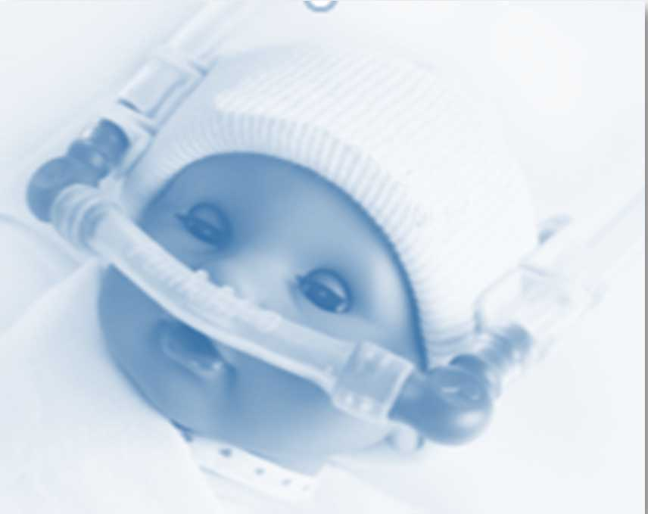
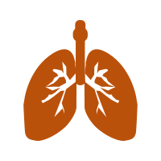
Why use CPAP??
In-utero
CPAP
Fetal lungs in utero remain distended due to the pressure of 3 – 4 cmH₂0 maintained by the fluid in the fetal lungs
CPAP mimics normal physiology.
Constant distending pressure at 3 – 4 cmH₂0.
Nasal Continuous Positive Airway Pressure (CPAP)for the Respiratory Care of the Newborn Infant Robert M DiBlasi RRT-NPS 2009
Image borrowed from https://consultqd.clevelandclinic.org/bubble-cpap-for-prevention-of-chronic-lung-disease-in-premature-infants/
4
Notes:
By avoiding endotracheal intubation and mechanical
ventilation, the constant distending pressure maintained in
the lung by CPAP may also provide some physiologic
benefits regarding lung protection and development. In
utero the transpulmonary pressure of the fluid-filled developing
lung is approximately 3–4 cm H2O.51 Coincidently,
CPAP at 5 cm H2O results in nasal pharyngeal
distending pressure of approximately 2–3 cm H2O.52 In
theory, spontaneous breathing, at a constant “low” distending
pressure, as provided by CPAP, would seem to be
more likely to provide some mechanical similarities to the
lungs in the intrauterine environment, promoting lung
growth/development and protection, than would mechanical
ventilation, which uses relatively high inflation pressure.
Much of the experimental evidence used to evaluate
these physiologic effects has been limited to a few studies
using animal models of prematurity

Slide 5
Indications for CPAP
The main indication is in the management of respiratory distress syndrome (RDS)
Other indications include;
  Meconium aspiration syndrome
  Transient tachypnoea of the newborn
  Persistent pulmonary hypertension of the newborn
  Pulmonary oedema
CPAP is also used in the prevention of apnoea of prematurity
5

Slide 6
Timing of CPAP initiation
Prophylactic CPAP | Rescue CPAP
< 32 weeks Initiated as soon as possible preferably in the delivery room Preterm with no signs of distress Good cardiac activity breathing spontaneously Reduces the need for mechanical ventilation | ≥ 32 weeks Signs of respiratory distress one or more of the following; Tachypnoea (RR>60bpm), Nasal flaring, Grunting, Sternal retraction, Lower chest indrawing Initiated after failed trial of oxygen therapy for 15 minutes Neonate with increased work of breathing and SpO₂< 90% on nasal prongs at 1L/min
Nasal Continuous Positive Airway Pressure (CPAP)for the Respiratory Care of the Newborn Infant Robert M DiBlasi RRT-NPS 2009
6

Slide 7
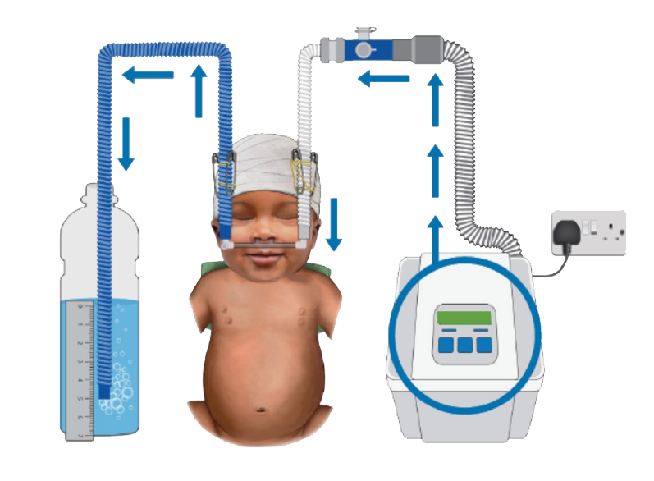
bCPAP Components
4
2
Five key components of bCPAP:
A source of continuous airflow
Inspiratory tube
Nasal Interface
Expiratory tube
Pressure-generating bottle
3
5
1
7

Slide 8
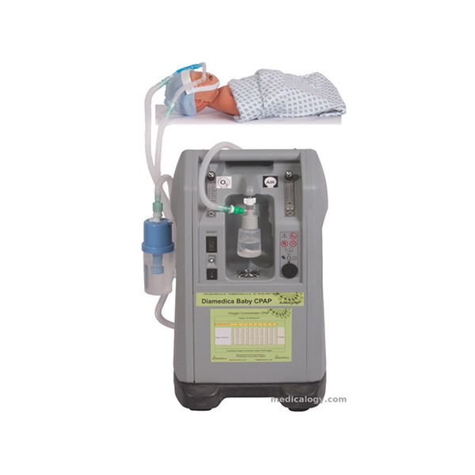
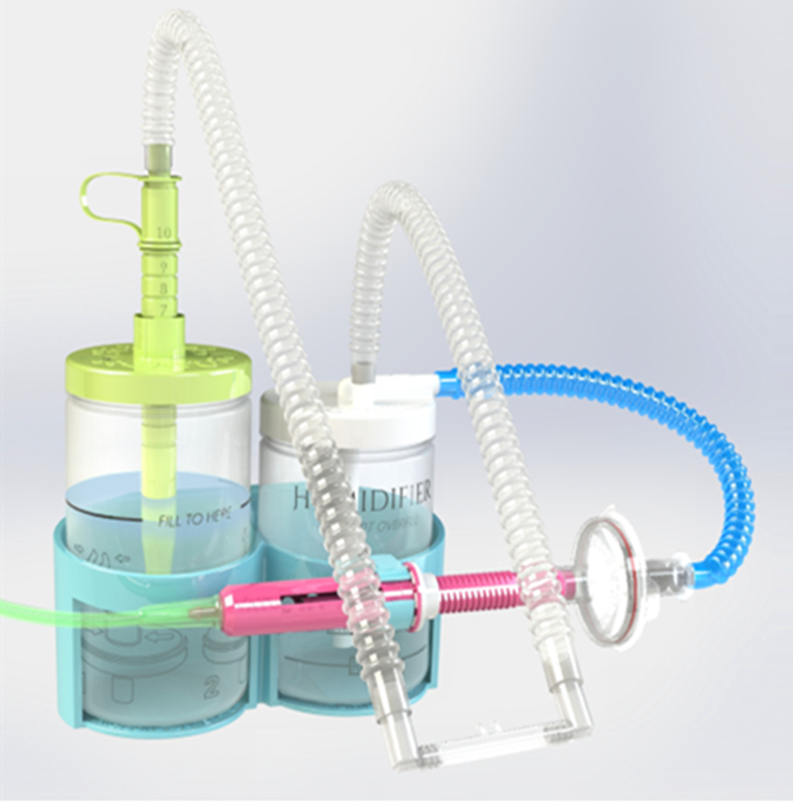
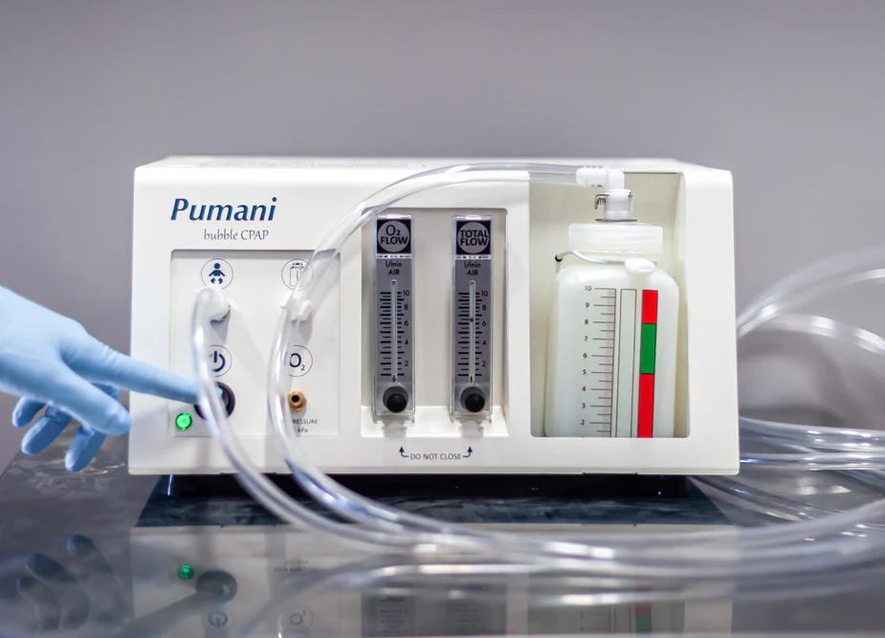
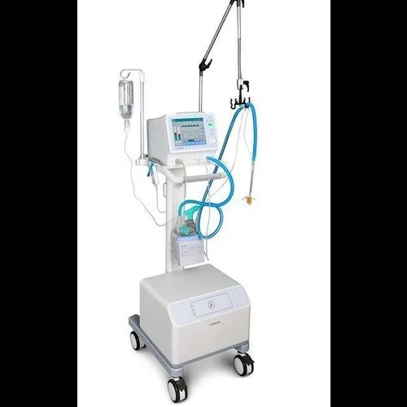
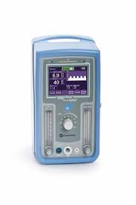
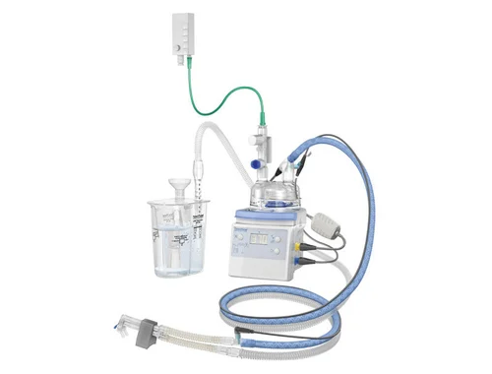
CPAP Devices
VAYU bCPAP
PUMANI bCPAP
DIAMEDICA BABY bCPAP
FISHER AND
PAYKEL bCPAP
COMEN CPAP
CAREFUSION CPAP
8

Slide 9
General principles for preparing a bCPAP machine for use
Observe IPC measures
Fill pressure generating and humidifier bottle with distilled water to the indicated level.
Connect both the inspiratory and expiratory tubing appropriately
Connect the correct size of the interface to the inspiratory and expiratory tubing
Connect an oxygen source to the air/oxygen blender
Set the oxygen flow (as per manufacturer instructions)
Set PEEP at 6cm of H₂O and FiO₂ of 50 % then adjust appropriately
Test for functioning (bubbling) Occlude the interface inlet with your finger
  Observe for bubbling in the pressure-generating bottle.
Machine is ready for use
9

Slide 10
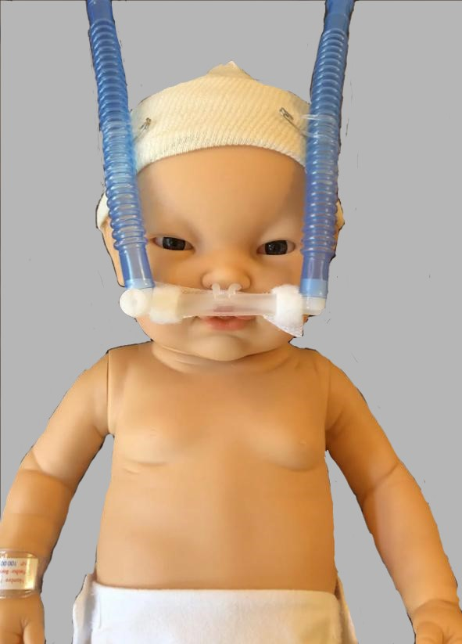
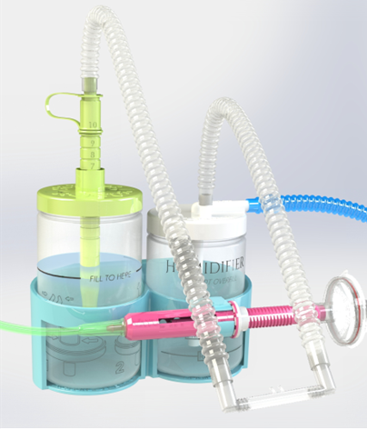
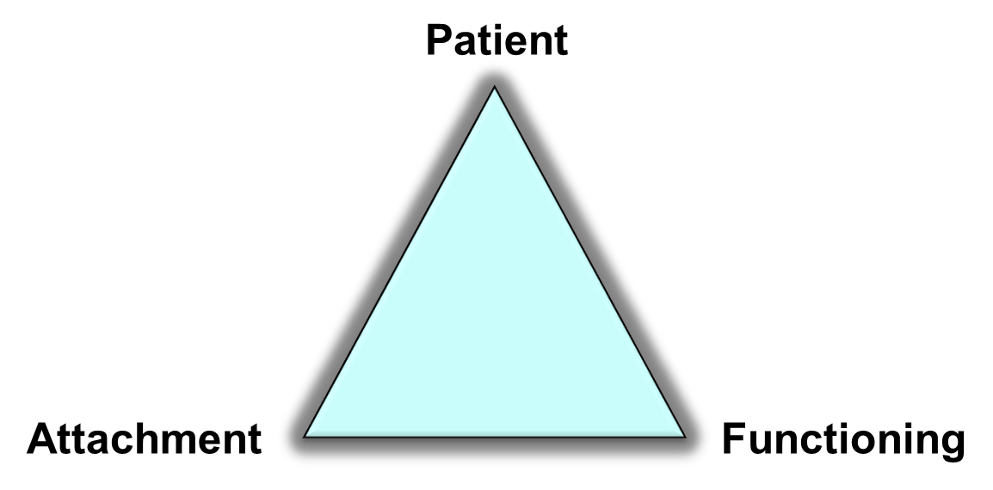
Monitoring
3 hourly monitoring of
Vital signs-RR, HR, Spo2,Temp
Work of breathing
Nasal blockage (instill normal saline)
Abdominal distension
Position of the prongs
Nasal septum intact
Tubing not kinked
Hat snuggly fit
Correct water level
Ensure oxygen flow
Ensure there is bubbling
Humidifier is filled
Correct blender setting
10
Notes:
Monitor patient;
Vital signs (respiratory rate, heart rate, SPO₂ and temperature)
Work of breathing
Nasal blockages - Provide a few drops of saline to each nostril
Abdominal distension – ensure oral gastric tube is in situ and open.
Check Attachment
Check position of the prongs - Prongs should not be against the nose
Check nasal septum for skin compromise
Check tubing - Tubing should not be kinked or misplaced
Check that the hat is not loose; if it is loose, replace with new hat
Check Equipment Function
Check water level: If water level is below or above the decided treatment level, add or remove the water from bottle cap holes using a syringe and an NG tube. Decrease or increase by 1cm of H₂O. For Pumani CPAP 1cm of H₂O = 40mls of water
Check that the CPAP is bubbling. If not may be due to the patient’s mouth being open or nasal prongs not fully fitting the patient’s nostrils.
Check that the seal at the patient port is not cracked
Check that oxygen and total flow settings are correct

Slide 11
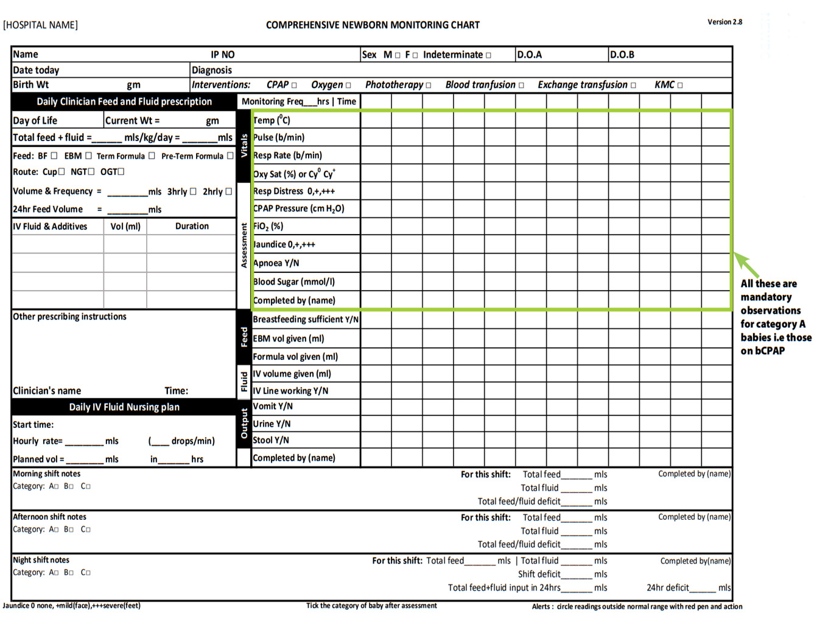
11

Slide 12

Questions

Slide 13

Summary
CPAP promotes lung growth/development and protects the lungs.
CPAP should be initiated at an FiO₂ of 50%, PEEP of 6cmH₂O, which is then titrated to achieve oxygen saturation targets of 90-95%.
Regularly monitor patient to optimize CPAP benefits and reduce risk of complications.

