Slide 1

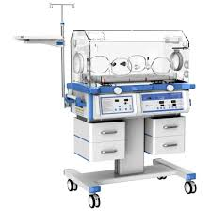
Use of Incubator

Slide 2

Objectives
  Discuss temperature setting of an incubator
  Illustrate the importance of incubator humidification
  Demonstrate the setting of incubator humidity
2

Slide 3
Servo-controlled mode incubator
Switch the control to manual (AIR) and preheat to 37°C
Place the baby in the incubator and attach the temp probe to the baby’s skin (The right side of the abdomen is best)
Make sure that the cable from the baby’s skin is correctly plugged into the incubator
Switch the incubator control from manual (AIR) to servo-controlled (SKIN)
Set the required skin temperature to 36.5°C on the control panel
The actual skin temp will be displayed on the panel
3

Slide 4
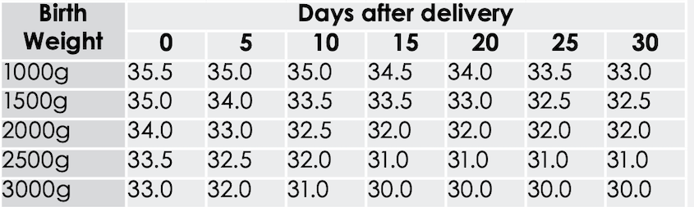
Incubator temperature setting
4

Slide 5
Humidification
Skin of a fetus begins to keratinize from 18 weeks gestation to 32-34 weeks gestation.
All neonates <30 weeks should be provided with incubator humidity due to lack of full skin keratinization.
Humidification is used to:
  reduce high levels of transepidermal water loss (TEWL)
  maintain electrolyte/fluid status
  maintain body temperature (36.5-37.5⁰C).
5

Slide 6
Incubator Humidification
Babies ≤27 completed weeks GA
Commence humidity of at least 80% and maintain at 70-80% for first 7 days
Wean by 5% each day if temp and fluid balance are stable on day 8.
Discontinue incubator humidity when 40% is achieved or at 21 days (whichever is reached first).
Babies 28-29 completed weeks GA
Commence humidification at 70-80%
Wean by 5% each day if temp and fluid balance stable after 48 hours
Discontinue incubator humidity when 40% is achieved
6

Slide 7
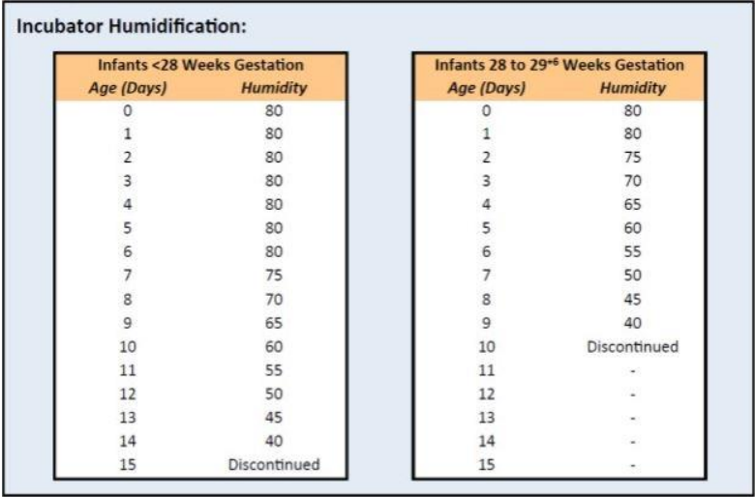
Humidification Settings

Slide 8
?
Questions?

Slide 9

Summary
All neonates <30 weeks should be provided with incubator humidity
Commence humidity of at least 80% and wean as per the gestational age
Ensure the temperature probe is placed in an incubator and functional before placing the baby in the in the incubator

